Slide 1

Feature extraction by activation function projection in the Reinforcement Learning Field

Slide 2
Summary
Reinforcement Learning in robotics
Activation function projection
Feature extraction in RL
Experiment and exploration
Final result
Conclusion

Slide 3


Reinforcement Learning in robotics
Powerful tool
Learn from rewards to succeed a task
Limited to games and simulation

Slide 4
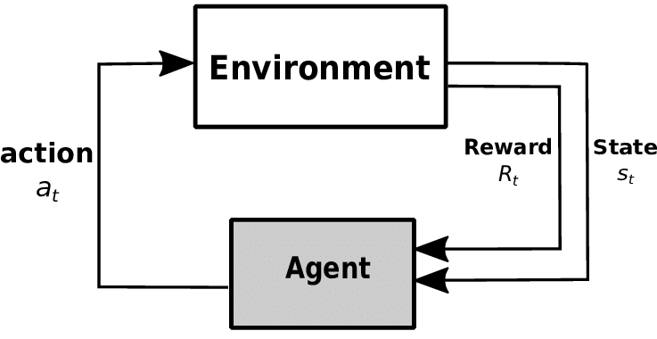
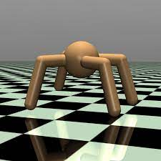
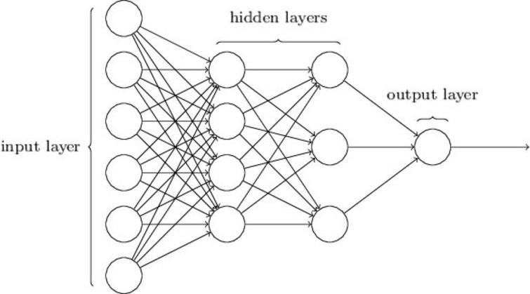
Reinforcement Learning in robotics

Slide 5
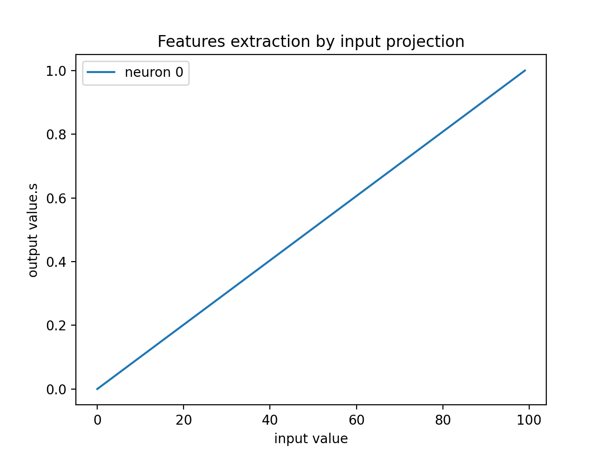
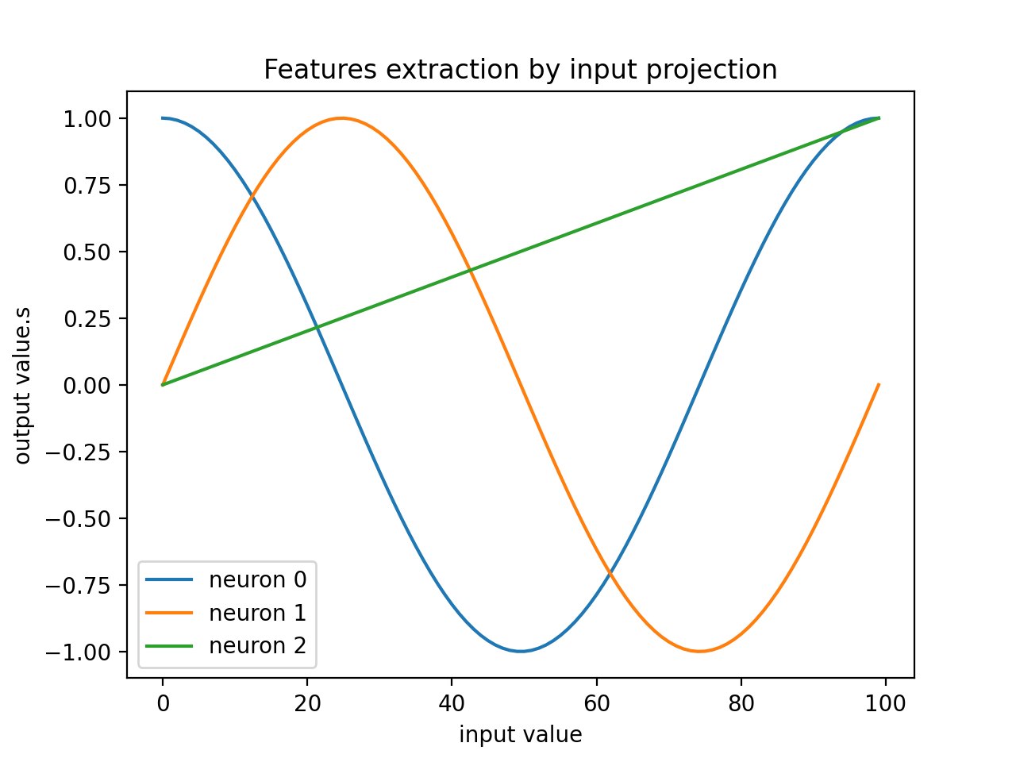
Activation function projection
Increase the understanding of the neural network
Augment the dimension of expression

Slide 6
Activation function projection
Linear :

Slide 7
Activation function projection
Multi-frequencies :

Slide 8
Activation function projection
Gaussian decomposition :

Slide 9
Activation function projection

Slide 10
Feature extraction in the RL field
Activation function
Auto-encoder / Convolution
Fourier Features
Radial Basis Function
Voxelisation/Coarse encoding
Kanerva coding
Bspline function

Slide 11
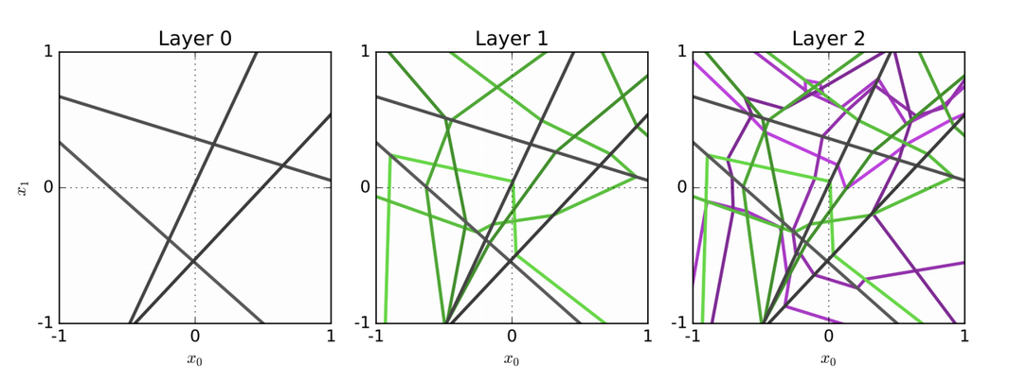
Feature extraction in the RL field
Activation function :
Introduce non-linearity
Describe an input

Slide 12
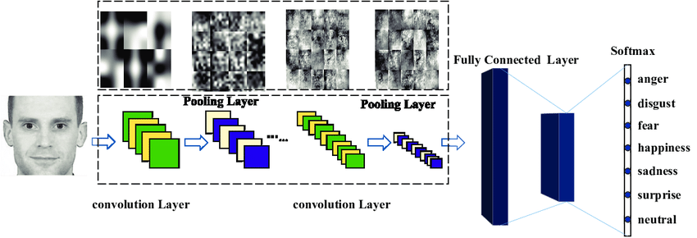
Feature extraction in the RL field
Auto-encoder / Convolution :
Recognize pattern and reduce data
Feature extraction

Slide 13
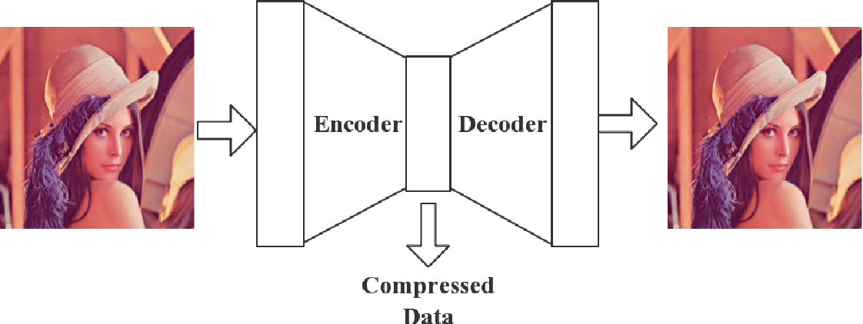
Feature extraction in the RL field
Auto-encoder / Convolution :

Slide 14
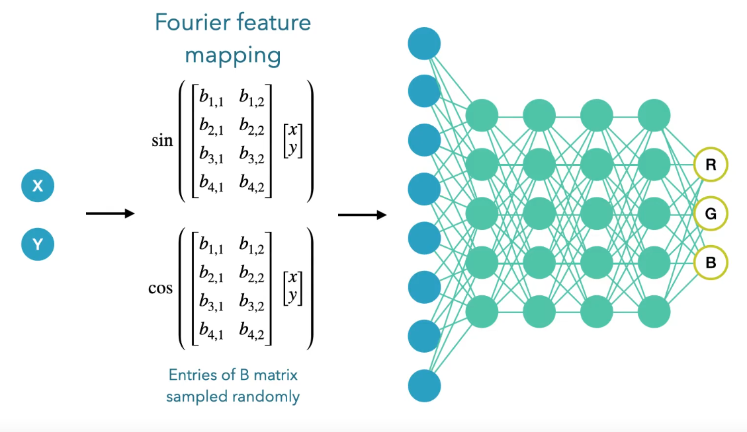
Feature extraction in the RL field
Fourier Features :
Multi-frequency decomposition
Increase the dimensional understanding

Slide 15
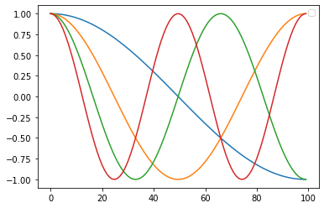
Feature extraction in the RL field
Fourier Features :

Slide 16
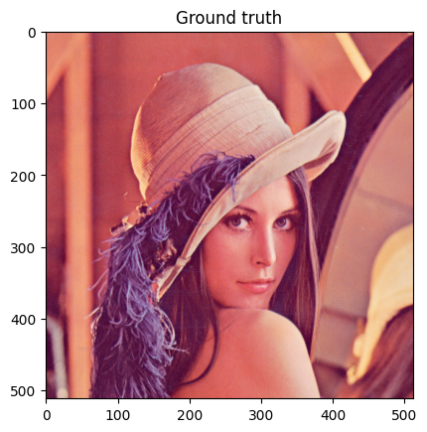
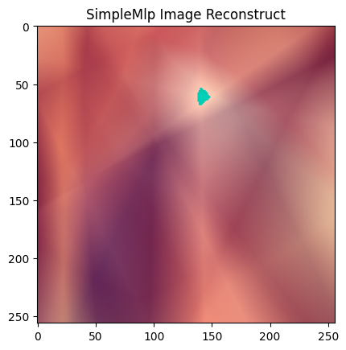
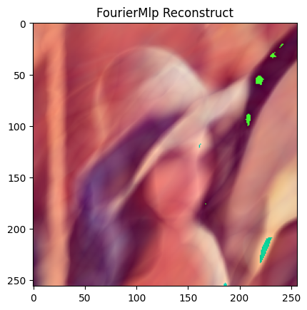
Feature extraction in the RL field
Fourier Features :

Slide 17
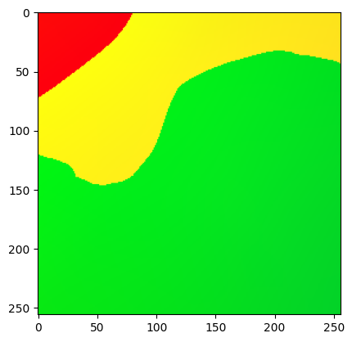
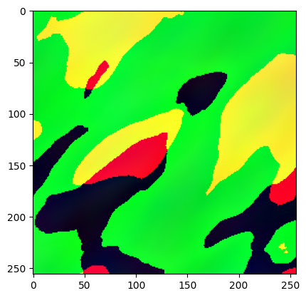
Feature extraction in the RL field
Fourier Features :

Slide 18
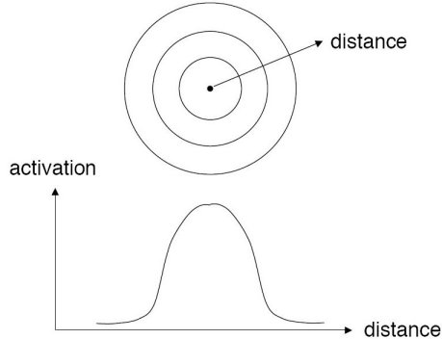
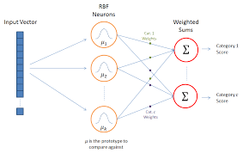
Feature extraction in the RL field
Radial Basis Function :
Supervised and Unsupervised Learning
Evaluate similarity between vectors

Slide 19
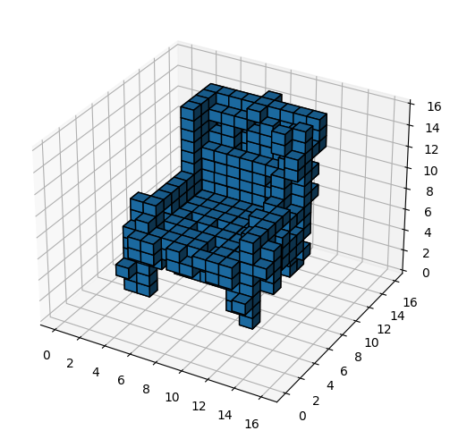
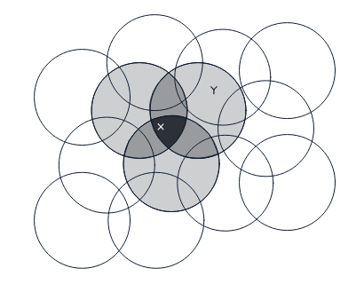
Feature extraction in the RL field
Voxelisation/Coarse encoding :
Convert dimensions to binary array

Slide 20
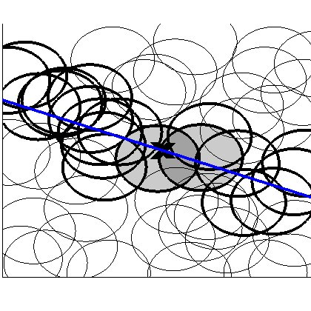
Feature extraction in the RL field
Kanerva coding :
Coarse encoding but one-dimensional focus

Slide 21
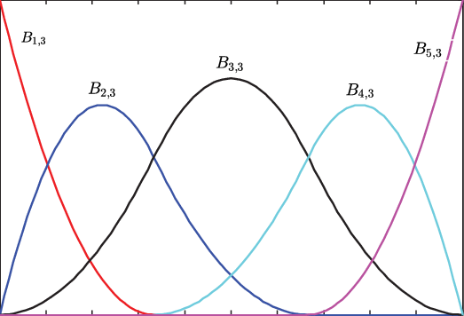
Feature extraction in the RL field
Bspline function :
Focus on a specific area

Slide 22
Feature extraction in the RL field
Conclusion :
Dimensional exploding
Data in-compressible
Each dimension is important

Slide 23
Experiment and exploration
Areas input decomposition :
Areas understanding
RL agent focus on the most important areas of its input

Slide 24
Experiment and exploration
Triangular activation function :
Fixed and Learned
Mix order of decomposition
Mix variance
Mix phase

Slide 25
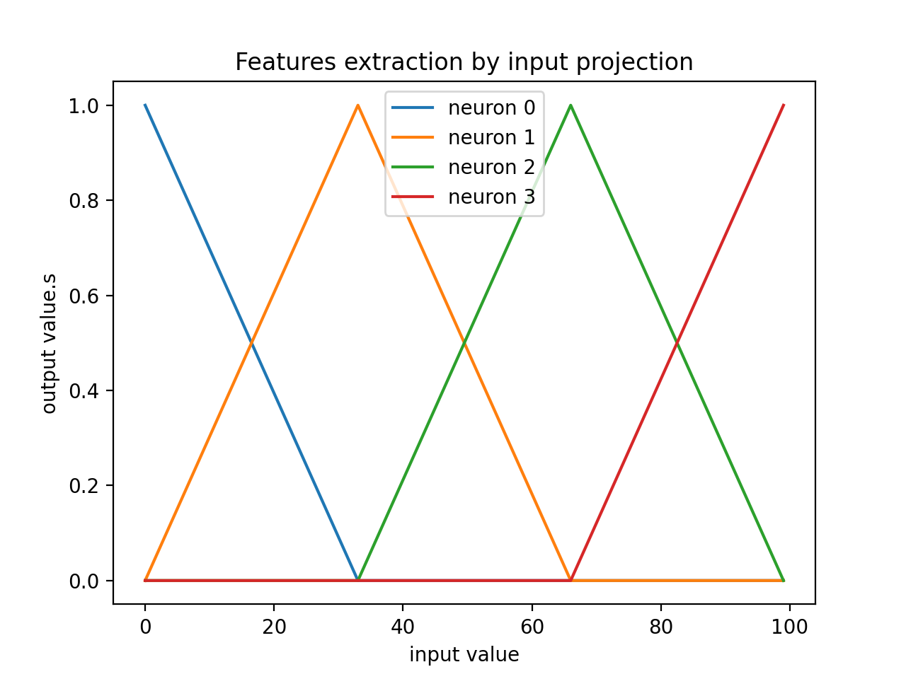
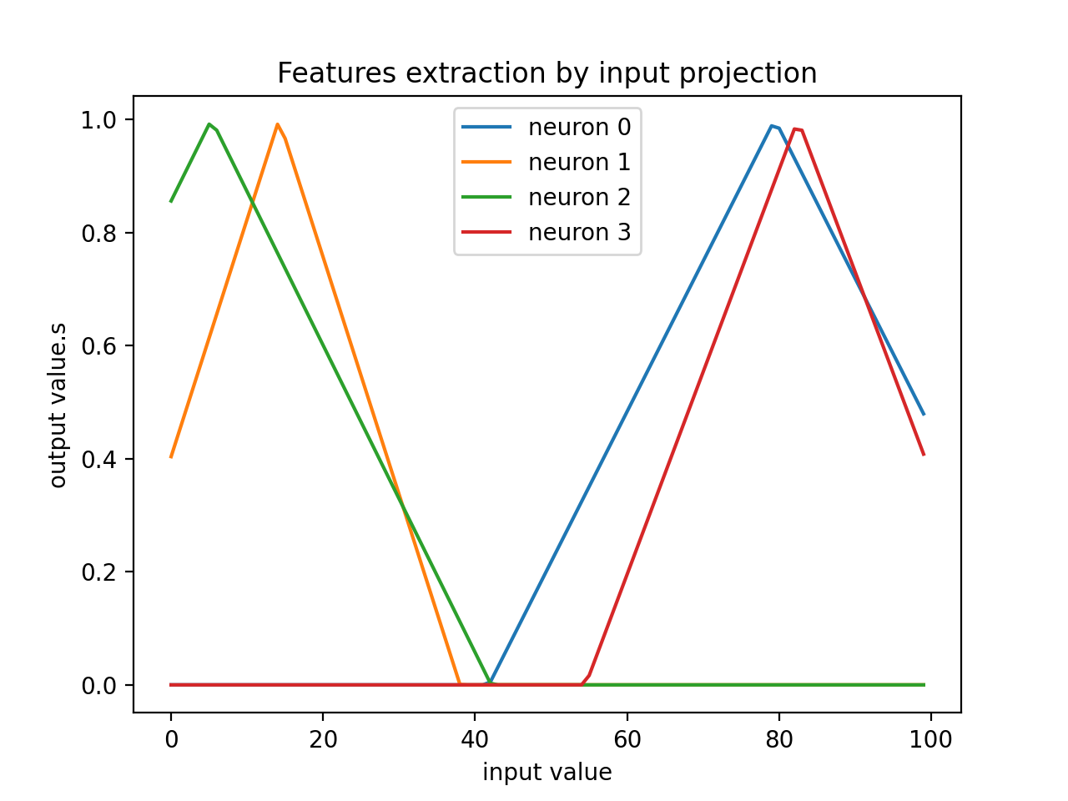
Experiment and exploration
Triangular activation function :
Fixed and Learned

Slide 26
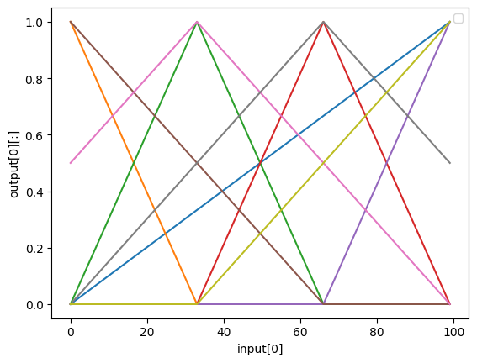
Experiment and exploration
Triangular activation function :
Mix order of decomposition

Slide 27
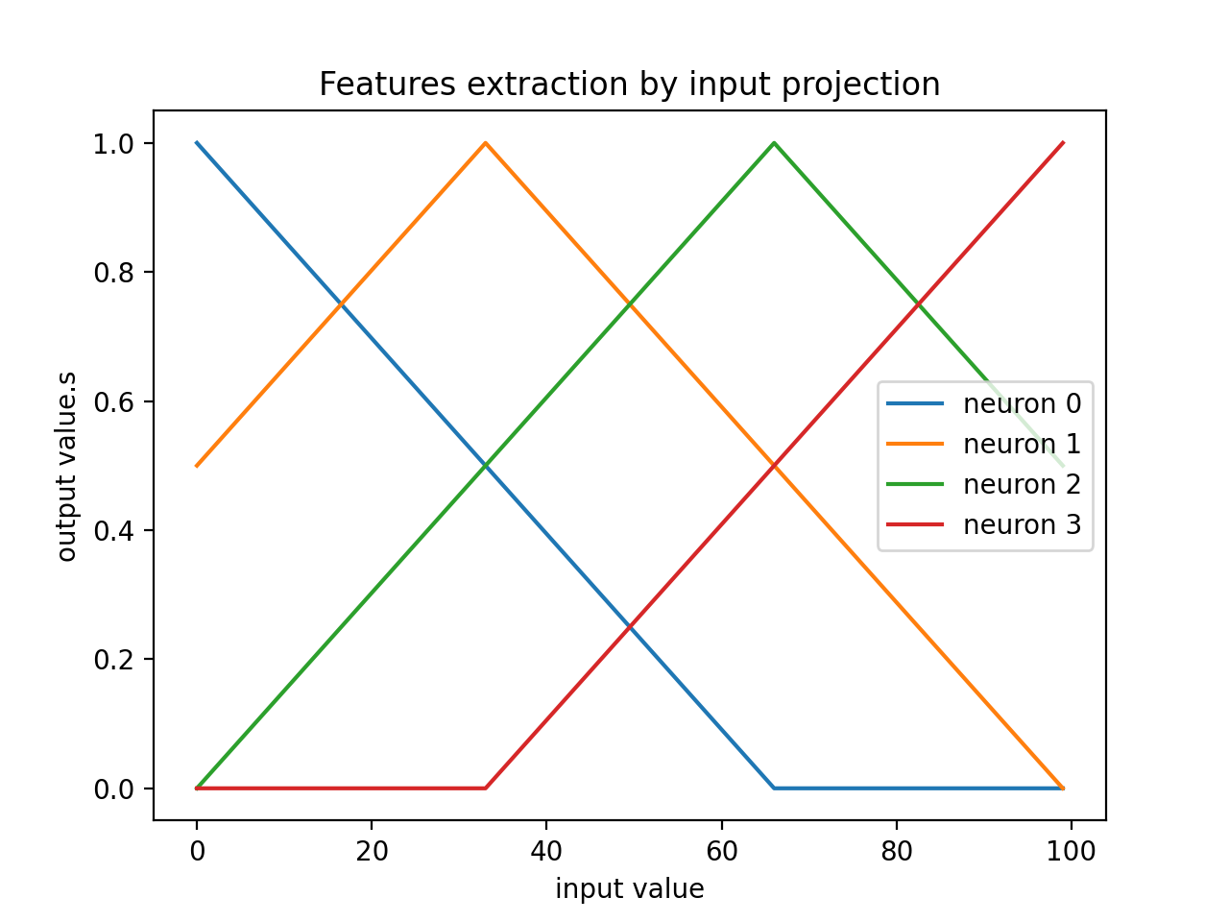
Experiment and exploration
Triangular activation function :
Mix variance

Slide 28
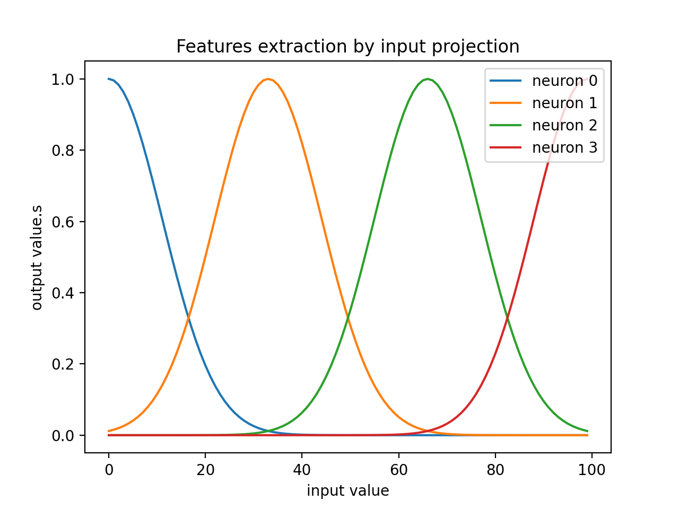
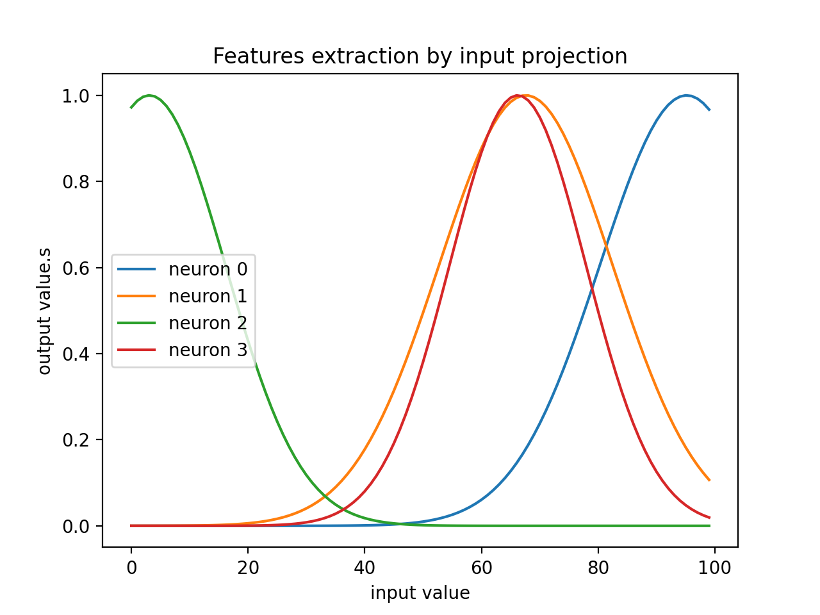
Experiment and exploration
Gaussian activation function :
Fixed and Learned

Slide 29
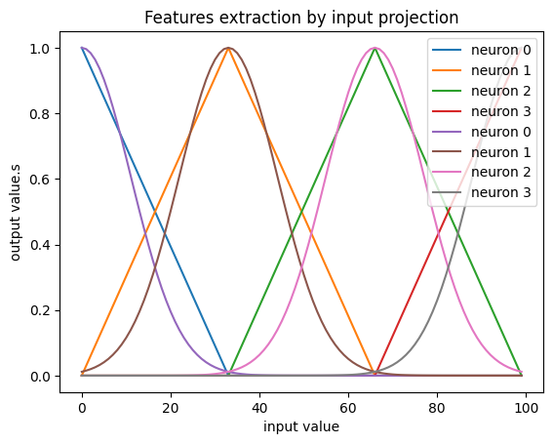
Experiment and exploration
Triangular activation function :
Similarity between triangular

Slide 30
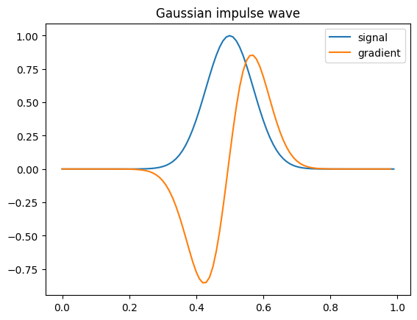
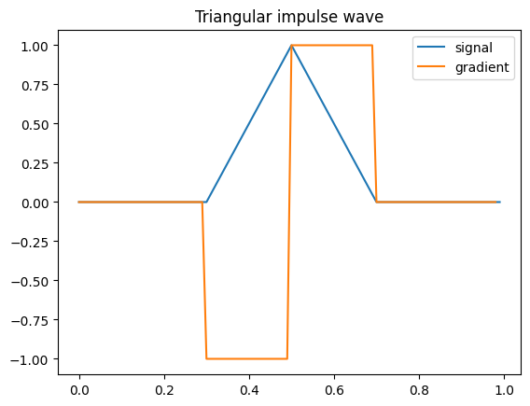
Experiment and exploration
Gaussian activation function :
Gradient

Slide 31
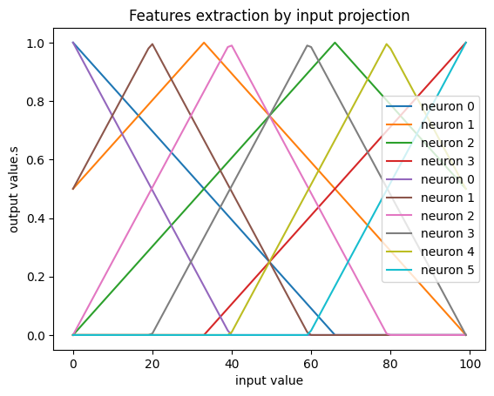
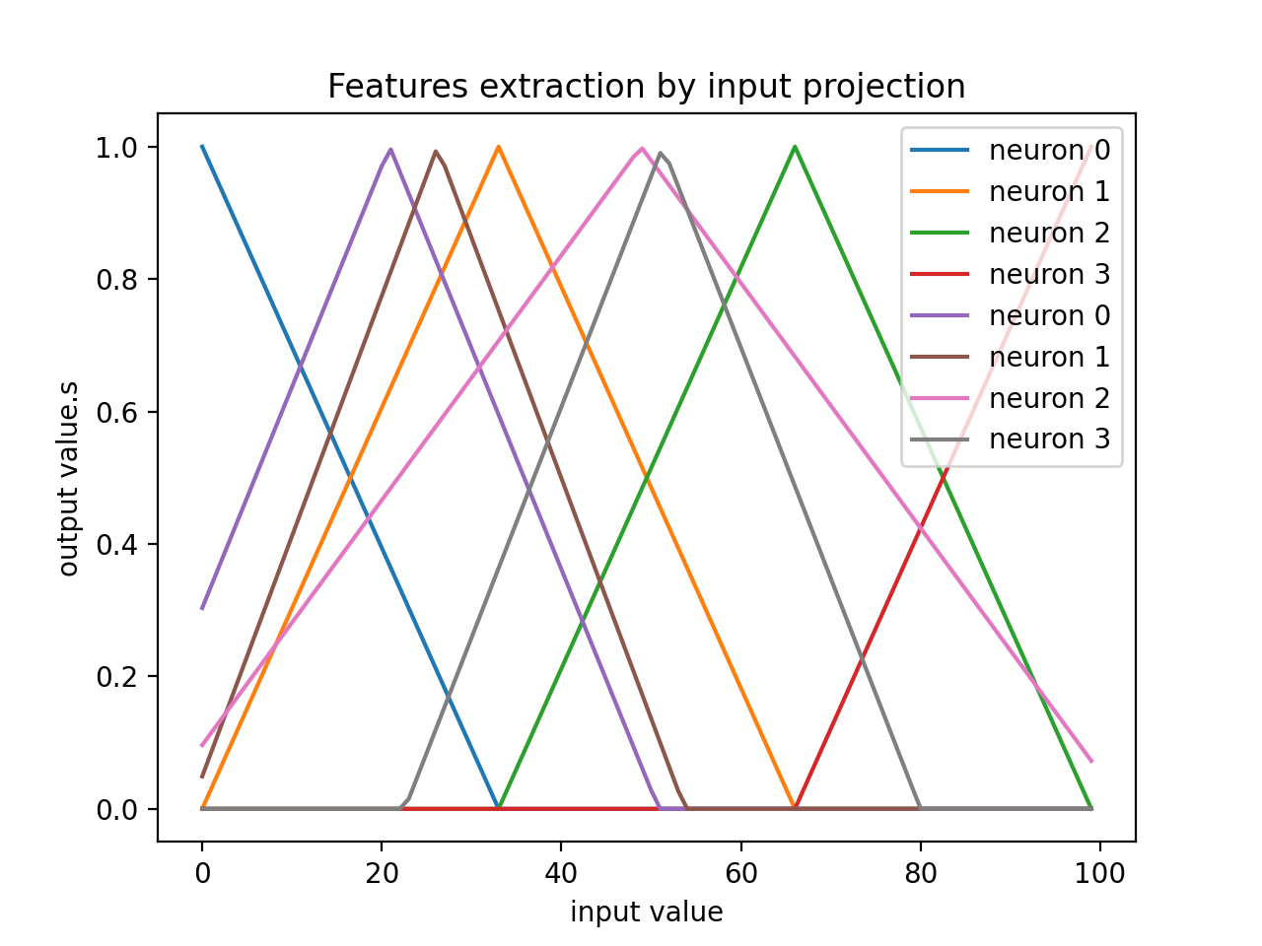
Experiment and exploration
Empiric mix :

Slide 32
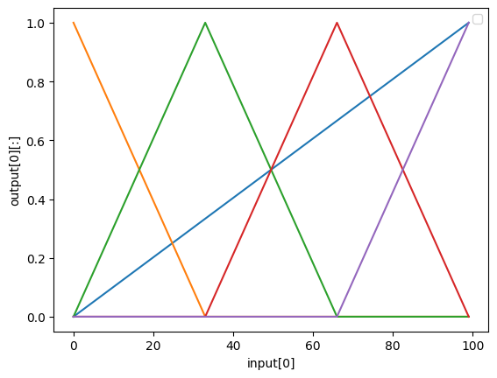
Final result
Triangular activation function :
Mix_final_1 and Mix_final_2

Slide 33
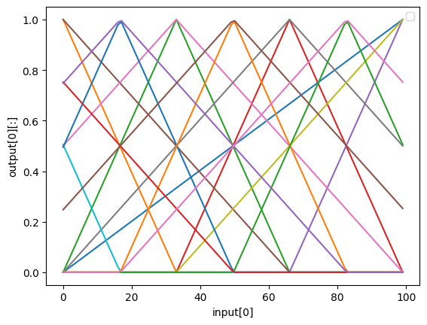
Final result
Triangular activation function :
Mix_final_3

Slide 34
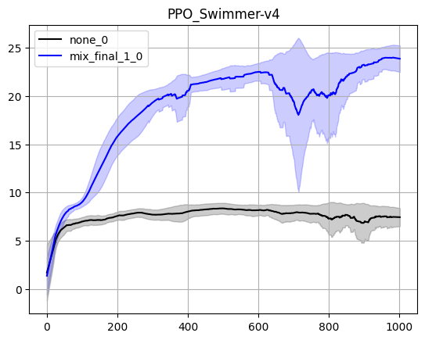
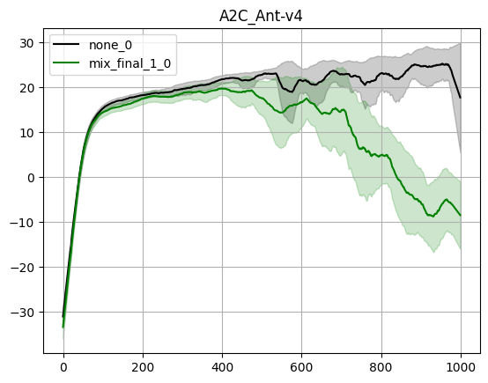
Final result
Triangular activation function result :

Slide 35
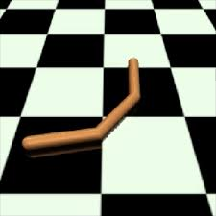
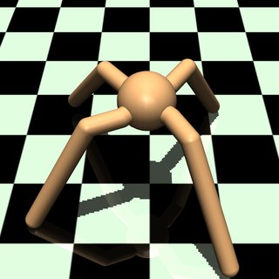
Final result
Triangular activation function result :

Slide 36
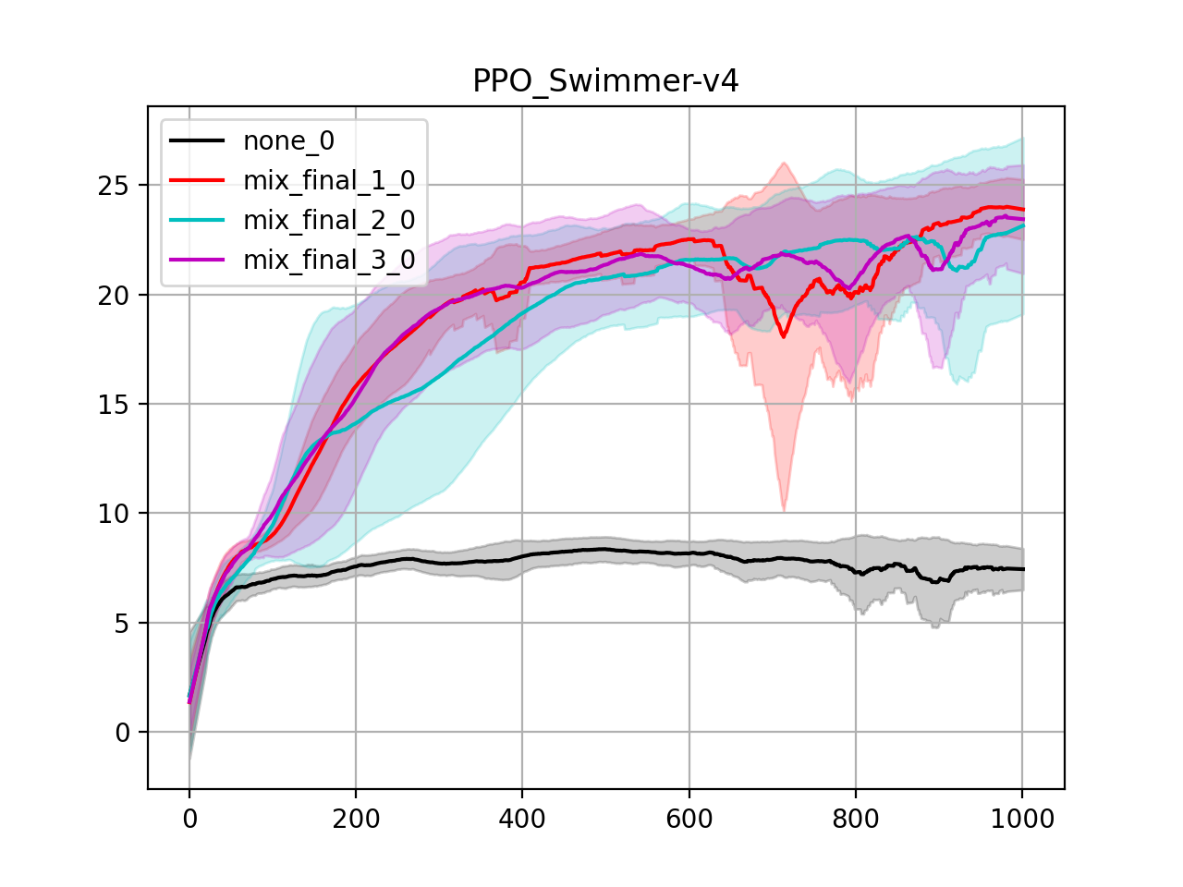
Final result
Triangular activation function result :

Slide 37
Final result
Without Triangular activation :

Slide 38
Final result
Without Triangular activation :

Slide 39
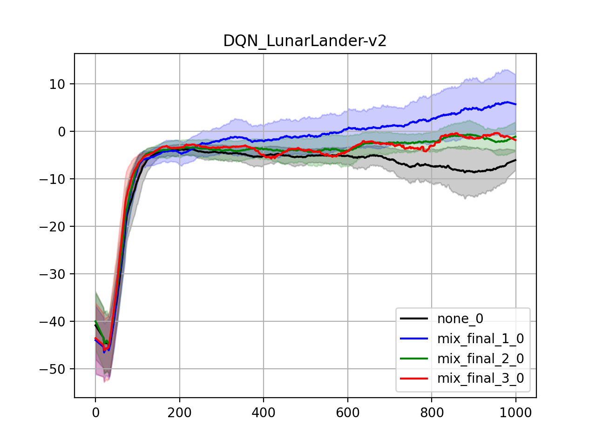
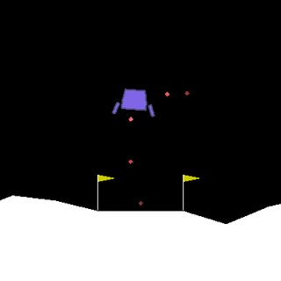
Final result
Triangular activation function result :

Slide 40
Final result
Without Triangular activation :

Slide 41
Final result
Without Triangular activation :

Slide 42
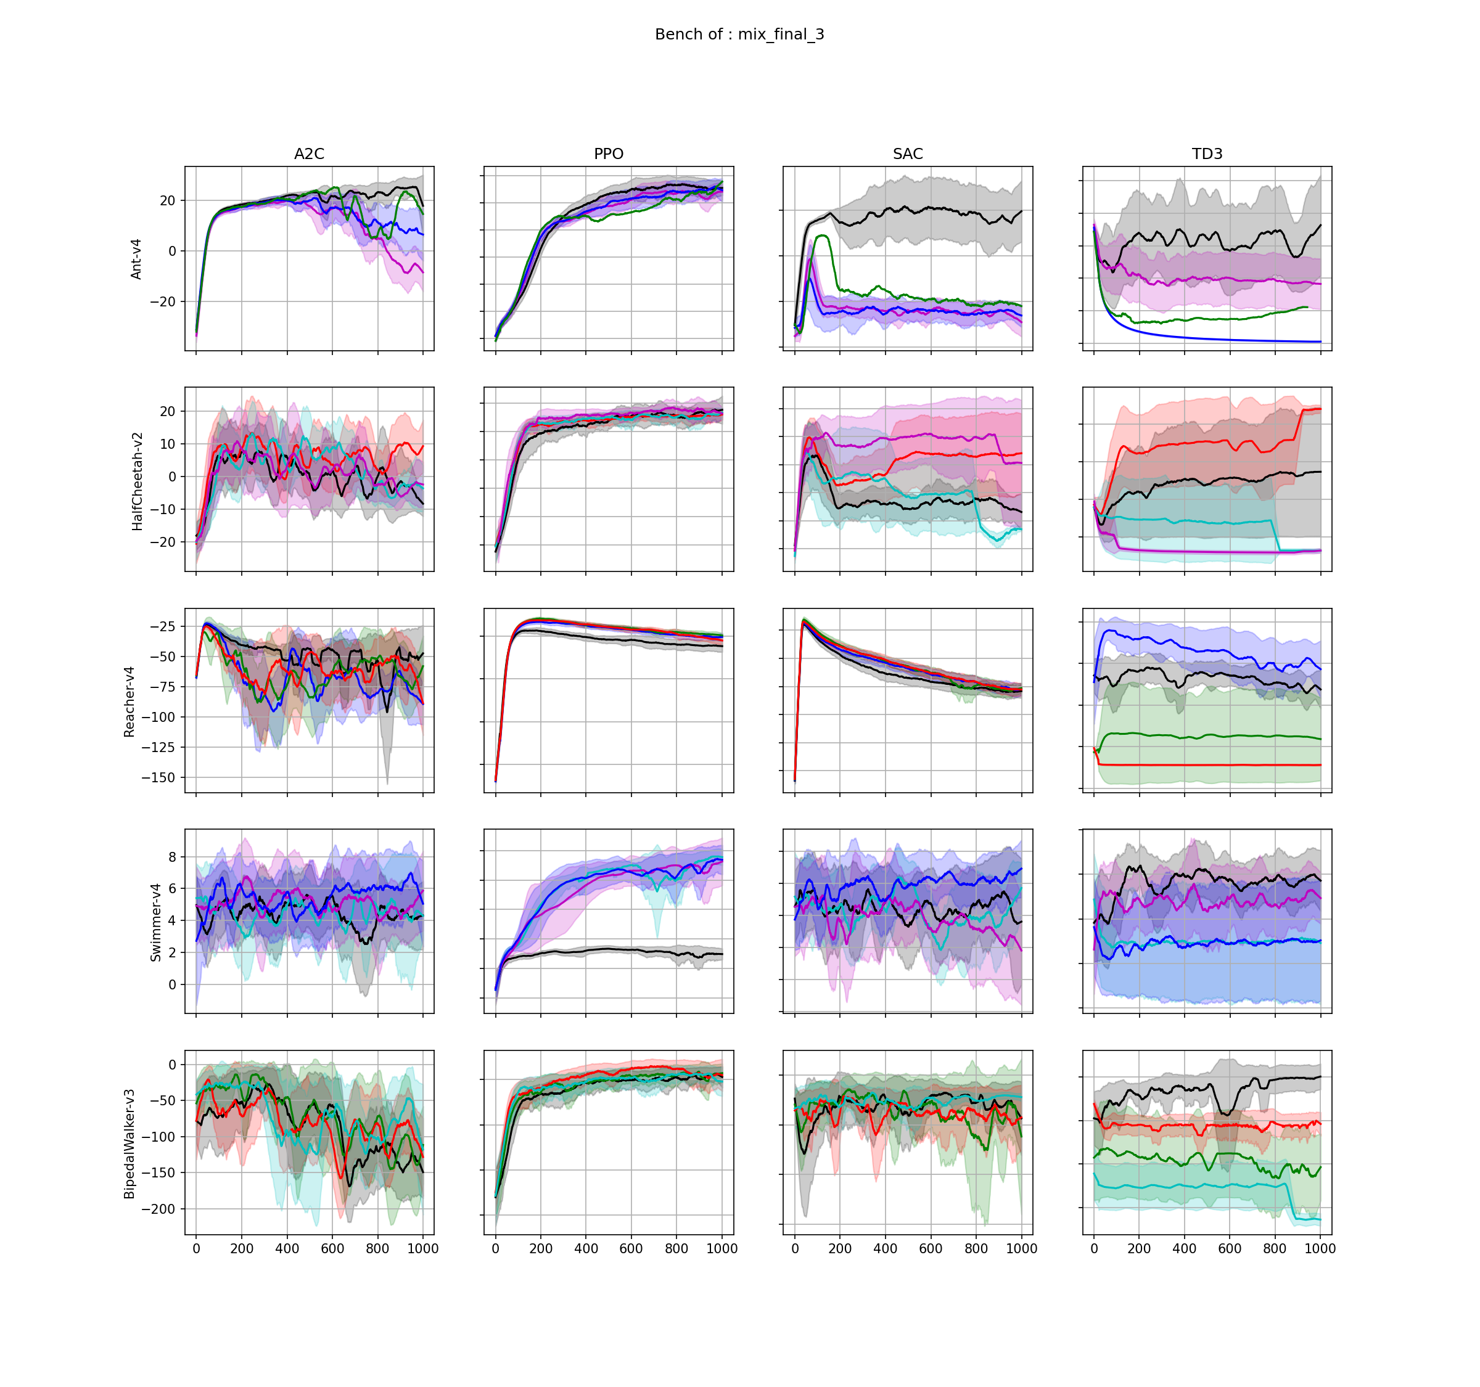
Final result
Triangular activation function result :

Slide 43
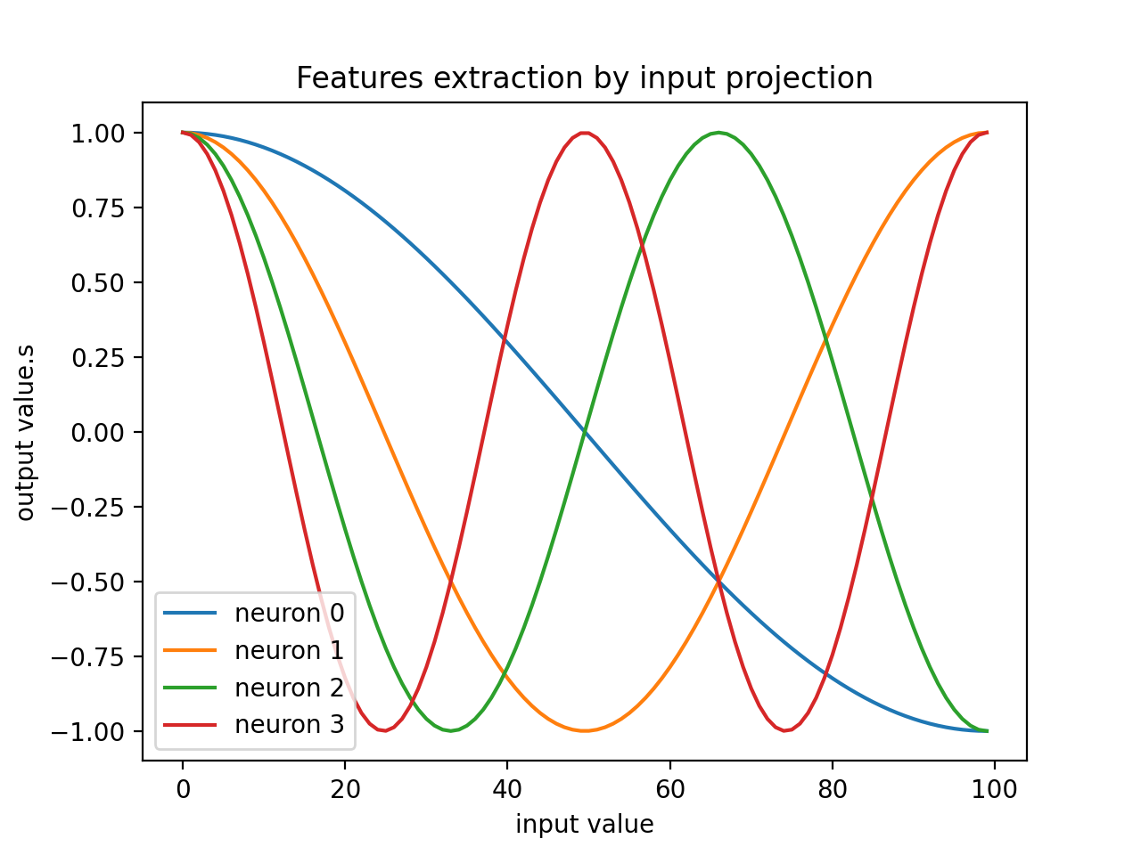
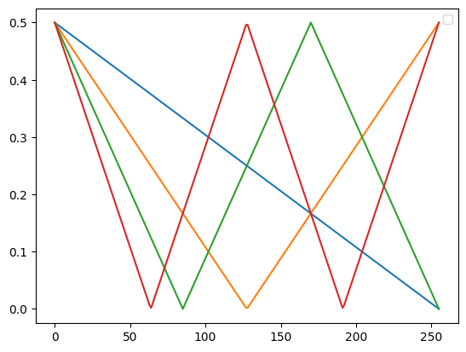
Final result
Triangular Light Feature :

Slide 44
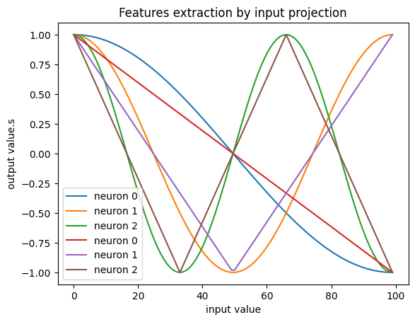
Final result
Triangular Light Feature :

Slide 45
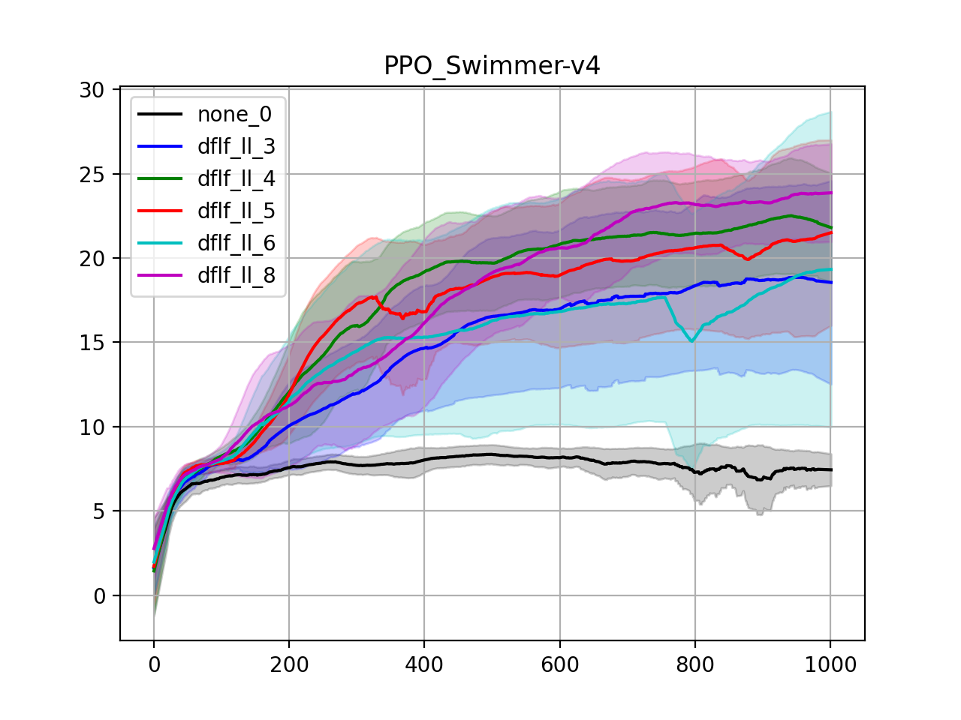
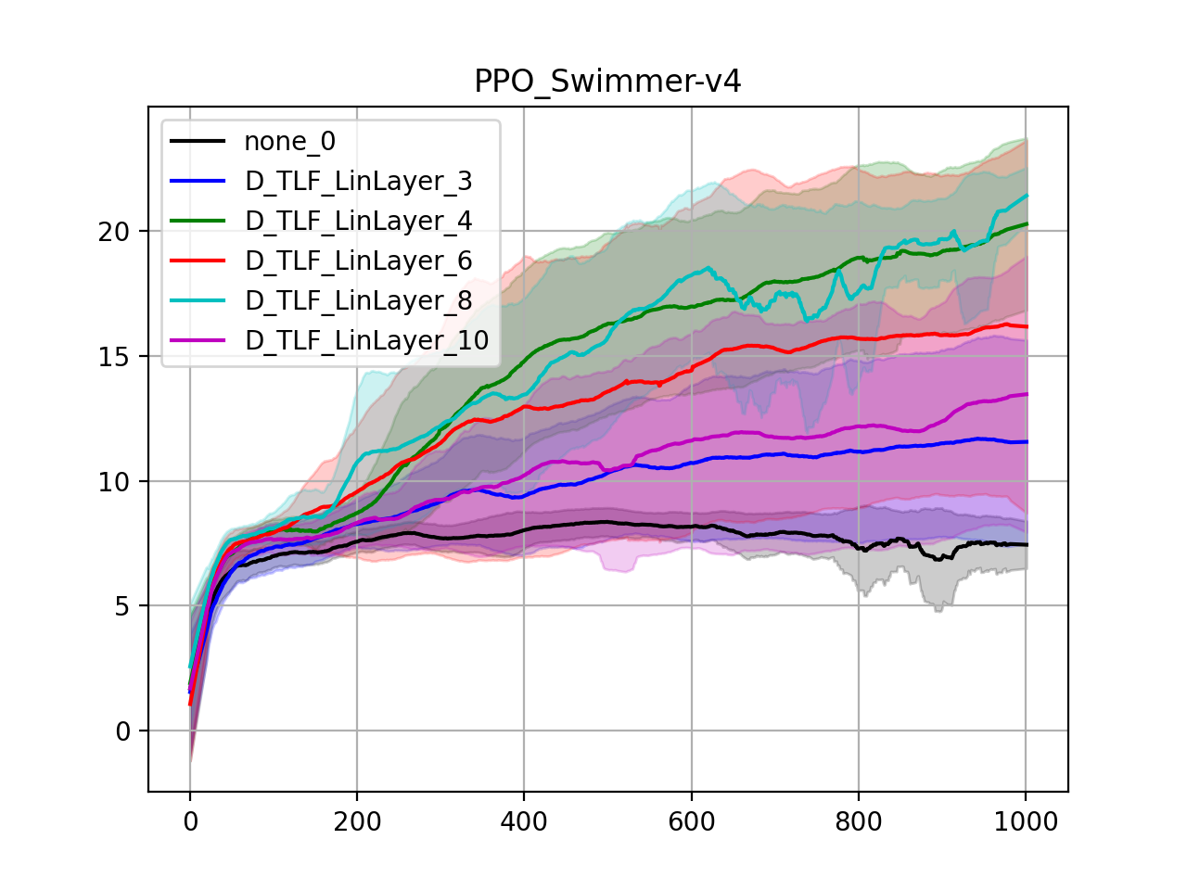
Final result
Triangular Light Feature result :

Slide 46
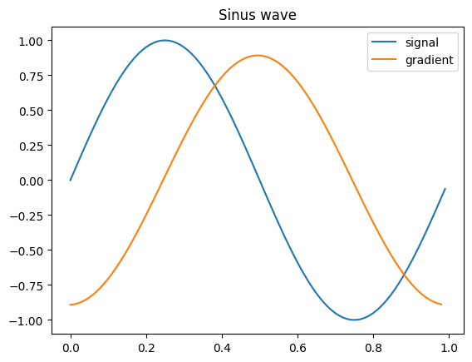
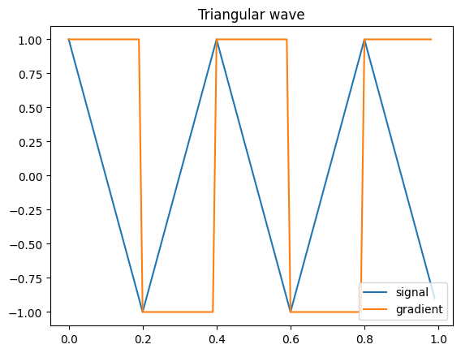
Final result
Triangular Light Feature :

Slide 47
Conclusion
Problematic
Result
Open problems and future research

Slide 48
Conclusion
Problematic

Slide 49
Conclusion
Result

Slide 50
Conclusion
Open problems and future research

Slide 51
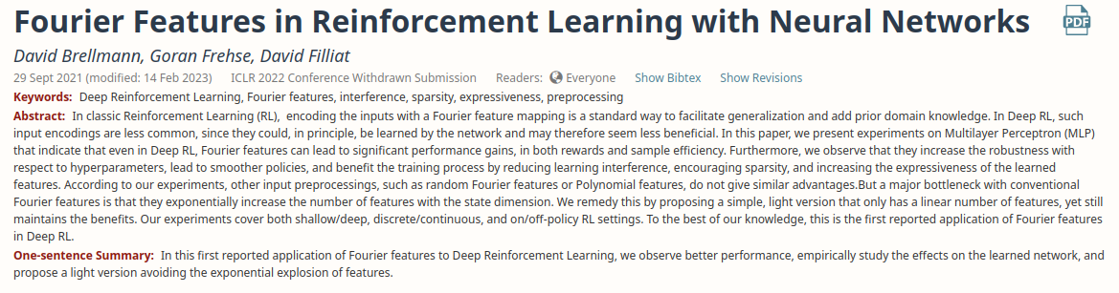
Conclusion
Open problems and future research

Slide 52

Conclusion
Open problems and future research

Slide 53

Conclusion
Open problems and future research

Slide 54
Questions ?

Slide 55

Triangular activation projection

Slide 56

Triangular activation projection

Slide 57


Triangular Light Features

Slide 58


Triangular Light Features

