Slide 1
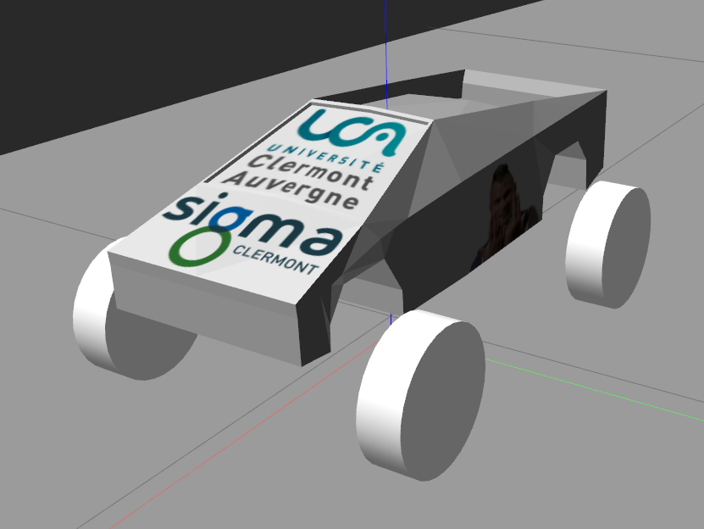
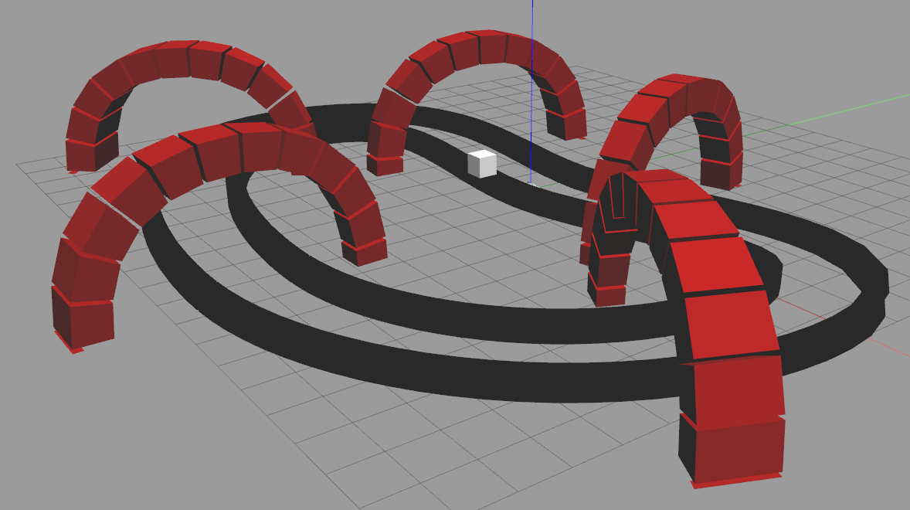
Project ROS : Car race

Slide 2
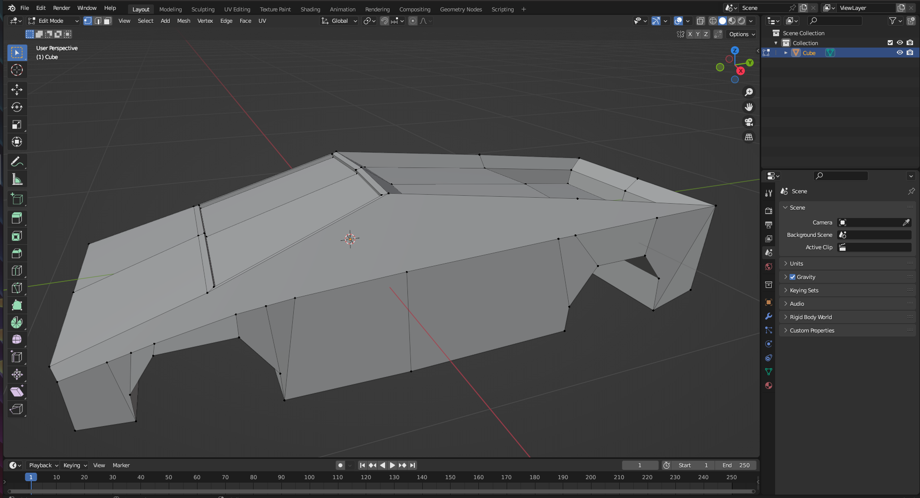
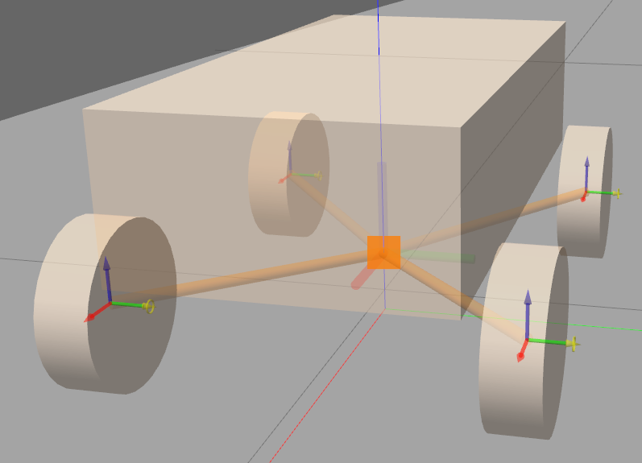
Car and road

Slide 3
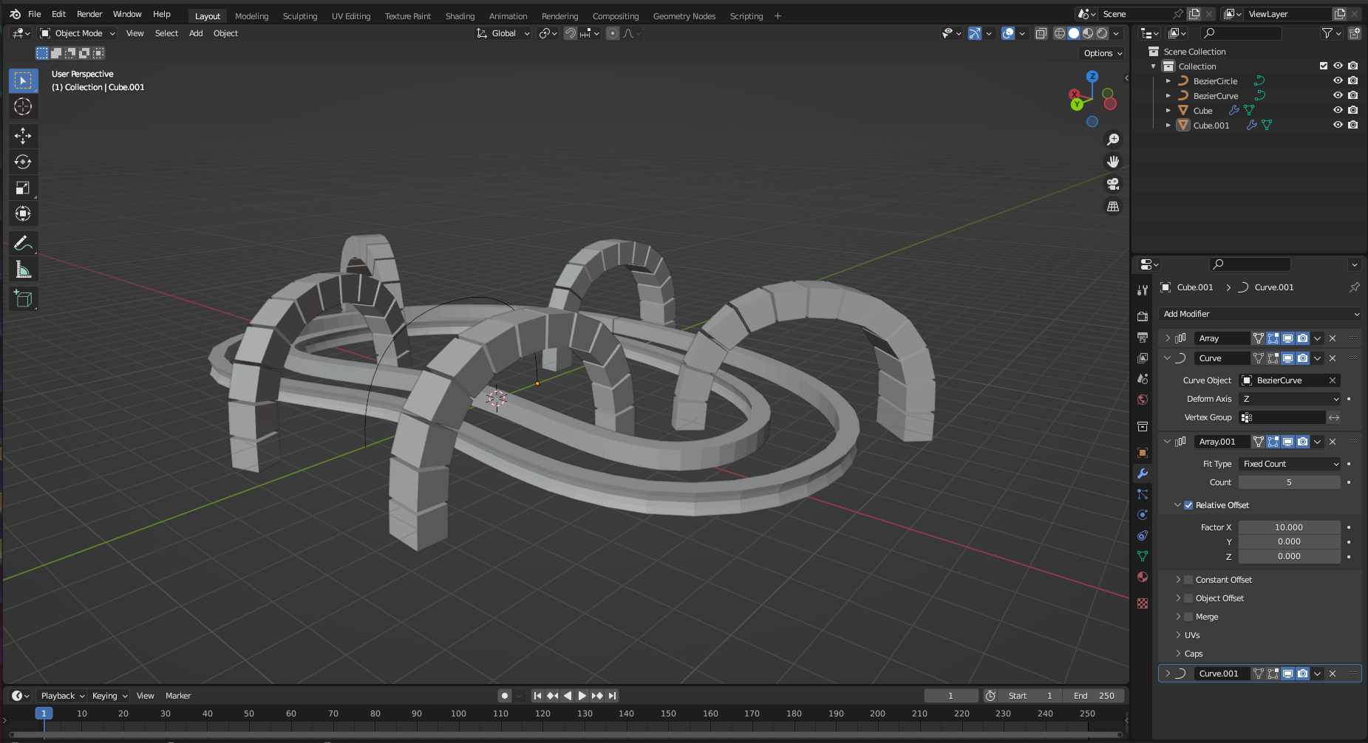
Car and road

Slide 4
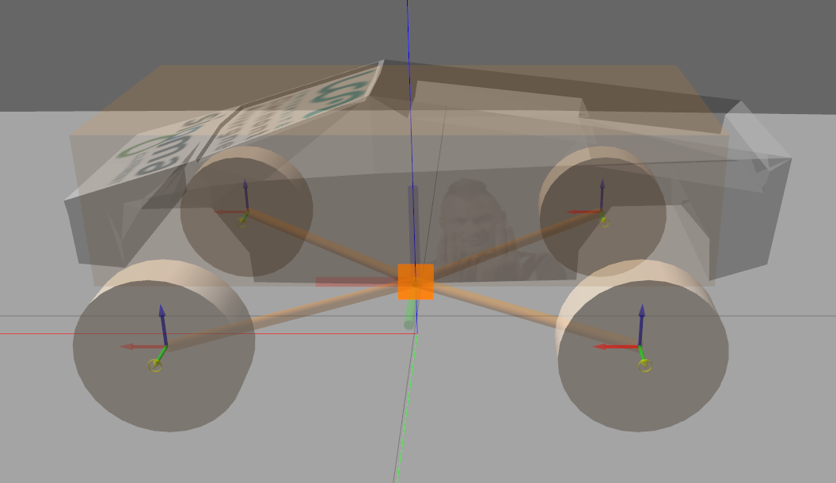
Car collision

Slide 5
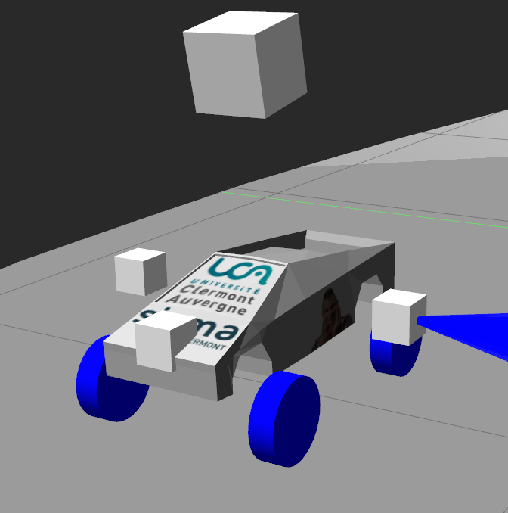
Car’s sensors
Camera
Range sensor

Slide 6
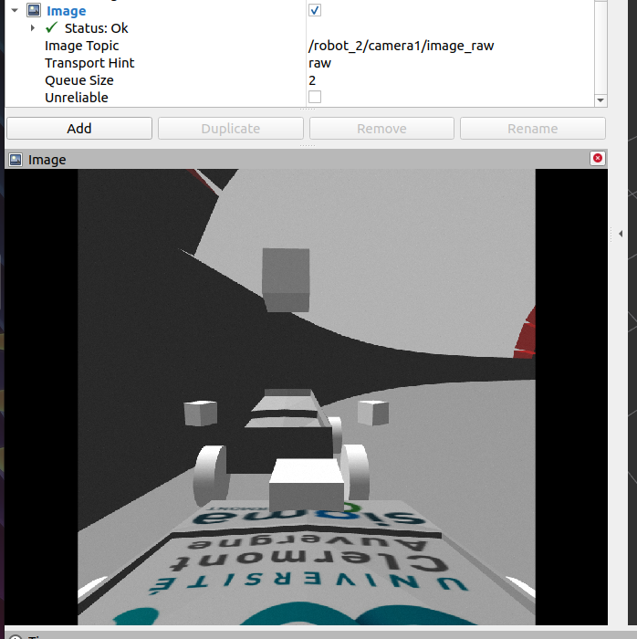
Car’s sensors

Slide 7
Car control
[Range_i], [0,50]
Control
Laws
Vx,Rz [0,1]

Slide 8
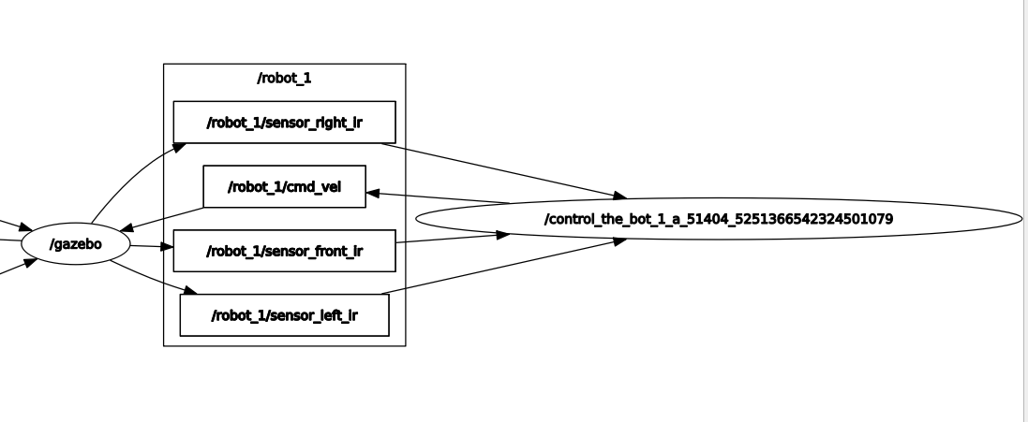
Car control
[Range_i], [0,50]
Control
Laws
Vx,Rz [0,1]

Slide 9
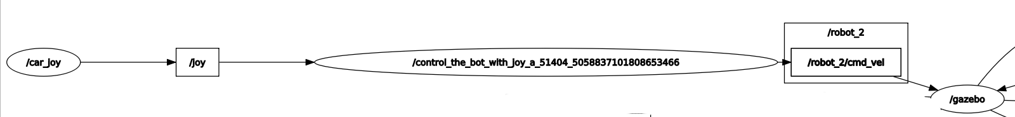
Car control
Joy
control
Vx,Rz [0,1]

Slide 10
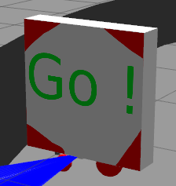
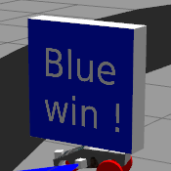
Control panel
Start the race
Detect the winner

Slide 11
Control panel
Start the race
Start ?
True / False

Slide 12
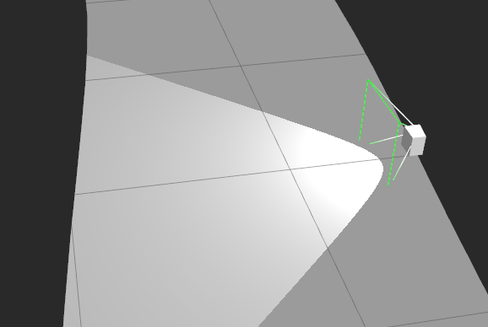

Control panel
Detect the winner

Slide 13
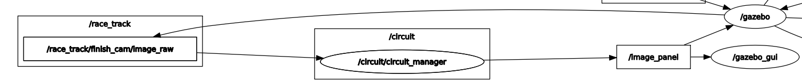
Control panel

Slide 14
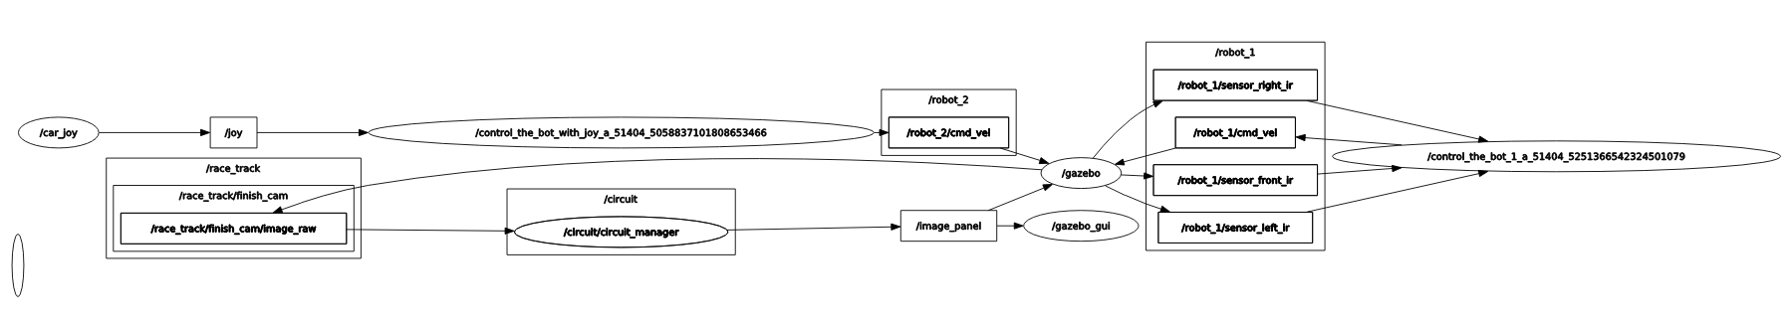
Final rqt graph

Slide 15
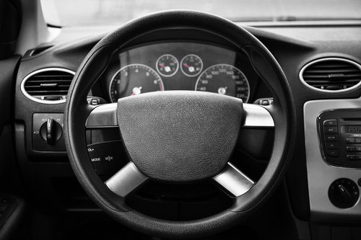
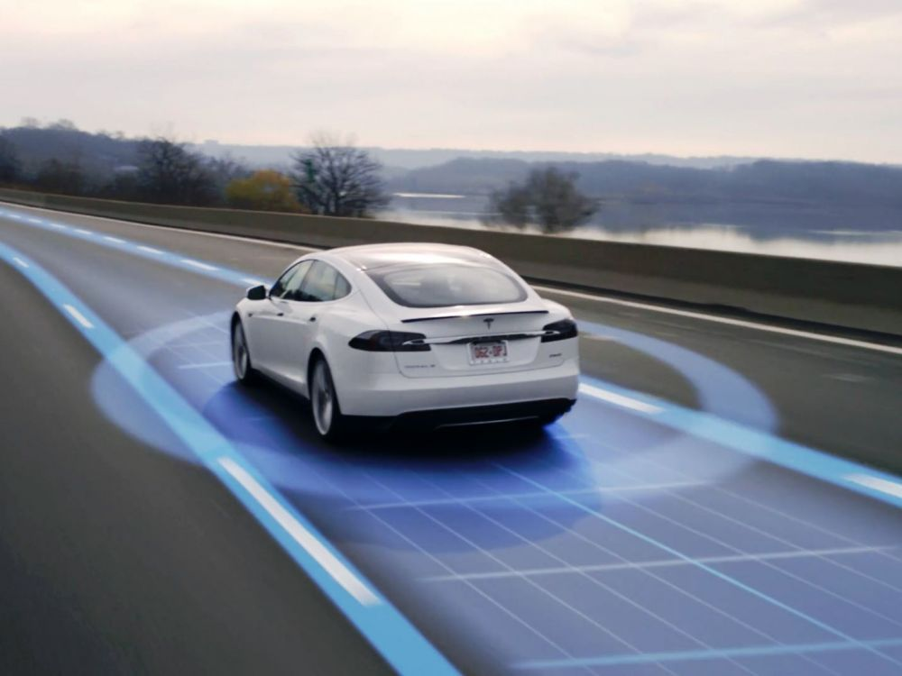
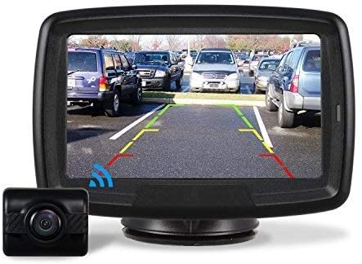
Conclusion

Slide 16


Questions ?
CHUPIN Clément
GUIGES Enzo

