Slide 1


Identifying participants at sporting events using AI and computer vision
By Clément GHYS
Slide 1 of 11

Slide 2
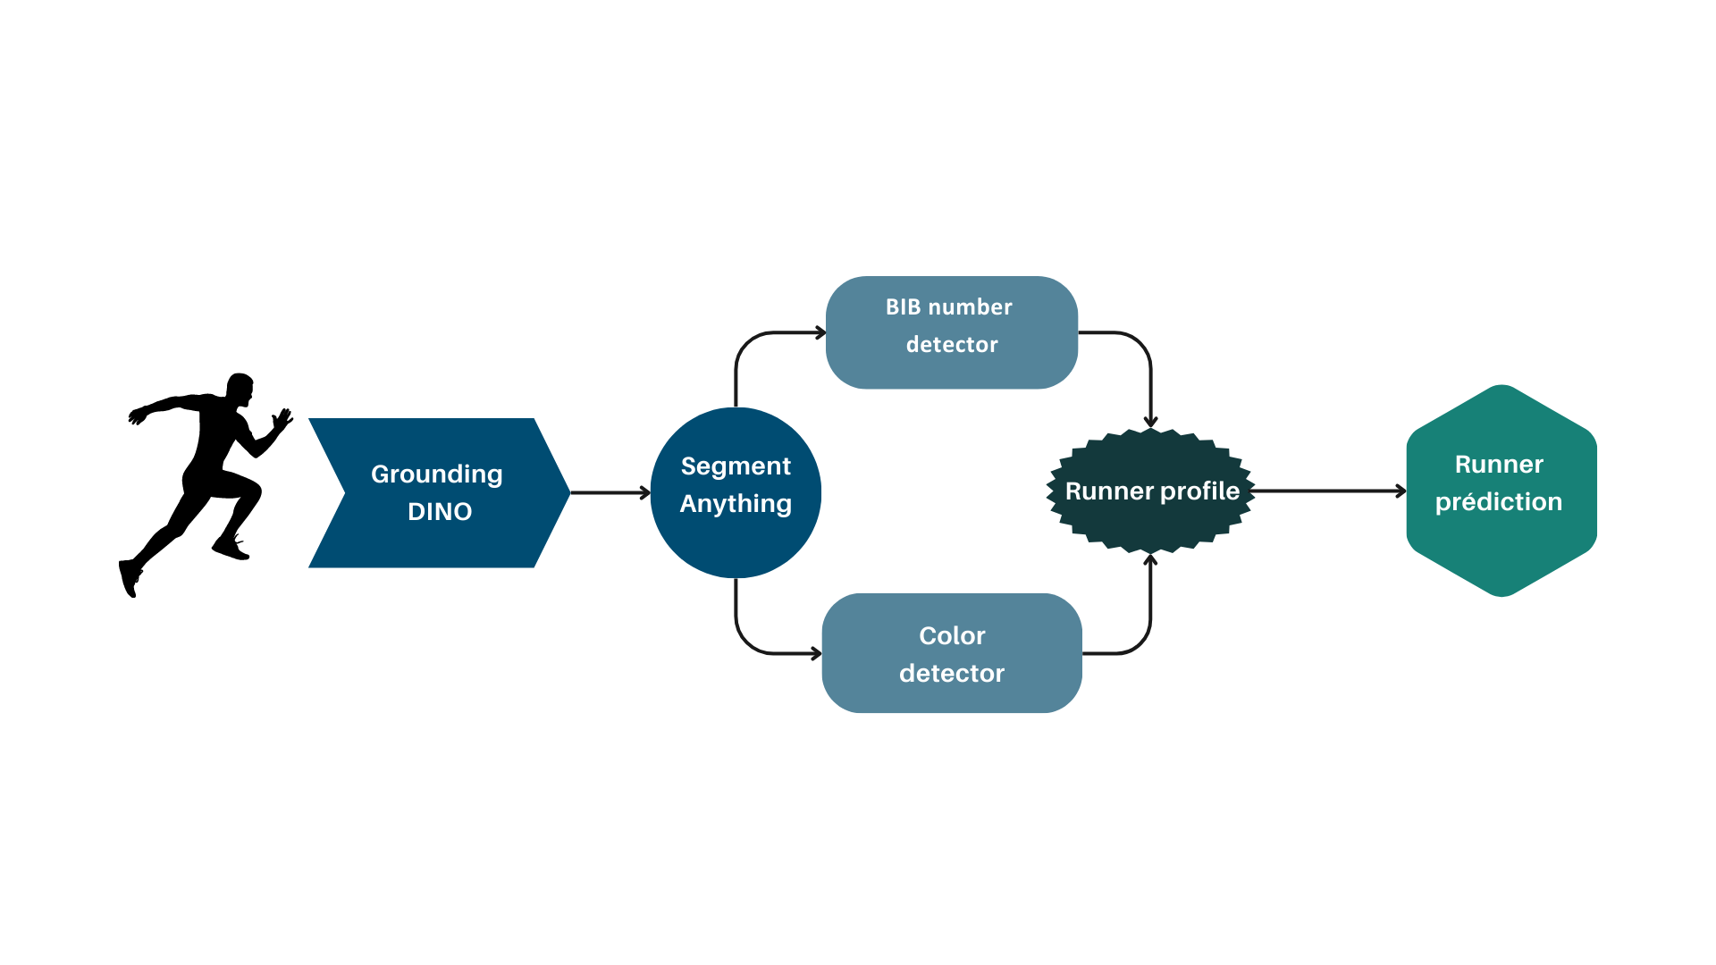
Summary
Introduction
Detection and Segmentation
Color detection and Classification
Runner Prediction
Conclusion
Detection and Segmentation

Slide 3

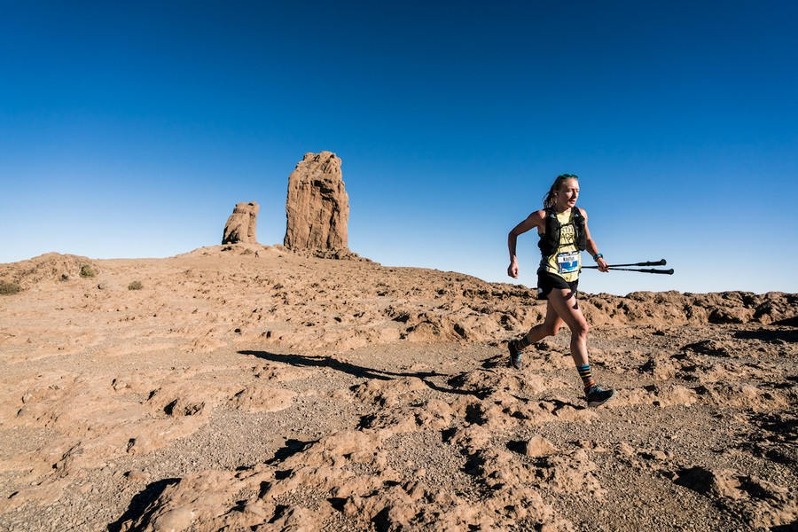
Introduction

Slide 4
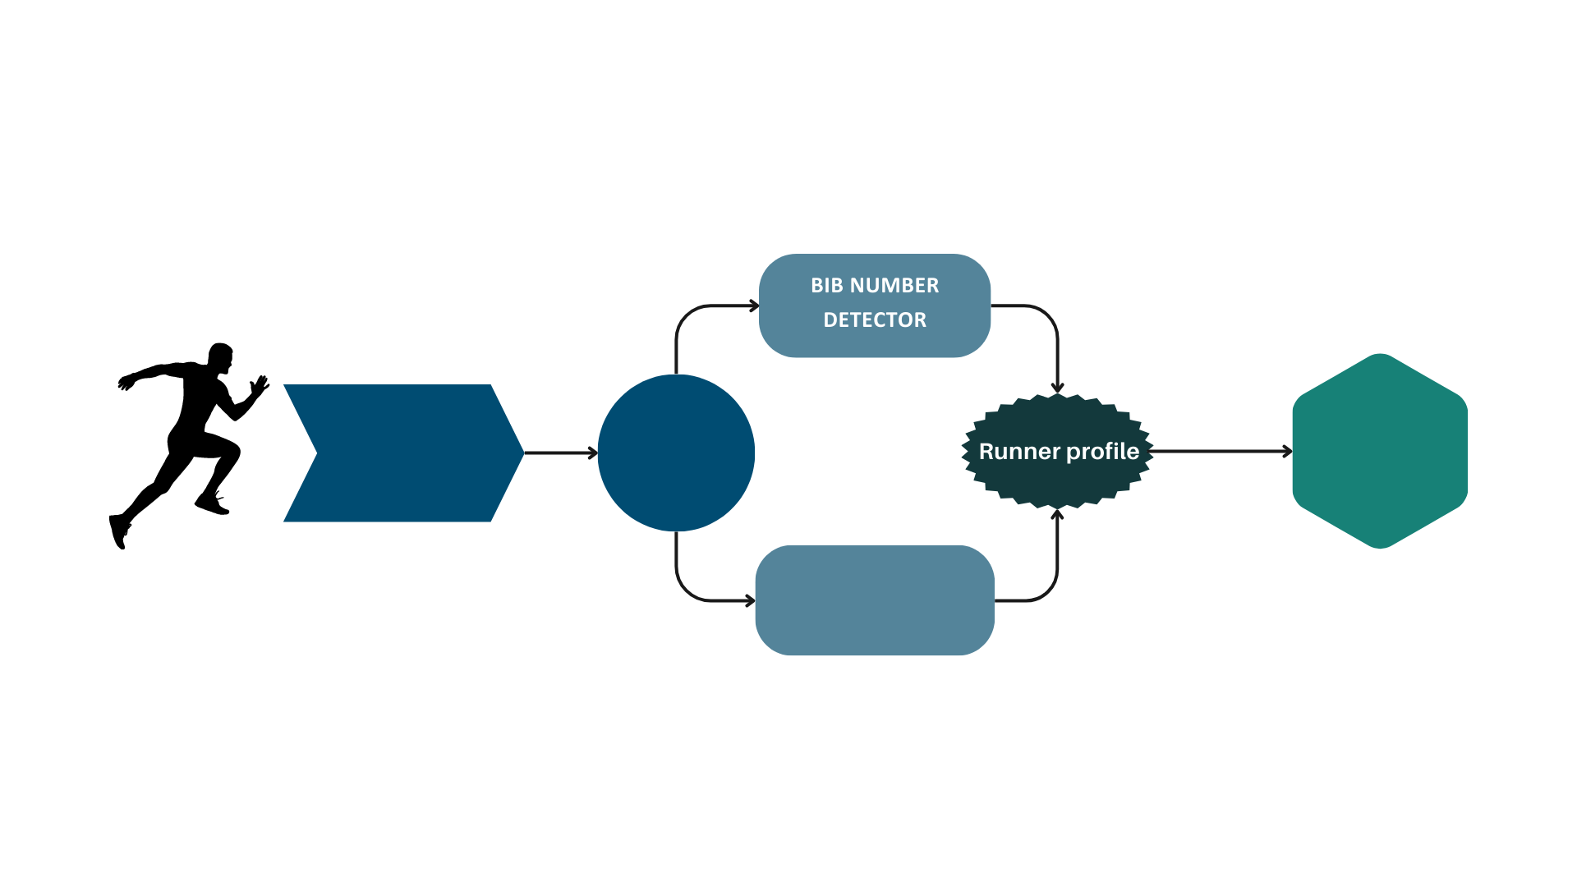






Slide 5
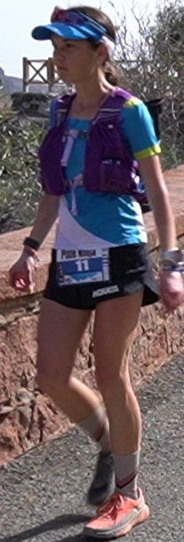
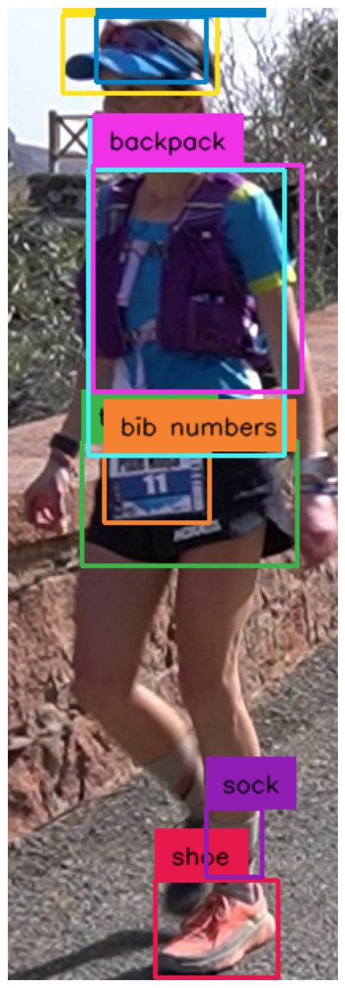
Grounding DINO
GROUNDING
DINO

Slide 6
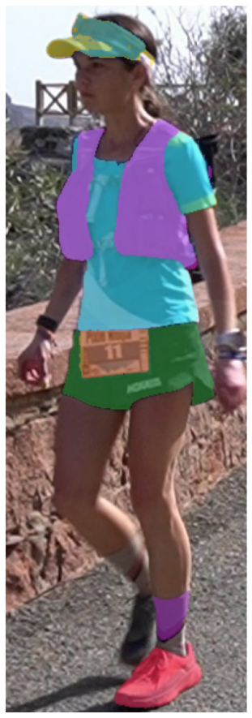
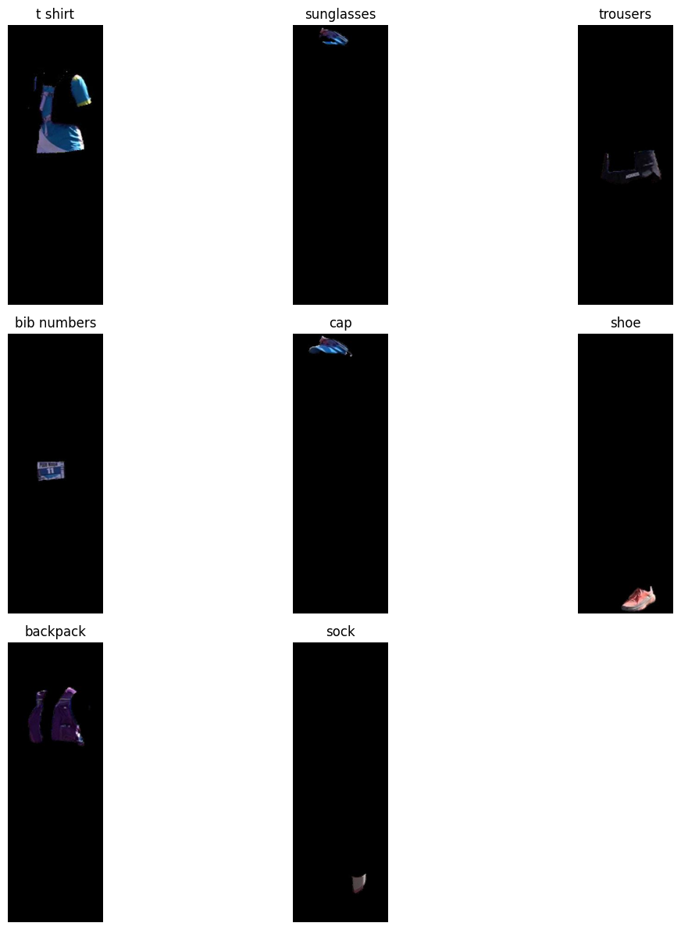
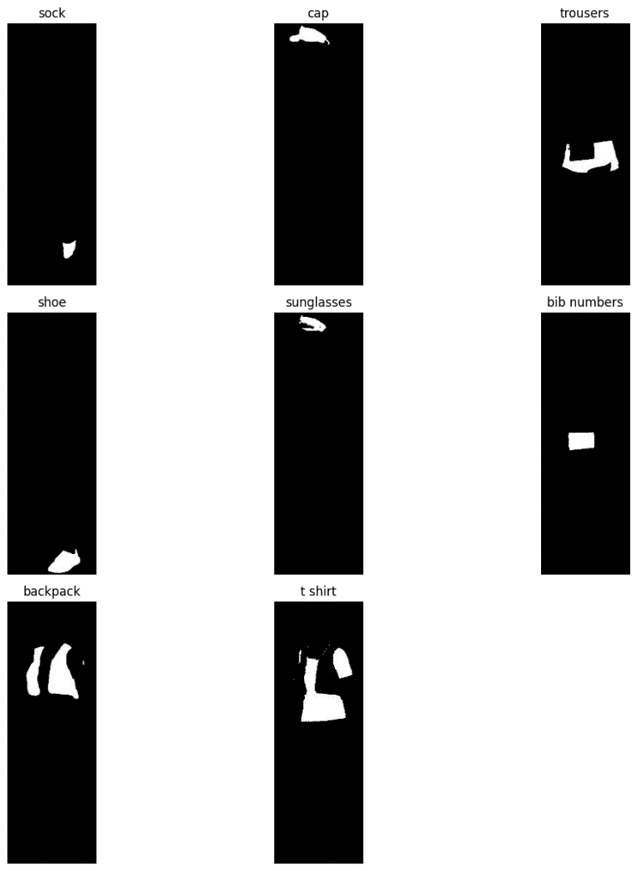
Segment Anything Model
SEGMENT
ANYTHING

Slide 7
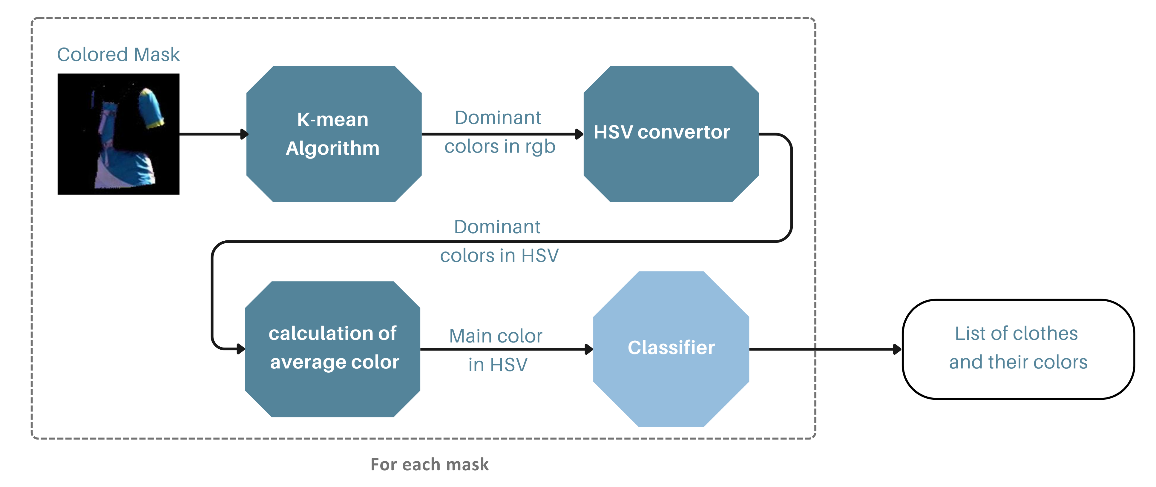


Color detector
COLOR DETECTOR

Slide 8
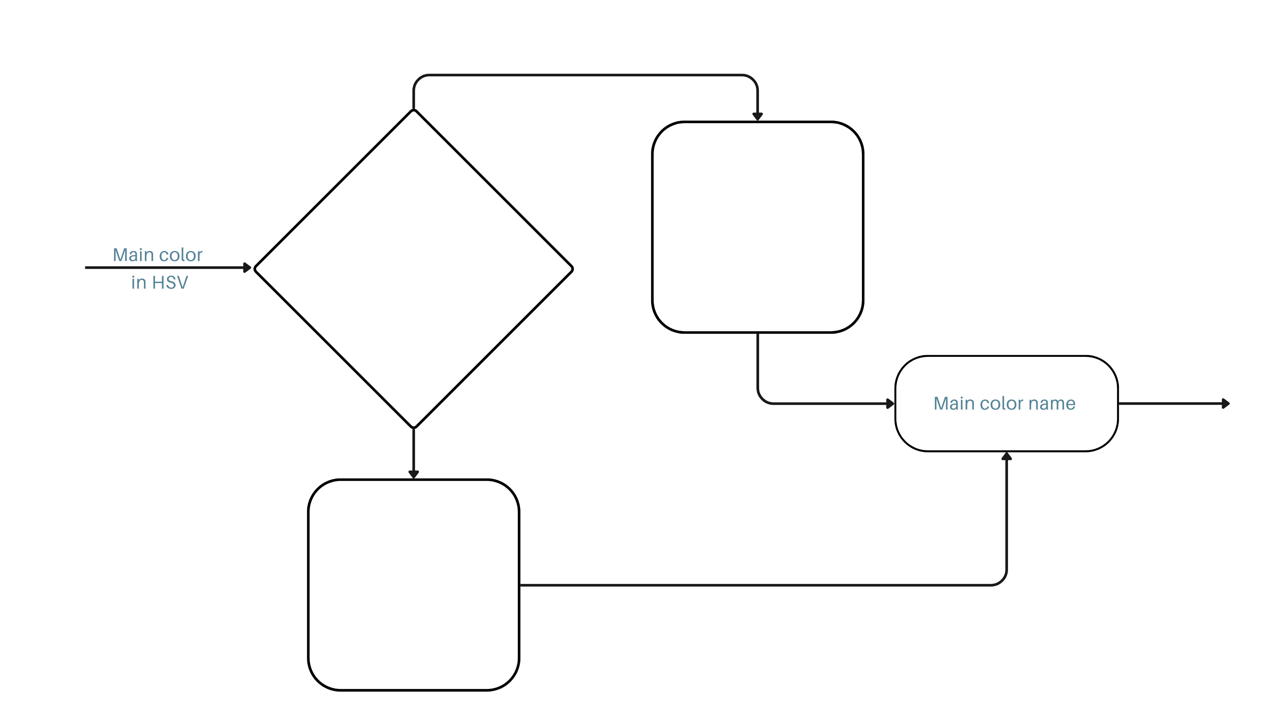
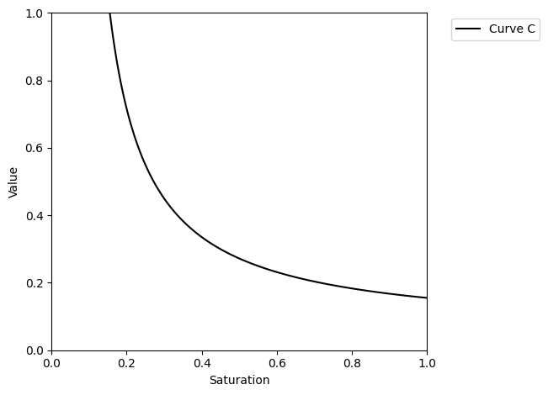
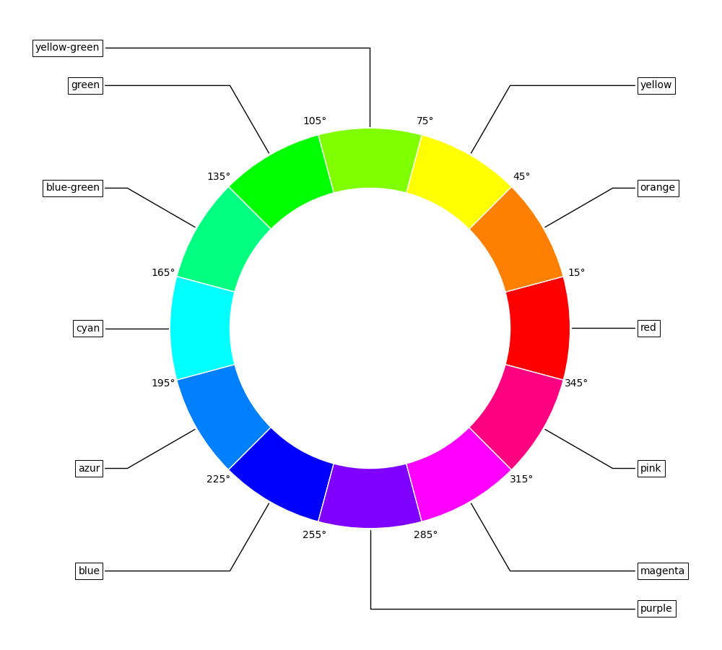
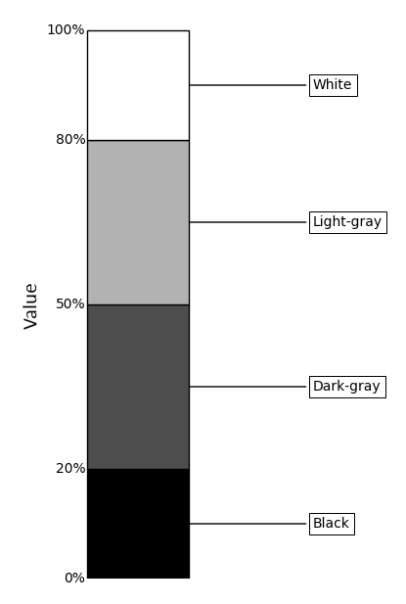
Color classifier
COLOR
CLASSIFIER

Slide 9
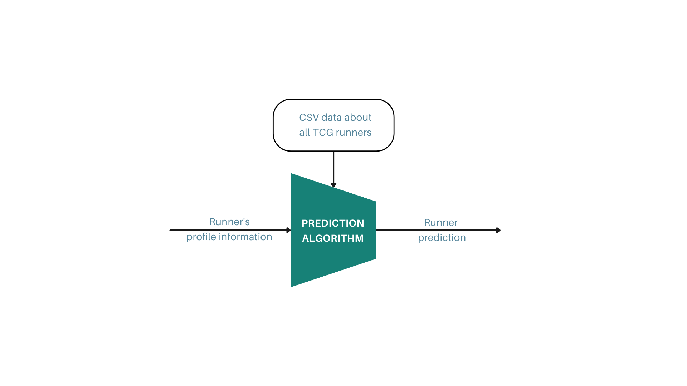
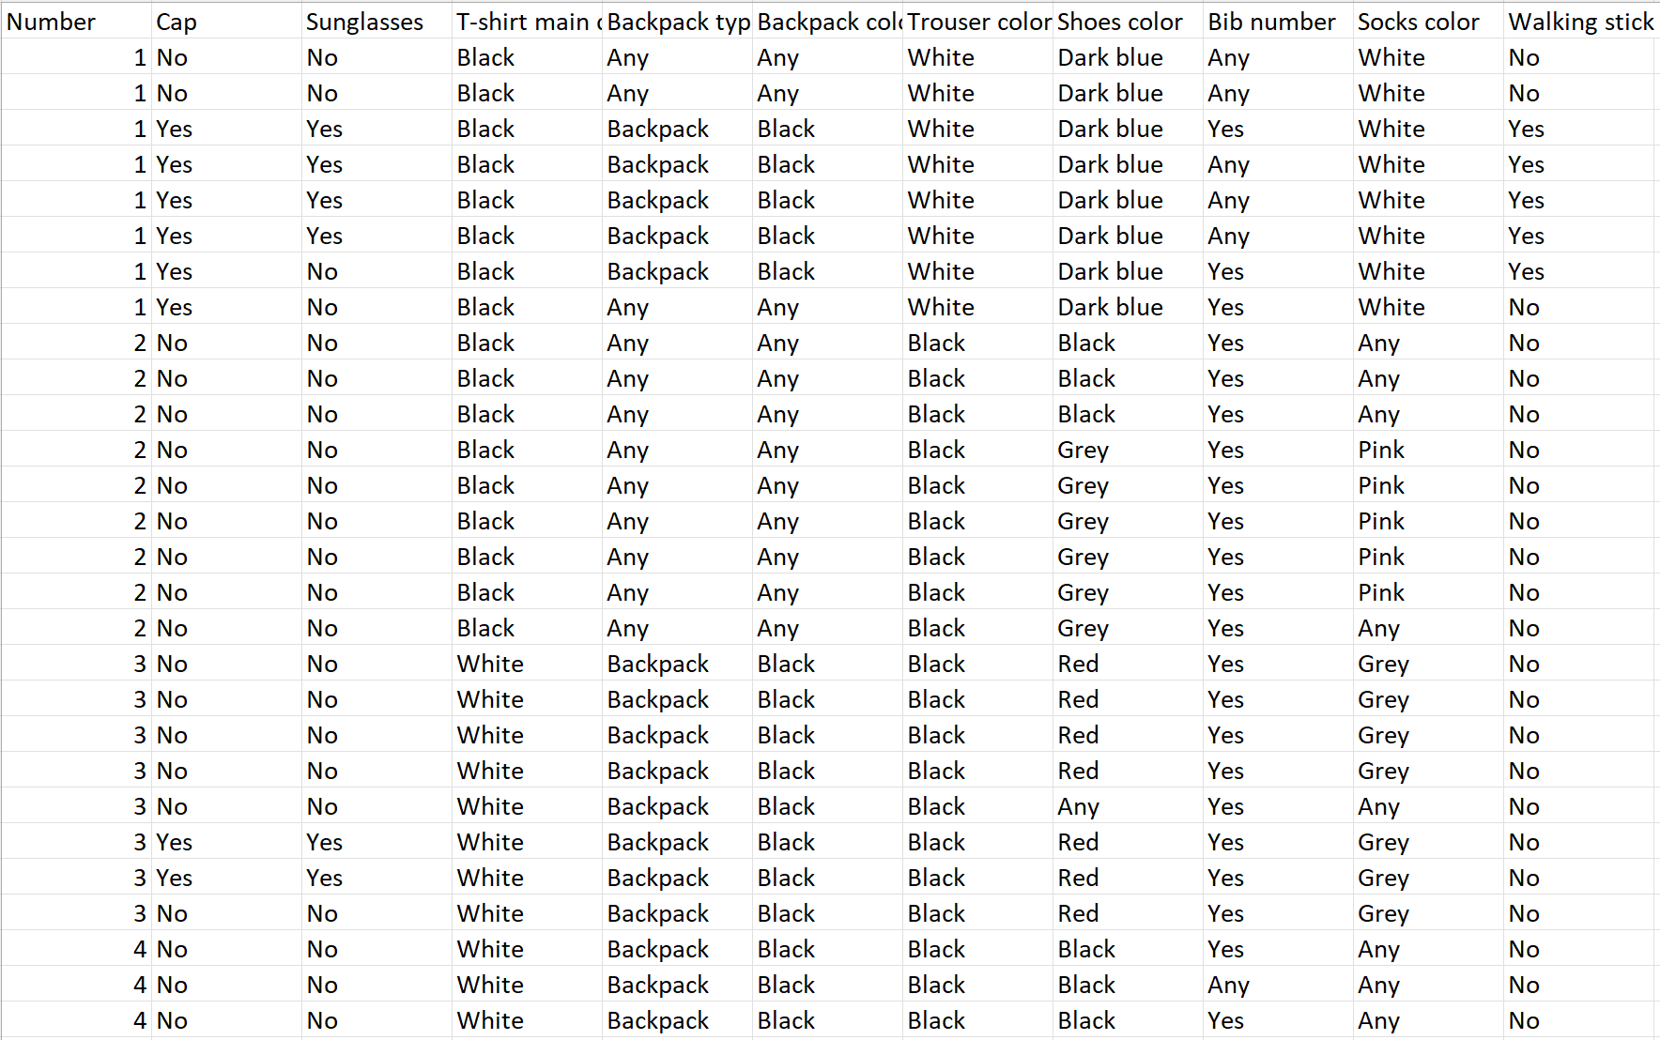
Runner prediction
RUNNER
PREDICTION

Slide 10
Conclusion
10

Slide 11
Thanks for your attention
11

