Slide 1
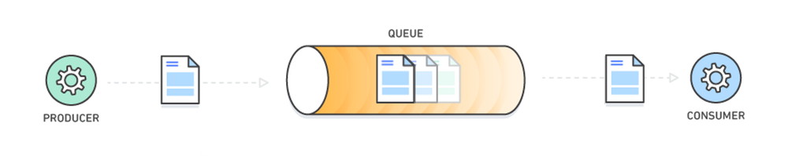
PROJET C : FILE DE MESSAGES
Clément GRESH
Hugo LIGNIER
Programmation Système Avancée
M1 Université de Paris
2021-2022

Slide 2
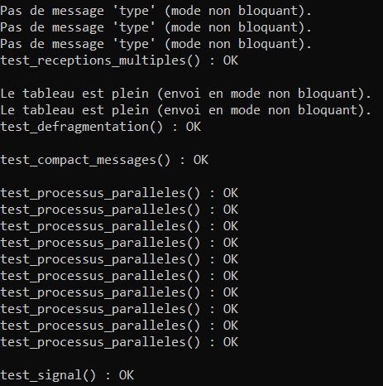
Fonctionnalités
Basiques
Création de files (nommées & anonymes)
Connexion à une file
Envoi de messages
Réception de messages (selon le type)
Tests
Avancées
Messages compactes
Notifications

Slide 3
ARCHITECTURE
MESSAGE
memory_size
flag
*shared_memory
LINE
header
char messages[]
HEADER
max_len
pipe_capacity
first_free
…
mutex
…
records[x]
types[y]
RECORDS
pid
signal
type
RECORDS
pid
signal
type
MON_MESSAGE
type
length
offset
char mtext[]
TYPES
type
number
mtext

Slide 4
MÉMOIRE PARTAGÉE
HEADER
max_len |  | … |  | first_free |  | first_occupied |  | … |  | mutex |  | … |  | records[x] |  |  | types[y]
 |  |  |  |  |  |  |  |  |  |  |  |  |  | pid | signal | type | type | number
Listes Chaînées
MESSAGES
mon_message |  |  |  |  |  |  |  |  | mon_message |  |  |  |  |  |  |  |  |  |  |  | mon_message
type |  | length |  | offset |  | mtext |  |  | type |  | length |  | offset |  | mtext |  |  |  |  |  | type |  | length |  | offset |  | mtext

Slide 5
MÉMOIRE PARTAGÉE
HEADER
max_len |  | … |  | first_free |  | first_occupied |  | … |  | mutex |  | … |  | records[x] |  |  | types[y]
 |  |  |  |  |  |  |  |  |  |  |  |  |  | pid | signal | type | type | number
MESSAGES
mon_message |  |  |  |  |  |  |  |  | mon_message |  |  |  |  |  |  |  |  |  |  |  | mon_message
type |  | length |  | offset |  | mtext |  |  | type |  | length |  | offset |  | mtext |  |  |  |  |  | type |  | length |  | offset |  | mtext
Tailles variables

Slide 6
MÉMOIRE PARTAGÉE
HEADER
max_len |  | … |  | first_free |  | first_occupied |  | … |  | mutex |  | … |  | records[x] |  |  | types[y]
 |  |  |  |  |  |  |  |  |  |  |  |  |  | pid | signal | type | type | number
MESSAGES
mon_message |  |  |  |  |  |  |  |  | mon_message |  |  |  |  |  |  |  |  |  |  |  | mon_message
type |  | length |  | offset |  | mtext |  |  | type |  | length |  | offset |  | mtext
Au début : 1 case libre

Slide 7
M_CONNEXION
2 cas:
O_CREAT
pas O_CREAT
Création --> build_msg()
Connexion --> connex_msg()
Fonction auxiliaire : build_prot()
Tests

Slide 8
M_ENVOI
Lock (mutex)
Recherche case libre
NON
OUI
lock
Signal (read cond)
Wait (write cond)
Retire case libre
Unlock (mutex)
Signal (write cond)
Copie message
Ajoute case occupée
Signal (read cond)
mutex
données

Slide 9
M_ENVOI
(tests parallélisme)
Lock (mutex)
Recherche case libre
NON
OUI
lock
Signal (read cond)
Wait (write cond)
Retire case libre
Signal (write cond)
Copie message
Ajoute case occupée
Signal (read cond)
Unlock (mutex)
mutex
données

Slide 10
NOTIFICATIONS
RECORDS[x]
m_enregistrement()
TYPES[y]
m_reception()
pid | signal | type
42 | SIGUSR1 | 0
325 | SIGUSR2 | -4
-1
type | effectif
0 | 7
6 | 0
-400 | 1
 | 0
Notification: m_ signal()

