Slide 1
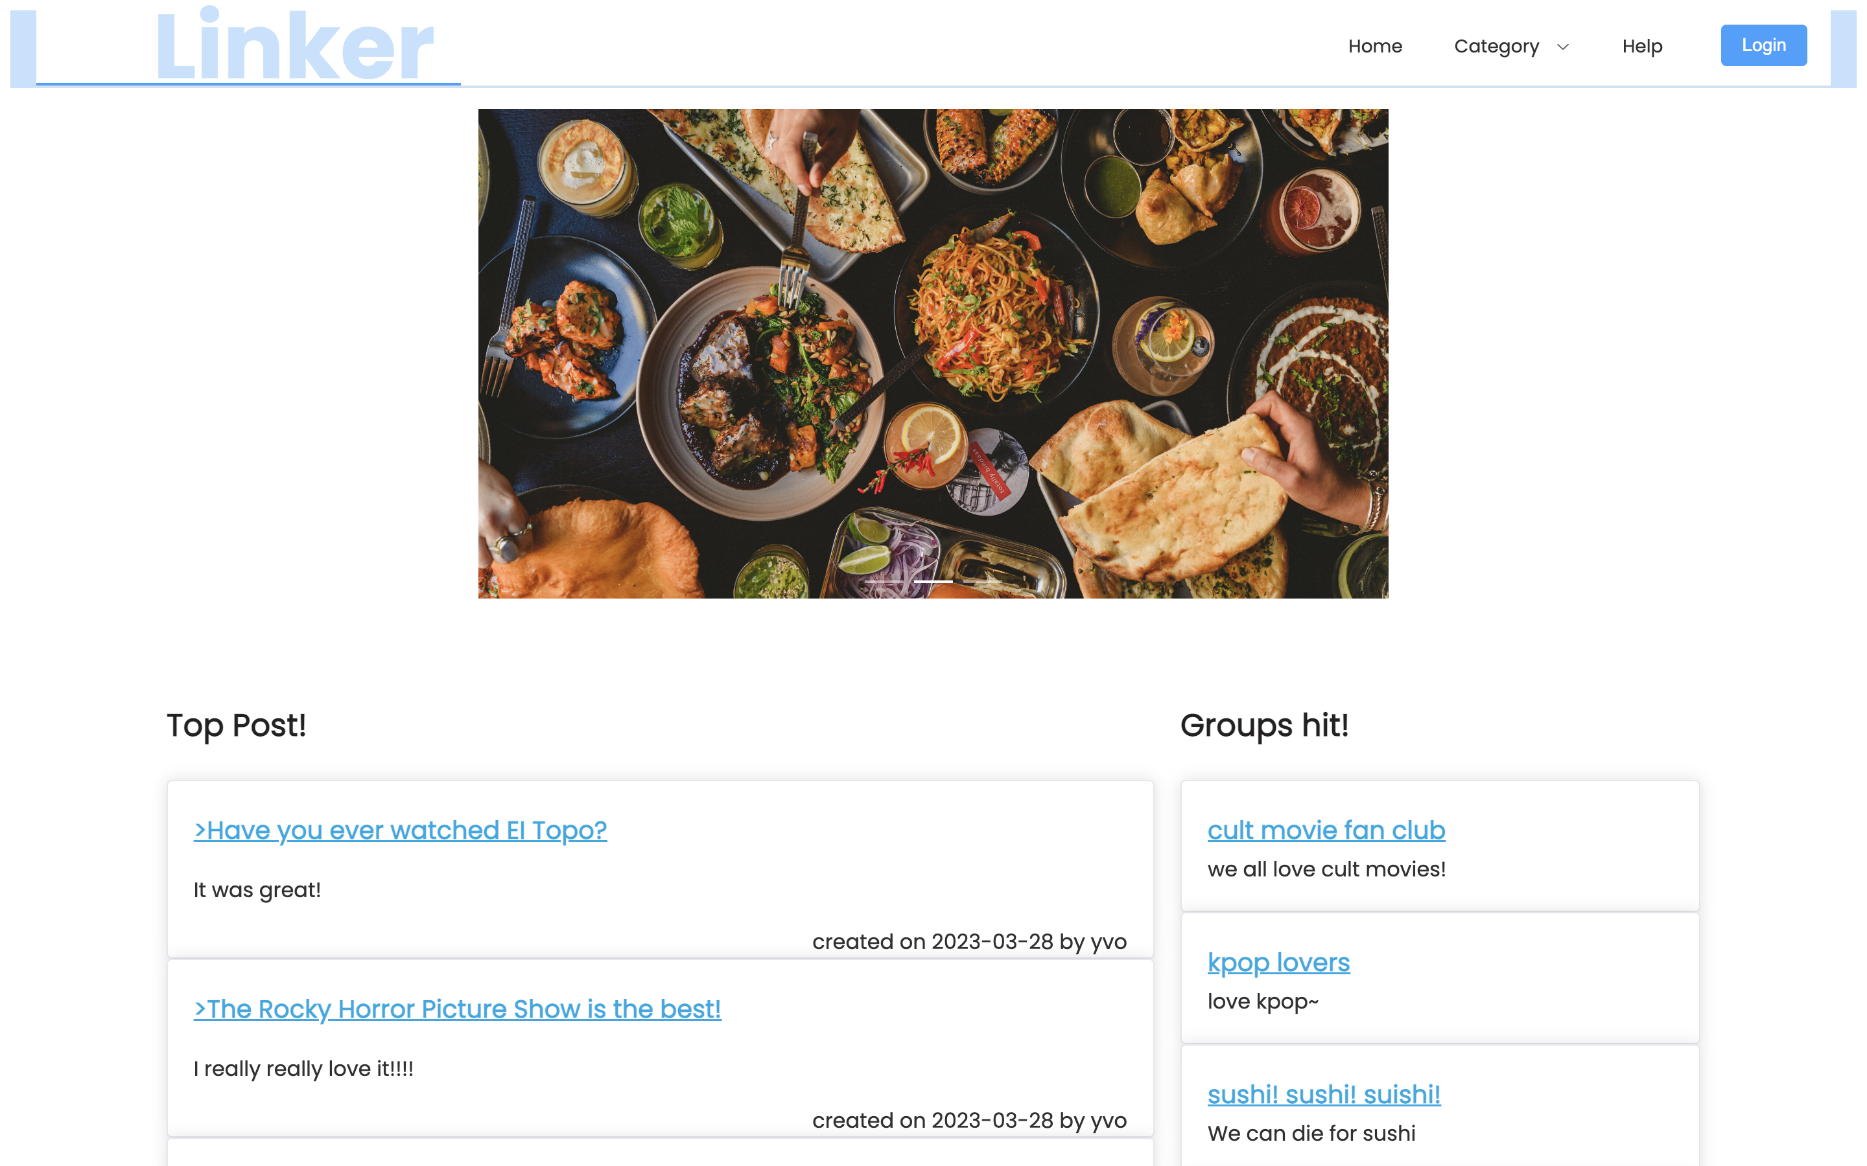
LINKER : GROUPES DE DISCUSSION
Clément GRESH
Yajie LIU
Zimeng ZHANG
Projet TP-ALT
M2 STL-INSTA

Slide 2
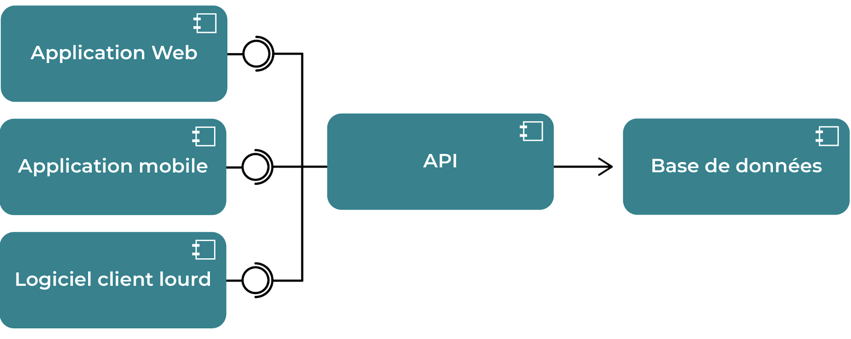
ARCHITECTURE
Users
Groups
Posts
Comments
Categories
Vue.js
Element PLus
Java
Spring Boot
MySQL

Slide 3
COMMUNICATIONS
Axios
Deserializer
PAYLOAD
QUERY SQL
PAYLOAD
FRONT
API
BDD
DTO
MODEL
Mapper

Slide 4
API : ARCHITECTURE
FRONT
Controller
Service
Model
CrudRepository<T, G>
Repository
Id
- Long
- UsersGroupsId
DB

Slide 5
API : GÉNÉRICITÉ DES CLASSES
Layers
Entities
- getAll
- getById
- save
- delete
GenericController
GenericPayload
UsersPayload
UsersController
- getUsersFromGroup
CreateUsersPayload
UpdateUsersPayload

Slide 6
API : TESTS

