Slide 1
SENSOR SENSEI
T-IOT-902
Valentin FICHE – Clément MENDES – Alexandre MERIGOT

Slide 2
SUMMARY
Project Context
Project management methodology
Sensors & Energy consumption
DEMO
Results

Slide 3
CUSTOMER REQUEST
Context
Needs expression
Sensor Sensei is an environmental IoT sensor project aimed at improving air quality monitoring using LoRa technology. The goal is to provide an alternative to Wi-Fi connectivity, which is often power-hungry and not easily accessible in remote areas.
Develop an IoT environmental sensor integrating LoRa.
Design firmware compatible with ESP32, managing sensor data and communication
Optimize energy consumption to maximize sensor autonomy.
A fully documented and ready-to-use solution.
Notes:
Client :
- Qui est notre client ?
- Quel est son secteur d’activité ?
Demande client :
Rappel du contexte : perte de vitesse des grands groupes traditionnels au profit des Fintechs qui évolue plus rapidement avec des offres de plus en plus compétitives
Besoin : Dans ce contexte la, le crédit agricole étudie la possibilité de fournir une solution de service de paiement simple et mondialisée. Vous nous avez mandaté pour faire une étude de marché et proposé une solution qui réponde aux besoins suivants :
Solution globale
Facilité d’utilisation
Disruptif par rapport au domaine bancaire traditionnel.

Slide 4
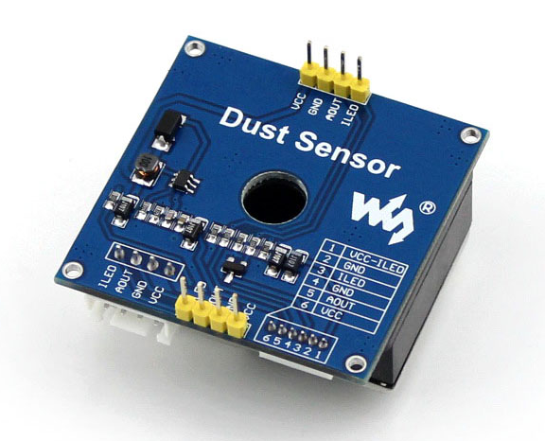
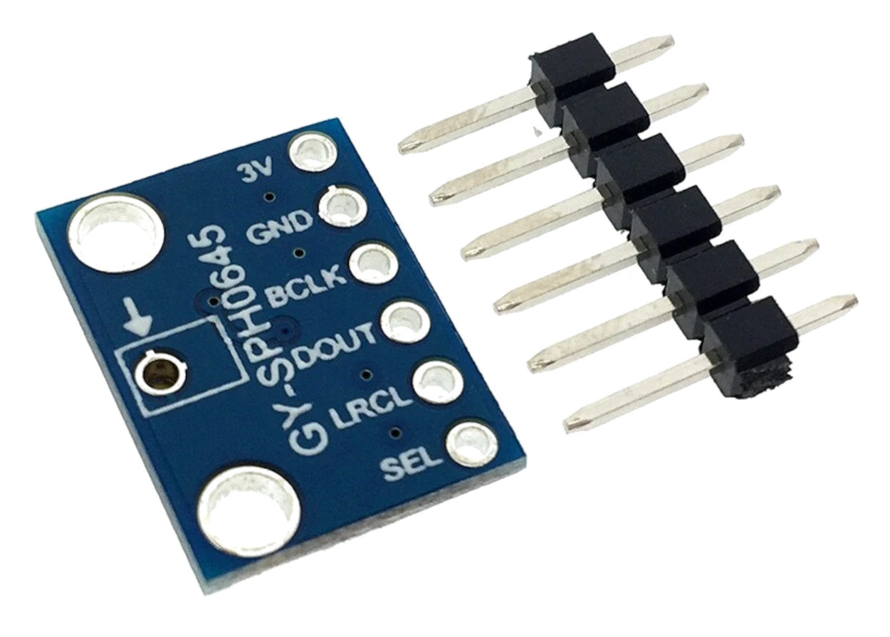
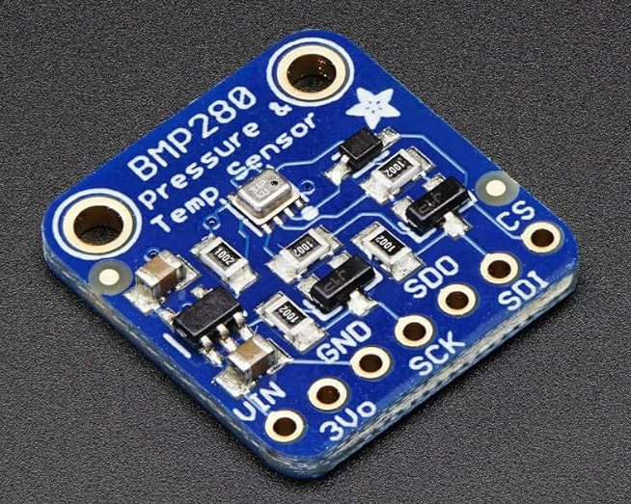
SENSORS & ENERGY CONSUMPTION
DUST SENSOR
SKU: 10500
SOUND SENSOR: SPH0645
TEMPERATURE, SENSOR: BMP280
Average typical current consumption:
~3.4 μA
Peak current consumption (High-performance mode):
~1.12 mA
Average current consumption (ultra-low power mode):
~2.7 µA @ 1 Hz
Average current consumption in sleep mode: ~0.1 µA
Power Consumption (Active Mode):
~20 mA (during the measurement cycle)
Power Consumption (Standby Mode): ~0.1 mA
Typical Power Consumption:
~800 µA (0.8 mA)

Slide 5
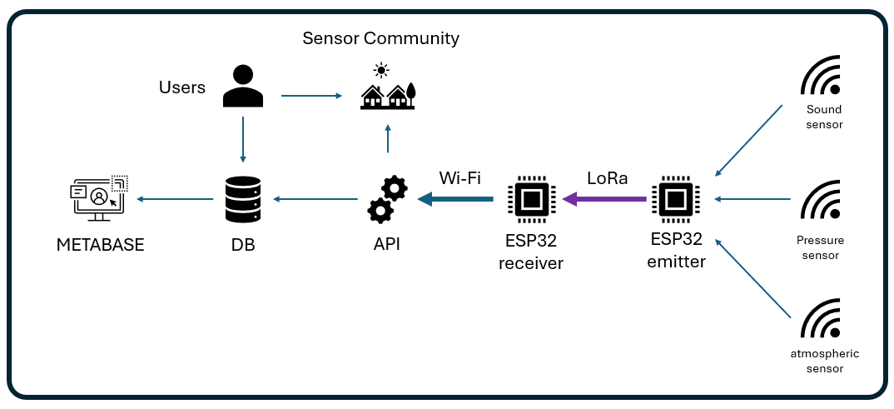
ARCHITECTURE

Slide 6
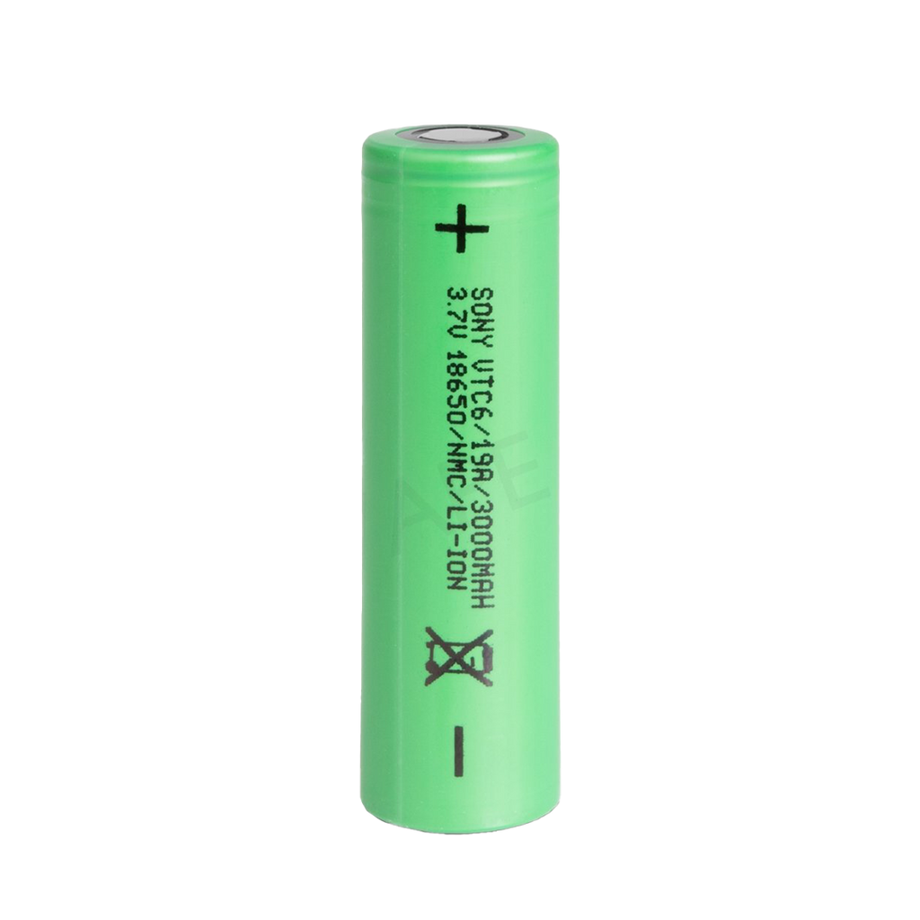
ENERGY CONSUMPTION
Active Period (10 seconds)
Deep Sleep Period (3590 seconds)
The calculated battery life is approximately 345 days when powered by a 3000 mAh LiPo battery.

Slide 7

DEMO

Slide 8
Results

Slide 9
MERCI

