Slide 1
Blunomy - Interview

Slide 2
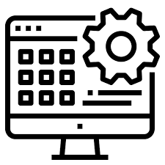
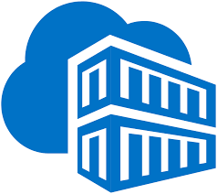
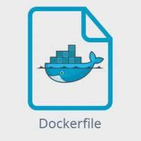


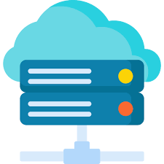

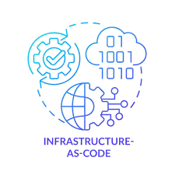
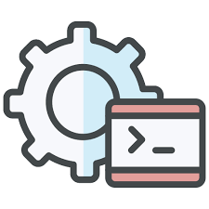
App diagram
Internal
Application backend
Dockerfile
Pipeline Build Stage
Container Registry
Pipeline Deploy Stage
User Access
Terraform Pipeline
Kubernetes Service and deployment
Infrastructure as Code
Cloud Kubernetes Infrastructure
Application UI
Running on specific port

Slide 3
Application Security
Encryption:
Use SSL certificates with Ingress
If using a backend Database, make sure data are encrypted and connection is secured (TLS, private internal IPs)
Image vulnerabilities:
Code scanning tools
Image scanning tool

Slide 4
Platform Security
Access Management
RBAC on resources
Secured Azure Active directory access with MFA
Service account for application and managed identities for resources
Infrastructure Security
Firewalls
Admin access via VPN
If backend database, API or storage, allow only via internal backend services

Slide 5
Monitoring
Monitoring
Security Logs
Monitor performance, and setup alerts if cluster is down (OOM)
Use Azure sentinel or 3rd party tool (Datadog)
Data Access logs
Store app sensitive data in an external secured database accessible only internally and by specific admins.
Audits
Regular monitoring and reports

