Slide 1
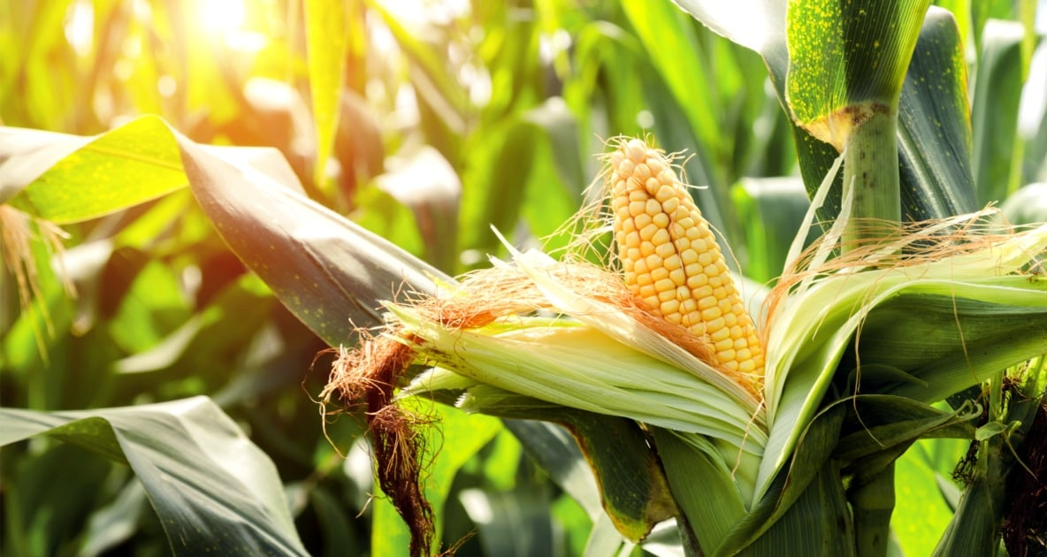
Corn Leaf Disease Classification
A Convolutional Neural Network Analysis
By Clement Chen

