Slide 1
Recursion
Chapter 6

Slide 2
Recursion
Recursion is a repetitive process in which an algorithm calls itself.

Slide 3
Recursion defined
Decompose the problem from the top to the bottom.
Then, solve the problem from bottom to the top.
The statement that solves the problem is known as the base case.
The rest of the algorithm is known as the general case.

Slide 4
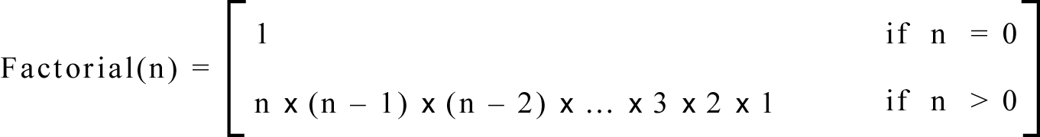
Factorial (4) = 4 x 3 x 2 x 1 = 24
Iterative algorithm definition.
Figure 6-1

Slide 5
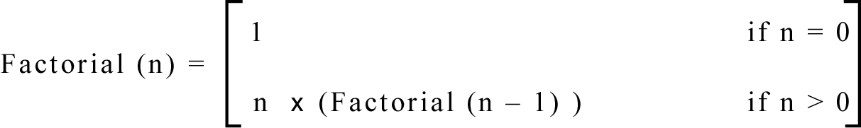
Factorial (4) = 4 x Factorial(3)
= 4 x 3 x Factorial(2)
=4 x 3 x 2 x Factorial(1) = 24
Recursive algorithm definition.
Figure 6-2

Slide 6
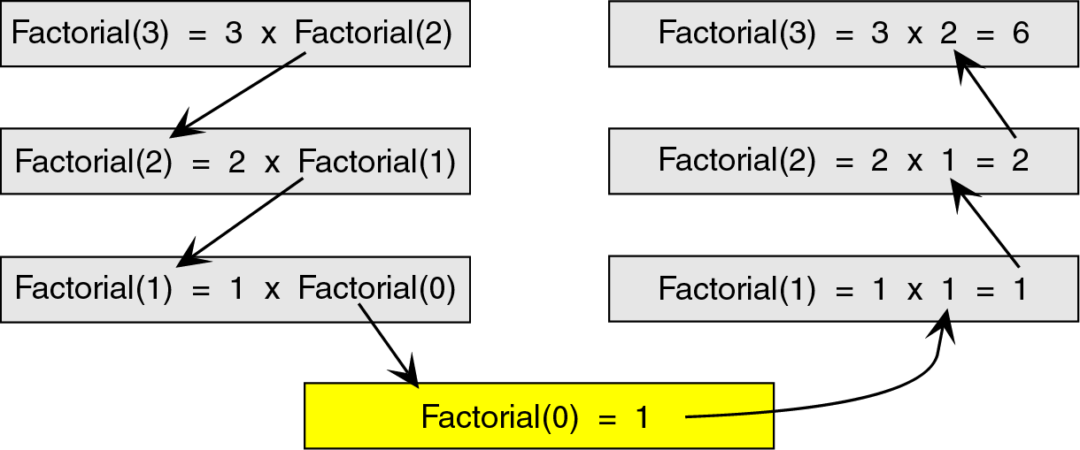
Base case is Factorial(0) = 1.
General case is n*Factorial(n-1).
Figure 6-3

Slide 7
How Recursion Works
When a program calls a subrutine, the current module suspends processing and the called subroutine takes over the control of the program.
When the subroutine completes its processing and returs to the module that called it.
The value of the parameters must be the same before and after a call.

Slide 8
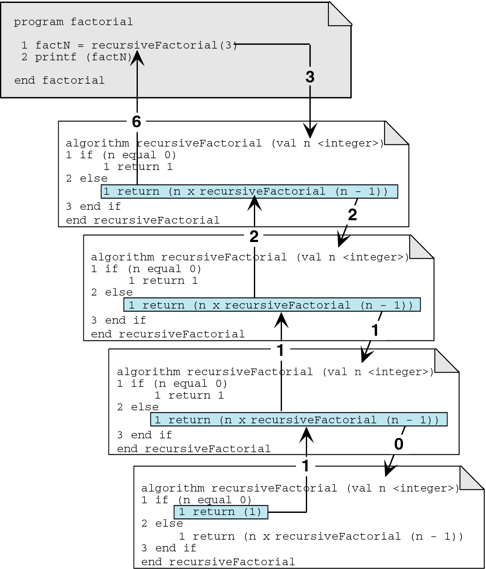
Figure 6-4

Slide 9
Designing Recursive Algorithm
First, determine the base case.
Then, determine the general case.
Combine the base case and general case into an algorithm.
Note: Recursion works best when the algorithm uses a data structure that naturally supports recursion!

Slide 10
Usage of Recursion
Is the algorithm or data structure naturally suited to recursion?
Is the recursive solution shorter and more understandable?
Does the recursive solution run in acceptable time and space limits?

Slide 11
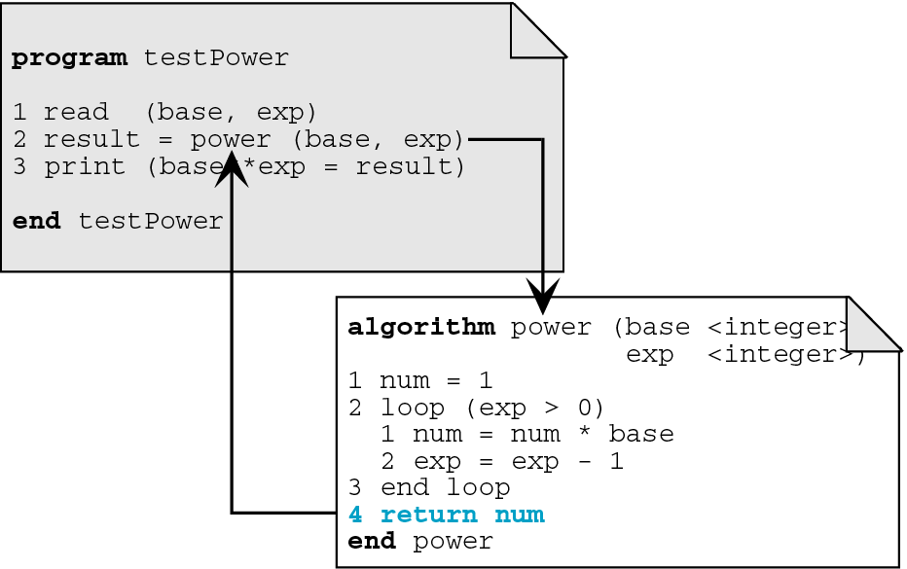
Figure 6-5

Slide 12
Recursive Power Algorithm
algorithm power ( val base <integer>, val exp <integer>)
This algorithm computes the value of a number, base, raised to the power of an exponent, exp.
Pre base is the number to be raised
exp is the exponent
Post value of base**exp returned
if (exp equal 0)
  return(1)
else
  return (base * power(base, exp-1)
end power

Slide 13
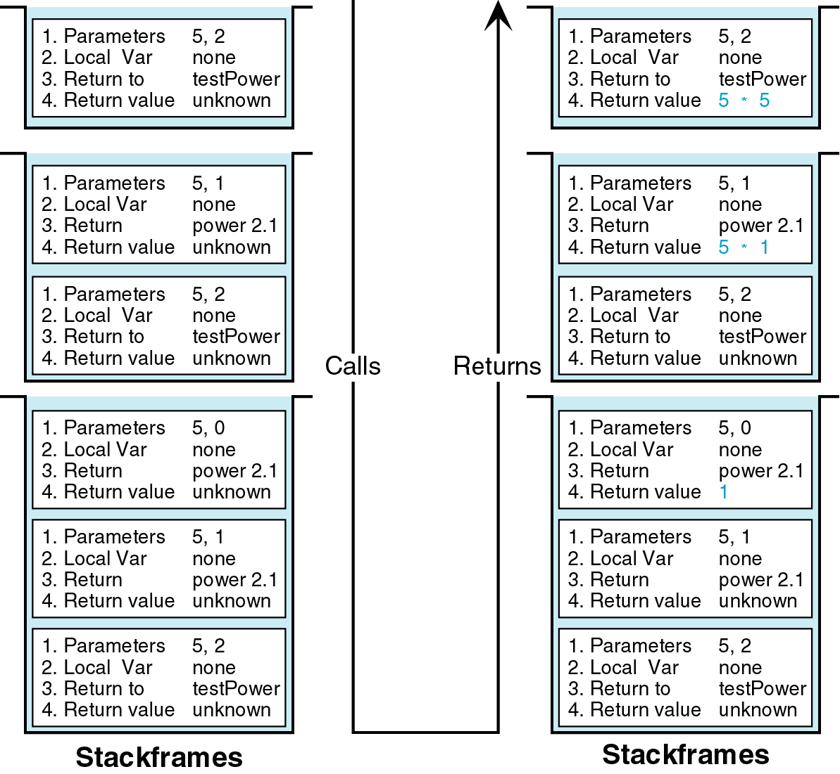
Figure 6-6

Slide 14
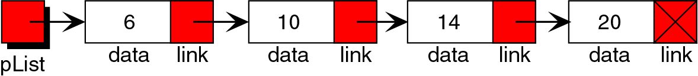
Reverse a Linked List
Figure 6-7

Slide 15
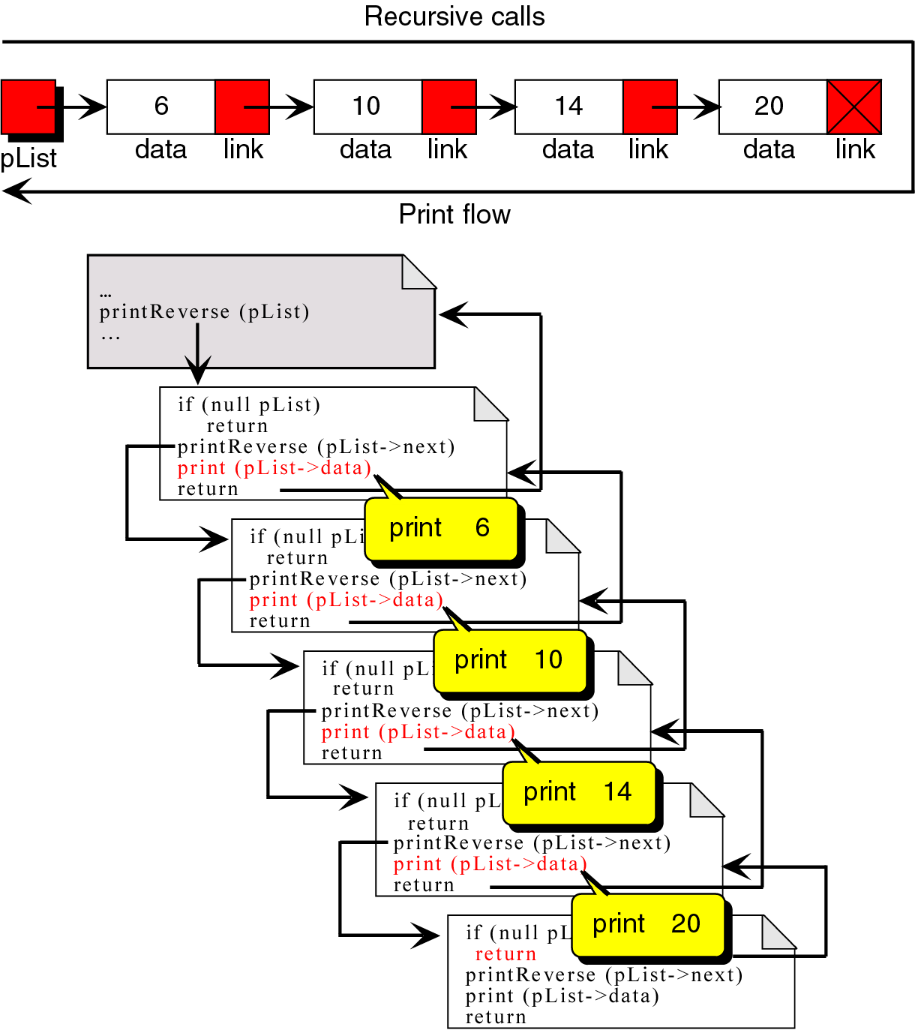
Figure 6-8

Slide 16
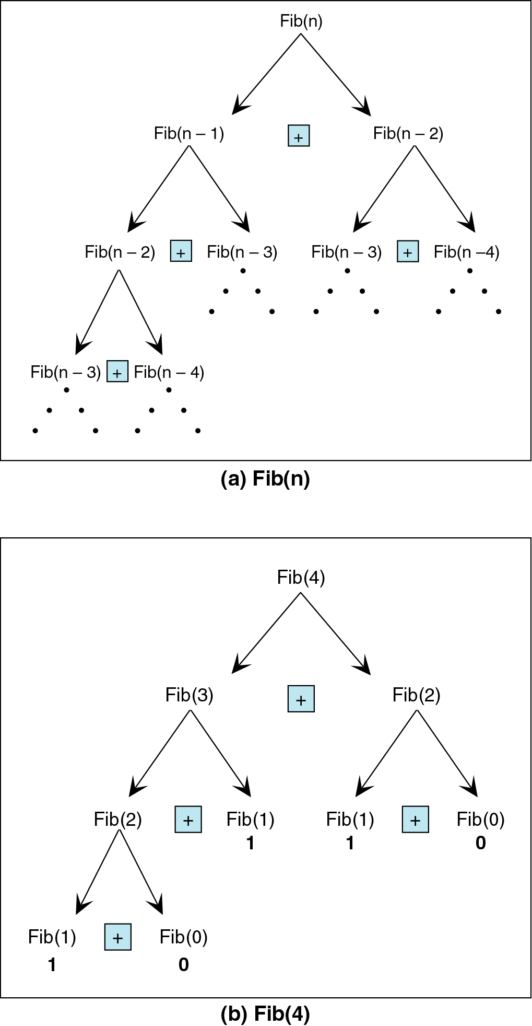
Fibonacci Numbers
0, 1, 1, 2, 3, 5, 8, 13, 21, 34, ...
We can generalize it:
Given: Fib(0)=0
Fib(1)=1
Then:
Fib(n)=Fib(n-1)+Fib(n-2)...

Slide 17
Fibonacci Numbers
program Fibonacci
This program prints out a Fibonacci series.
print ( This program prints a Fibonacci Series)
print (How many numbers do you want?)
read (seriesSize)
if (seriesSize < 2)
  seriesSize = 2
print (First seriesSize Fibonacci numbers are)
looper = 0
loop (looper < seriesSize)
  nextFib= fib(looper)
  print(nextFib)
  looper = looper + 1
end
Recursive function!

Slide 18
Fibonacci Numbers
algorithm fib(val num <integer> )
Calculates the nth Fibonacci number.
Pre num identified the original of the Fibonacci number.
Post returns the nth Fibonacci number.
if (num is 0 OR num is 1)
  “Base case” return(num)
return(fib(num-1) + fib(num-2))
end fib

Slide 19
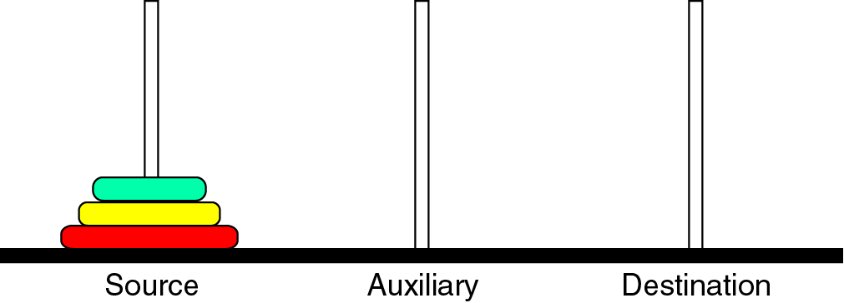
The Towers of Hanoi
Only one disk could be moved at a time.
A larger disk must never be stacked above a smaller one.
One and only one auxillary needle could be used for the intermediate storage of disks.

Slide 20
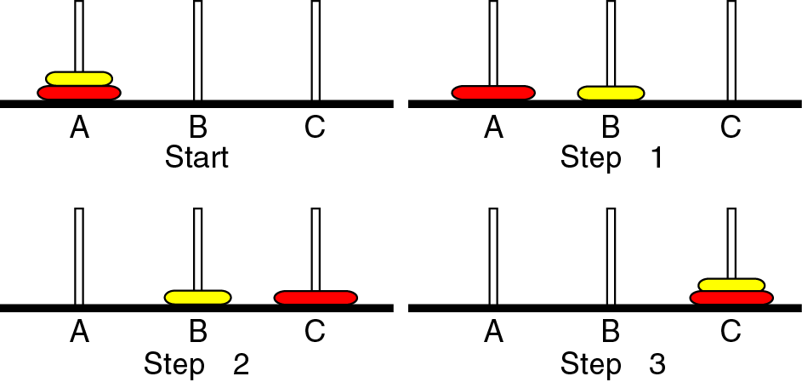
The Towers of Hanoi
Case 1
Figure 6-11

Slide 21
The Towers of Hanoi
Move one disk to auxiliary needle.
Move one disk to destination needle.
Move one disk from auxiliary to destination needle.
Figure 6-11

Slide 22
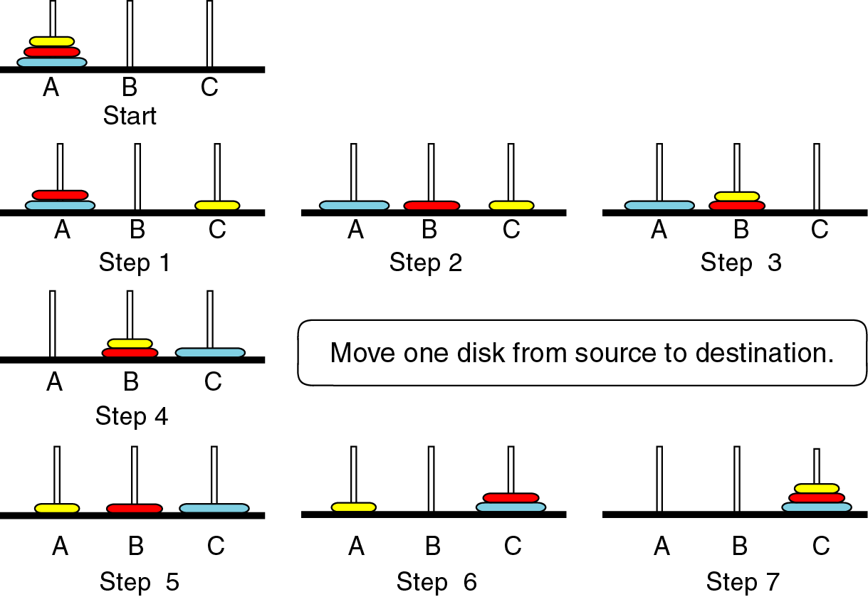
Move two disks from source to auxiliary needle. (Step-3)
Move one disk from source to destination needle. (Step-4)
Move two disks from auxiliary to destination needle. (Step-7)

Slide 23
The Towers of Hanoi
Move n-1 disks from source to auxiliary. General Case
Move one disk from source to destination. Base Case
Move n-1 disks form auxiliary to destination. General Case
Call Towers( n-1, source, auxiliary, destination)
Move one disk from source to destination
Call Towers(n-1, auxilary, destination, source).

Slide 24
The Towers of Hanoi
algorithm towers (val disks <integer>,
val source <character>,
val dest <character> ,
val auxiliary <character>,
step <integer>)
Recursively move one disk from source to destination.
Pre: The tower consists of integer disks
Source, destination and auxilary towers given.
Post: Steps for moves printed

Slide 25
The Towers of Hanoi
1 print(“Towers :”, disks, source, dest, auxiliary)
2 if (disks =1)
1 print(“Step”, step, “Move from”, source, “to”, dest)
2 step = step + 1
3 else
1 towers(disks – 1, source, auxiliary, dest, step)
2 print(“Step1”, step, “Move from”, source, “to”, dest)
3 step = step + 1
4 towers (disks – 1, auxiliary, dest, source, step)
4 return
end towers

Slide 26
1 print(“Towers :”, disks, source, dest, auxiliary)
2 if (disks = 1)
1 print(“Step”, step, “Move from”, source, “to”, dest)
2 step = step + 1
3 else
1 towers(disks – 1, source, auxiliary, dest, step)
2 print(“Step”, step, “Move from”, source, “to”, dest)
3 step = step + 1
4 towers (disks – 1, auxiliary, dest, source, step)
4 return
end towers
Towers (3, A, C, B)
Towers (2, A, B, C)
Towers (1, A, C, B)
Step 1 Move from A to C
Step 2 Move from A to B
Towers(1, C, B, A)
Step 3 Move from C to B
Step 4 Move from A to C
Towers(2, B, C, A)
Towers(1, B, A, C)
Step 5 Move from B to A
Step 6 Move from B to C
Towers(1, A, C, B)
Step 7 Move from A to C

Slide 27
Exercise #1
Write the recursive program, that calculates and returns the length of a linked list.

Slide 28
Exercise #1
typedef struct student{
int studentId;
char studentName[20];
struct student *nextPtr;
}STD;
insertStudent(STD *headNode);
deleteStudent(STD *headNode);
displayList(STD *headNode);
int countList(STD *tempNode);
int main(void){
//define a head node that initialize the list
char choice = 0;
STD *headNode = (STD *)malloc(sizeof(STD));
headNode->nextPtr = NULL;
for(;;){
printf("Yapmak istediginiz islemi giriniz..\n"); printf("1.Ogrenci Ekleme\n");
printf("2.Ogrenci Cikarma\n");
printf("3.Tum Listeyi Goruntuleme\n");
printf("4.Listedeki kayıt sayısı \n");
printf("5.Exit\n");

Slide 29
Exercise #1
scanf("%c",&choice);
switch(choice){
case '1': insertStudent(headNode); break;
case '2': deleteStudent(headNode); break;
case '3': displayList(headNode); break;
case '4': { printf("\n node count of the list = %d \n", countList(headNode));
break;}
case '5': exit(0);
}
}
}
int countList(STD *tempNode) {
if (tempNode->nextPtr == NULL) return 0;
else return(1+countList(tempNode->nextPtr));
}

Slide 30
Exercise #2
Implement the Russian peasant algorithm to multiply two integer values by using recursive structure. Here are the multiplication rules:
Double the number in the first operand, and halve the number in the second operand.
If the number in the second operand is odd, divide it by two and drop the remainder.
If the number in the second operand is even, cross out that entire row.
Keep doubling, halving, and crossing out until the number in the second operand is 1.
Add up the remaining numbers in the first operand.
The total is the product of your original numbers.
Example:
16 x 27 = ?
  16...27
  32...13
  64...6
  128...3
  256...1
The product: 16+32+128+256=432

Slide 31
Exercise #2
#include<stdio.h>
#include<stdlib.h>
#include<string.h>
int russian(int op1, int op2);
int main(void){
int op1, op2;
printf("\n operand 1 i giriniz:");
scanf("%d", &op1);
printf("\n operand 2 i giriniz:");
scanf("%d", &op2);
printf("\n %d * %d = %d \n", op1, op2, russian(op1, op2));
}
int russian(int op1, int op2) {
if (op2 = = 1) { printf("\n %d", op1); return(op1);}
if ((op2 % 2) = = 0) return(russian((op1*2), (op2/2)));
else return(op1 + russian((op1*2), (op2/2)));
}

Slide 32
Exercise #3 (Quiz ?!!)
Write a recursive procedure that has as arguments an array of characters and two bounds on array indices. The procedure should reverse the order of those entries in the array whose indices are between the two bounds. For example, if the array is;
A[1] = “A” A[2]= “B” A[3]= “C” A[4]= “D” A[5]= “E”
and the bounds are 2 and 5. Then after the procedure is run the array elements should be:
A[1] = “A” A[2]= “E” A[3]= “D” A[4]= “C” A[5]= “B”

Slide 33
Exercise #3
convert (int first, int end, char A[])
{ char temp;
if (end > first)
{ temp = A[end];
A[end]= A[first];
A[first] = temp;
first ++;
last -- ;
convert(firts, end , A);
}
}

