Slide 1
Microbially MEdiated Data Server (MMEDS)
David S. Wallach
Clemente Lab
Icahn School of Medicine at Mount Sinai

Slide 2
Technical Features
Storage
  Data stored in MongoDB server
  Metadata stored in SQL
Access
  Hosted on Minerva
  Accessed via python-based web application
Functionality
  Runs Qiime 1.9.1 & 2 scripts
  Including DADA2, Deblur, and alpha & beta diversity

Slide 3
Why Mmeds?
Ease of use
  No Downloads
  No Installs
Multiple tools with one format
  Qiime 1.9.1 & 2
Meta Analysis
  Uploaded data can be private or public
  Public data is available to other users

Slide 4
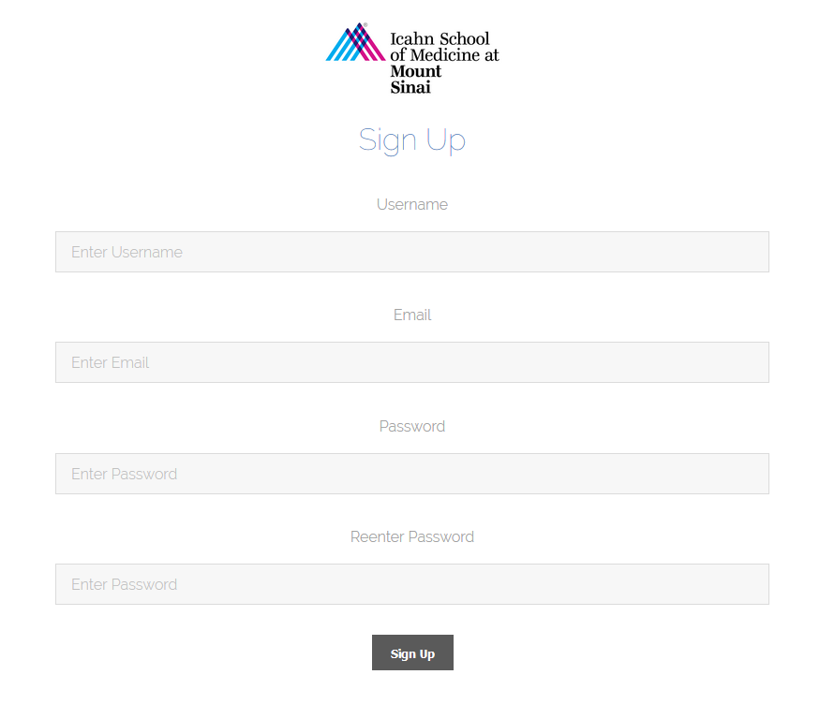
How do you use it?
Sign Up
  A user creates an
  account on the
  server

Slide 5
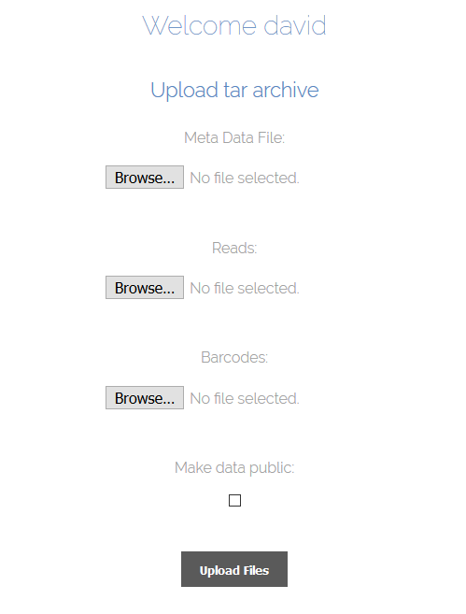
Upload
  Upload a meta data
  file and a data file at
  the same time or
  add it later

Slide 6
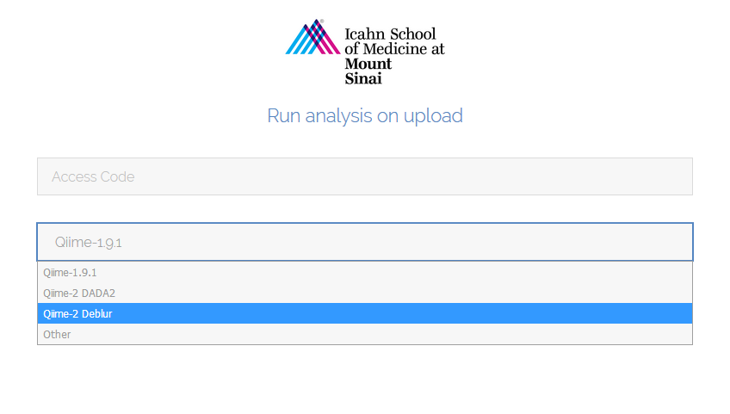
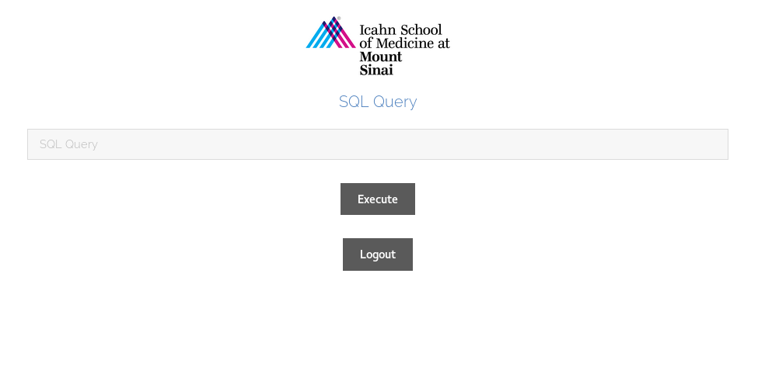
Access
  An access code for is
  sent to the email on
  record
  Run analysis on the
  uploaded data
  Run queries on the
  database from the
  web

Slide 7
Meta Data Validation
Errors
  Type consistency within columns
  Missing columns
  Non-Standard NA formats
  Multiple studies in one meta data file
  Column headers implying PHI
Warnings
  Subject previously uploaded by a user
  Value outside of two standard deviations of column

Slide 8

Analysis Functionality
Qiime 1.9.1
  Older
  Consistent results
  No longer supported
Qiime 2
  Newer
  Potentially more accurate results
  Under continuous development

Slide 9
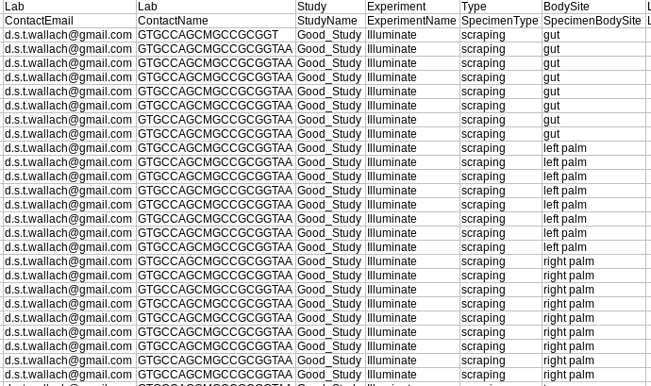
Example MetaData

Slide 10
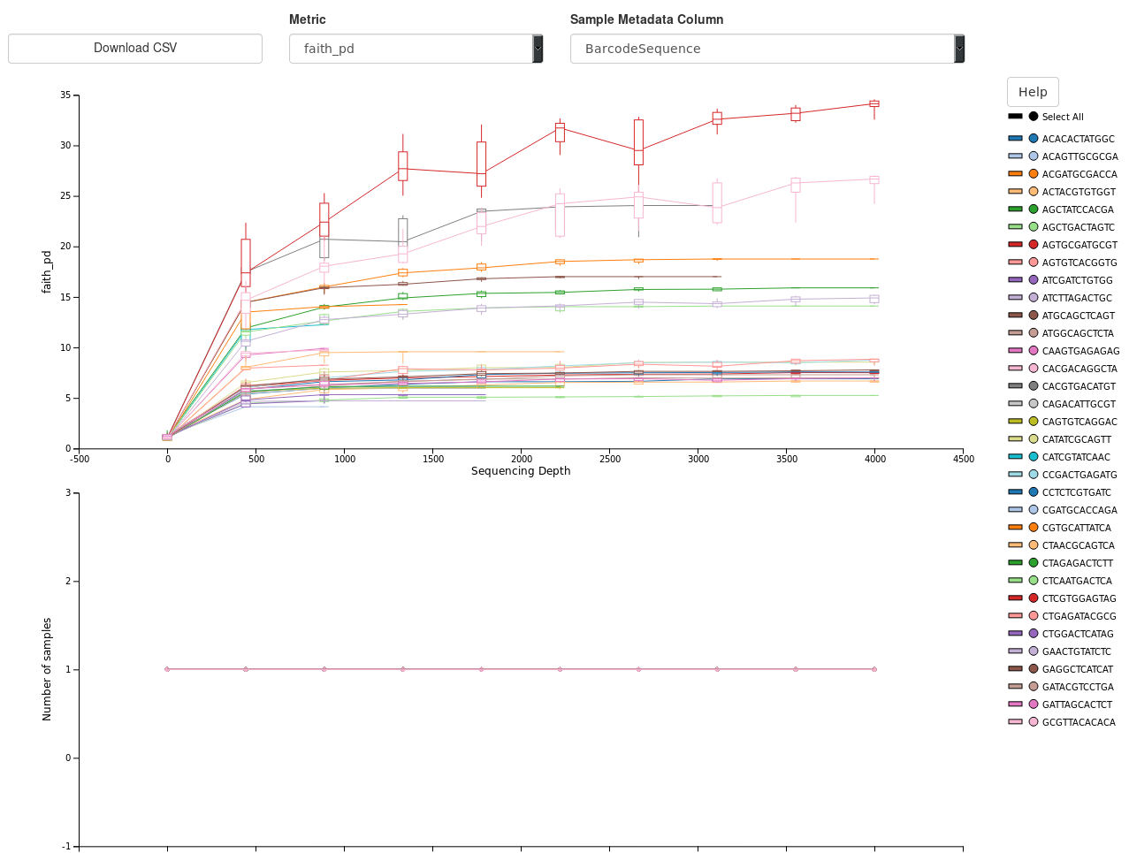
Example Output: Qiime2 DADA2

Slide 11
How is it Validated?
Stress Testing
  Testing the load capacity of all web pages
Validation Testing
  Validating the correctness of all functions used by the server
Integrity Testing
  Ensuring all the data and metadata uploaded is stored correctly

Slide 12
How is it secured?
  Passwords are salted and encrypted with SHA-256
  Connections to the server are secured with HTTPS
  Data exclusive to a particular study can only be viewed by that study’s owner
  Accounts will be linked to Mount Sinai accounts so the source of the data is known

Slide 13
Future Features
  Automatic fixing of certain issues in the meta data file
  Dedicated server hosted by Mount Sinai
  Competed testing setup
  Interface for creating queries without writing SQL directly
  Additional tools such as PYCRUST and Lefsc

Slide 14
The End

Slide 15
Additional Slides

Slide 16
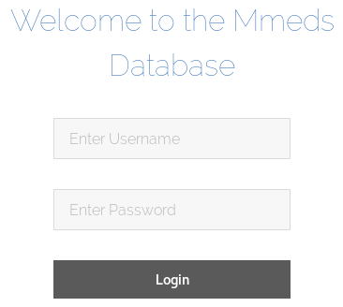
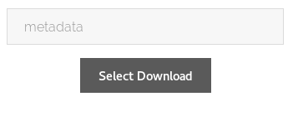
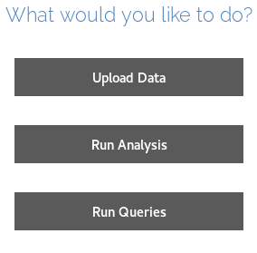
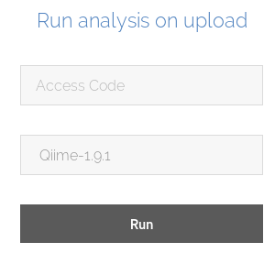
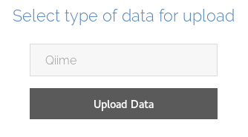
How do you use it?
  Login
  Decide on an action
  Upload Data
  Run analysis
  Download Results

