Slide 1
NoSQL Databases
A short overview

Slide 2
Types
Document Databases
Graph Stores
Key-Value Stores
Wide-Column Stores

Slide 3
Document Databases
Each key is paired with a ‘Document’
Documents are objects with specific properties that store the data
Properties can be added dynamically
Documents can contain many different key-value pairs, or key-array pairs, or even nested documents

Slide 4
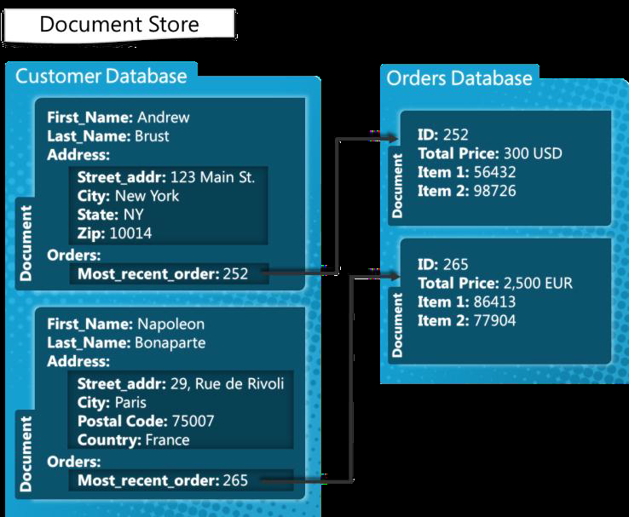
Document Database: Example

Slide 5
Graph Store
Graph structures are used with edges, nodes and properties which provides index-free adjacency
These databases that uses edges and nodes to represent and store data.
The nodes are organized by some relationships with one another, which is represented by edges between the nodes.
Both the nodes and the relationships have some defined properties.

Slide 6
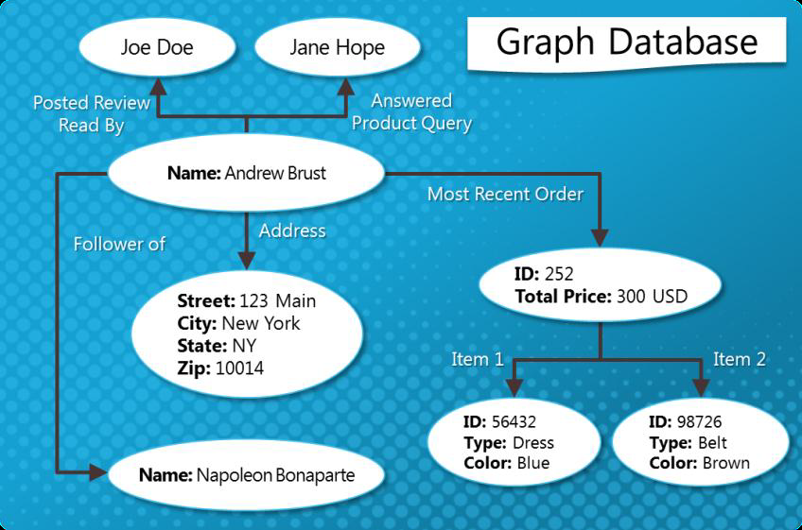
Graph Store: Example

Slide 7
Key-Value Store
Uses a hash table in which there exists a unique key and a pointer to a particular item of data
Some key-value stores allow each value to have a type, such as 'integer', which adds functionality
Very simple to implement

Slide 8
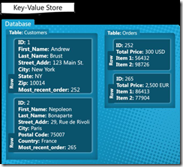
Key-Value Store: Example

Slide 9
Wide-Column Store
Data is stored in cells grouped in columns of data rather than as rows of data
Columns are logically grouped into column families
Column families can contain a virtually unlimited number of columns that can be created at runtime or the definition of the schema
Read and write is done using columns rather than rows

Slide 10
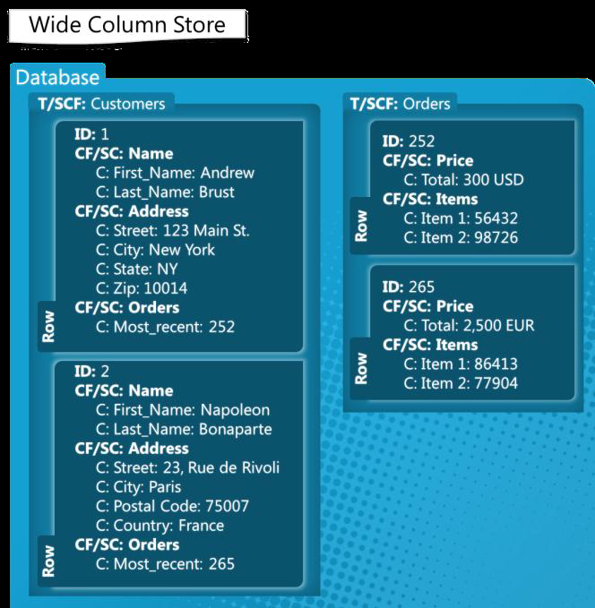
Wide-Column Store: Example

