Slide 1
MMMeds (More MMeds)
David Wallach

Slide 2
The Current Layout
Four Main Areas
  Study/Lab
  Subject/Attributes
  Disease/Illness
  Sample/Analysis

Slide 3
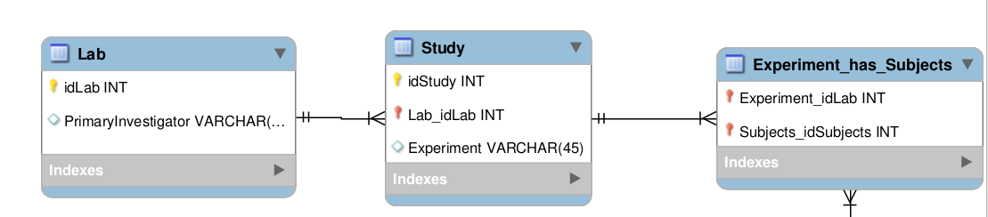
Study / Lab

Slide 4
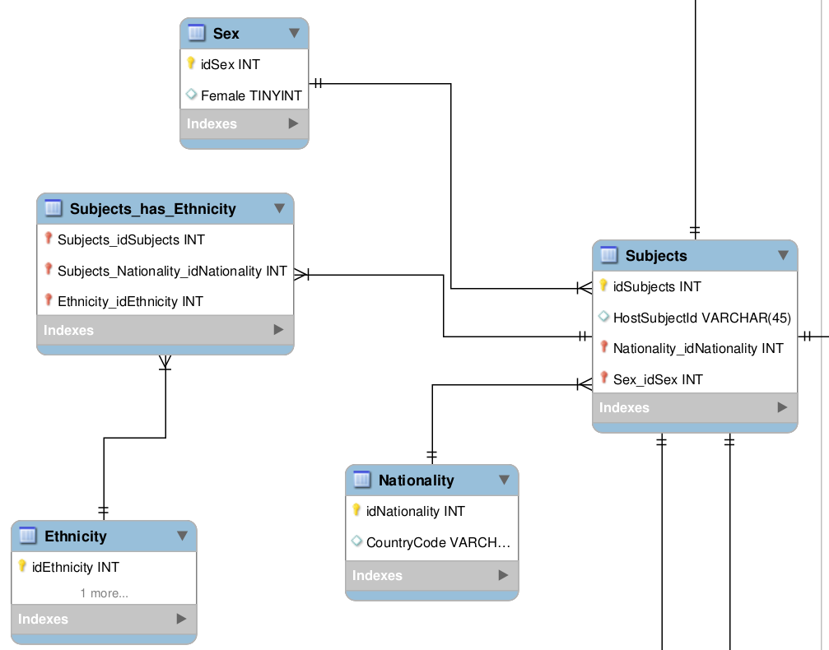
Subject / Attributes

Slide 5
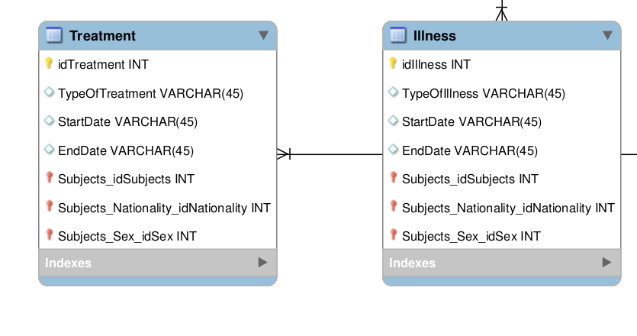
Disease / Illness

Slide 6
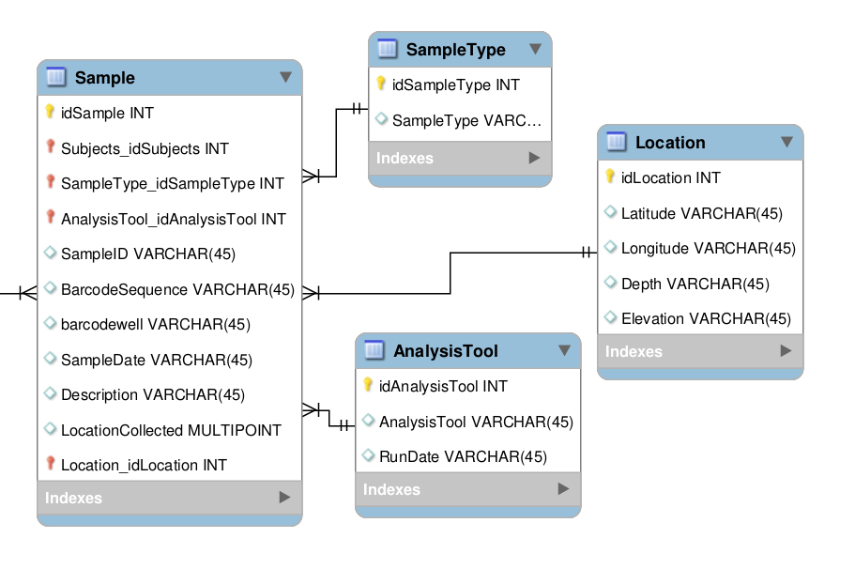
Sample / Analysis

