Slide 1
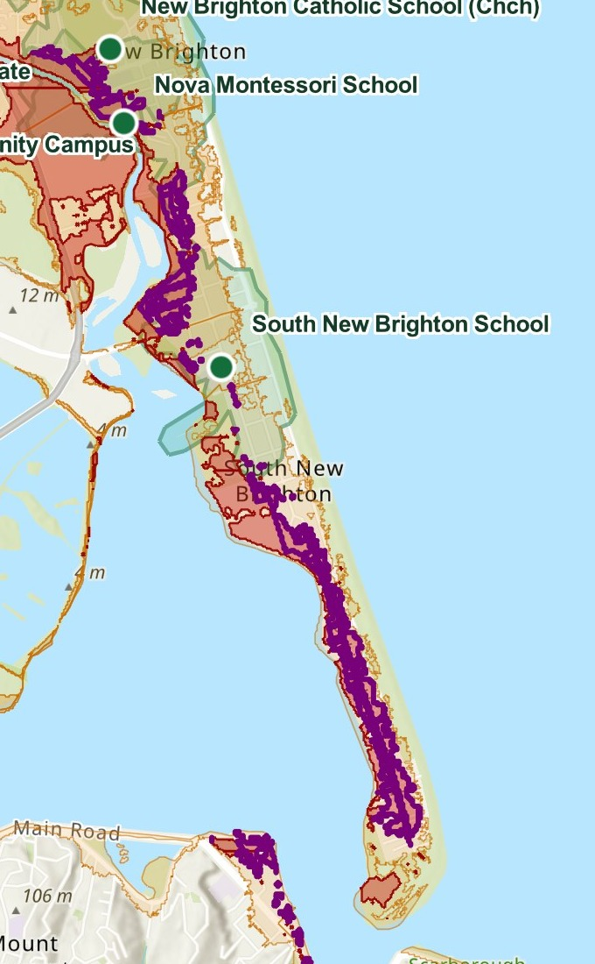
M9U4 · RESILIENT NEIGHBOURHOOD STRATEGY · CLIENT BRIEFING
Keeping South New Brighton connected: where should Christchurch invest first?
SHOCK
Coastal and estuary inundation: CCC Flood Hazard High band (1-in-500-year, risk to life).
STRESS
Sea-level rise: CCC classes the surrounding land as a Flood Management Area vulnerable to it.
EXPOSED
Residents inside the District Plan High Flood Hazard overlay, and primary-school children on a spit with one road out.
Client (proposed, confirm): Christchurch City Council
Decision we support: [one sentence: which intervention to prioritise, and why]
South New Brighton / Southshore spit. Source: CCC Open Data, ArcGIS Online.

Slide 2
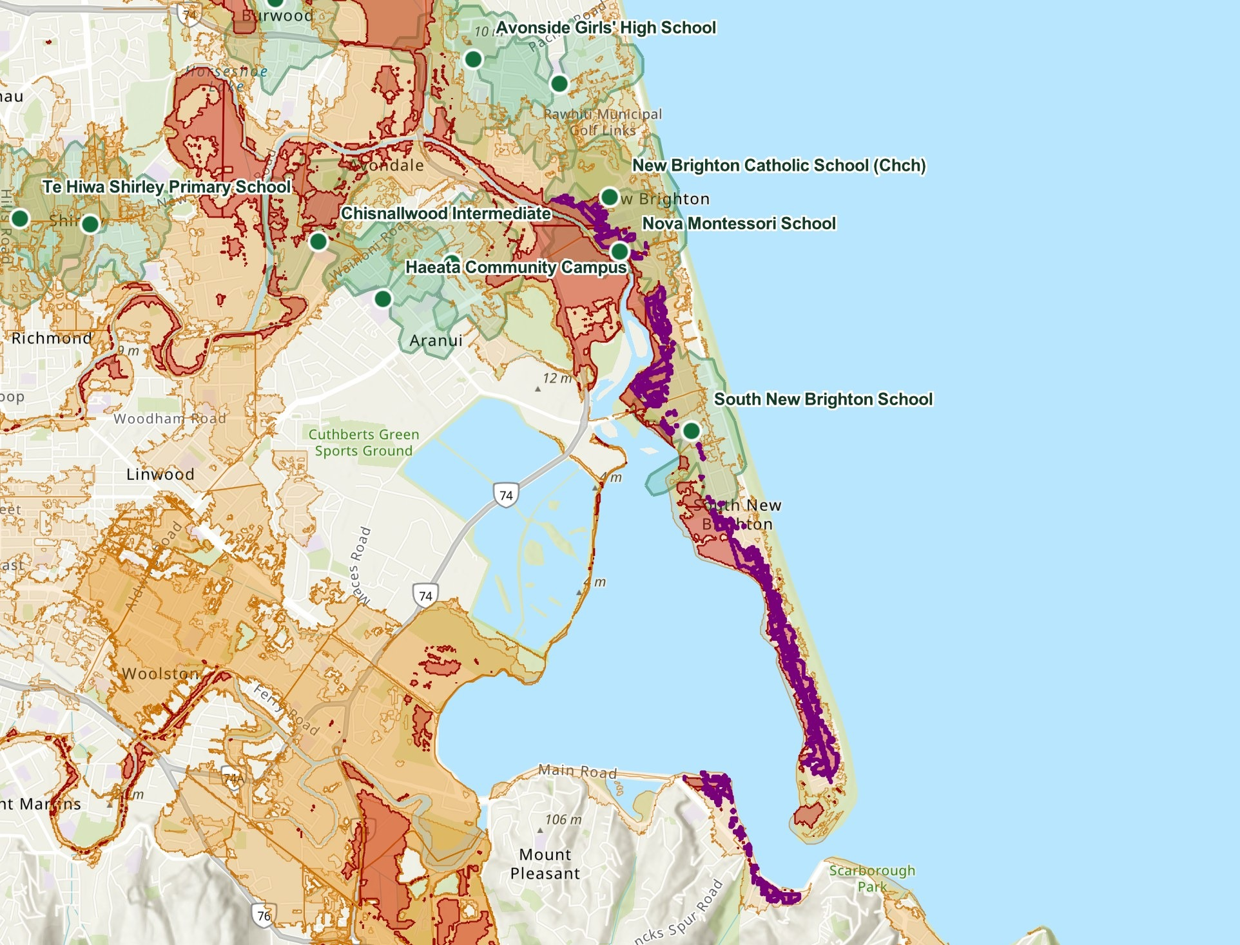
SLIDE 2 · ARCGIS ONLINE DIAGNOSIS
Diagnosis: who can walk to a school, and what floods first
LEGEND
School (MoE directory, 13 east Christchurch schools)
10-minute walk catchment to school
Flood Hazard High (1-in-500-yr, risk to life)
Flood Management Area (tidal / rainfall, SLR-vulnerable)
District Plan High Flood Hazard Residential Overlay
WHAT THE MAP SHOWS
Only South New Brighton School sits on the spit. [Verify with a number: share of overlay dwellings inside a 10-minute walk.]
The catchments were computed without flood barriers, so we read this as exposure, not proven severance.
AI prompting evidence
[2–3 prompt screenshots + one line on how each changed the diagnosis. Shane]
Source: ArcGIS Online web map (M9U4 South New Brighton Resilience Diagnosis); CCC District Plan; MoE schools directory.

Slide 3
SLIDE 3 · PRIORITY CHALLENGE AND INDICATORS
One priority challenge: flood-severed access on a one-road-out spit
Indicator | Threshold | Owner | Baseline | Source
% of overlay dwellings within a 10-minute walk of a school that does not cross Flood Hazard High | ≥ 80% | CCC Community Board | [compute] | ArcGIS + dwelling data
Independent road exits from the spit passable in a 1-in-100 tidal event | ≥ 2 | CCC Transport / Waka Kotahi | [compute] | CCC flood layers
Minutes on foot from Southshore Reserve to the Bridge St / Pages Rd junction | ≤ 15 min | Canterbury CDEM | [route run] | ArcGIS route analysis
Check before this slide is final:
Every indicator needs a computed baseline, or slide 5 has nothing to improve. The spit is roughly 2.7 km long, so a 15-minute walk cannot reach the far end: either the baseline shapes the intervention (a refuge or hub mid-spit) or the threshold is revised. Dwelling counts need a real source (e.g. LINZ building outlines or Census).

Slide 4
SLIDE 4 · AUTODESK FORMA SITE DESIGN
Forma test: [name the intervention]
BASELINE
[Forma view of the sub-site as it is today]
OPTION A
[Forma view with the intervention, from site automation]
WHAT WE TESTED
Sub-site: [about a 200 m block, not the whole 1 km² strip]
Site automation: [settings / prompt used]
Forma analyses run: [e.g. sun, wind, microclimate, carbon: whatever the licence offers]
Flood logic comes from the District Plan hazard bands, not from Forma.
[One line: what changed between the two, and why it answers the priority challenge]
Automation / AI evidence
[screenshot of the site-automation inputs and outputs, and of the analysis panel. Malak]
DRAFT · owner: Malak (due Saturday) · needs: sub-site, intervention, before/after screenshots
Notes:
Site boundary GeoJSON is in the M9U4 Group folder (import into Forma; fallback is drawing the boundary). Confirm which analyses the licence offers and whether Forma has building/terrain context for Christchurch. Avoid adding housing inside the High Flood Hazard band.

Slide 5
SLIDE 5 · BEFORE / AFTER AND ALIGNMENT
Expected impact, and how it aligns with the frameworks
Indicator | Before | After | Source
[Indicator 1 from slide 3] | [value] | [value] | [ArcGIS]
[Forma output 1] | [value] | [value] | [Forma]
[Carbon KPI] | [value] | [value] | [Forma]
SDG 11 or ESG
[choose one, then name the target, e.g. SDG 11 resilience target]
Carbon KPIs
[embodied / operational / whole-life figure and how it was obtained]
LEED ND or BREEAM Communities
[choose one; name the credit(s) the intervention supports. Verify credit references]
Whole-life caveat: [embodied carbon of the intervention vs. operational benefit; one honest sentence. Osama]
DRAFT · owner: Osama (impact) + Malak (numbers) · the brief requires all three framework rows
Notes:
The brief requires: one of SDGs/ESG, Carbon KPIs, and one of LEED/BREEAM. Do not drop the framework row even if the numbers are thin. Before/after values must come from a tool output.

Slide 6
SLIDE 6 · DECISION AND LIMITS
Our recommendation, and what we could not measure
Recommended decision: [proceed with X on segment Y, because indicator Z moves from A to B]
Indicator | Named instrument | Named verifier | Gap we could not close
Walk access to schools | ArcGIS Generate Travel Areas, 10-min walk | [team to name, e.g. CCC GIS] | Catchments run without flood barriers; schools only, no health layer
Road exits in a tidal event | CCC flood layers overlay | [team to name] | No road-flood modelling
Minutes to safe junction | ArcGIS route analysis | [team to name] | Evacuation routing not run yet (credit limit)
Also disclose: Map Viewer AI assistant not enabled by the org; prompting was done with an external assistant. Walk catchments were run for 13 east Christchurch schools only (credit cap).
DRAFT · owner: Osama (critic) + Leticia · verifiers are placeholders
Notes:
Gaps are taken from Shane's README ('Honest gaps'). Naming the instrument, the verifier and the gap per indicator was suggested by Shane's assistant from the lecturer's slides; check that deck before relying on it.

Slide 7
DELETE THIS SLIDE IF APPENDICES COUNT TOWARD THE 6-SLIDE LIMIT
APPENDIX: AI prompt log
ArcGIS prompt 1
[screenshot + one-line outcome. Shane]
ArcGIS prompt 2
[screenshot + one-line outcome. Shane]
ArcGIS prompt 3
[screenshot + one-line outcome. Shane]
Forma step 1
[screenshot + one-line outcome. Malak]
Forma step 2
[screenshot + one-line outcome. Malak]
Forma step 3
[screenshot + one-line outcome. Malak]
DRAFT · check Canvas / coordinator whether an appendix is allowed, or submit this as a separate PDF

