Slide 1
Intro to Scripting
Jacob Tye
January Enrichment Friday

Slide 2
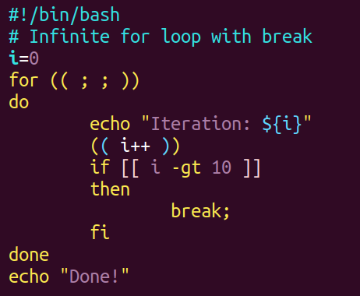
What Is a Script?
A list of commands written down and saved into a file.

Slide 3
Benefits of Scripts
Help avoid mistakes
Reduce typos
Reduce forgetting steps
Speed up simple tasks
Ease complex tasks that would be difficult to run manually
Makes work repeatable
Reduces mental load

Slide 4
Types of Scripts
Bash
Expect
Python

Slide 5

Tasks That Benefit from Scripting
https://app.sli.do/event/vxedS52bnYCaGCUQoffH7N

Slide 6
When Not to Script
One-time commands
Highly exploratory work
Tasks with good existing tools
When it is faster to just do the command

Slide 7
Examples
https://github.com/clementlab/EnrichmentMeetings/blob/main/lessons/intro_to_scripting/examples/example_scripts.ipynb

Slide 8
Intro to Bash
Bash scripts automate the terminal
Same commands you already use
Saved in .sh files
Run top to bottom

Slide 9
Bash Basics
https://github.com/clementlab/EnrichmentMeetings/blob/main/lessons/intro_to_scripting/cheat_sheets/bash-cheat-sheet.md

Slide 10
Bash Configuration (.bashrc)
.bashrc runs automatically when you start a terminal
Used to customize your shell environment
CHPC discourages heavy edits to .bashrc to avoid breaking system behavior
  https://www.chpc.utah.edu/documentation/software/modules.php#sum
Instead use custom.sh – A bash script!
Sourced by .bashrc

Slide 11
Intro to Expect
https://github.com/clementlab/EnrichmentMeetings/blob/main/lessons/intro_to_scripting/cheat_sheets/expect-cheat-sheet.md

Slide 12
Putting It All Together – Let’s write a script
https://app.sli.do/event/vxedS52bnYCaGCUQoffH7N/embed/polls/1a46b908-5bd8-42e1-b0e4-d9e0d64c89b0

Slide 13
Questions

