Slide 1
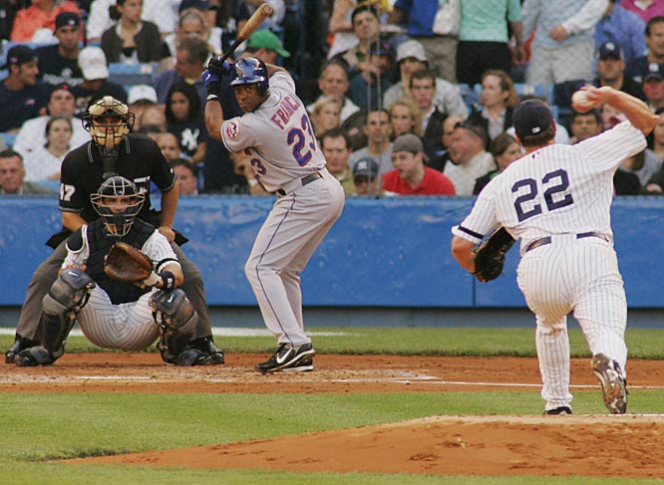
Batter-pitcher matchups
Final Demonstration

Slide 2
Refresher
In baseball, it is crucial to have an idea of how a batter will do against a given pitcher, but there are almost always too few matchups to draw any conclusions
Our goal is to cluster pitchers together based on the types of pitches that they throw in order to better predict how batters will do
PitchFX data contains extensive information about every pitch thrown in major league play over the past 6-7 seasons, recorded by cameras installed in every ballpark

Slide 5
CLustering
K-means clustering algorithm over pitcher attributes (approx. 450 pitchers)
For initializing centroids, used k-means++ to avoid poor results
In each iteration, we reassign point to nearest cluster
We stopped when the clusters did not change

Slide 7
Evaluating our Output
What does it mean to be successful?
The way a batter does against a cluster one year should predict how he does against that cluster the next year.
If we sum up the differences in OBP between our predictions and the actual, the closer we are to zero, the better.
We weight by plate appearances so that differences in larger clusters is worse than differences in clusters with less information.

Slide 8
Neo4j Graph db
Used py2neo to interact with neo4j server
Nodes for players (both pitchers and catchers), teams, clusters
Relations:
Player- ‘PLAYS FOR’-> team
player- ‘BELONGS TO’-> cluster
player -‘MATCHUP-> cluster
‘MATCHUP’ properties
On base percentage, plate appearances

Slide 9
CYPHER
MATCH (p:player)-[:`BELONGS TO`]->(c:cluster)<-[m:`MATCHUP`]-(b:player)-[:`PLAYS FOR`]->(t:team) WHERE p.name = "Tim Wakefield" and t.name = "New York Yankees" and m.PA > 0 RETURN b.name,m.OBP,m.PA ORDER BY m.OBP DESC;
MATCH (c:cluster)<-[:MATCHUP]-(p:player) -[:`PLAYS FOR`] -(t:team) WHERE p.name = "Jeff Francoeur" RETURN p,t,c

