Slide 1
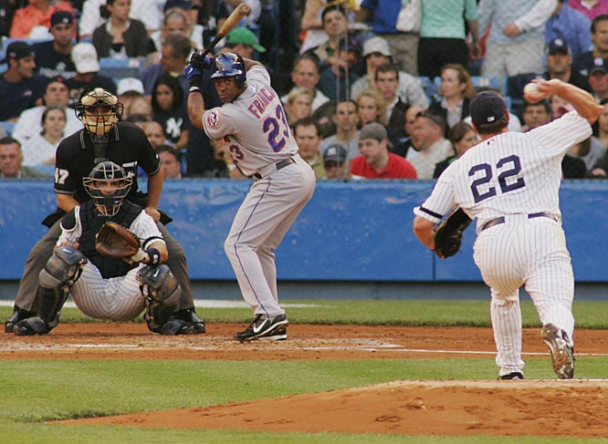
Batter-pitcher matchups
Prototype Update

Slide 2
REminder
While individual matchups don’t happen that often, the hitter has probably faced pitchers who throw similar types of pitches much more often.
Maybe seeing how a hitter does against that pitcher type can provide more accurate information about what the actual chance of success would be.
Our goal is to develop a system that based on the current hitter/pitcher, to recommend which pinch hitter or reliever a coach should use from the players on his roster based on how the hitter has fared against pitchers of similar type.

Slide 3
The Data
Initially, we intended to pull the data from an R repository, however we realize that the dataset was incomplete
Through research, we found and modified a perl script developed by Mike Fast to pull one year’s worth sample data for our analysis
We then wrote a script to translate the xml data into JSON data, since it is easier to load into javascript (for the front end later), and the message size is smaller

Slide 4
Aggregation
Given the purpose of our project, we needed a dataset of pitchers and not pitches, with each pitcher having a vector of attributes
Since the data was a folder of pitches, we wrote a python script to aggregate the data into a dictionary, which we then pickled
For each attribute, we had to determine how we would aggregate them, taking the average per pitch type of each attribute
As a result, there is definitely room in improving both the speed of aggregation, as well as determining the important attributes, and the formula for aggregating them

Slide 5
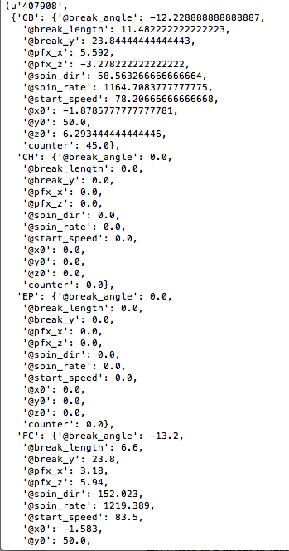
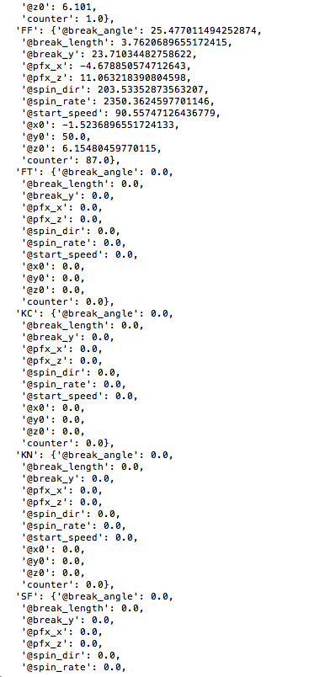
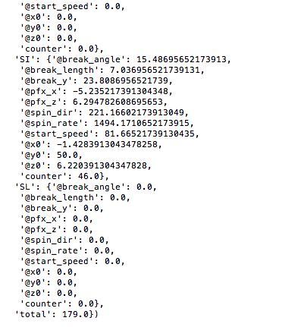

Slide 6
CLUSTERING
We have implemented a k-nearest neighbor algorithms
We believe it is the best method out of the ones we have tried, for our purposes
We can easily change how many pitchers we look at in order to get a reasonable sample size for specific hitters
It appears that pitchers do not divide neatly into clusters, so we are hesitant to move forward with k means clustering (our attempts have not led to stable clusters)

Slide 7
Remaining Tasks
Matchups: We need to go through each hitter and find how they did aginst different clusters that we determine from our analysis. Since all of the data is organized by at-bats, aggragating a single hitter's at-bats could be more computationally expensive and might require parallelization.
Parallelization: The Aggregation task can be converted into a map-reduce task, whereas the clustering could also be performed in a similar fashion. Additionally, the matchups could be parallelized using MPI.
Recommendation engine: Given our data, and if we implement the matchups part correctly, putting the data inside a graph database will allow for fast traversals hence fast recommendation for coaches.
Visualization: If enough time, we would like to be able to visualize the clusters.

Slide 8
Challenges Ahead
With our current project, we believe that the benefits of parallelization are not fully maximized, as they would be more significant if we had a larger data set, or if we had more computationally expensive algorithms/analysis
We are looking into performing more complex operations than pure clustering, even though we are running through multiple clustering methods.
Making our recommendation smart enough to potentially predict the other manager's move
Performing Time-Series Analyses of players, either over a game or across the past few years.

