Slide 1
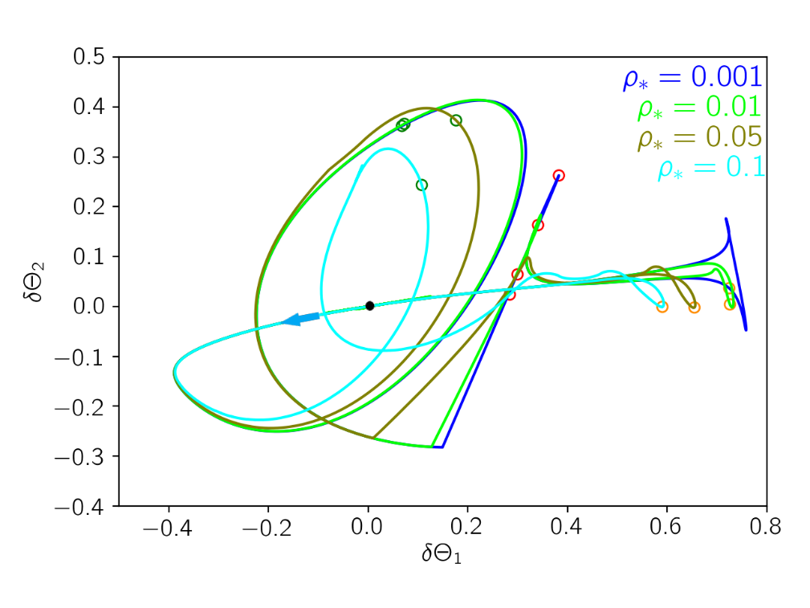
VBBinaryLensing’s extension to Astrometric Microlensing
Valerio Bozza
University of Salerno, Italy

Slide 2
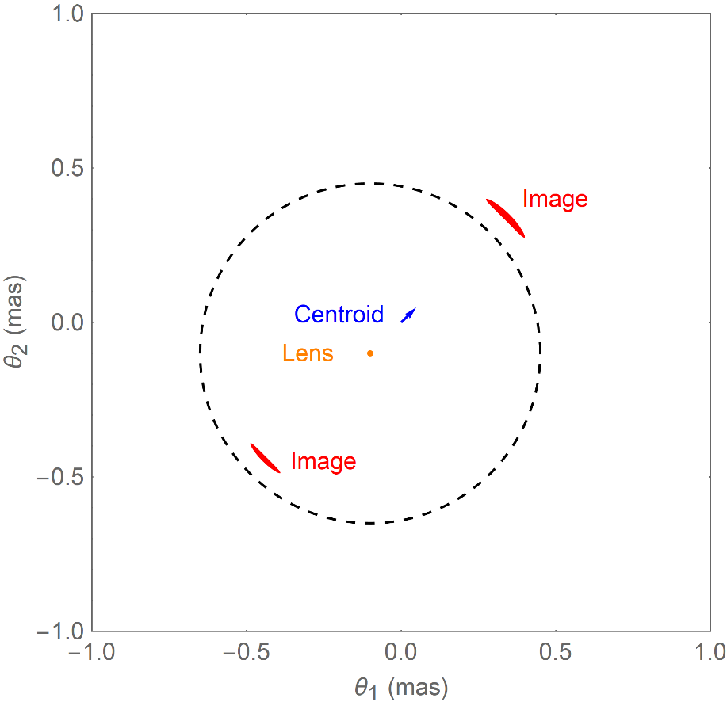
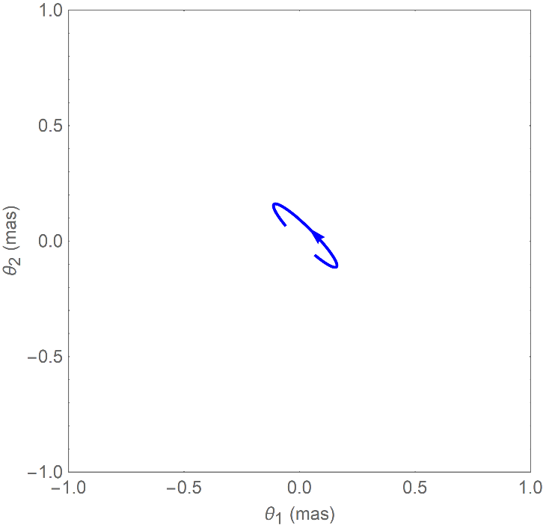

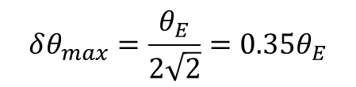
Astrometric Microlensing
Individual images in microlensing remain unresolved (order 1 mas needed!)
Precision astrometry may detect the centroid shift!
$$δθ=\frac{u}{u^{2}+2}θ_{E}$$
$$δθ_{max}=\frac{θ_{E}}{2\sqrt{2}}=0.35θ_{E}$$
Direct measurement of the Einstein angle $θ_{E}!$

Slide 3
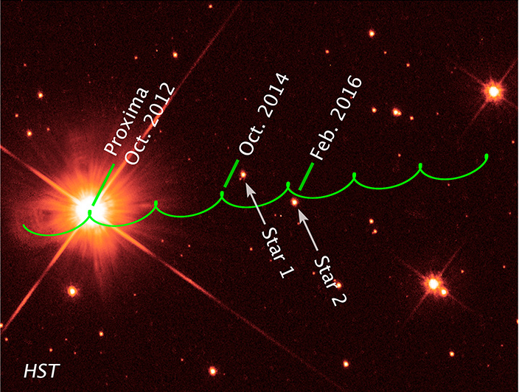
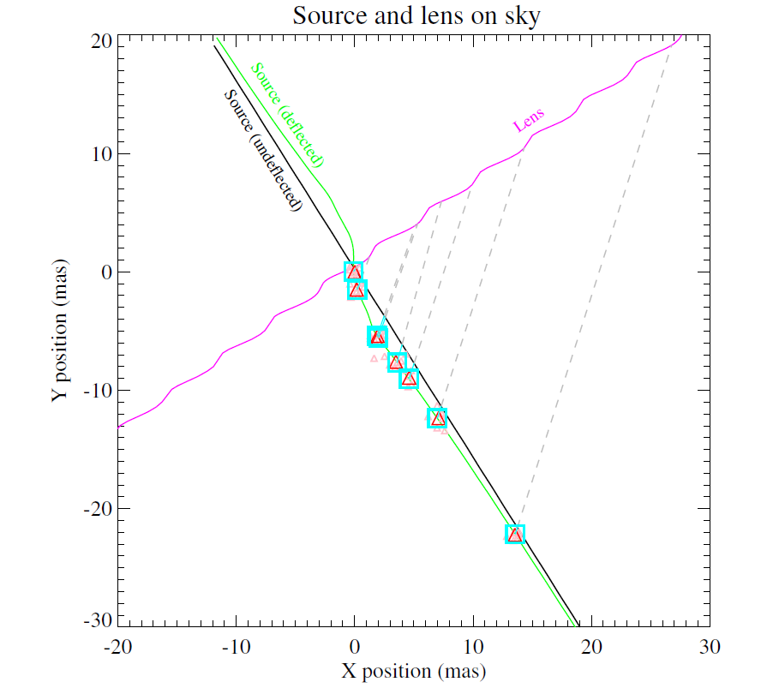
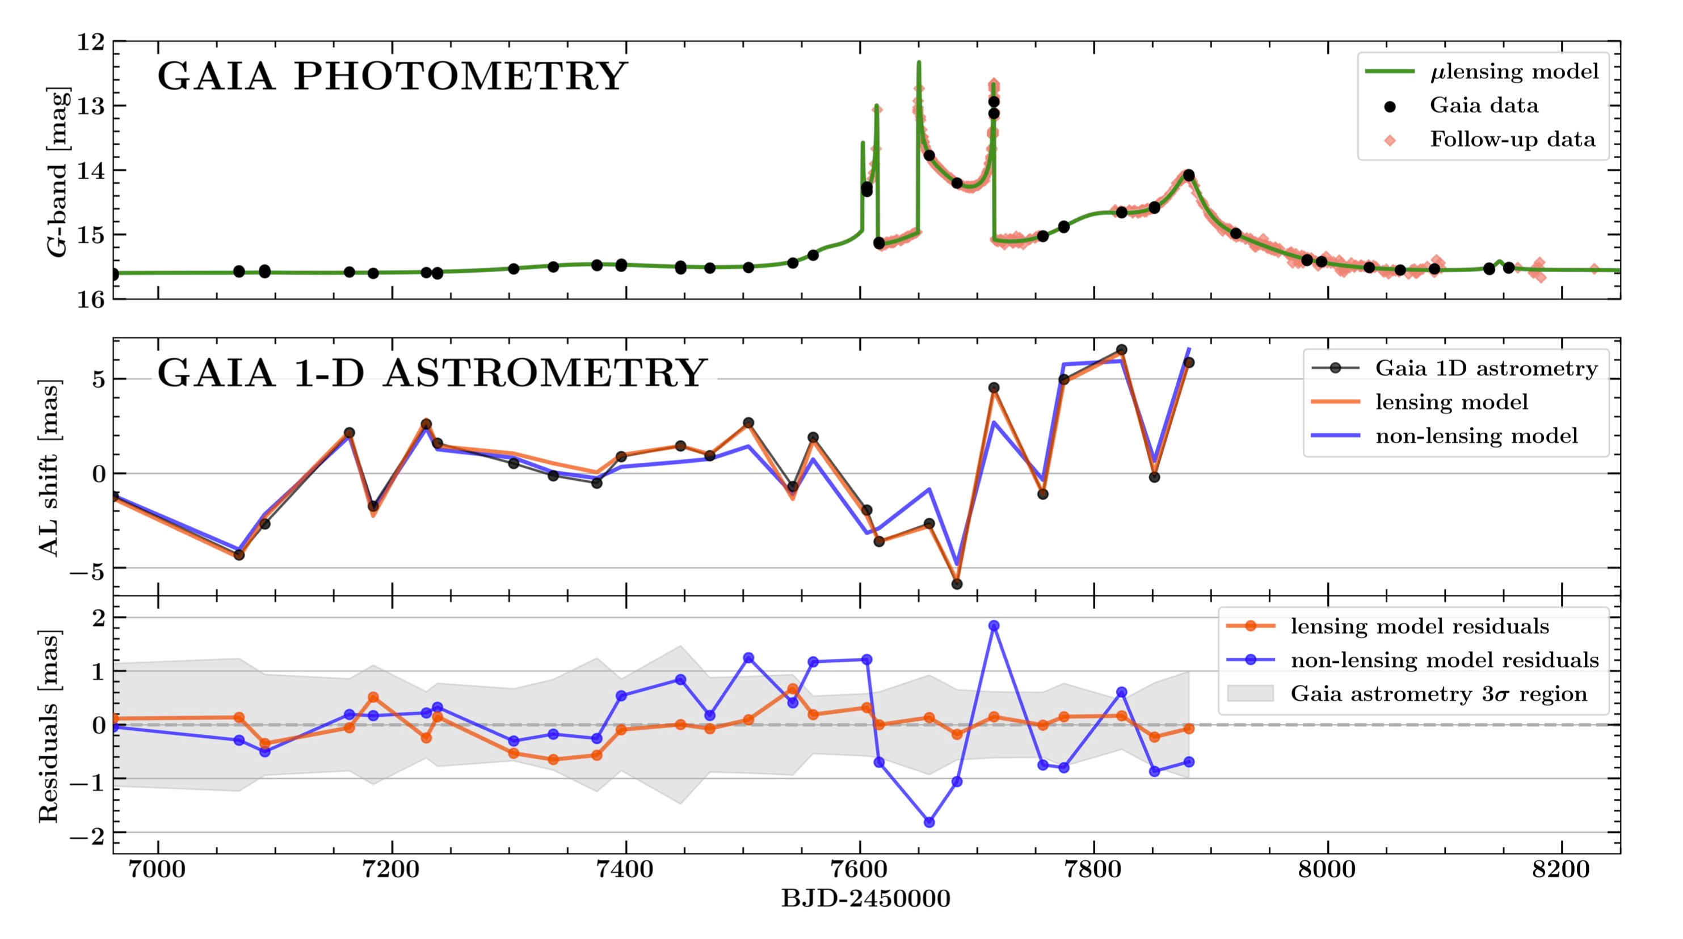
Detections of astrometric microlensing
White dwarfs by HST (Sahu et al. 2017, Mcgill et al. 2022)
Proxima Centauri by VLT (Zurlo et al. 2018)
MOA-2011-BLG-191/OGLE-2011-BLG-0462: an isolated BH of 7 M by HST Sahu et al. (2022), Lam et al. (2022)
Binary system in Gaia transient Gaia16aye (Rybicki 2022)

Slide 4
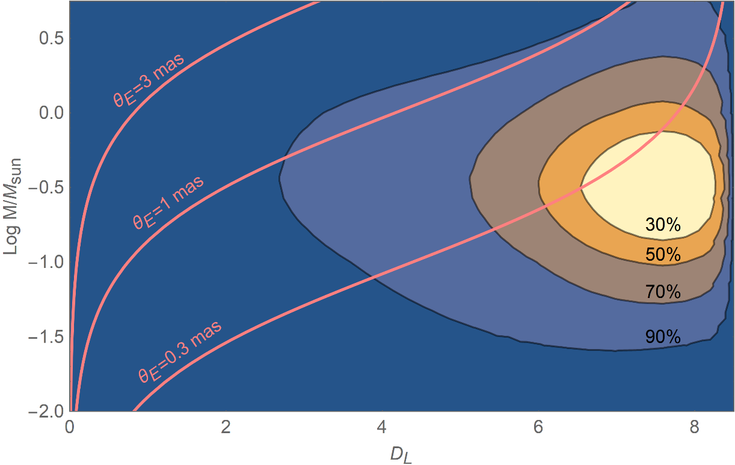
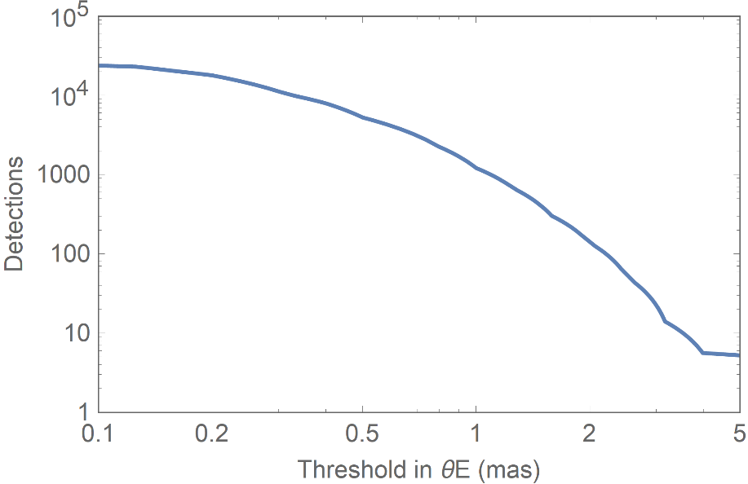
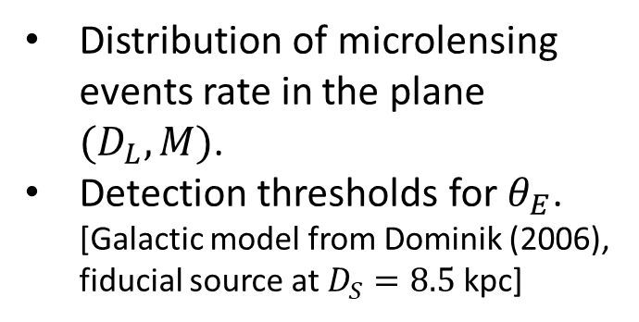
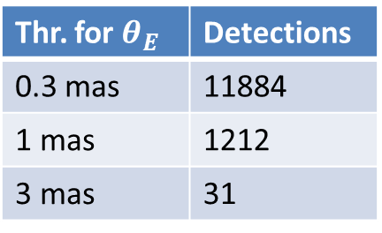
Astrometric Microlensing with Roman
Distribution of microlensing events rate in the plane ${(D}_{L},M)$.
Detection thresholds for $θ_{E}$. [Galactic model from Dominik (2006), fiducial source at $D_{S}=8.5$ kpc]
The number of detections quickly drops with the threshold:
Thr. for $θ_{E}$ | Detections
0.3 mas | 11884
1 mas | 1212
3 mas | 31

Slide 5
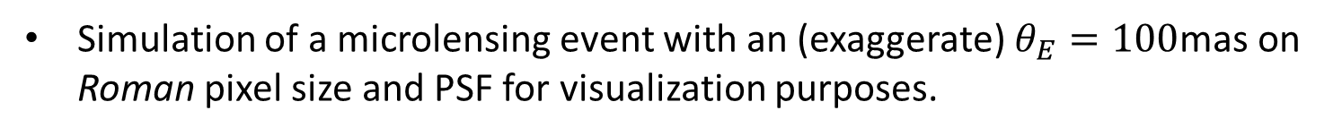
Astrometric Microlensing with Roman
Simulation of a microlensing event with an (exaggerate) $θ_{E}=100$mas on Roman pixel size and PSF for visualization purposes.
Roman should be able to reach an astrometric precision of 1 mas.

Slide 6
Computation in Microlensing
Simultaneous modeling of photometry and astrometry required.
Additional effects must be taken into account
Finite source effect
Limb darkening
Binary or planetary lenses
Parallax, orbital motion, xallarap
VBBinaryLensing 3.0 (VB 2010; VB et al. 2018; VB et al. 2021)
Microlensing computation including advanced methods
Public code (https://github.com/valboz/VBBinaryLensing)
Written in C++, importable in Python
VBBL 3.0 at the core of several modeling platforms:
RTModel (http://www.fisica.unisa.it/GravitationAstrophysics/RTModel.htm)
pyLIMA (https://github.com/ebachelet/pyLIMA, Bachelet et al. 2018)
MulensModel (https://github.com/rpoleski/MulensModel, Poleski & Yee 2019)
muLAn (https://github.com/muLAn-project/muLAn, Cassan & Ranc 2017)
Adopted as the base computation code in Roman microlensing pipeline

Slide 7

VBBinaryLensing 3.0
Lens inversion: inversion of lens equation by Skowron-Gould algorithm.
Contour integration: area of the images from Green’s theorem on the boundaries.
Parabolic correction: Residuals are of order ${∆x}^{5}$ instead of ${∆x}^{3}$.
Error control: Error estimators for each boundary arc to assess the accuracy.
Optimal sampling: Sampling is increased where error is largest.
Limb darkening: Computation repeated on concentric annuli with optimized radii.
Decision tree: Contour integration triggered when quadrupole correction high.
Higher orders: Parallax, satellites, orbital motion, xallarap available.

Slide 8
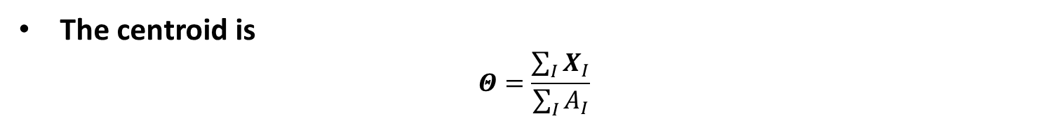

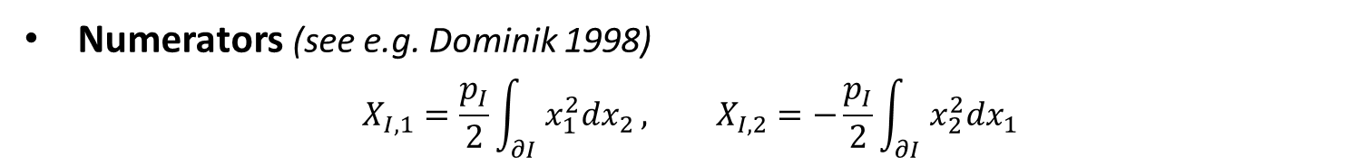
Astrometric contour integration
The centroid is
$$Θ=\frac{\sum_{I}{X_{I}}}{\sum_{I}{A_{I}}}$$
Area of an image
$$A_{I}=−p_{I}\int_{∂I}{x_{2}dx_{1}}$$
Numerators (see e.g. Dominik 1998)
$$X_{I,1}=\frac{p_{I}}{2}\int_{∂I}{x_{1}^{2}dx_{2}}, X_{I,2}=−\frac{p_{I}}{2}\int_{∂I}{x_{2}^{2}dx_{1}}$$
Additional integrals use the same sampling: almost for free!
Parabolic correction easily included: improved accuracy.

Slide 9
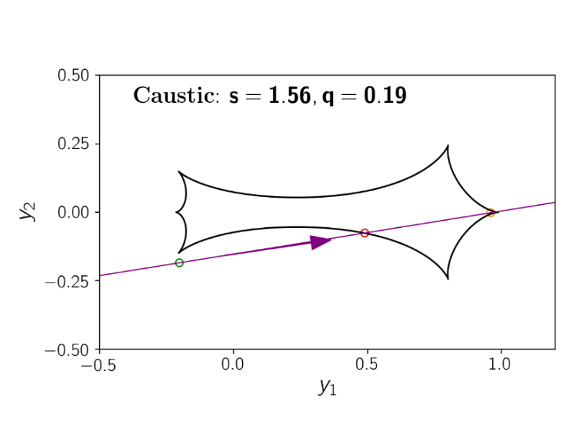

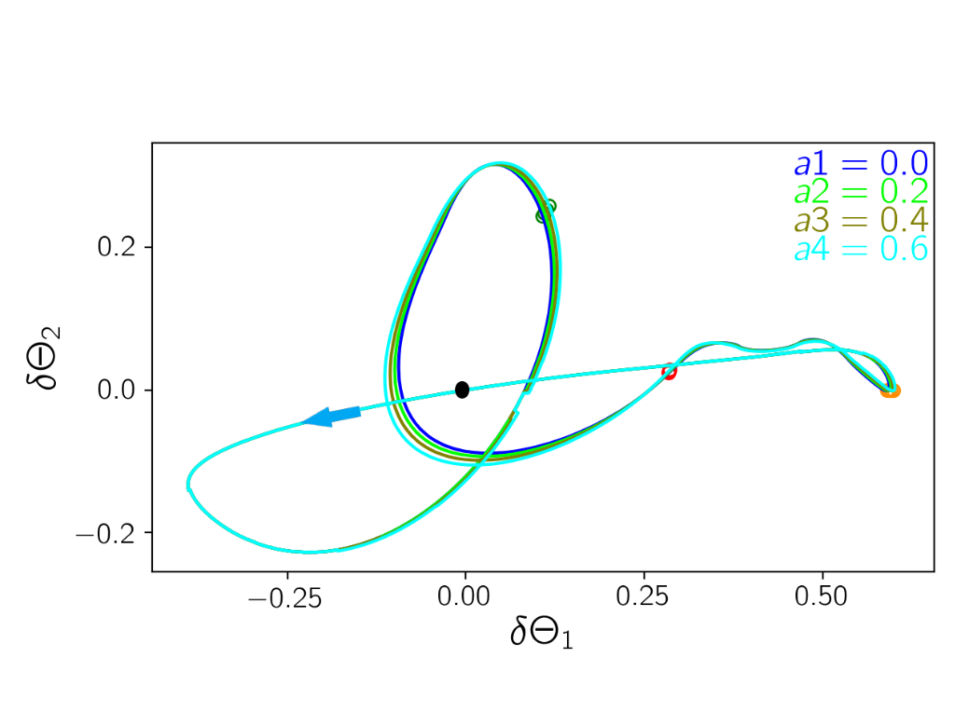
Binary-lens + Finite-source
For binary lenses, the creation of additional images brings to sudden jumps.
Finite-source effect washes out these jumps.
Limb darkening leads to small adjustments for larger sources.

Slide 10
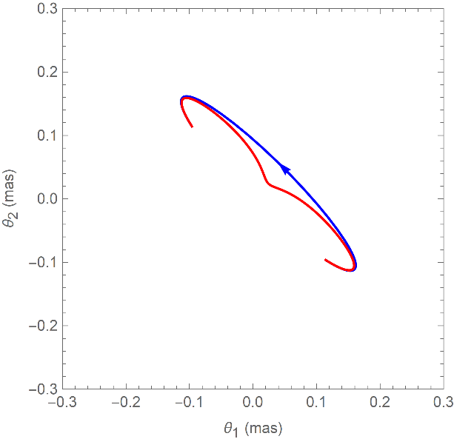
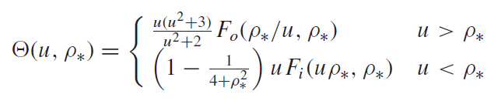
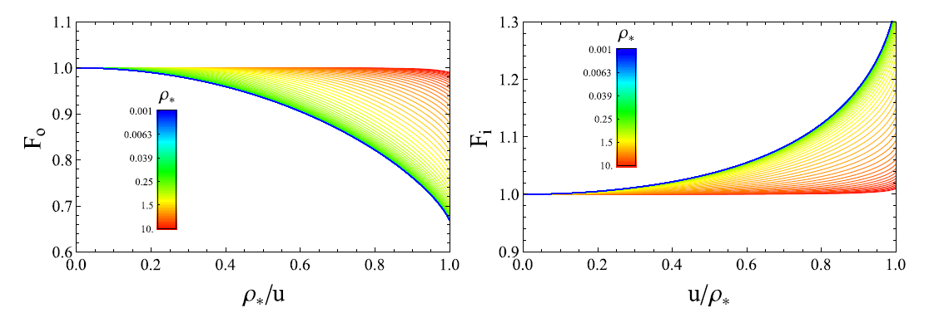
Single-lens + Finite-source
The centroid for a single-lens describes an ellipse
The finite-source effect can be taken into account through pre-calculated tables of elliptic integrals.
Much faster!

Slide 11
Example of use
#include <stdio.h>
#include “VBBinaryLensingLibrary.h”
int main()
{
VBBinaryLensing VBBL;
double Mag,s,q,y1,y2,rho,a1,accuracy;
s=0.8; //separation
q=0.1; // mass ratio
y1=0.01; // source position
y2=0.3;
rho=0.01; // source radius
VBBL.a1=0.51; // Linear limb darkening coefficient
VBBL.Tol=1.e-2; // Accuracy goal
VBBL.astrometry = true;
Mag=VBBL.BinaryMag2(s,q,y1,y2,rho);
printf("Magnification = %lf\n",Mag);
printf(“Centroid = (%lf,%lf)\n",VBBL.astrox1,VBBL.astrox2);
return 0;
}

Slide 12
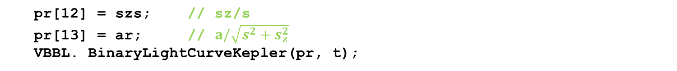
Parallax, Xallarap, Orbital motion
pr[0] = log(s);
pr[1] = log(q);
pr[2] = u0;
pr[3] = alpha;
pr[4] = log(Rs);
pr[5] = log(tE);
pr[6] = t0;
VBBL.BinaryLightCurve(pr, t);
Static binary light curve
Parallax
pr[7] = paiN;
pr[8] = paiE;
VBBL.BinaryLightCurveParallax(pr, t);
pr[9] = gamma1; // ds/dt/s
pr[10] = gamma2; // dalpha/dt
pr[11] = gamma3; // dsz/dt/s
VBBL.BinaryLightCurveOrbital(pr, t);
Circular orbital motion
pr[12] = szs; // sz/s
pr[13] = ar; // $a/\sqrt{s^{2}+s_{z}^{2}}$
VBBL. BinaryLightCurveKepler(pr, t);
Keplerian orbital motion

Slide 13
Parallax, Xallarap, Orbital motion
pr[0] = log(s);
pr[1] = log(q);
pr[2] = u0;
pr[3] = alpha;
pr[4] = log(Rs);
pr[5] = log(tE);
pr[6] = t0;
VBBL.BinaryLightCurve(pr, t);
Static binary light curve
pr[7] = xi1; // xallarap components
pr[8] = xi2;
pr[9] = omega; // 2Pi/Period
pr[10] = inc; // orbital inclination
pr[11] = phi0; // phase at t0 from ascending node
pr[12] = log(qs); // Mass ratio of the two sources
VBBL.BinSourceBinLensXallarap(pr, t);
Xallarap

Slide 14
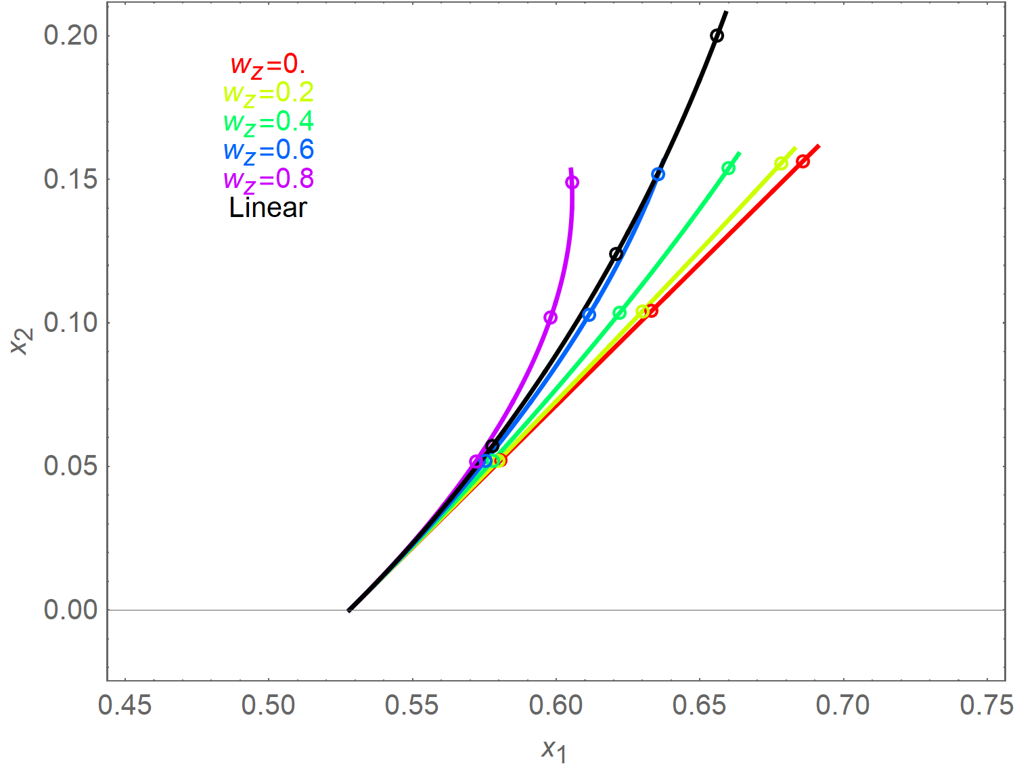
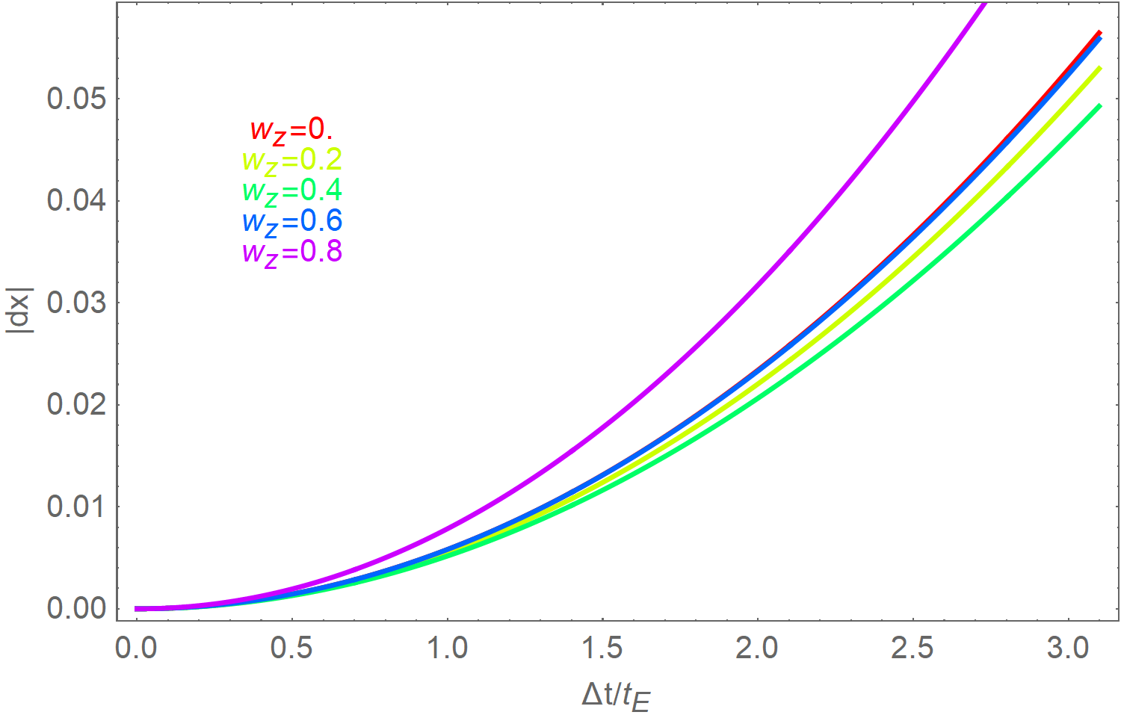
Circular vs Linear Orbital Motion
3t_{E}
Linear orbital motion approximation: constant ds/dt/s and dα/dt.
3t_{E}
Circular orbital motion adds w_{z}=dsz/dt/s (poorly constrained).
2t_{E}
1t_{E}
However, linear orbital motion is unphysical!
Linear approximation deviates from any physical trajectories
See also Ma, Zhu & Yang (2021)
Parameters from OB180022 (Han et al. 2019)

Slide 15
Conclusions
The potential for astrometric microlensing with Gaia and Roman is very high and yet to be fully investigated.
Mass measurement for hundreds of dark lenses (black holes, remnants, brown dwarfs, …)
VBBinaryLensing has become the reference code for photometric and astrometric microlensing.
Wide range or possible use: from basic calculations to advanced functions tracking parallax, xallarap and orbital motion.
https://github.com/valboz/VBBinaryLensing
VB, MNRAS 408 (2010) 2188
VB, E. Bachelet, F. Bartolic, T.M. Heintz, A.R. Hoag, M. Hundertmark, MNRAS 479 (2018) 5157
VB, E. Khalouei and E. Bachelet, MNRAS 505 (2021) 126

