Slide 1
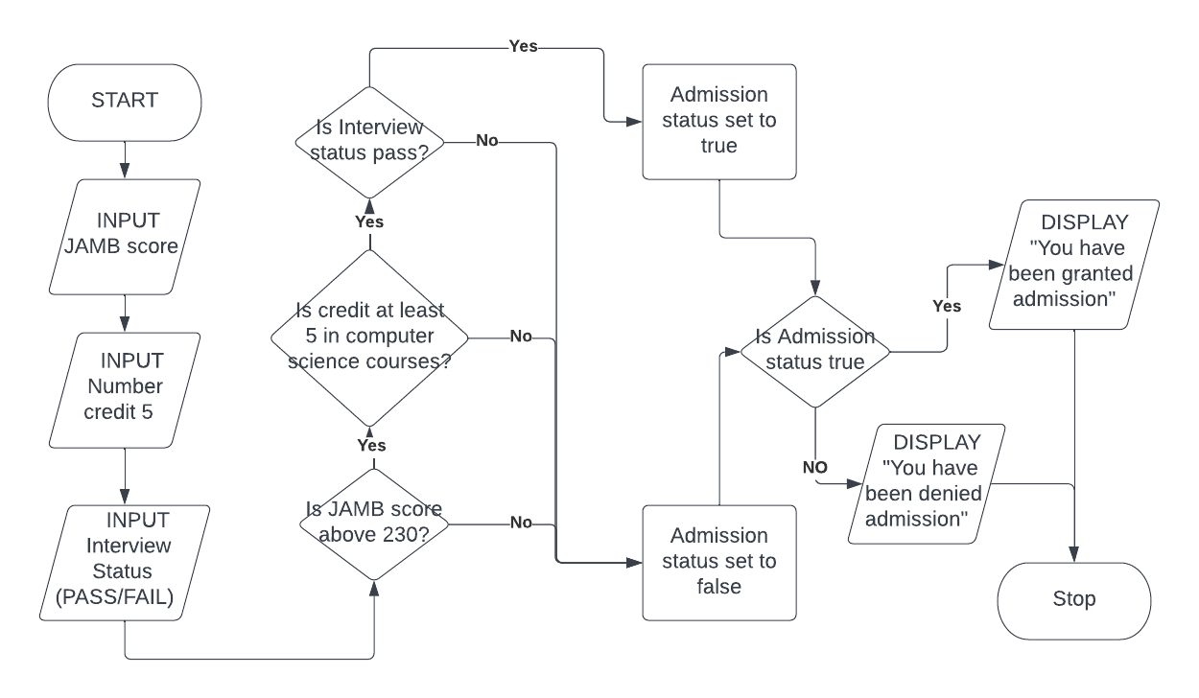
ADMISSION STATUS CHECKER
Flowchart

