Slide 1
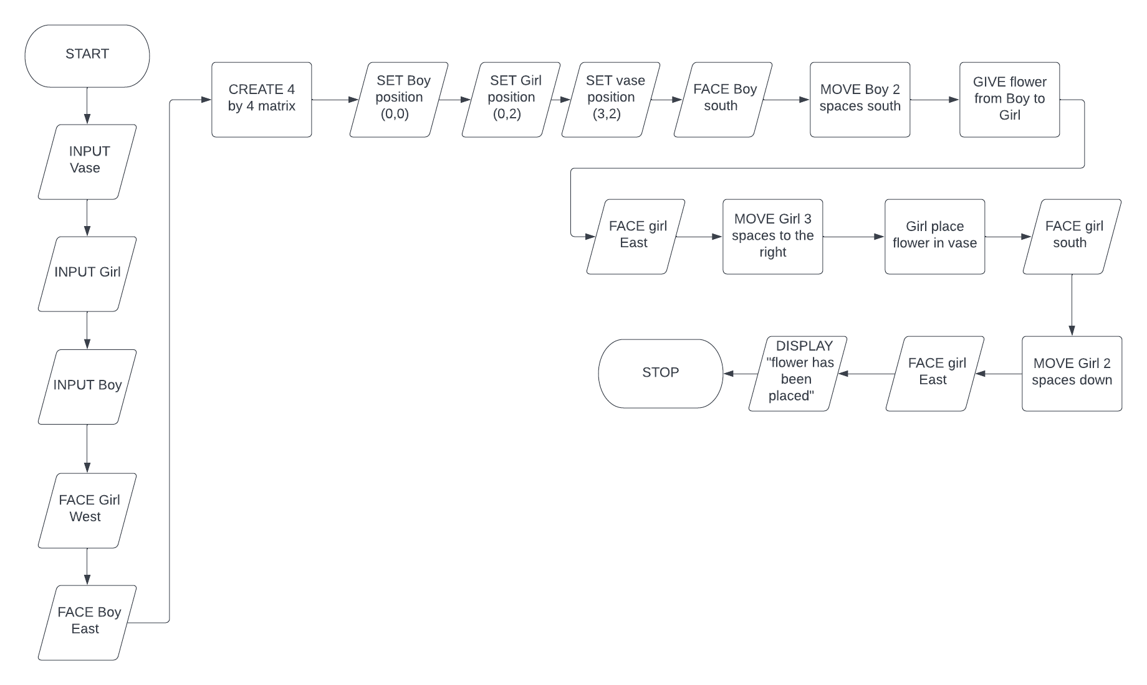
BOY AND GIRL FLOWER TRANSPORT MISSION
Flowchart

