Slide 1
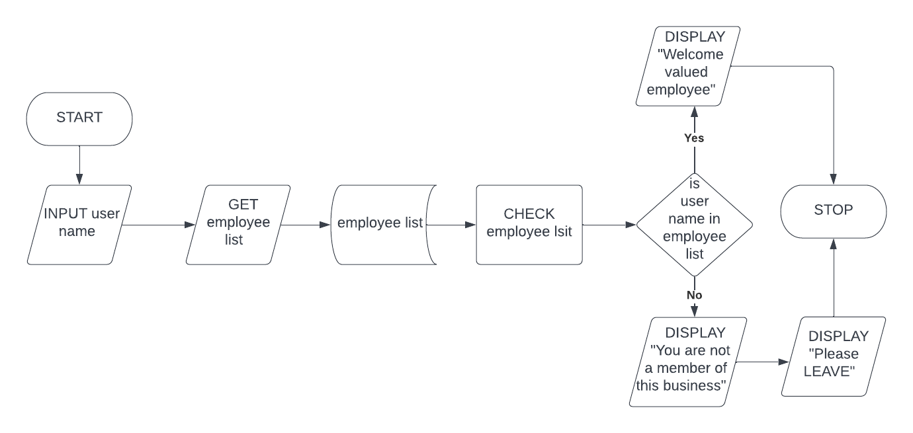
EMPLOYEE CHECKER
Flowchart

Slide 2
Pseudo code
BEGIN
INPUT Username
GET employee list
CHECK employee list for Username
IF Username in employee list
THEN PRINT “Welcome valued employee”
ELSE PRINT “You are not a member of this business”
PRINT “Please LEAVE”
END

