Slide 1
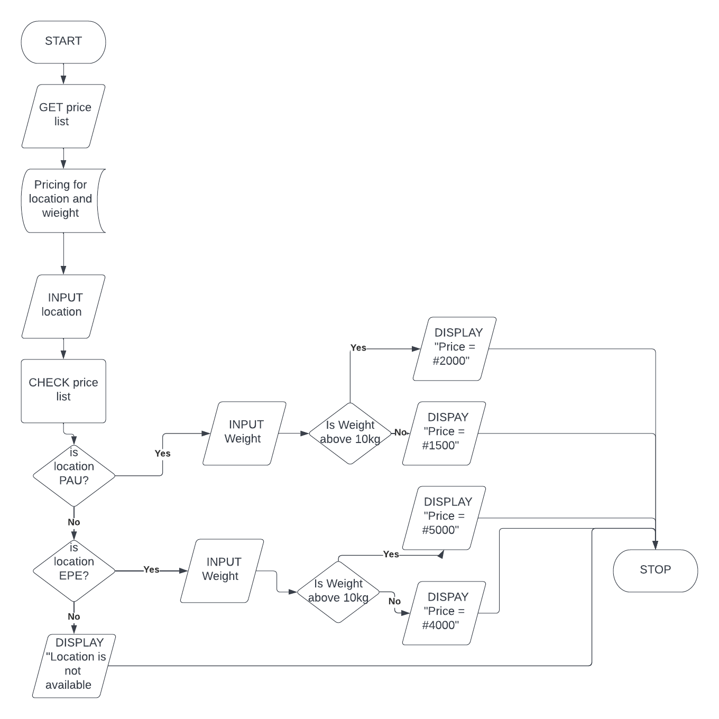
CLEMENT’S DELIVERY SERVICE
Flowchart

Slide 2
Pseudo code
BEGIN
GET price list
Price list
INPUT location
CHECK price list for location
IF location is equal to PAU
THEN INPUT Weight
IF Weight is above 10kg
THEN PRINT “Total price #2000”
ELSE PRINT “Total price is #1500”
ENDIF
ELSE IF location is equal to EPE
THEN INPUT Weight
IF Weight is above 10kg
THEN PRINT “Total price #5000”
ELSE PRINT “Total price is #4000”
ENDIF
ELSE PRINT “PRINT Location is not available”
ENDIF
ENDIF END

