Slide 1
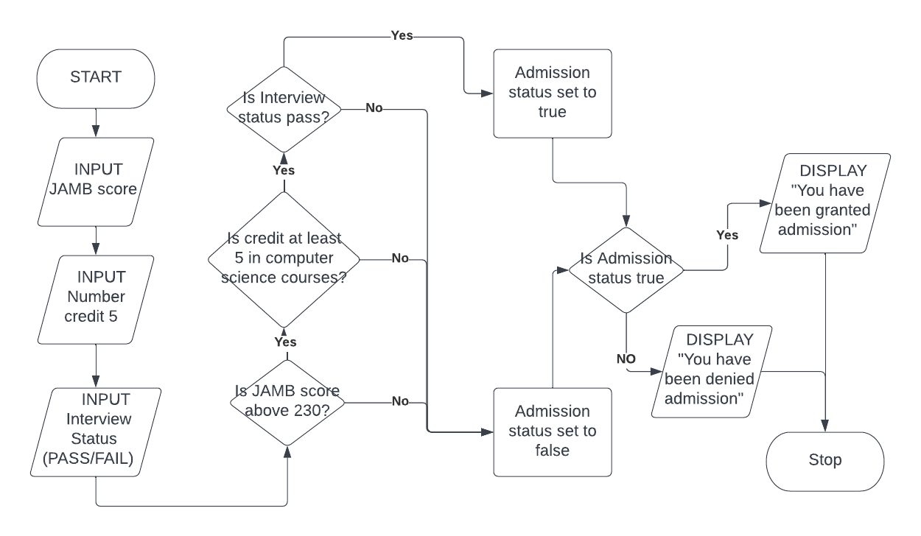
ADMISSION STATUS CHECKER
Flowchart

Slide 2
Pseudo code
BEGIN
INITIALIZE Admission status = FALSE
INPUT JAMB Score
INPUT Number of credits passed
INPUT Interview Status (PASS/FAIL)
IF JAMB Score is greater than 230
THEN IF Number of credits passed in computer science related subjects is at least 5
THEN IF Interview Status is PASS
THEN Admission status is equal to TRUE
ELSE Admission status is equal to FALSE
ENDIF
ELSE Admission status is equal to FALSE
ENDIF
ELSE Admission status is equal to FALSE
ENDIF
END

