Slide 1
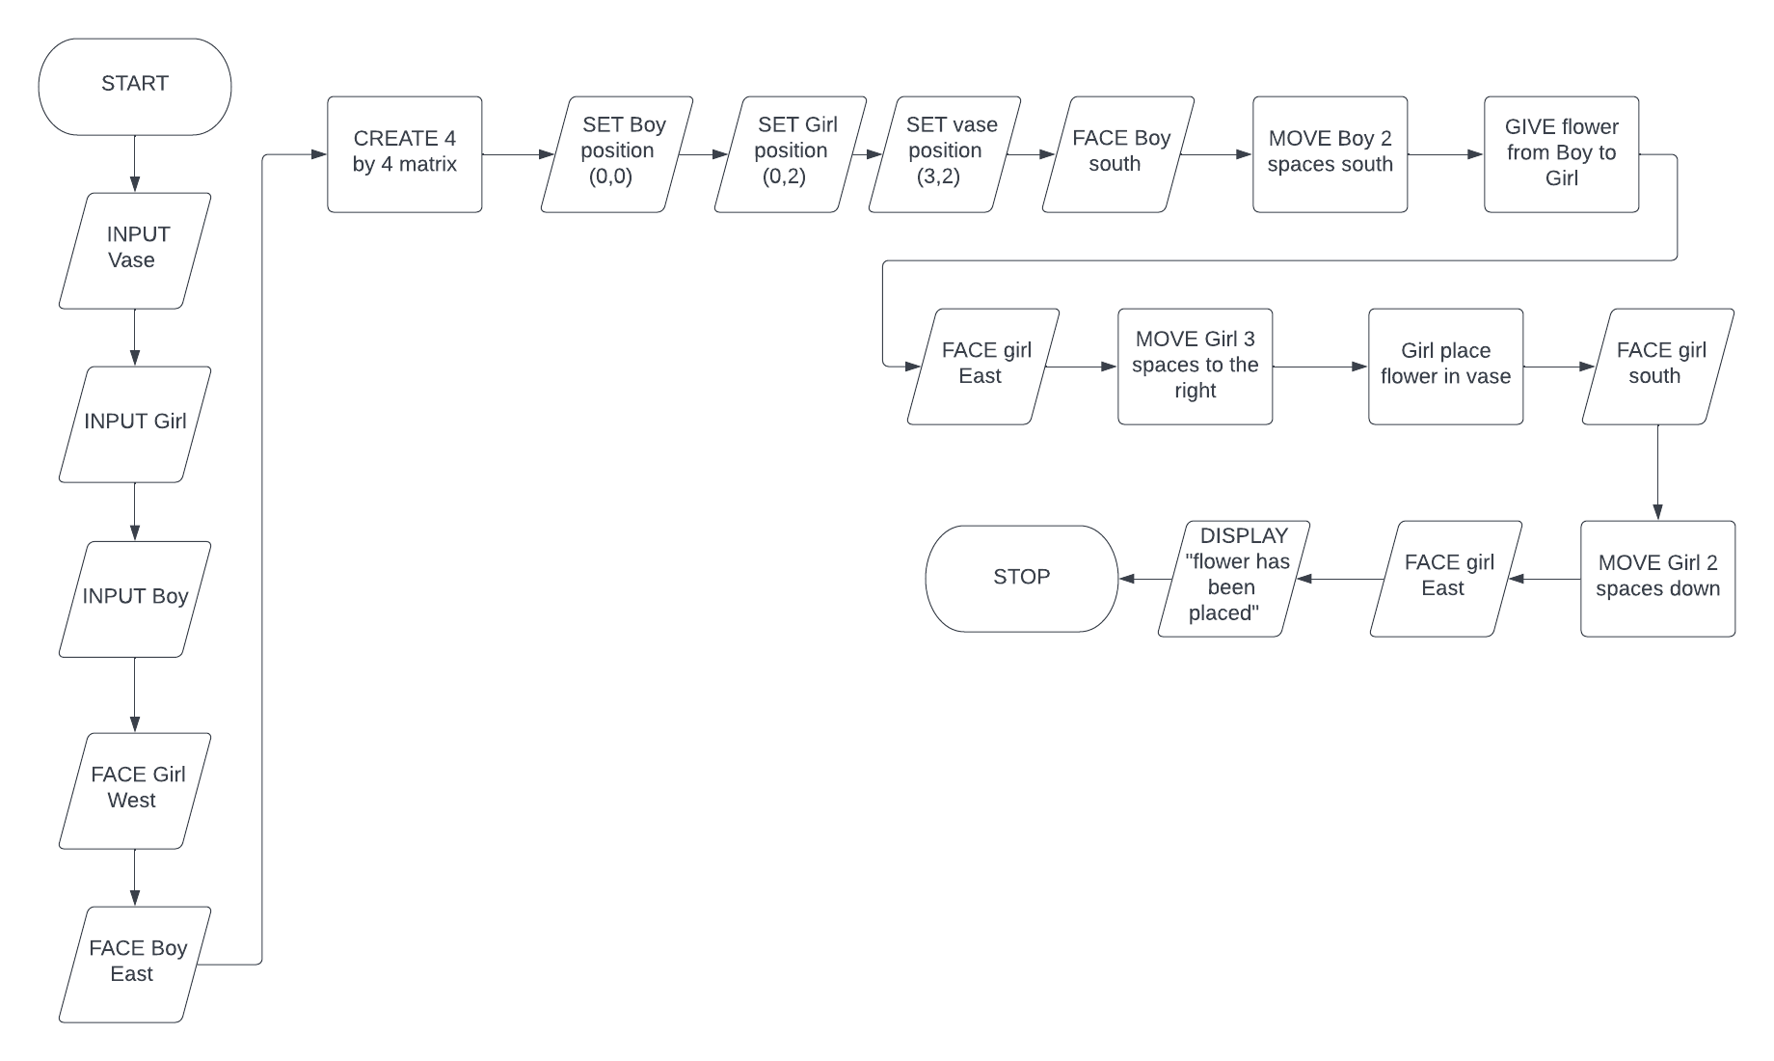
BOY AND GIRL FLOWER TRANSPORT MISSION
Flowchart

Slide 2
Pseudocode
BEGIN
INPUT Vase INPUT Girl INPUT Boy
FACE Girl west
FACE Bot east
CREATE 4 by 4 matrix
SET Boy position (0,0) SET Girl position (0,2) SET Vase position(3,2)
PRINT ”Loading complete”
FACE Boy south
MOVE Boy two steps south
GIVE flower from Boy to Girl
FACE Girl east
MOVE Girl three steps east
PLACE Flower in vase from Girl
FACE Girl south
MOVE Girl one step south
PRINT “Flower has been placed”
END

