Slide 1
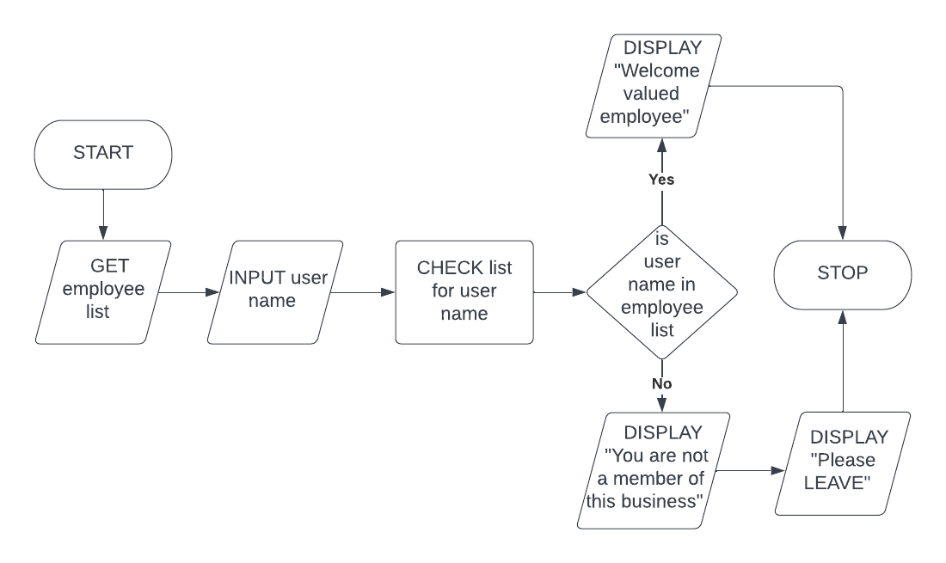
EMPLOYEE CHECKER
Flowchart

