Slide 1
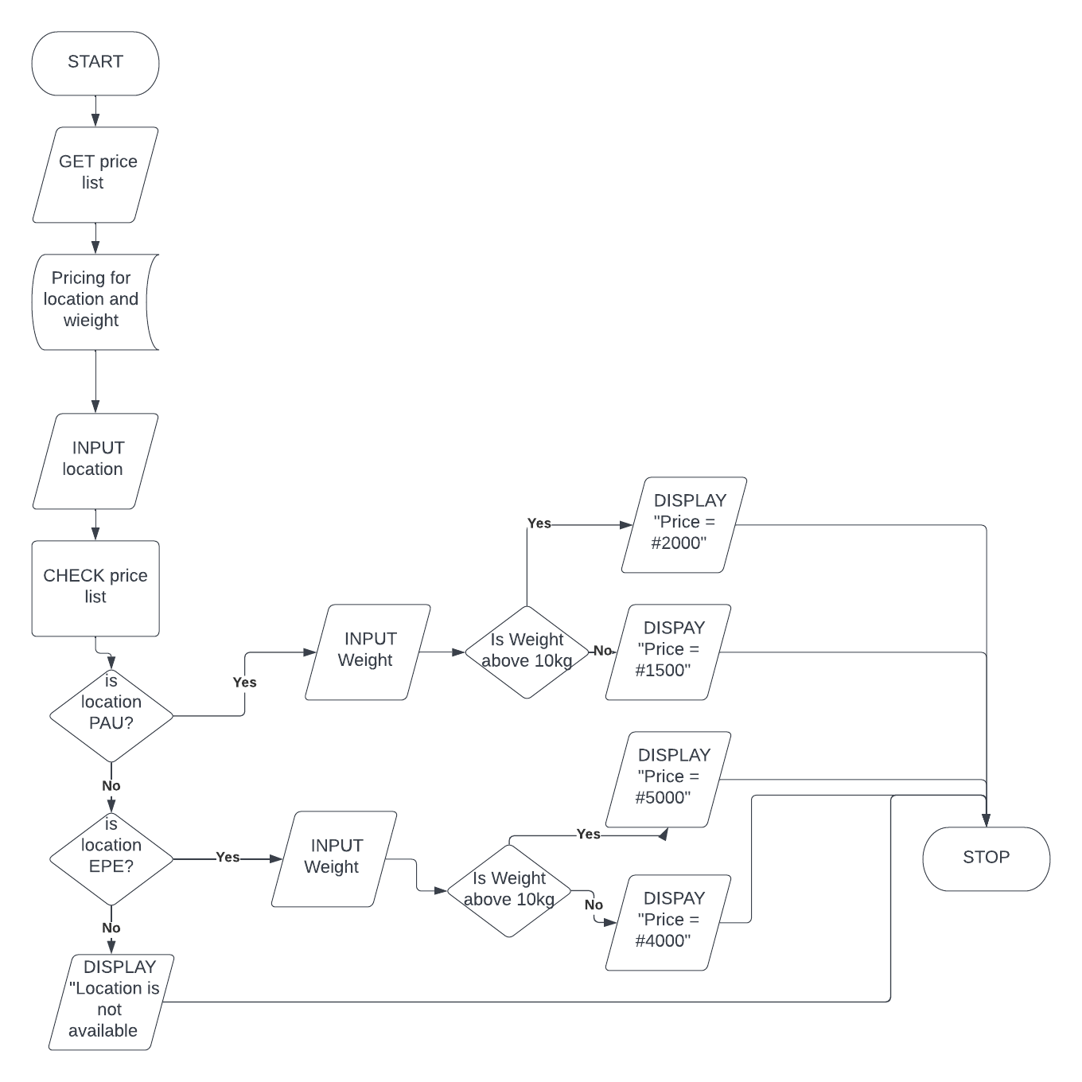
CLEMENT’S DELIVERY SERVICE
Flowchart

