Slide 1
Stochastic gradient methods
Pierre Ablin
CNRS, Université Paris-Dauphine

Slide 2

Let’s build an algorithm that tells whether there is a cat in a picture:
Yes
No

Slide 3
Let’s build an algorithm that tells whether there is a cat in a picture:
Yes

Slide 4

Let’s build an algorithm that tells whether there is a cat in a picture:
Yes

Slide 5
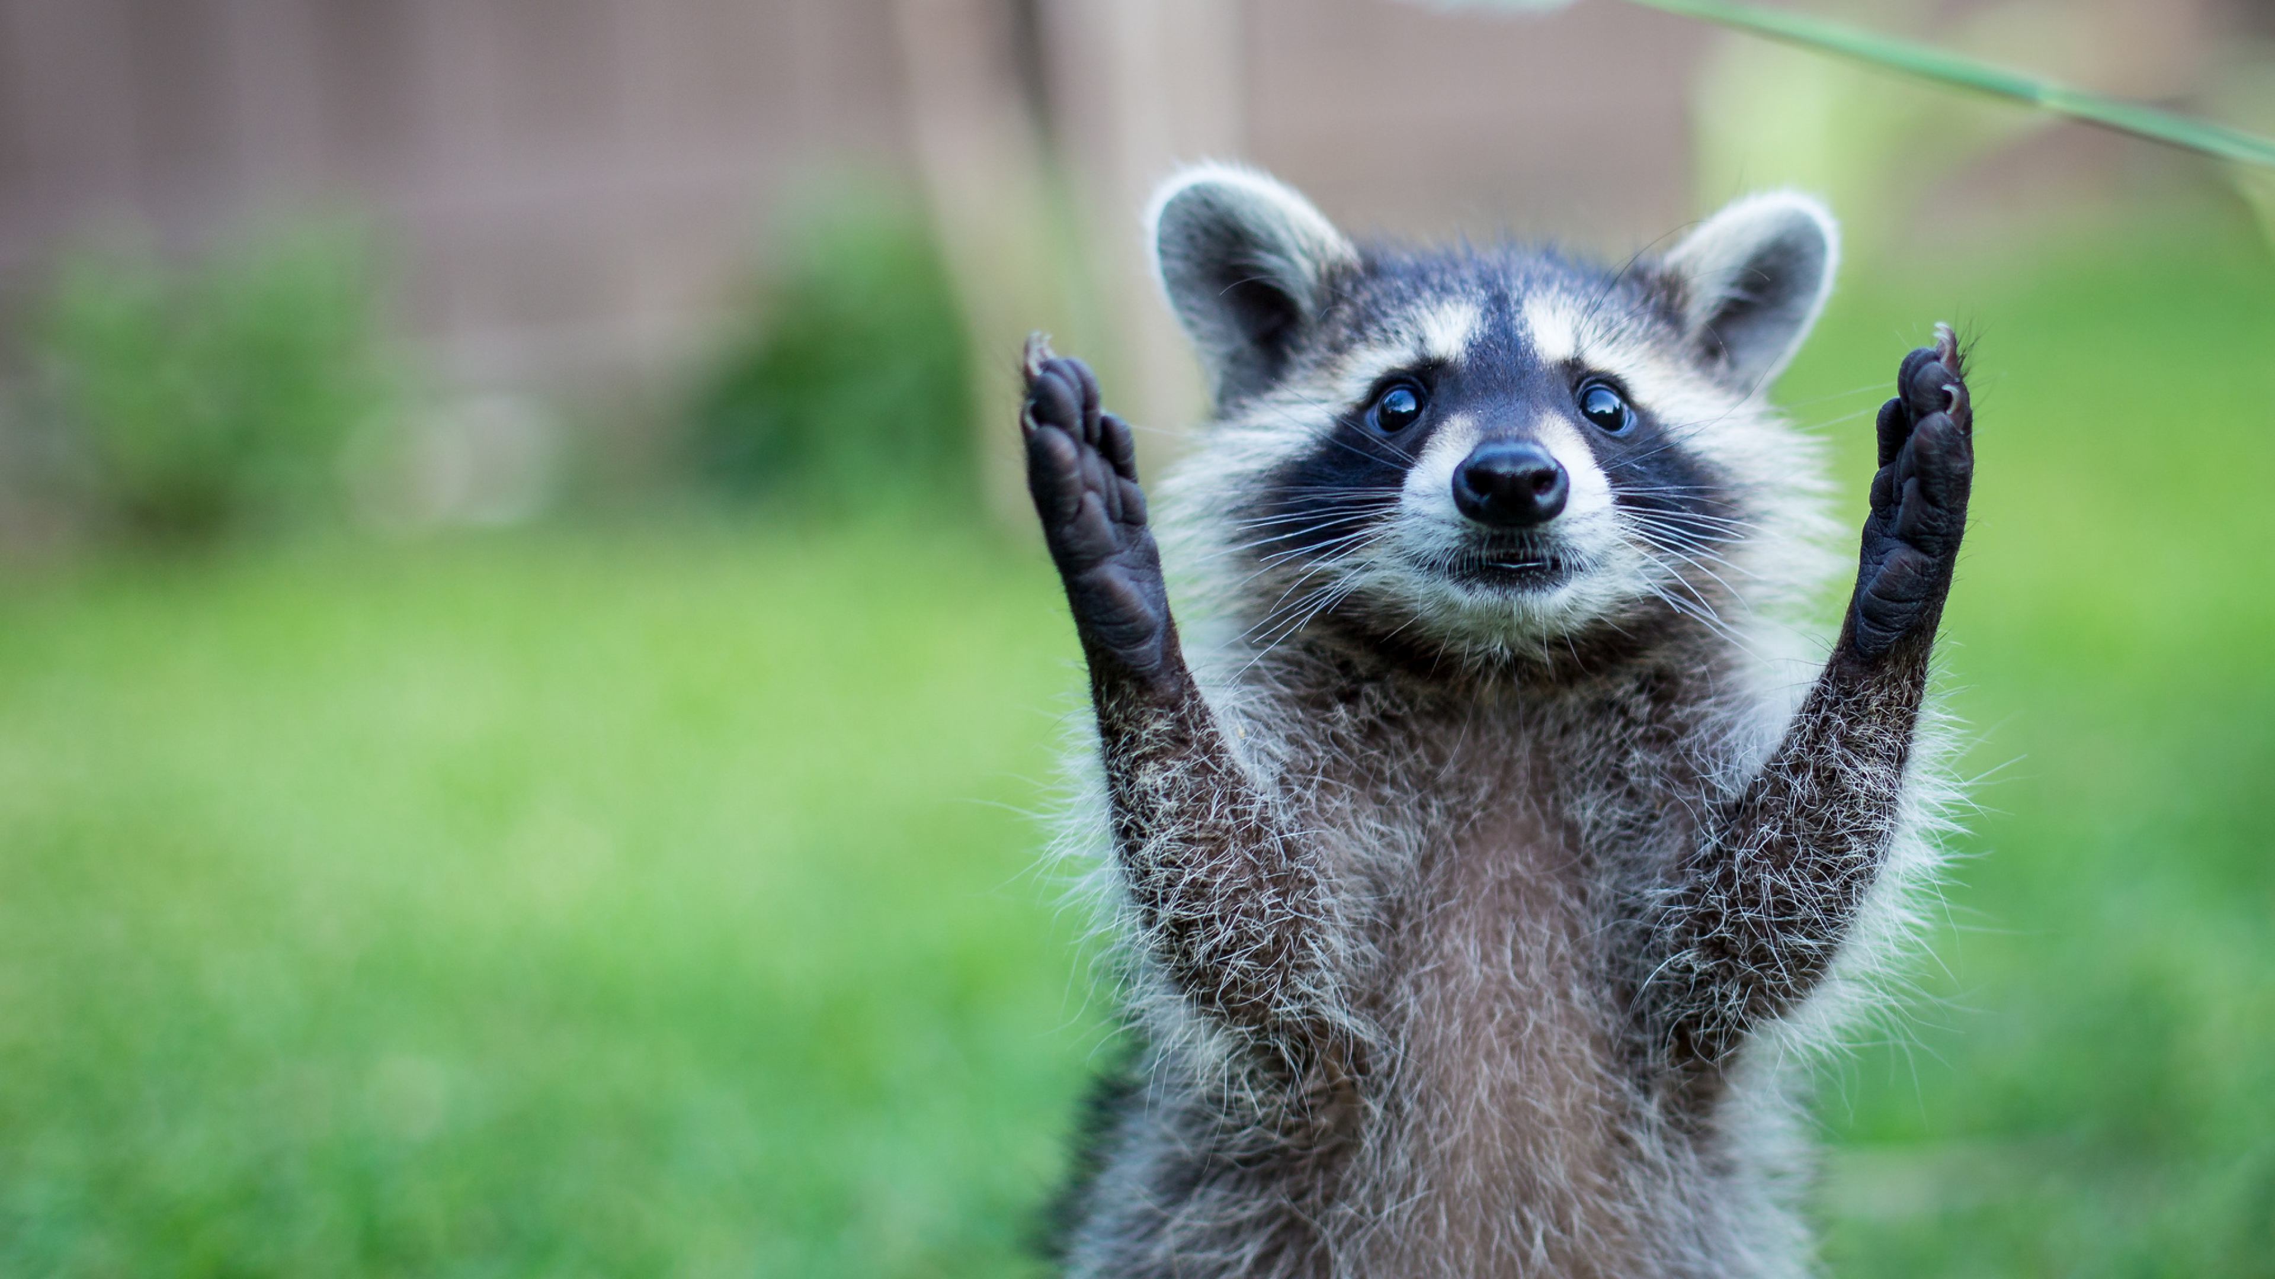
Let’s build an algorithm that tells whether there is a cat in a picture:
No

Slide 6
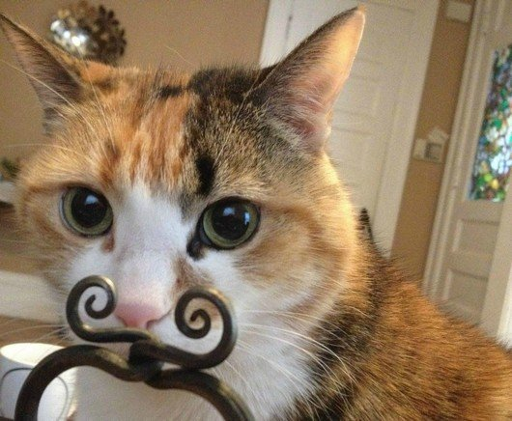
Let’s build an algorithm that tells whether there is a cat in a picture:
Yes

Slide 7



Let’s build an algorithm that tells whether there is a cat in a picture:
Yes
No
x: Input/Feature
y: Output/Target
Find mapping h that assigns the “correct” target to each input

Slide 8


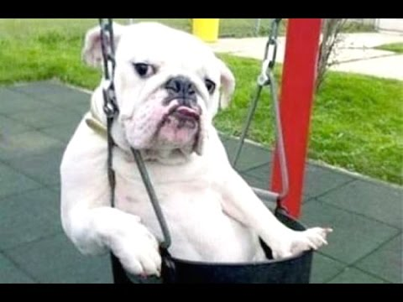
Labelled Data: The training set
y= -1 means no/false
Learning Algorithm
-1

Slide 9


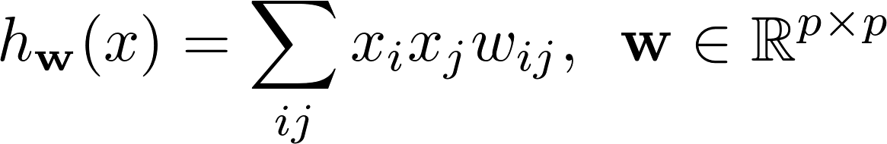



A parametrized decision function
h is a function parametrized by parameters
Examples
Linear:
Polynomial:
Neural network:

Slide 10

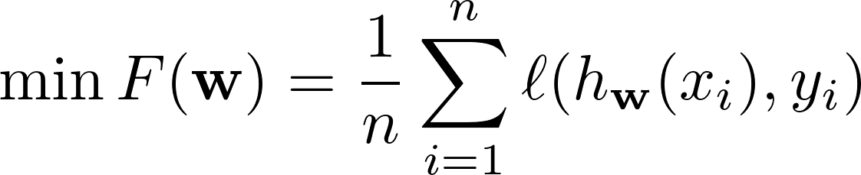
Learning parameters
Goal :
Find w such that for (x, y) in our dataset :
Mathematical reformulation
Find w that minimizes a discrepancy:

Slide 11
Learning parameters
Goal :
Find w such that for (x, y) in our dataset :
Mathematical reformulation
Find w that minimizes a discrepancy:
As many terms as images !

Slide 12

Solving the Finite Sum Training Problem

Slide 13
Recap
Training Problem
L(w)
General methods
Why not keep them separate?
Gradient Descent

Slide 14
Optimization Sum of Terms
A Datum Function
Finite Sum Training Problem
Can we use this sum structure?

Slide 15
The Training Problem

Slide 16
The Training Problem

Slide 17
Stochastic Gradient Descent
Is it possible to design a method that uses only the gradient of a single data function at each iteration?

Slide 18
Stochastic Gradient Descent
Is it possible to design a method that uses only the gradient of a single data function at each iteration?
Unbiased Estimate
Let j be a random index sampled from {1, …, n} selected uniformly at random. Then

Slide 19

Stochastic Gradient Descent
Is it possible to design a method that uses only the gradient of a single data function at each iteration?
Unbiased Estimate
Let j be a random index sampled from {1, …, n} selected uniformly at random. Then

Slide 20
Stochastic Gradient Descent
Is it possible to design a method that uses only the gradient of a single data function at each iteration?
Unbiased Estimate
Let j be a random index sampled from {1, …, n} selected uniformly at random. Then
EXE:

Slide 21
Stochastic Gradient Descent

Slide 22
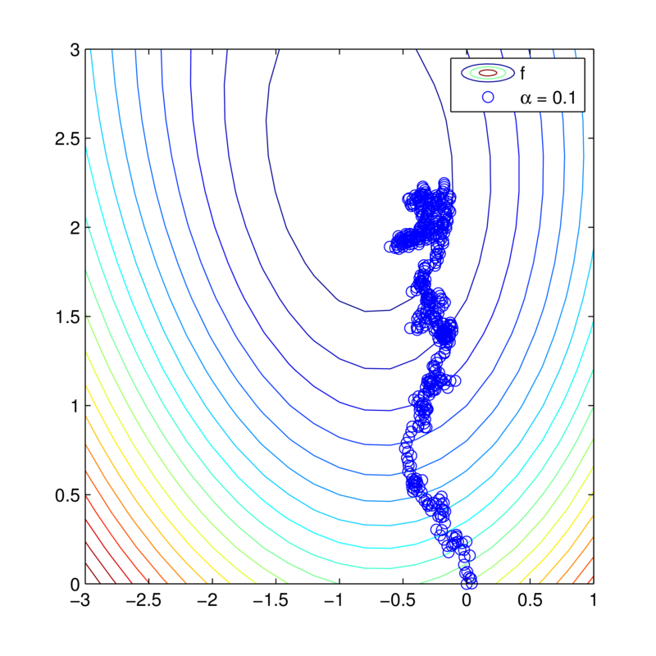
Stochastic Gradient Descent
Optimal point

Slide 23
Convergence Strongly Convex and Bounded Gradient
Theorem
EXE: Do exercises on convergence of random sequences.

Slide 24
Proof:
1) Show that
2) Show that
Taking expectation with respect to j
Unbiased estimator
3) Using strong convexity, demonstrate that
4) Show that
Where the expectation is taken w.r.t. the whole past. Conclude.

Slide 25
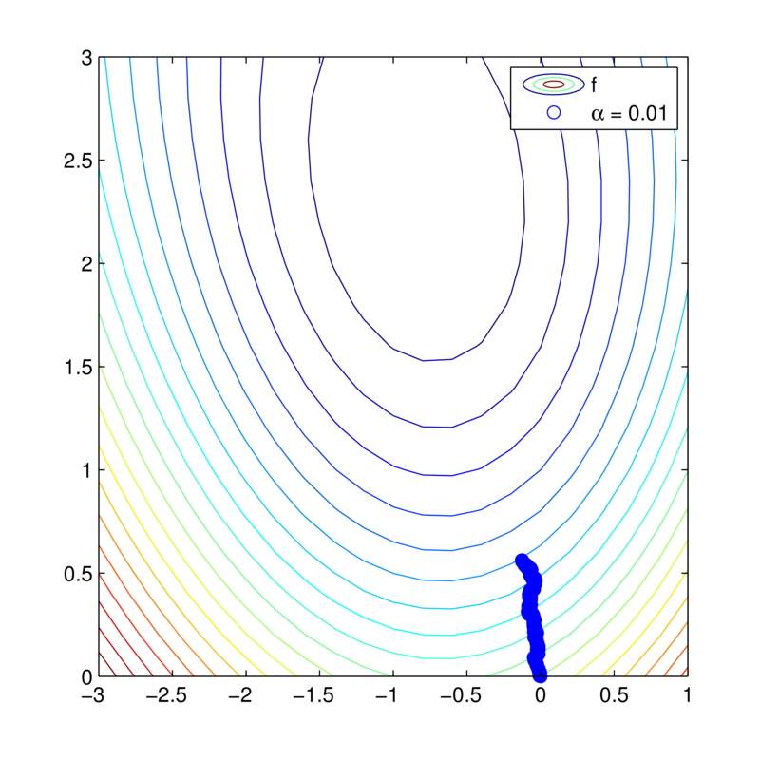
Stochastic Gradient Descent
α =0.01

Slide 26
Stochastic Gradient Descent
α =0.1

Slide 27
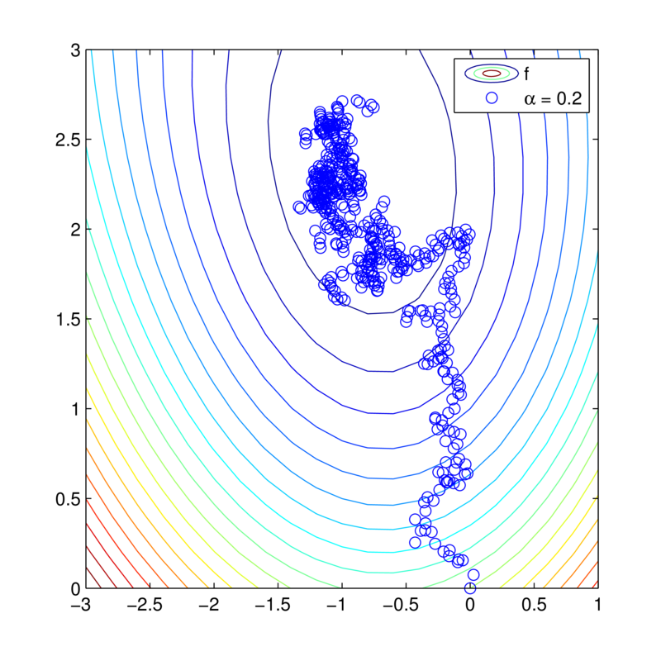
Stochastic Gradient Descent
α =0.2

Slide 28
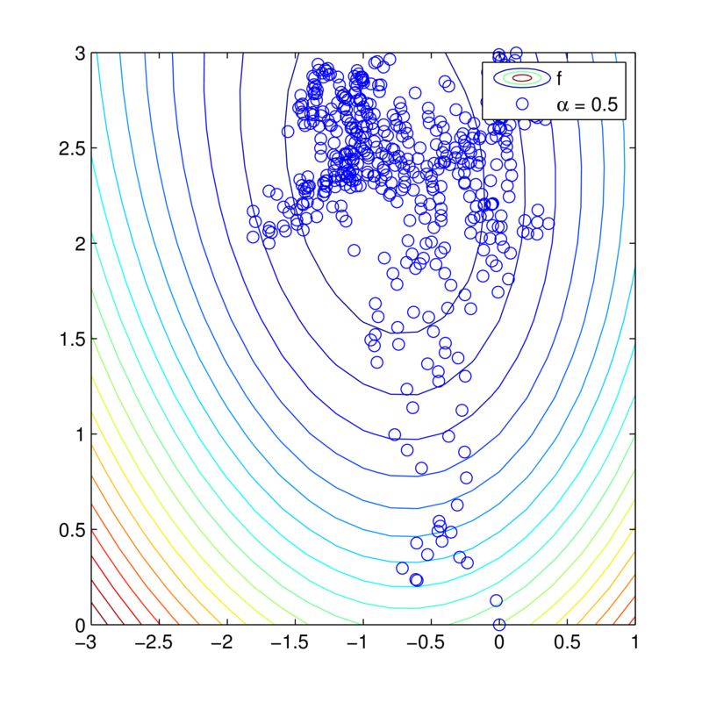
Stochastic Gradient Descent
α =0.5

Slide 29
Stochastic Gradient Descent
α =0.5

Slide 30
Stochastic Gradient Descent
α =0.5
1) Start with big steps and end with smaller steps

Slide 31
Stochastic Gradient Descent
α =0.5
1) Start with big steps and end with smaller steps
2) Try averaging the points

Slide 32
SGD shrinking stepsize
Shrinking Stepsize

Slide 33
SGD shrinking stepsize
How should we sample j ?
Shrinking Stepsize
Does this converge?

Slide 34
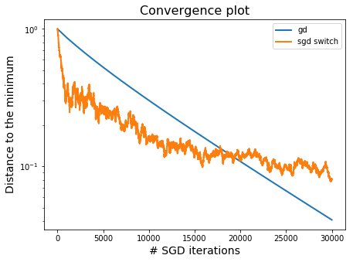
SGD with shrinking stepsize
Compared with Gradient Descent
Gradient Descent
SGD 1.0

Slide 35
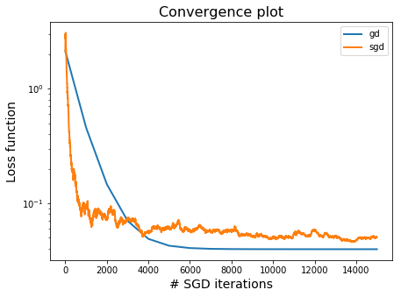
SGD with shrinking stepsize
Compared with Gradient Descent
Gradient Descent
Noisy iterates. Take averages?
SGD

Slide 36

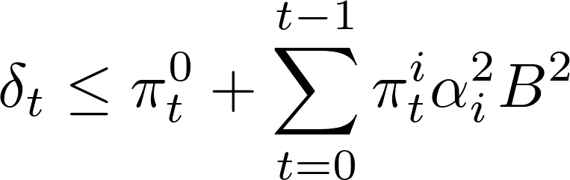
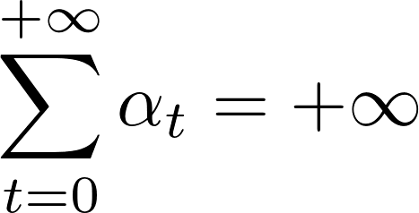
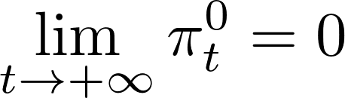
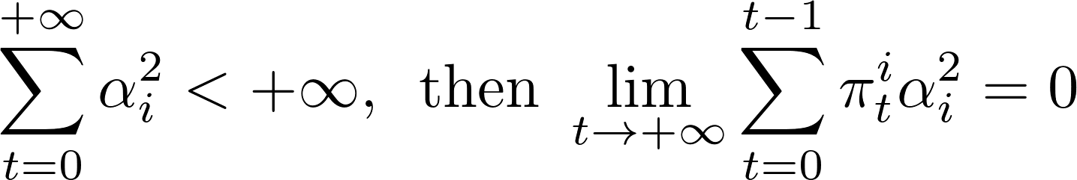

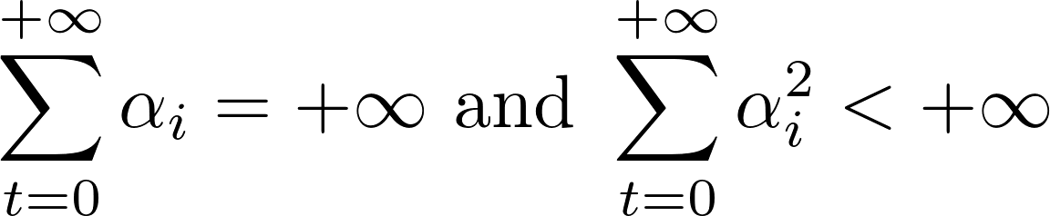
Proof:
1) Recall that
Let and
2) Show that if then
3) Using , show that if
Convergence when

Slide 37

SGD with (late start) averaging
B. T. Polyak and A. B. Juditsky, SIAM Journal on Control and Optimization (1992)
Acceleration of stochastic approximation by averaging

Slide 38
SGD with (late start) averaging
This is not efficient. How to make this efficient?
B. T. Polyak and A. B. Juditsky, SIAM Journal on Control and Optimization (1992)
Acceleration of stochastic approximation by averaging

Slide 39
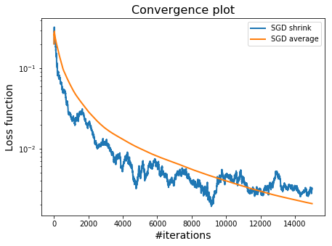
Stochastic Gradient Descent
With and without averaging
Starts slow, but can reach higher accuracy

Slide 40
Stochastic Gradient Descent
With and without averaging
Starts slow, but can reach higher accuracy
Only use averaging towards the end?

Slide 41
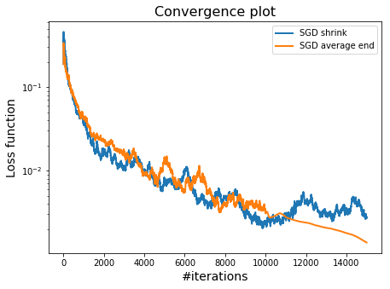
Stochastic Gradient Descent
Averaging the last few iterates
Averaging starts here

Slide 42
Comparison GD and SGD for strongly convex
SGD
GD
Iteration complexity

Slide 43
Comparison GD and SGD for strongly convex
SGD
GD
Iteration complexity
Cost of an iteration

Slide 44
Comparison GD and SGD for strongly convex
SGD
GD
Iteration complexity
Cost of an iteration
Total complexity*

Slide 45
Comparison GD and SGD for strongly convex
SGD
GD
Iteration complexity
Cost of an iteration
Total complexity*

Slide 46
Comparison GD and SGD for strongly convex
SGD
GD
Iteration complexity
Cost of an iteration
Total complexity*
What happens if is small?
What happens if n is big?

Slide 47
Why Machine Learners Like SGD

Slide 48
Why Machine Learners like SGD
Though we solve:
We want to solve:
The statistical learning problem:
Minimize the expected loss over an unknown expectation
SGD can solve the statistical learning problem!
SGD can solve the statistical learning problem!

Slide 49
Why Machine Learners like SGD
The statistical learning problem:
Minimize the expected loss over an unknown expectation

Slide 50
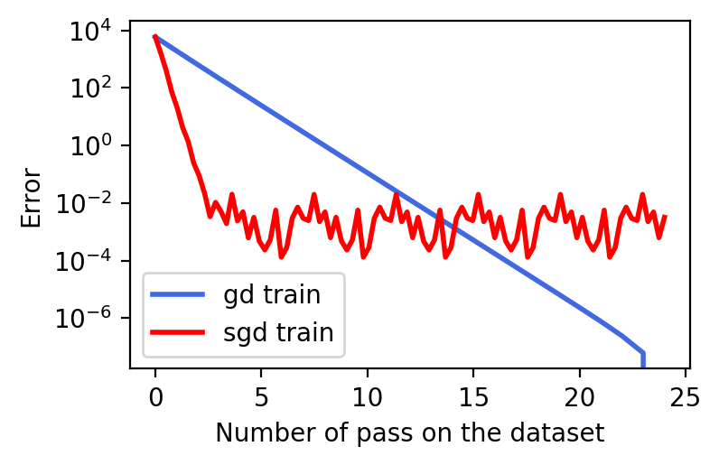
Train error

Slide 51
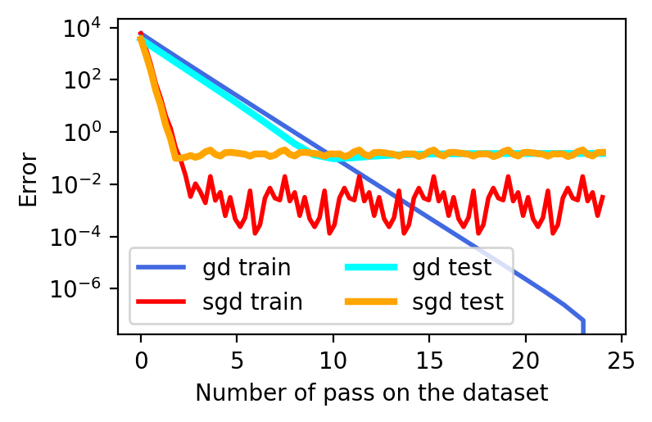
Train error and test error

Slide 52
Variance reduction methods

Slide 53
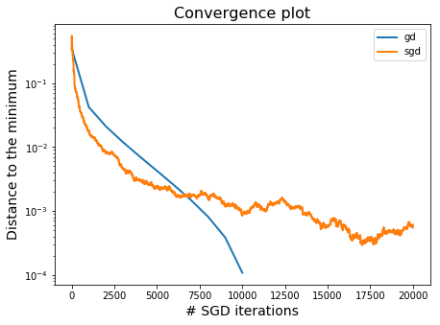
SGD initially fast, slow later
SGD suffers from high variance

Slide 54
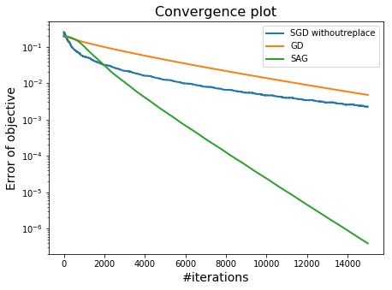
Can we get best of both?
Let’s learn about methods like this one

Slide 55

Build an Estimate of the Gradient
Instead of using directly
Use to update estimate
We would like gradient estimate such that:
Similar
Converges in L2

Slide 56

Controlled Stochastic Reformulation
Covariate functions:
Cancel out
covariate
Original finite
sum problem
Controlled Stochastic Reformulation
Use covariates to control the variance

Slide 57
Variance reduction as SGD on another function
By design we have that
How to choose ?

Slide 58
Covariates
Let x and z be random variables. We say that x and z are covariates if:
Variance Reduced Estimate:
EXE:
Larger covariance between x and z is good

Slide 59
Covariates
Let x and z be random variables. We say that x and z are covariates if:
Variance Reduced Estimate:

Slide 60
Choosing the covariate as a
linear approximation
We would like:
Linear approximation around w
A reference point/ snap shot

Slide 61
SVRG: Stochastic Variance reduced method gradient
Johnson & Zhang, 2013 NIPS
Reference point
Sample
Grad. estimate
It’s unbiased because:

Slide 62


free-SVRG: Stochastic Variance Reduced Gradients
Jonhson & Zhang
NIPS 2013
Sebbouh, et. al 2019
Neurips 2019
Adding
indices in
k and t
Adding
indices in
t and s
Adding
indices in
k and t
Reference point is an
average of inner iterates
Most iterates cost O(1)
Tune inner loop size m

Slide 63
SAGA: Stochastic Average Gradient
Defazio, Bach, & Lacoste-Julien, 2014 NIPs
Sample
Grad. estimate
Store grad.

Slide 64
SAGA: Stochastic Average Gradient
No inner loop, rolling update
Stores a matrix

Slide 65
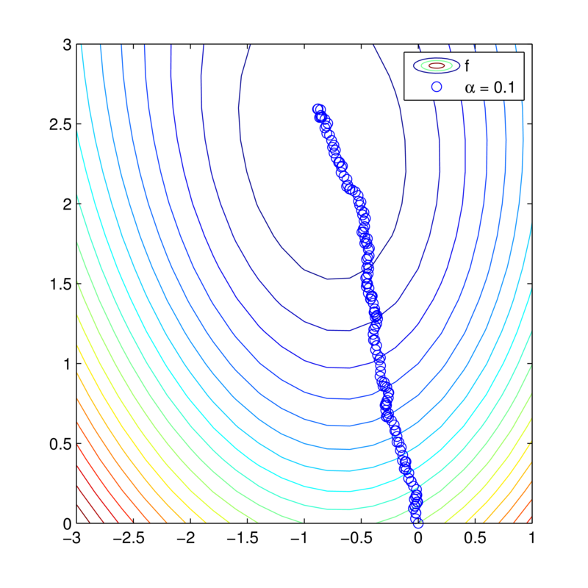

The Stochastic Average Gradient
How to prove this converges? Is this the only option?

Slide 66
Convergence Theorems

Slide 67
Assumptions for Convergence
Strong Convexity
Smoothness + convexity
EXE:

Slide 68

Convergence SAGA
Theorem SAGA
An even more practical convergence result!
Difficult proof technique
A. Defazio, F. Bach and J. Lacoste-Julien (2014)
NIPS, SAGA: A Fast Incremental Gradient Method With Support for Non-Strongly Convex Composite Objectives.

Slide 69


Comparisons in total complexity for strongly convex
Approximate solution
SGD
Gradient descent
SVRG/SAGA/SAG
Variance reduction faster than GD when

Slide 70
Practicals implementation of SAG for Linear Classifiers
Finite Sum Training Problem
L2 regularizer + linear hypothesis
Nonlinear in w
Linear in w
Only store real number
Reduce Storage to O(n)
Stoch. gradient estimate
Full gradient estimate

Slide 71
Take for home Variance Reduction
Variance reduced methods use only one stochastic gradient per iteration and converge linearly on strongly convex functions
Choice of fixed stepsize possible
SAGA only needs to know the smoothness parameter to work, but requires storing n past stochastic gradients
SVRG only has O(d) storage, but requires full gradient computations every so often. Has an extra “number of inner iterations” parameter to tune

