Slide 1
Low-hanging-fruit Dfam pipeline: the algorithms, stage by stage
Stages 0-3 implemented and run on GCA_951799975.1 (black goby) - 12 candidate clusters, 48 Dfam-format seeds, 0 lint errors
Notes:
Purpose of this deck: get sign-off on the ALGORITHMS before any code is written. Each of stages 0-4 gets one or two slides: what the stage does, why it is designed that way, and the measurement that justifies it.
Two things changed in the plan because of measurements shown here: (1) REPET turns out to have full consensus coordinates, so it is a first-class clustering participant, not an EDTA-like special case; (2) connected-component clustering chains badly, and naive fragment merging would swallow real insertions in 63% of cases.
DECK STATUS: every number on these slides is measured on the black goby, and stages 0-3 are now implemented code rather than proposals — the config values quoted in the panel titles are the values the pipeline actually runs. Four slides are new since the design review: stage 1.5 (library-consensus over-assembly), stage 2.1 (pooling and the support/completeness result), stage 3 (seed + lint), and the validation slide. The two questions the earlier version ended on are both settled.

Slide 2
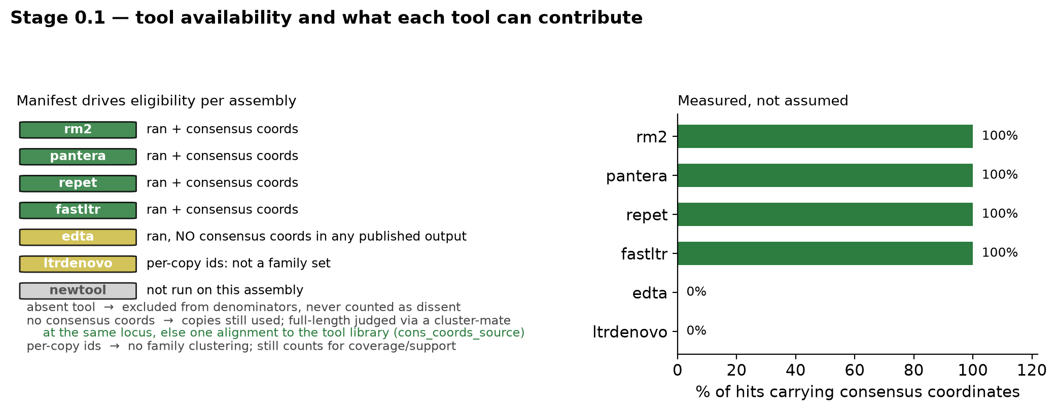
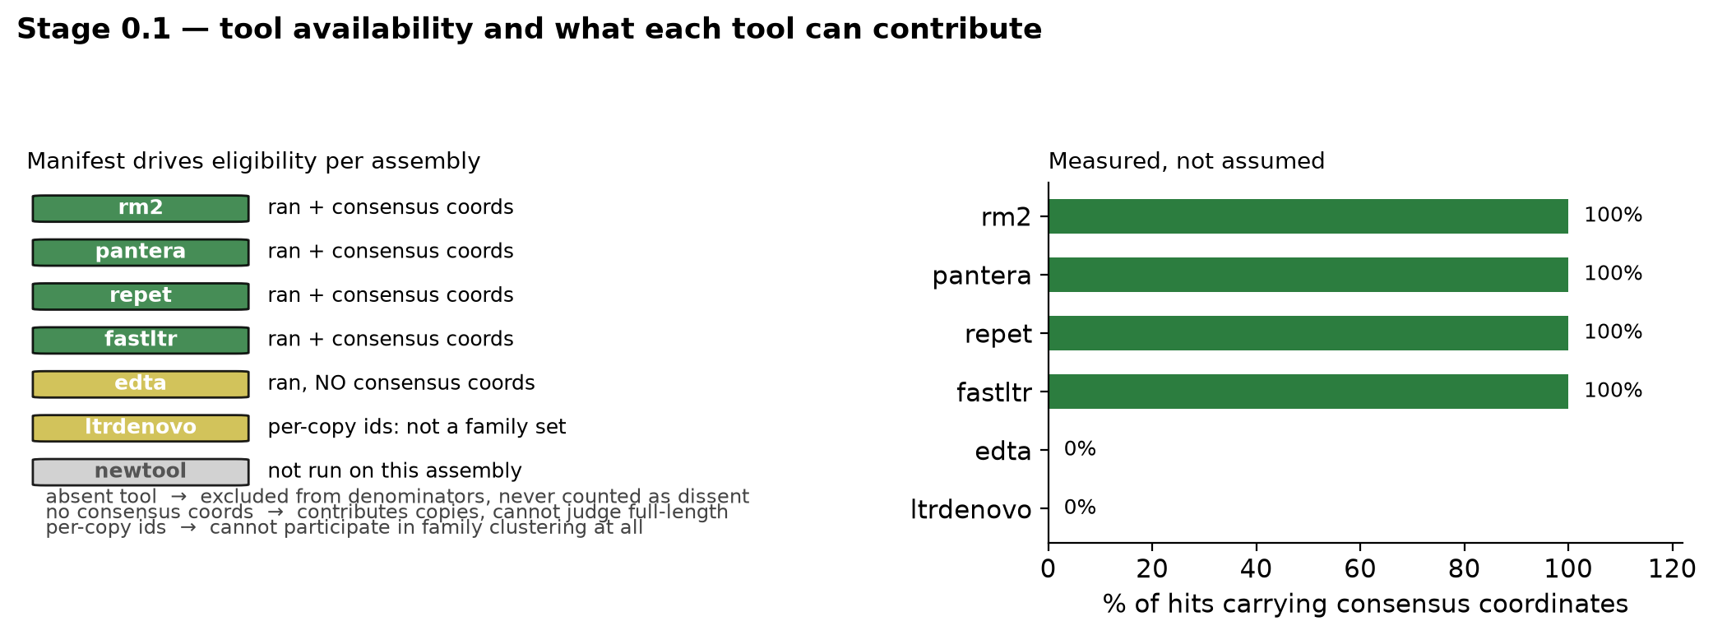
Stage 0.1 — who is eligible to contribute, per assembly
Tool absence and tool capability are different things, and both are read from the manifest
Measured: rm2, pantera, REPET, fastLTR carry consensus coordinates on 100% of hits; EDTA and LTRDeNovo on 0%.
REPET is therefore a full clustering participant — the earlier plan wrongly grouped it with EDTA.
LTRDeNovo has one name per hit (3,104 names / 3,104 hits) — per-copy ids, not families: it cannot cluster at all.
Notes:
Three distinct states a tool can be in, and the pipeline must not conflate them:
1. Ran, with consensus coordinates -> full participant (rm2, pantera, REPET, fastLTR).
2. Ran, no consensus coordinates -> contributes copies and footprints, but cannot judge 'near-full-length' for its own families (your annotation answered on-slide: yes, EDTA members are mapped to the library — full-length is judged via a cluster-mate at the same locus, else one pairwise alignment to the EDTA library entry, recorded as cons_coords_source. EDTA: GenomeArk publishes GFF3 only, no .out, no Target attribute — the information is absent upstream, not lost in conversion).
3. Not run / not available on this assembly -> excluded from all denominators. Silence is never dissent. This is the same principle as the hub's scope gating.
Fourth case discovered while measuring: LTRDeNovo names are per-copy identifiers, so it has no family concept to cluster. It stays a coverage/support tool.
Q: "What if a tool is added later?" A: the manifest drives everything; adding a tool re-runs stage 0 and every cluster is recomputed. Nothing is hardcoded per tool.
CG COMMENT — split structural/per-copy calls from homology calls, and include them when they overlap general-purpose clusters: AGREED, and it is now the planned design (F11). Measured support for it: fastltr joins only 117 of 1,206 strict clusters (9.7%), but 113 of those 117 are LTR by majority order (96.6%), and it never appears alone — edta co-occurs in 116/117, rm2 in 112/117. Its presence lifts the candidate rate to 89% vs 56% among LTR clusters, and the effect survives matching on exactly which other tools are present (0.97 vs 0.70 in the richest stratum, where the fastltr clusters are SMALLER). ltrdenovo is the second structural channel: 3,104 hits, every one classified LTR, but one name per hit so it cannot cluster at all. Planned as structural_ltr_support — a per-cluster flag counting overlapping fastltr members and ltrdenovo copies — rather than as clustering participants. Your boundary point is the strongest argument: structural callers find terminal repeats and TSDs, so they are the ones most likely to have the boundary right.

Slide 3
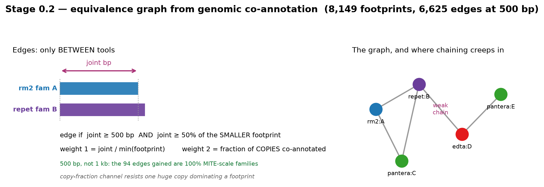
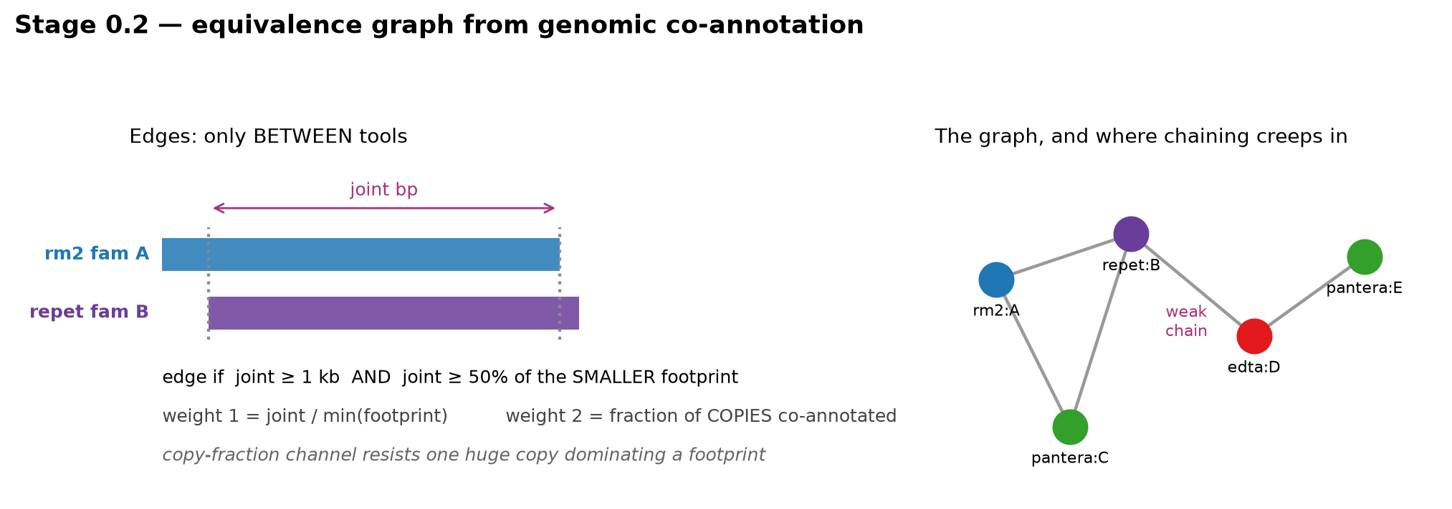
Stage 0.2 — building the family equivalence graph
Edges only between tools, with two independent weight channels
Edge if joint footprint ≥ 500 bp (config edge_min_joint_bp; was 1 kb) AND ≥ 50% of the smaller family's footprint — reciprocal by construction.
Second channel (fraction of copies co-annotated) resists a single huge copy dominating a bp-based overlap.
Simple/tandem/multigene families and (MOTIF)n entries are excluded before clustering.
Notes:
Why genomic co-annotation rather than library sequence clustering: the coordinates exist right now for every tool, whereas the library FASTAs are not all on hand. Sequence clustering (80-80-80 via mmseqs2) stays available as a third channel later, and would be a useful cross-validation, but it is not required for v1.
Why edges only BETWEEN tools: an edge within one tool's library would be asserting that the tool redundantly discovered the same family twice. That is a real phenomenon and worth measuring separately, but it is not what defines a deposition unit here.
The 50%-of-smaller rule is deliberately asymmetric-tolerant: a small fragmentary family that sits entirely inside a large family's footprint SHOULD link to it. Requiring 50% of both would miss exactly the truncation cases we want to fix.
Numbers on the goby: 8,149 family footprints across 5 tools -> 6,531 edges after both thresholds.
MITE threshold (your annotation on this slide): measured. Dropping the joint minimum from 1 kb to 500 bp gains 94 edges; 100% of them involve a MITE-scale family (median copy <= 800 bp; median copy length of the smaller partner 141 bp) and 100% of the smaller partners are small families (<5 kb footprint) — i.e. the gained edges are exactly the MITE links the 1 kb rule was starving, not noise. Decision: default joint minimum = 500 bp, configurable; 250 bp gains a further 181 edges and is left as an option pending the first batch.
IMPLEMENTED (config edge_min_joint_bp = 500, edge_min_reciprocal = 0.5): the 1 kb figure in this diagram is the value we started from; 500 bp is what the pipeline runs. On the real 5-tool graph that yields 8,149 footprints and 6,625 edges.
CG COMMENT — real examples wanted here: TO DO in the next iteration. The instruction to Claude Code is to dump, for one concrete edge, the two family names, their footprints, the joint bp, both weight channels, and a screenshot-able locus where they overlap — then this slide shows a real pair instead of fam A / fam B.

Slide 4
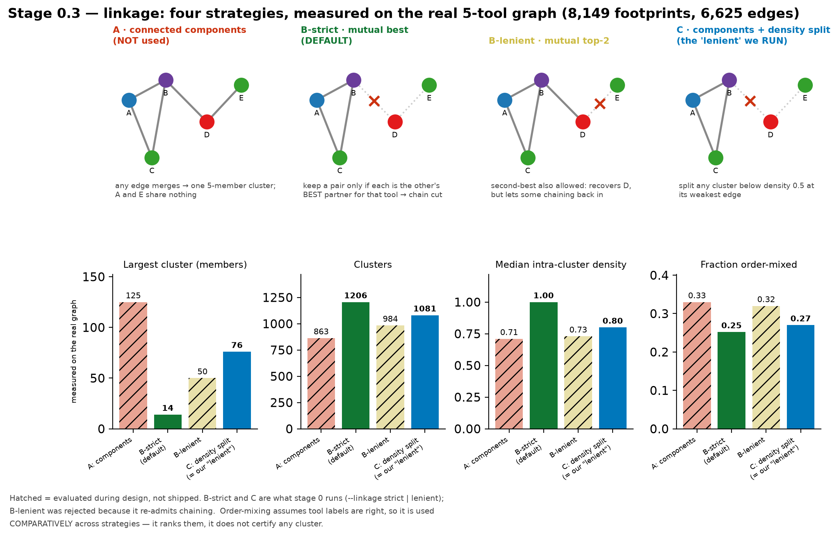
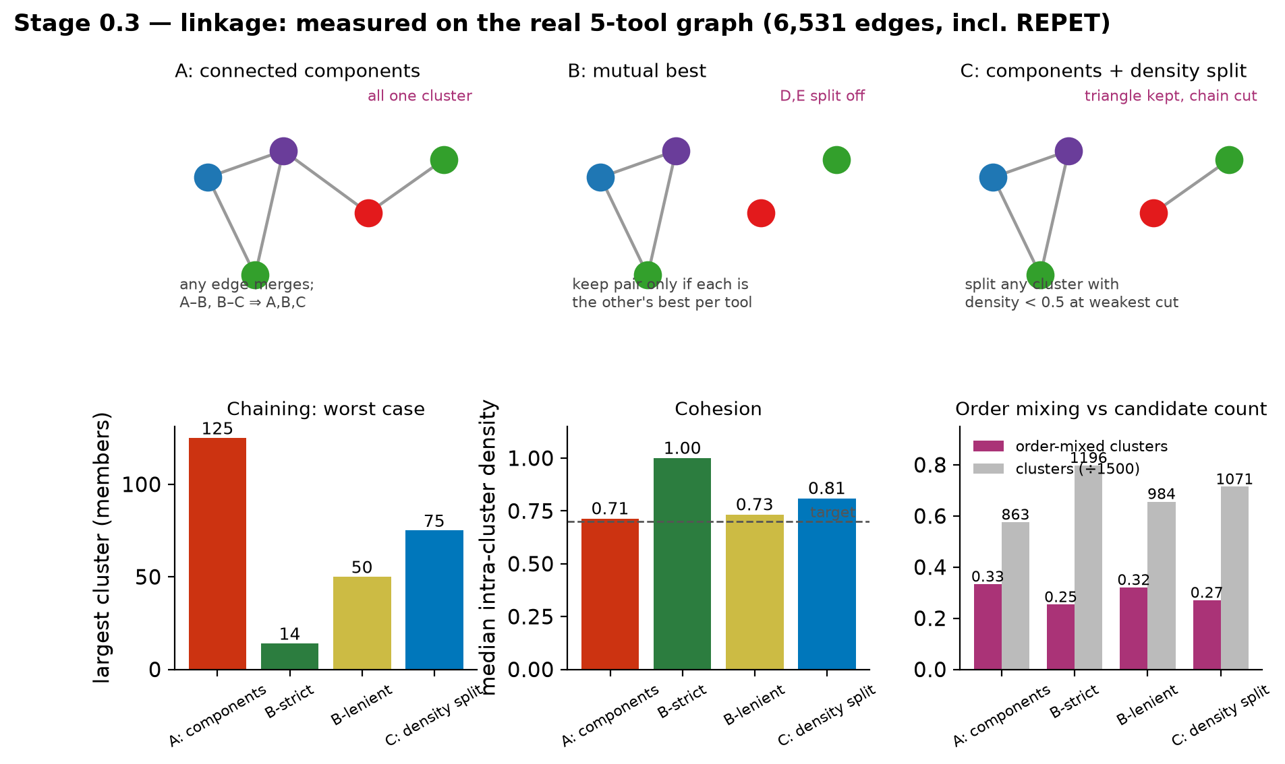
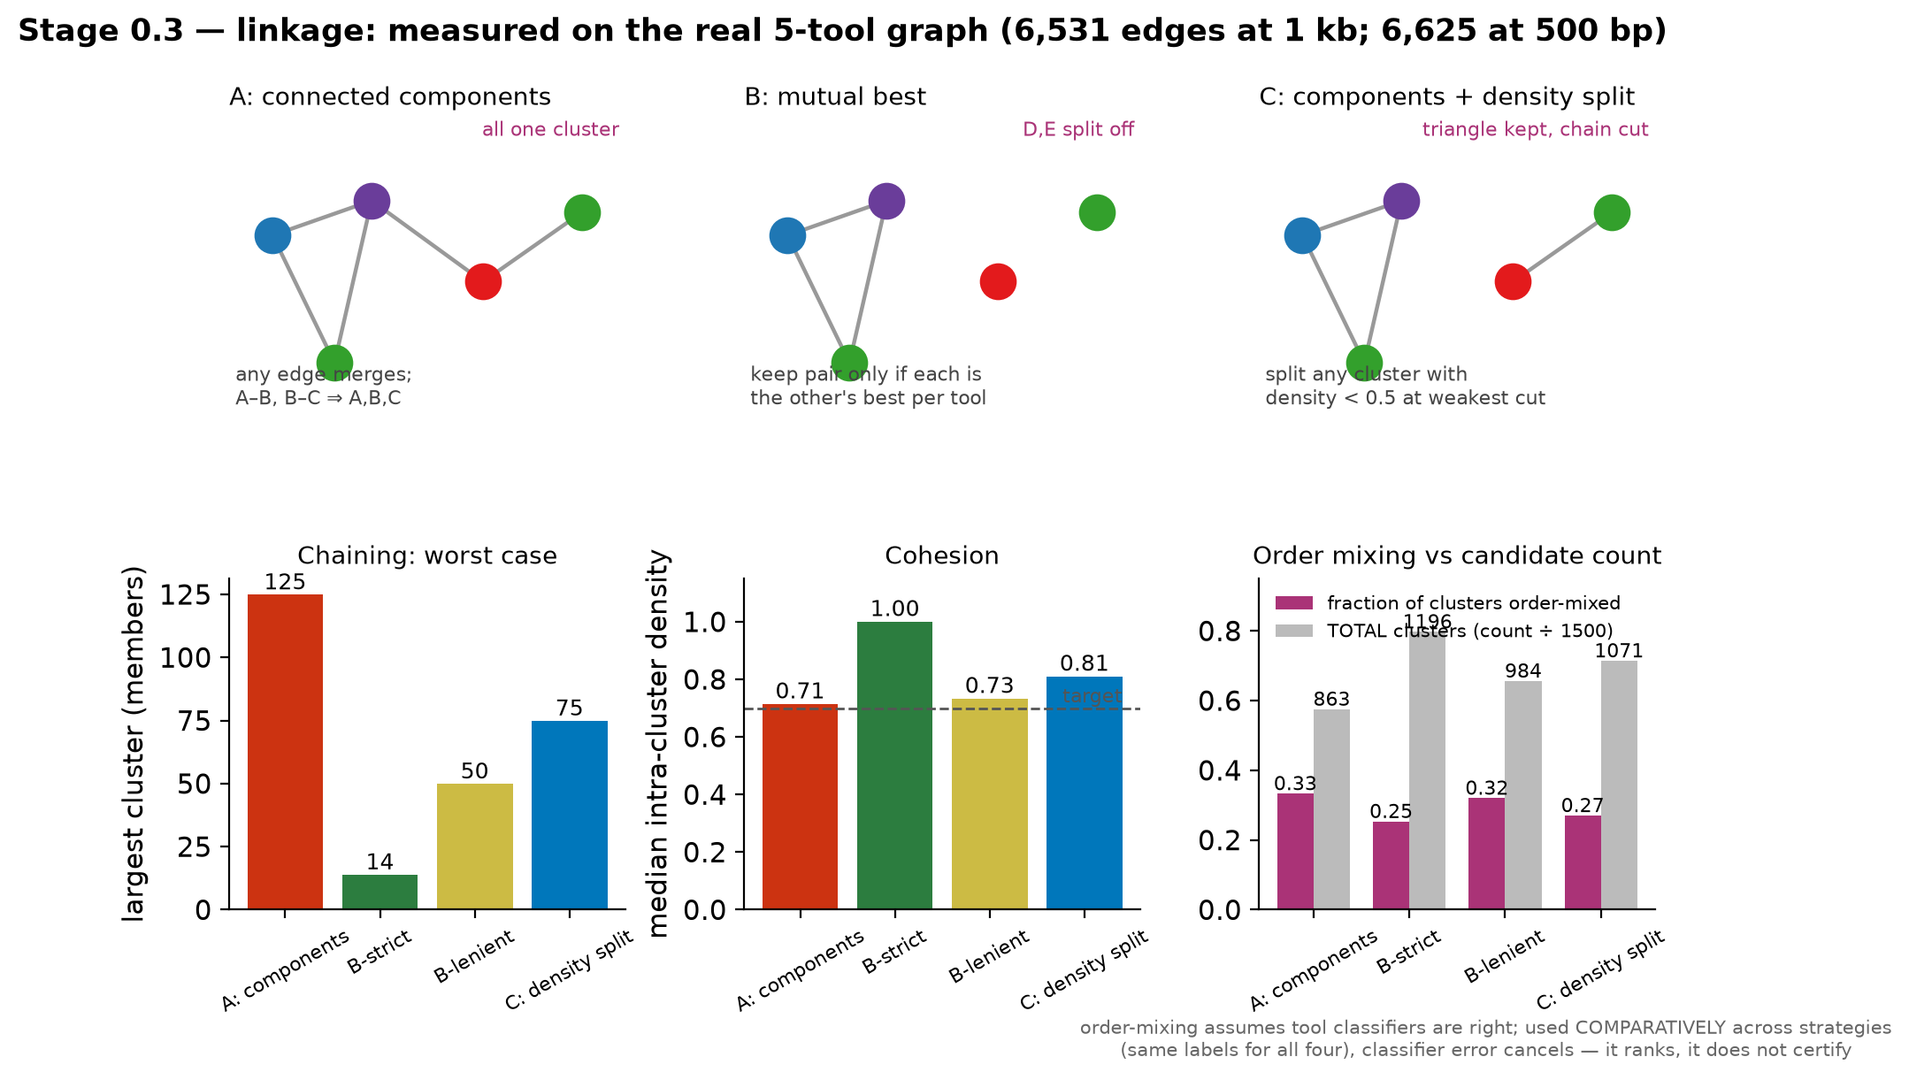
Stage 0.3 — linkage: three strategies, measured not argued
The current connected-component clustering chains badly; this is the fix, quantified
Notes:
THE CORE FINDING. Connected components (what the report currently ships) merges A and C whenever A-B and B-C exist, even if A and C share nothing. On the goby with REPET added: largest cluster 125 members, median intra-cluster density 0.71, and a THIRD of clusters (33%) mix TE orders — i.e. contain both, say, a LINE family and a TIR family. A 125-member order-mixed cluster is not a family.
The three candidates and what they cost:
- B-strict (mutual best, top-1): max cluster 14, density 1.00 (by construction), order mixing down to 25%, and the MOST clusters (1,196). Cost: 3,599 members retained vs 4,960 — it drops the weakest edges entirely.
- B-lenient (mutual top-2): intermediate on everything (max 50, density 0.73). Your suggestion of strict vs lenient modes is exactly this pair, and it is worth keeping both for comparison.
- C (components + density split at tau=0.5): max 75, density 0.81, order mixing 27%, 1,071 clusters, 4,169 members. Best density-per-member-retained.
Recommendation: run BOTH B-strict and C on the first batch and compare seeds. B-strict is the safe default (no chaining possible); C retains more evidence. The order-mixing column is the honest arbiter, because a cluster mixing LINE and TIR is wrong regardless of overlap arithmetic.
Note: fragmenting a genuinely large family into several clusters is ACCEPTABLE (your note) — each fragment still yields a valid seed. Chaining is not acceptable, because it produces a chimeric consensus.
On order-mixing assuming classifiers are correct (your caveat): agreed, and the metric survives it because it is used COMPARATIVELY — all four strategies are scored against the SAME family labels, so classifier error hits all four equally and cancels in the ranking. It ranks strategies; it does not certify any cluster. Per-cluster it is advisory (shown to the curator), never a hard filter.
IMPLEMENTED AND RUN (lhfseeds/stage0.py: link_strict = mutual-best, link_lenient = components + density split at tau 0.5). Actual run on GCA_951799975.1: strict 1,206 clusters, max 14 members, median density 1.00, 763 candidates; lenient 1,081 clusters, max 76, density 0.80, 728 candidates. Strict is the default; lenient runs alongside for comparison, as agreed.
CG COMMENT — FIXED. The chart had four bars against three diagrams; there are now four diagrams, one per bar, and the hatching marks which strategies were only evaluated during design (A: connected components, and B-lenient) versus which the pipeline actually runs. STRICT vs LENIENT, plainly: strict = mutual best — an edge survives only if each family is the other's single best partner for that tool, so a chain A-B-C-D cannot form (max cluster 14 members, density 1.00, 763 candidates). Lenient = connected components followed by a density split: any cluster whose intra-cluster edge density falls below 0.5 is cut at its weakest edge (max 76, density 0.80, 728 candidates). B-lenient (mutual top-2) was the intermediate we rejected: it recovers members but re-admits chaining (max 50, density 0.73).

Slide 5
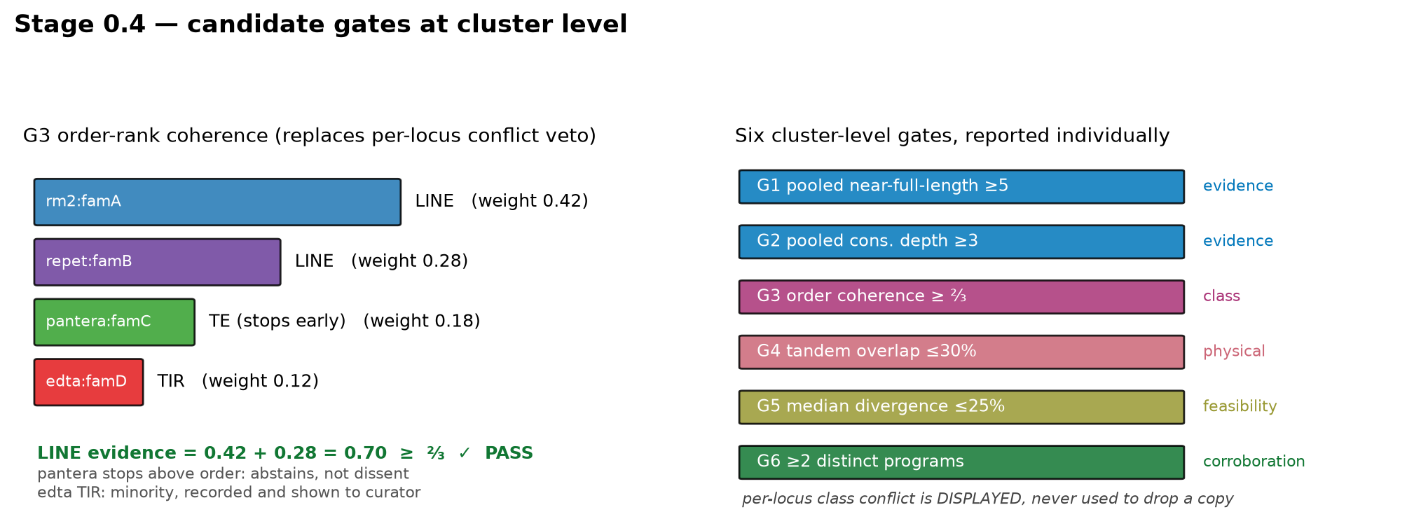
Stage 0.4 — candidate gates, at cluster level
Order-rank coherence replaces the per-locus class-conflict veto
Your objection: a per-locus veto gives one tool's class call the power to drop a copy. Removed.
G3 now asks the cluster-level question: do the tools broadly agree what KIND of element this is (≥⅔ member-weighted, order level)?
Tandem overlap stays a filter — unlike a class opinion, it is a physical property measured by independent array finders.
Notes:
Why order level and not superfamily: superfamily agreement is rare across tools with different vocabularies (Pantera stops above order on 62% of hits). Order (LINE / SINE / LTR / TIR / Helitron / Maverick) is the level at which 'low-hanging fruit' is meaningful — the tools broadly know what kind of thing it is.
Weighting is by member evidence (bp or copies), so a tiny fragmentary member cannot outvote the bulk of the cluster. A member that stops above order abstains; it does not dilute.
The ⅔ threshold is your call to start here. It is reported per cluster so it can be re-thresholded from the table without recomputation.
What happened to per-locus conflict: it is computed and DISPLAYED on the QC sheet, so a curator sees 'these three loci are contested', but it never silently removes evidence. That is the difference between an annotation and a filter.
IMPLEMENTED (lhfseeds/gates.py): G1 pooled full-length >= 5; G2 depth (a member spanning at depth >= 3); G3 order coherence >= 0.667, member-weighted, abstention-aware; G4 tandem overlap <= 0.30; G5 median divergence <= 25; G6 >= 2 tools. Reported individually; the shortlist requires all six. Per-locus class conflict is displayed, never used to drop a copy — as you asked.

Slide 6
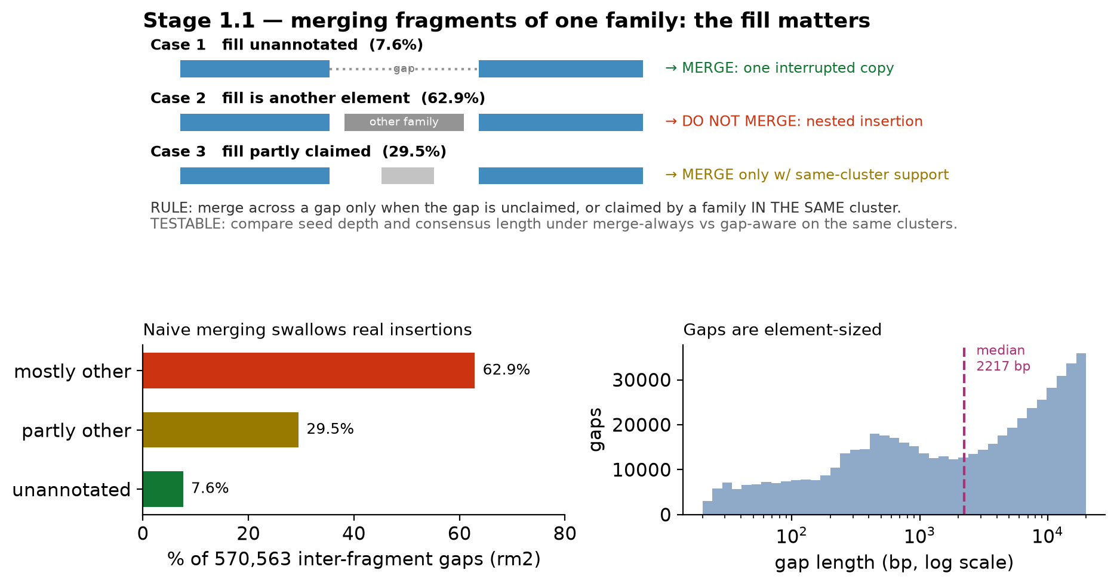
Stage 1.1 — merging fragments: the gap between them matters
Measured: 63% of inter-fragment gaps are mostly occupied by a different element
Notes:
YOUR ANNOTATION, CONFIRMED EMPIRICALLY. The question was whether merging two fragments of the same family across a gap should swallow the gap. Measured on 570,563 rm2 inter-fragment gaps (20 bp - 20 kb): only 7.6% of gaps are unannotated; 62.9% are MOSTLY covered by another element's hits; 29.5% partly. Median gap length 2,217 bp, q90 15 kb — these are element-sized, not indel-sized.
So merge-always would routinely absorb a nested insertion into the copy, and that sequence would then enter the alignment as if it belonged to the family. Directly produces overextended and chimeric consensi.
The rule: merge across a gap only when the gap is unclaimed, OR claimed by a family in the SAME cluster (a within-family duplication is legitimately part of the element). Otherwise emit two separate copies.
Your caveat is respected too: the other tool may itself be chimeric, so 'claimed by another family' is not automatically truth. That is why the rule is testable — build the same clusters both ways and compare seed depth, consensus length, and the overextension flag rate. The comparison is a work-order item, not an assumption.
REPET is a special case in our favour: its fragments already carry the parent copy id (hit_id), so its own fragmentation is explicit rather than inferred.
RESOLVED AT SEED LEVEL — and the expected test was NOT the decisive one. Across 12 clusters built both ways with 100 sampled copies each: rebuilt consensus length differs by 0.0 bp in the median (gap_aware longer in 5, shorter in 5, equal in 2) and median seed depth by +0.5 (better in 6 of 12). So depth and consensus length — the criteria the plan named — do not separate the modes; whatever merge-always absorbs, the aligner and consensus caller discard again.
The modes separate on the secondary criteria, and gap_aware wins all three: +580 deduplicated loci in the median and MORE loci in 12 of 12 clusters; 4 fewer bridged (multi-fragment) rows in the seed, better in 11 of 12; ~6 fewer copies over 1.5x the modal consensus, better in 8 of 12. DECISION: gap_aware is the default — not because it builds a better consensus, but because it reaches the same consensus from cleaner, more numerous, less chimeric evidence.

Slide 7
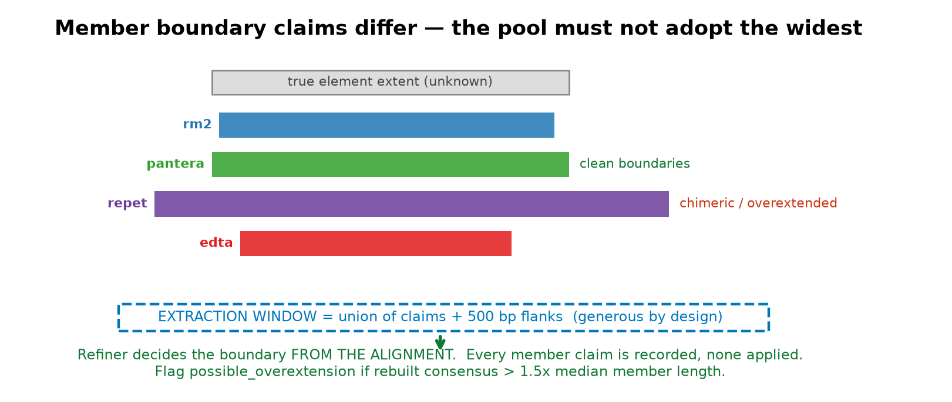
Stage 1.2 — extraction window is not the element boundary
Rev 1's 'keep the widest interval' let the most overextended member set the boundary — exactly the chimera failure you flagged. Deleted.
The window is deliberately generous; Refiner decides the boundary from the alignment. Member claims are recorded, never applied.
Notes:
The separation of concerns: extraction must not exclude real sequence (so be generous), but the boundary must come from evidence across many copies (so let the alignment decide).
Recording each member's boundary claim per locus is what makes the curator fallback possible: the QC sheet can show 'rm2 ends here, pantera ends here, REPET runs 1.4 kb further', and a curator can accept a specific tool's boundaries.
The overextension guard: if the rebuilt consensus exceeds 1.5x the MEDIAN member consensus length, flag possible_overextension. Median, not max, precisely because one chimeric member should not set the reference.
Flanks (±500 bp) serve two purposes: they let Refiner see where homology actually stops, and they are required for TSD detection (a TSD is in the flank, not in the element).
IMPLEMENTED: boundaries come from the alignment, never from the widest member claim, exactly as this slide argues. The guard is possible_overextension = rebuilt consensus > 1.5x the MEDIAN member consensus length (median, so one chimeric member cannot set the reference). Across all 24 packets built so far it has fired ZERO times — the alignment-derived boundaries are staying within bound.

Slide 8
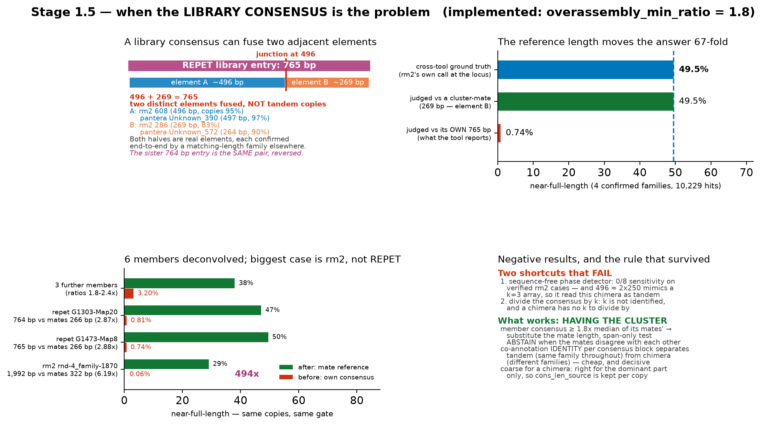
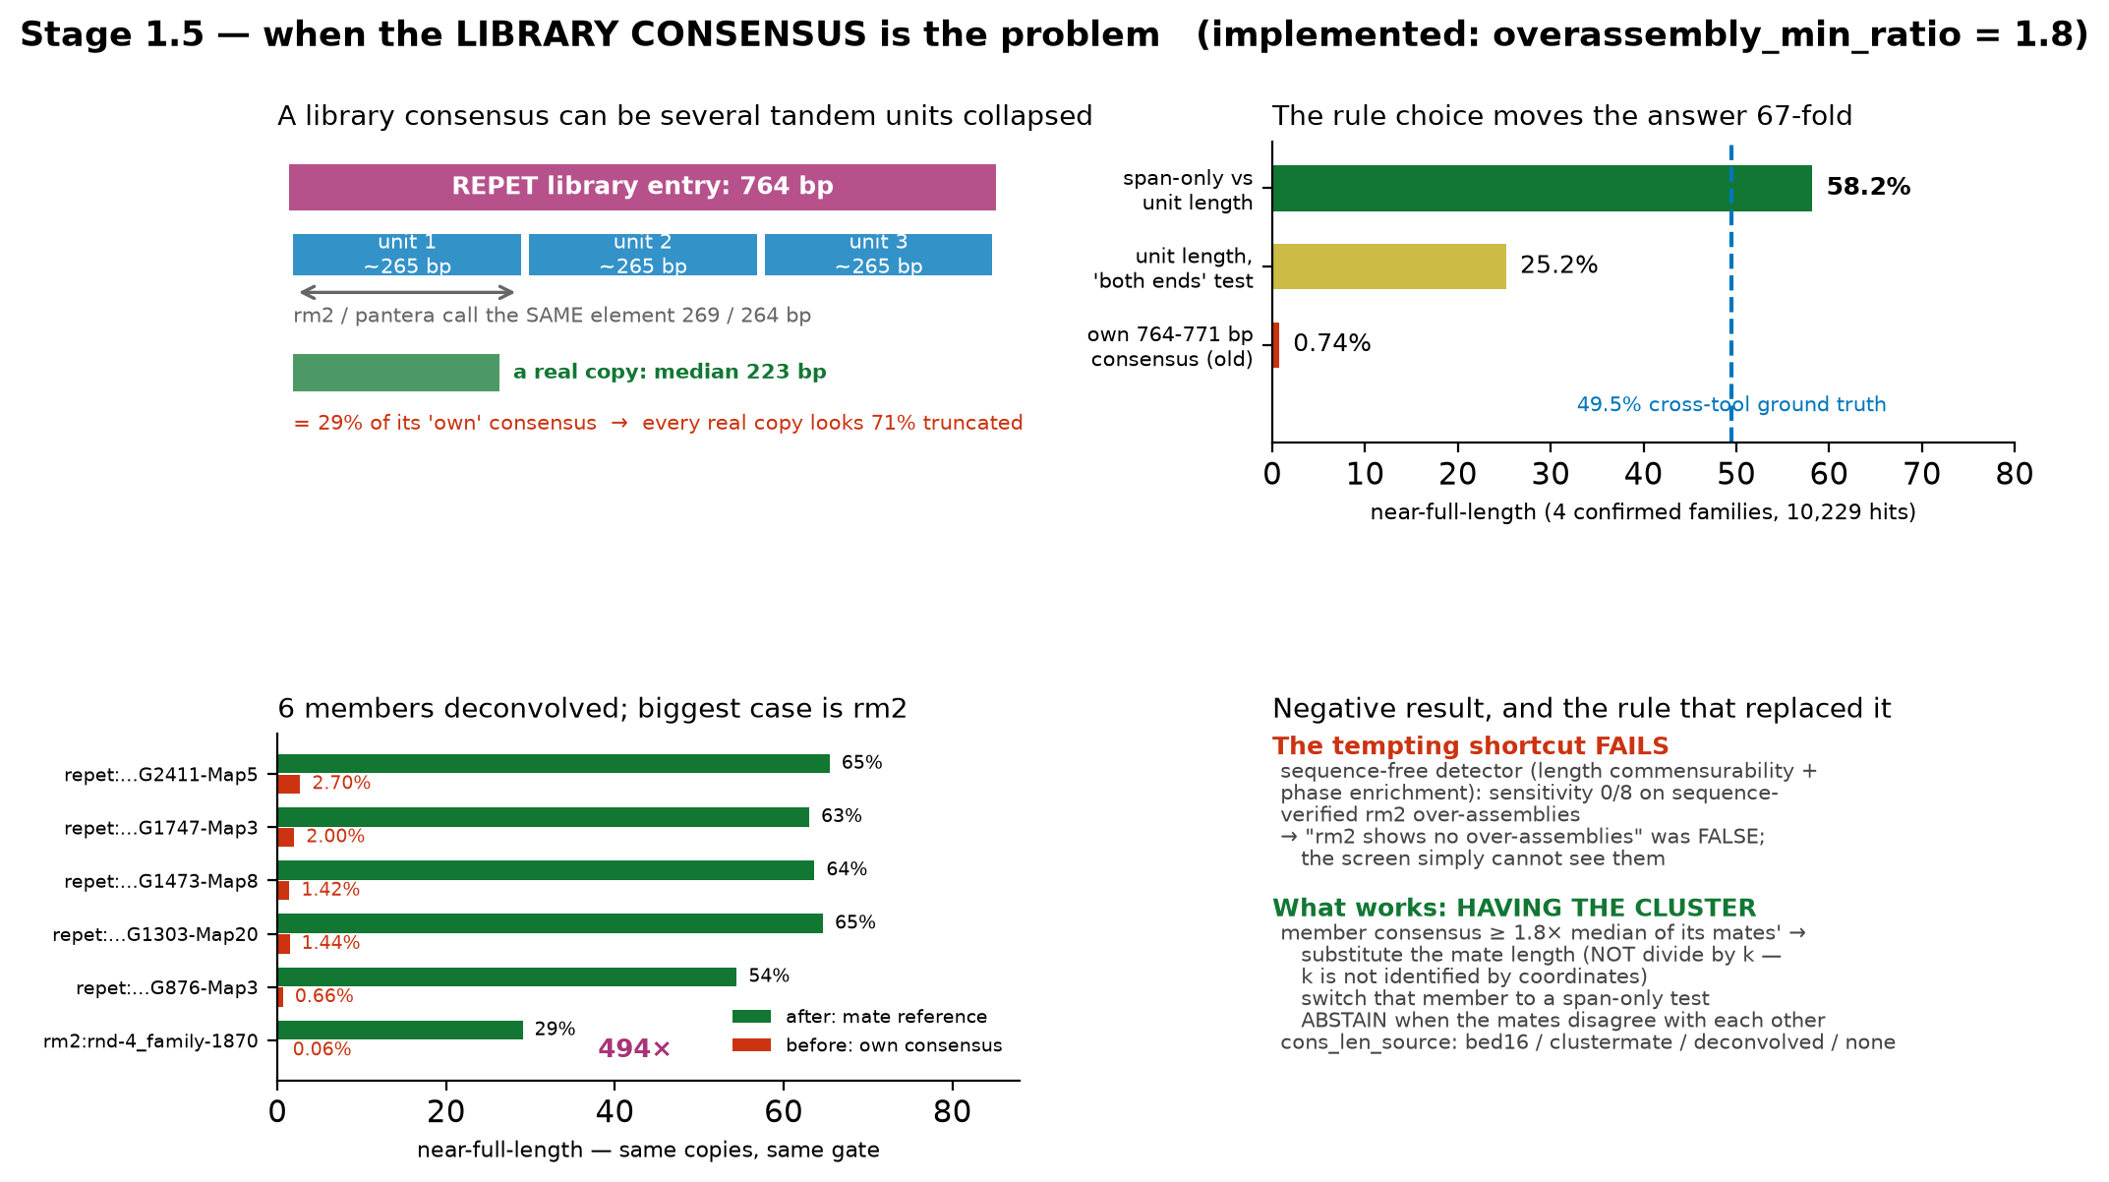
Stage 1.5 — when the library consensus is the problem
Your 764/765 bp observation, chased to its conclusion: a CHIMERA of two elements (496 + 269), not tandem units
Notes:
THIS SLIDE EXISTS BECAUSE OF YOUR ANNOTATION on the two REPET families with suspiciously clean 764/765 bp consensi, and it has now been CORRECTED TWICE — both times by you.
FIRST CORRECTION: your palindromic-MITE hypothesis was tested and rejected. Adjacent rm2 hits within 700 bp are 75% SAME strand, only 25% opposite, i.e. below the 50% expected by chance, whereas a palindrome whose consensus captured one arm would show an excess.
SECOND CORRECTION (this is the one that matters): I reported the mechanism as ~3 tandem units of a ~255 bp element. That was WRONG, and you caught it by looking at the locus in the genome browser. My analysis had filtered each tool to the single cluster family, so everything those tools call under OTHER family names at the same locus appeared as empty space.
WHAT IT ACTUALLY IS: a chimera of two distinct, adjacent elements. The decisive test is co-annotation IDENTITY per consensus block — tandem units of one element must be co-annotated by the SAME family at every block; a chimera by DIFFERENT families. Measured on G1473-Map8: consensus positions 51-484 are co-annotated by rm2 rnd-1_family-608 (a 496 bp consensus) at 55-100% purity, and positions 484-765 by rm2 rnd-1_family-286 (269 bp) at 79-100%. 496 + 269 = 765. The junction falls exactly where the arithmetic predicts. The sister entry G1303-Map20 (764 bp) is the SAME PAIR FUSED IN THE OPPOSITE ORDER, which is why the two entries partition loci almost perfectly instead of double-annotating them.
Both halves are real. Element A is confirmed end-to-end by pantera Unknown_390 (497 bp consensus, median copy 482 bp = 97% of it) and rm2 rnd-1_family-608 (median copy 473 bp = 95%). Element B by rm2 286 and pantera Unknown_572 at 83-90%. Neither is a fragment of the other.
WHY THE COORDINATE-ONLY DETECTOR WAS FOOLED, and this is worth saying out loud: 496 is approximately 2 x 250, so a chimera whose two parts happen to be ~2x and ~1x a similar length produces endpoint clusters near multiples of ~255 — indistinguishable from a k=3 array by phase enrichment alone. That is a second, independent reason not to trust the phase detector, on top of its measured 0/8 sensitivity.
WHAT SURVIVES UNCHANGED: the gate error. Judged against its own 765 bp consensus, 0.74% of those copies look near-full-length; against the cross-tool ground truth, 49.5%. A 67-fold error that would sink every real copy at any completeness gate. And the biggest single case in the batch is still rm2's rnd-4_family-1870 (1,992 bp against mates at 322 bp, 494-fold change), so this is not a REPET quirk.
WHAT CHANGES: the deconvolution rule is now known to be COARSE for a chimera rather than exact. Substituting the mate length is still the right action, but it is right only for the part of the family the cluster's mates correspond to. Cluster 1103 holds the B-side mates (264, 269) and not the A-side ones, so REPET copies are judged against ~269 — correct for the B fragments, wrong for the ~21% of G1473-Map8 hits that fall in the A-dominated blocks. That is why cons_len_source is recorded per copy rather than per family.
Q: "Should the pipeline split a chimeric family?" A: It cannot, from coordinates — it can only flag it. Splitting needs the library sequence, which is task C1-C3 in the instructions. What the pipeline CAN do today is refuse to treat the fused length as the element length.
Q: "How common is it?" A: Honest answer, unknown per tool. Four REPET entries confirmed in this assembly; a per-tool rate needs the libraries.

Slide 9
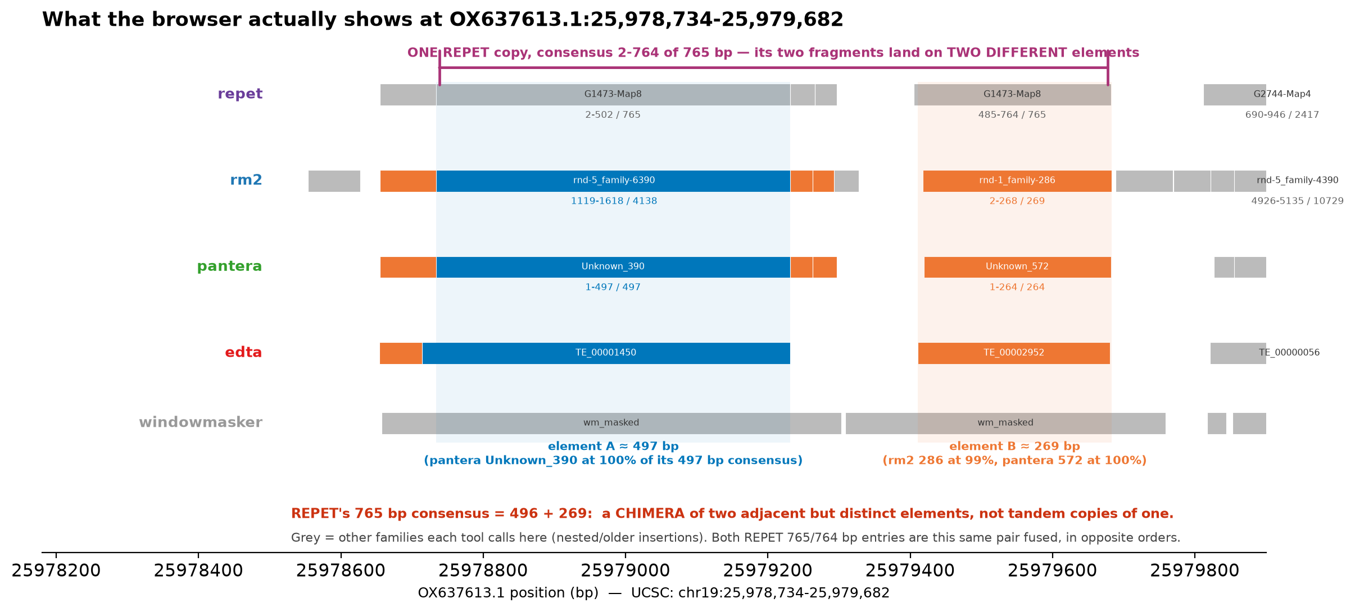
The same locus in the browser — one worked example
OX637613.1:25,978,734-25,979,682 (UCSC chr19, same coordinates) — every family every tool calls here, not just the cluster's
Notes:
THIS IS THE "REAL EXAMPLE" YOUR SLIDE-3 AND SLIDE-10 COMMENTS ASKED FOR, and it is also the figure that corrected me. Read it straight off the browser: 949 bp, chr19:25,978,734-25,979,682.
WHAT TO POINT AT, in order:
1. The REPET lane. ONE copy (hit_id ms119910, two fragments, consensus 2-764 of 765) spans the whole window. Its repeat_left reaches 1 — REPET believes it found a complete, full-length element. This is not a truncated or low-confidence call, which is exactly why no per-tool quality check can catch it.
2. The blue block on the left, ~497 bp. Every tool calls it, and pantera calls it Unknown_390 at 1-497 of a 497 bp consensus — 100% of its own length. That is element A, and it is a real, independently confirmed element.
3. The orange block on the right, ~270 bp. rm2 calls rnd-1_family-286 at 2-268 of 269 (99%), pantera Unknown_572 at 1-264 of 264 (100%), edta TE_00002952 at 270 bp. That is element B, equally real.
4. So REPET's single "full-length copy" is one copy of A plus one copy of B, fused. 496 + 269 = 765.
5. The grey blocks are the other families each tool calls in the same window — nested or older insertions (a SINE, a TcMar-Mariner, an L2, an Ngaro LTR at the right edge). They are why my first version of this figure was wrong: I had filtered to the cluster's families, so all of this was blank space and the browser looked nothing like my slide.
THE DIVERGENCE DETAIL IS A FREE SECOND SIGNATURE: REPET's two fragments of the same "consensus" carry 1.2% and 7.6% divergence. One real element aging as a unit cannot do that; two independent elements can. Cheap to compute, and it points the same way as the block test.
WHY THIS LOCUS AND NOT ANOTHER: it is one of only two places in this cluster where a REPET copy of 600 bp or more contains three or more rm2 hits, i.e. where the fusion is visible in a single screenful. The other (CATOHO010000068.1:22,720-24,345) has an older, more fragmented arrangement.
Q: "Is this element a tandem repeat?" A: No, measured — the cluster's 6.87 Mb footprint overlaps fastan 1.16%, trf 0.56%, satellome 0.07%. Note that windowmasker masks the whole window, but windowmasker is excluded from clustering (one name for 4.36 M hits). The two 35 bp fragments in the middle of the window are the tail of one B copy and the head of the next — genuinely adjacent B insertions, which is how a library builder ends up fusing A and B in the first place.

Slide 10
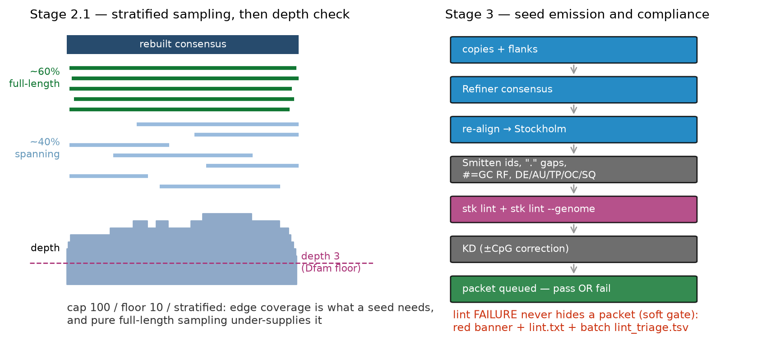
Stages 2–3 — sampling, consensus, and Dfam compliance
Acceptance is machine-checked by stk lint; failure is loud, never silent
Stratified sampling (~60% full-length / ~40% spanning) because a seed needs coverage at the consensus EDGES.
Soft gate per your instruction: lint-failing packets still reach the curator, flagged, plus a batch-level lint_triage.tsv.
Notes:
Sampling: cap 100 / floor 10 as agreed. The stratification matters because full-length copies all cover the middle; edge coverage (the ≥3-per-position Dfam floor at the termini) comes from partial copies that reach one end. Pure full-length sampling looks good and fails the floor at the edges.
Dfam compliance specifics, all machine-checkable: Smitten identifiers (assembly:sequence:1-based-fully-closed_strand — note our BED16 is 0-based half-open, so conversion is a correctness requirement that discoord validates against the assembly), '.' as gap character, #=GC RF line, and required #=GF fields DE/AU/TP/OC/SQ.
KD (Kimura divergence) per your call: computed in v1, with CpG-hypermutability correction ON by default, and BOTH values stored in packet.json so the effect of the correction is auditable per family.
Why the soft gate: a hard gate would make systematic failures invisible — the queue would just be shorter. lint_triage.tsv aggregates failure codes across the batch so a coordinate-convention bug announces itself immediately.
Your note on repeatome intactness: correct and intrinsic to the approach — a taxon with young, intact repeats yields more full-length copies and a more favorable stratification ratio than one with old, degraded repeats. The 60/40 target is aspirational; the REALIZED composition is recorded in packet.json per family, so cross-assembly comparisons of seed quality can condition on it rather than assume the ratio was met. Low-hanging fruit will simply be more abundant in some species — that is the screen working, not a bias to fix.
NO LONGER A PLAN — this stage is built and the project milestone is met. 12 clusters x 2 merge modes x 2 engines = 48 Dfam-format seeds, all passing stk lint with 0 ERRORs, and 4,929 of 4,929 alignment rows independently verified to reproduce the assembly at the coordinates their Smitten identifier claims. Sampling is wired (cap 100 / floor 10 / 60% full-length target, realized composition recorded per packet). tp_map.tsv EXISTS: 18 of 24 packets carry an exact Dfam TP, 6 fall back to the placeholder. Kimura divergence is emitted as #=GF KD with CpG correction on by default. See the new slides that follow.

Slide 11
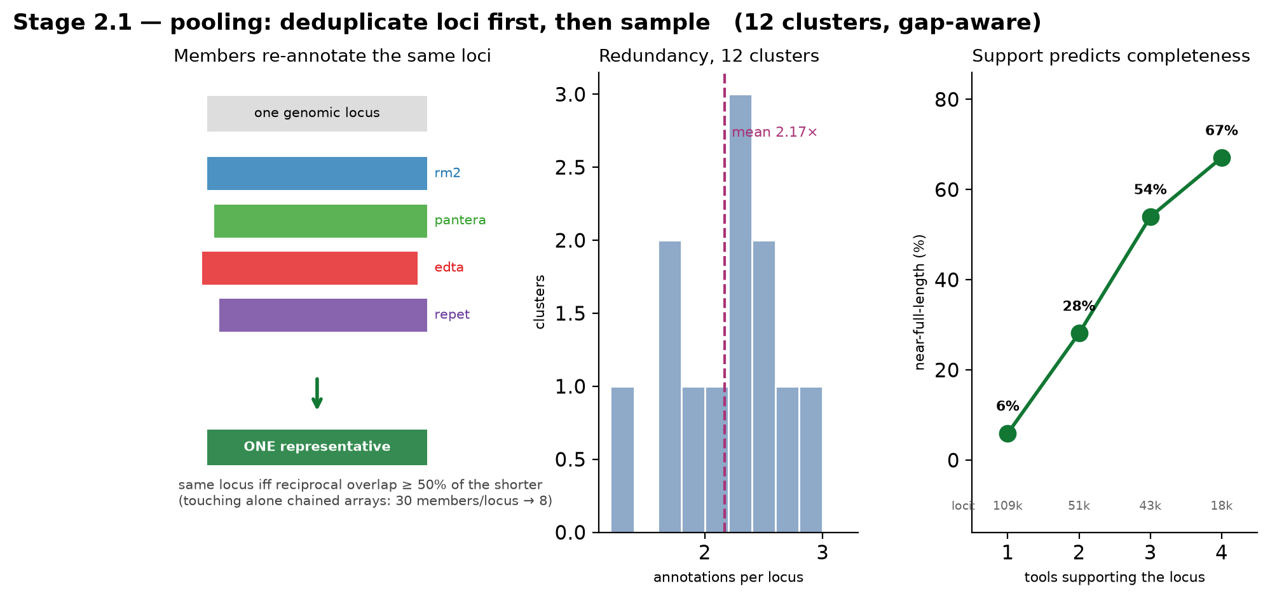
Stage 2.1 — pooling: deduplicate loci first, then sample
Cluster members re-annotate the same loci ~2.2x over; and cross-tool support predicts copy completeness
Notes:
THE PROBLEM: the members of a cluster were grouped precisely because they describe the same element, so they annotate the same loci repeatedly. Measured across 12 clusters: a mean of 2.17 annotations per locus (range 1.26-3.04). Pairwise, in cluster 62 the overlap is near-total — rm2 vs pantera 94.3% of the smaller member's copies. A pooled seed built by sampling copy ROWS would place the same sequence in the alignment about twice on average, inflating apparent depth and weighting the consensus toward whichever tool annotates most prolifically.
THE RULE: collapse to one representative per locus before sampling. Two annotations are the same locus when they overlap RECIPROCALLY by at least 50% of the shorter — the same test stage 0 uses for graph edges. Mere adjacency is not enough, and this is F1's failure mode for the third time: these elements occur in tandem arrays, and a touch-based rule chained whole arrays into single 'loci' (max 30 members per locus under touching, 8 under reciprocal overlap).
THE PAYOFF, AND IT IS THE BEST ARGUMENT FOR THE WHOLE CLUSTERING PREMISE: with loci deduplicated you can count how many TOOLS support each locus, and near-full-length rises monotonically with it. Pooled over the 12 clusters: 1 tool 108,884 loci at 5.9% near-full-length; 2 tools 50,964 at 28.1%; 3 tools 43,214 at 54.0%; 4 tools 18,255 at 67.1%. A locus only one tool sees is almost never a complete copy; a locus all four see usually is.
This is the first direct measurement that multi-tool agreement carries information about COPY QUALITY rather than merely about tool overlap. It also feeds straight back into the VGP report's technical level, which currently reports agreement without being able to say what agreement is worth.
Q: 'Why not just take the longest annotation per locus?' A: Same reason boundaries do not come from the widest member claim (stage 1.2) — that lets the most over-extended tool decide. The representative is a locus, and the boundary is decided later, from the alignment.
Q: 'Does the 60/40 full-length target survive deduplication?' A: The target is aspirational and the REALIZED composition is recorded per packet. Repeatome intactness varies by taxon, as you noted, so the achievable ratio does too.
CG COMMENT — 'not 100% explained how the representative is built': FAIR, and flagged as the top didactic TO DO. What the code does, step by step, for the next iteration to draw: (1) take every copy row from every member of the cluster; (2) sort by chrom, then start; (3) walk the sorted list and put two rows in the same locus group when they overlap RECIPROCALLY by at least 50% of the shorter — not when they merely touch, because touching chains tandem arrays (max 30 members per locus under touching, 8 under reciprocal); (4) within a locus group, the representative is the row that will be extracted — its fragment list is what gets pulled from the assembly, and the group's member count becomes the locus's support value (1-4 tools). Deliberately NOT the longest row, for the same reason boundaries do not come from the widest member claim: that would let the most over-extended tool decide. Next iteration: one real locus with four member rows drawn to scale, showing which becomes the representative and what support value it carries.

Slide 12
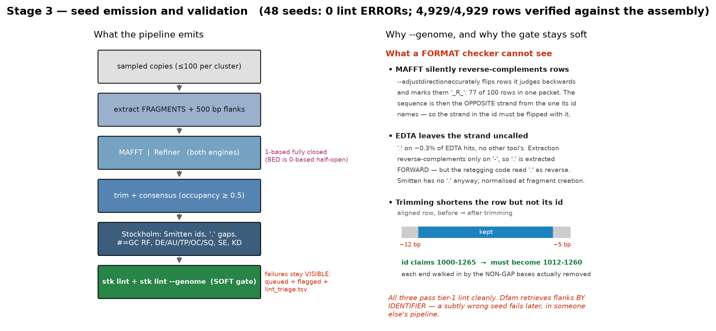
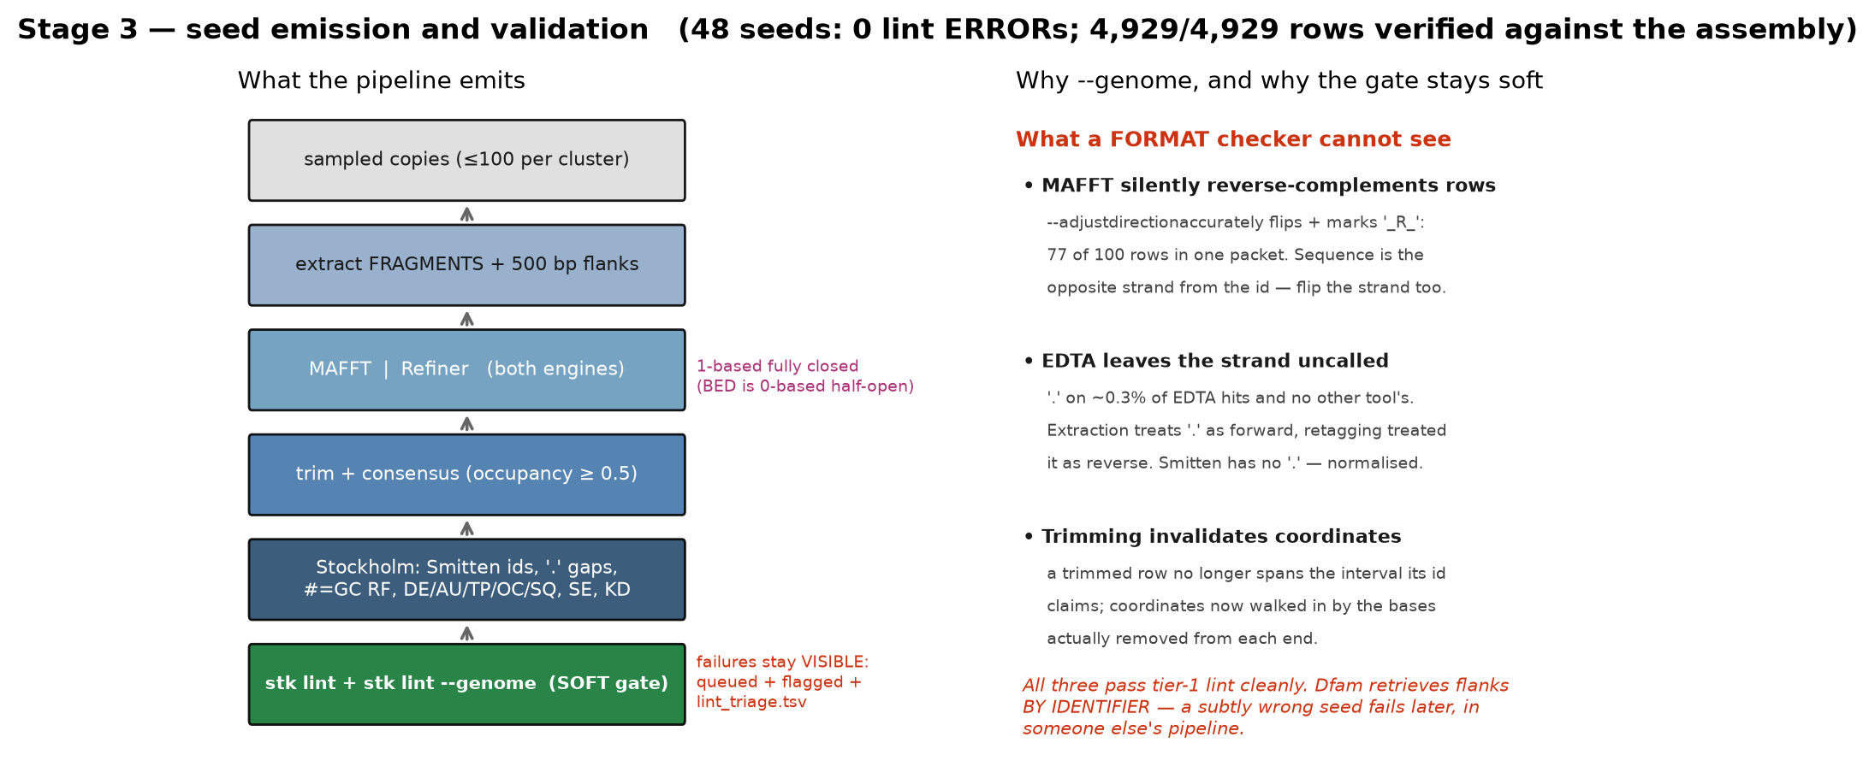
Stage 3 — seed emission, and what a format checker cannot see
48 seeds: 0 lint ERRORs, 4,929/4,929 alignment rows verified against the assembly
Notes:
THE MILESTONE THAT DE-RISKED THE PROJECT: stk lint-clean Dfam seed alignments, built from track data, validating against the assembly. 12 clusters x 2 merge modes x 2 engines = 48 seeds, 0 ERRORs at both tiers, the only remaining diagnostic being an optional orcid_missing INFO.
Note on reading the lint table: the tier-1 pass emits a WARN [genome] saying coordinates cannot be verified without an assembly — that is the checker correctly reporting what it was not given. The tier-2 pass supplies the FASTA and emits nothing but the ORCID INFO. 'ERROR=0, WARN=0' refers to the genome-validated pass.
WHY --GENOME IS NOT OPTIONAL. Three identifier-integrity bugs were caught here that every structural check missed, because each produces a seed with the correct field set, correct widths and correct gap characters while asserting coordinates whose sequence is not what sits beside them:
1. MAFFT silently reverse-complements rows. --adjustdirectionaccurately flips rows it judges backwards and marks them with an _R_ prefix: 77 of 100 rows in one packet. The sequence in a flipped row is the opposite strand from the one its identifier names, so the strand must be flipped with it.
2. EDTA leaves the strand uncalled. '.' appears on about 0.3% of EDTA hits and on no other tool's. Extraction reverse-complements only on '-', so an uncalled strand is extracted forward — but the retagging code treated '.' as reverse. Smitten has no '.' anyway; normalised where fragments are created.
3. Trimming invalidates coordinates. A trimmed row no longer contains the whole interval its identifier claims; every row's coordinates are now walked in by the number of non-gap bases actually removed from each end.
THE ARGUMENT FOR A SOFT GATE, in one sentence: Dfam's downstream TSD and extension algorithms retrieve flanking sequence BY IDENTIFIER, so a seed with subtly wrong coordinates is worse than one that fails loudly — it fails later, in someone else's pipeline. Failures stay queued, flagged, and counted in lint_triage.tsv rather than silently dropped, which is what you asked for.
Also worth knowing: the placeholder AU string 'C. Goubert, Wheeler Lab' is itself a lint ERROR (au_format rejects abbreviated first names). A spelled-out first name passes; an ORCID prefix clears the remaining INFO. That field needs settling before deposition.
Q: 'Coordinates are 1-based fully closed?' A: Yes — Dfam Smitten format. Our BED16 is 0-based half-open, so the conversion is a correctness requirement, and we verify every row against the assembly ourselves rather than relying on lint, whose coordinate checks are advisory.
CG COMMENT — FIXED both points. Arrows now point DOWN the flow (they were reversed). Trimming is now a worked example instead of prose: an aligned row loses 12 non-gap bases from its left end and 5 from its right, so an identifier claiming 1000-1265 has to become 1012-1260. The rule is that each end is walked in by the number of NON-GAP bases actually removed from that end — gap columns do not count, because they consume no genomic sequence.

Slide 13
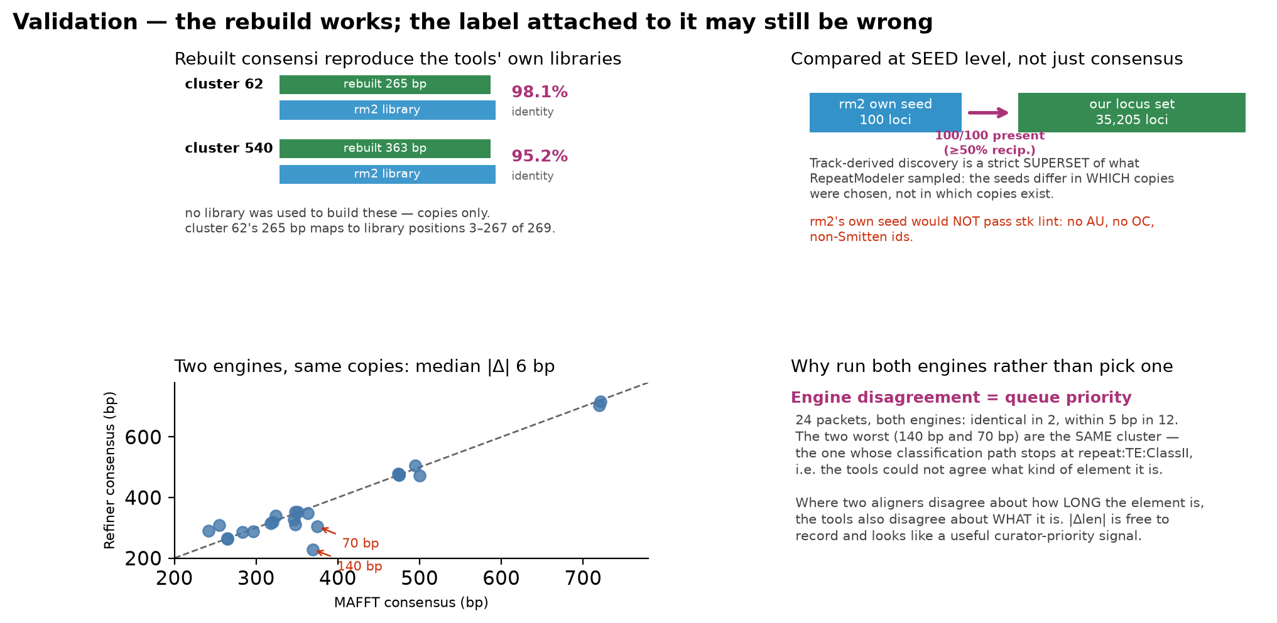
Validation — the rebuild works; the label attached to it may not
Rebuilt consensi reproduce the tools' own libraries at 95-98%, from copies alone
Notes:
THE POSITIVE RESULT: the stage-2 consensus, built from at most 100 sampled genomic copies with NO access to any tool's library, reproduces RepeatModeler2's independent consensus for the same family at 98.1% (cluster 62: 265 bp vs 269 bp) and 95.2% (cluster 540: 363 bp vs 378 bp). Not merely similar — co-terminal: cluster 62's 265 bp maps to library positions 3-267 of 269.
COMPARED AT SEED LEVEL, not just consensus. GenomeArk publishes rm2's own .stk seeds, so the comparison can be made where it matters. Its record for rnd-1_family-286 carries 100 rows with median span 265 bp — the same length we rebuild — and ALL 100 of those loci are present in our 35,205-locus set for that cluster. Track-derived discovery is a strict superset of what RepeatModeler sampled for its own seed: the two seeds differ in WHICH copies were chosen, not in which copies exist. And rm2's own seed would not pass stk lint — no AU, no OC, non-Smitten identifiers. The gap between what a tool emits and what Dfam accepts is exactly the gap this pipeline closes.
THE COUNTERWEIGHT, AND IT IS THE F2 CAVEAT MADE CONCRETE. Cluster 62's rebuilt consensus carries a terminal inverted repeat — 14 bp with one mismatch, the first 10 perfect — and is 265 bp with no coding capacity. That is a MITE, a Class II element. The cluster's member-weighted majority path is repeat:TE:ClassI:LINE:Jockey, so the emitted seed carries #=GF TP LINE/I-Jockey: a Class I label on a Class II element. The tool labels are wrong here, the pipeline faithfully propagates them into a Dfam field, and nothing in the lint chain can object — tp_unknown only checks the value exists in Dfam's vocabulary, not that it fits the sequence.
This is precisely your standing caveat that order-mixing assumes tool classifiers are correct. Three consequences worth acting on: the curator queue must show the rebuilt consensus and its structural features NEXT TO the inherited classification and treat that classification as a proposal; a TIR at both ends of a short consensus contradicts any Class I TP, which is a cheap automatic cross-check and TE-Aid already computes what is needed; and until then #=GF TP should be read as 'what the tools said' and stated that way in the packet.
WHY BOTH ENGINES. MAFFT and Refiner, given identical sampled copies, agree to a median of 6 bp (identical in 2 of 24, within 5 bp in 12). But the tail is informative: the two worst disagreements, 140 bp and 70 bp, are the SAME cluster — the one whose classification path stops at repeat:TE:ClassII, i.e. where the tools could not agree what kind of Class II element it is. Where two independent aligners disagree about how long the element is, the tools also disagree about what it is. The difference is free to record and looks like a useful queue-priority signal, worth testing against the first batch of curator verdicts.
CG COMMENT — 'very interesting signal, must be dug further and kept for the final presentation': agreed, and it is now a work item. Honest status on whether one genome suffices: at n=24 packets only 6 have |delta| > 20 bp, so the whole 'signal' group is 6 points and the apparent association with a shallow classification path rests on a single cluster. That is an anecdote, not a result. But this genome can supply much more: 763 strict candidates exist and only 12 have been built (1.6%), spread across TIR 261, LTR 220, LINE 190, plus 34 unresolved-ClassII, Helitron 26, PLE 15, DIRS 9, SINE 8. At a measured 17 s per cluster per engine pair, a 200-cluster stratified batch costs about 2 hours single-threaded and would give roughly 50 discordant packets with the classification-path depth known independently. That tests the association WITHOUT any curator verdicts. What one genome cannot do is test whether the relationship generalises across taxa, or calibrate it against actual curator effort — those need more assemblies and the first batch of decisions respectively.

Slide 14
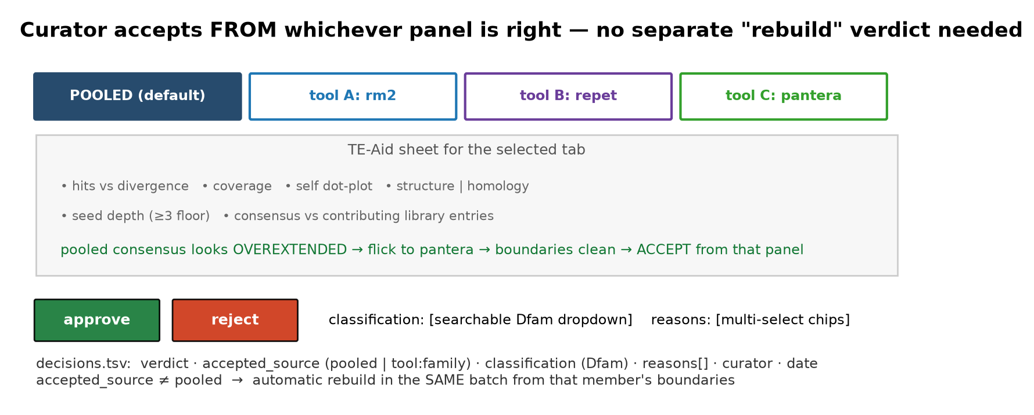
Stage 4 — curator accepts from whichever panel is right
Your refinement: no separate 'rebuild' verdict — the panel selection IS the decision
Default tab = pooled cluster consensus. Additional tabs = one TE-Aid sheet per member family, from that tool's own consensus and hits.
accepted_source records which panel was accepted; anything other than 'pooled' triggers an automatic rebuild in the same batch.
Classification is required on approval and constrained to the Dfam scheme (searchable dropdown); rejection reasons are multi-select and complementary.
Notes:
This is your simplification and it is better than rev 2's three-verdict scheme. The curator does not need to reason about 'rebuild' as a concept: they look at the pooled sheet, and if it looks overextended they flick through tool tabs until one looks right, then accept from there. The pipeline infers the rest.
accepted_source is also a measurement worth having: tallying which program most often supplies the accepted boundaries is a direct, quantitative library-building finding ('Pantera has the best boundaries on young LTR elements' becomes a number rather than an impression).
Classification constrained to the Dfam scheme gives compliance by construction — and since the Dfam scheme is currently being reconciled with Repbase as the two databases fold together, the dropdown is built from a versioned snapshot (tp_map.tsv with scheme_version), so a scheme change is a table regeneration, not a code change.
Multi-select reasons because they are genuinely complementary: 'nested_insertion + tandem_contamination + alignment_poor' is one coherent diagnosis, not three competing ones. Reason frequencies cross-tabulated against gate values are how the gates get re-calibrated after the first batch.

Slide 15
What I need from you
Your answers, and what the next iteration owes you
ALL FOUR ANSWERED · next iteration is didactic: real examples, step-by-step representative build, split slide 8
1. TP contradiction → curator decides the final label
emitted #=GF TP is a PROPOSAL; the TIR-vs-ClassI check becomes a flag beside it, never a gate
2. AU / ORCID → spelled-out name + ORCID, proceed
blocking the re-run together with the REPET libraries; documented for the next iteration
3. Structural LTR support channel → proceed as a flag, not a clustering participant
also covers EDTA-structural and LTRDeNovo per your slide-2 note: include when they overlap general-purpose clusters
4. Engine disagreement → needs more data; this genome gives partial scale
at n=24 only 6 packets are discordant — an anecdote. 763 candidates exist, 12 built (1.6%): a 200-cluster
stratified batch is ~2 h and yields ~50 discordant packets. Cross-taxon and curator calibration still need more.
Notes:
Question 1 is the only one that gates work. My recommendation is to run both because the comparison is cheap (same graph, different linkage) and the result is a reportable finding about inter-tool redundancy in its own right — it belongs in the VGP report's technical level regardless of which linkage the pipeline adopts.
Question 2 similarly: building the first batch both ways costs one extra run and settles whether gap-awareness matters in practice as much as the 63% figure suggests it should.
STATUS UPDATE: both questions on this slide are settled. Linkage — strict default with lenient run alongside (done). Fragment fill — built both ways and compared at seed level (done; see the stage 1.1 notes). What is open now is different and further downstream: whether engine disagreement predicts curator effort, whether structural LTR evidence should become a support channel rather than a clustering participant, and the au_string / ORCID fields before anything is actually deposited.
CG ANSWERS, all four recorded:
1. TP contradiction — the final label is changed according to the CURATOR decision, so #=GF TP as emitted is a proposal and the curator's classification overrides it in the deposited seed. The automatic TIR-vs-ClassI cross-check therefore becomes a FLAG shown next to the proposal, not a gate.
2. AU/ORCID — proceed with a spelled-out first name plus ORCID; document in the slides for the next iteration.
3. Structural LTR support channel — makes sense, proceed (see slide 2 notes for the measured effect).
4. Engine disagreement — needs more data; the question of whether one genome suffices is answered in the validation-slide notes (partly: 763 candidates give internal scale, but cross-taxon generalisation and curator calibration need more).

