Slide 1
REPRODUCIBILITY & EXTENSION CHALLENGE · DEEP LEARNING FOR NLP
Reproducing TinyStories
How small can a language model be and still tell a coherent story?
Eldan & Li (2023), Microsoft Research — reproduced & extended
WHAT WE DID
EXTENSION
REPOSITORY
Trained 5 GPT models (1M–56M), ran GPT-4 evaluation & memorization analysis
Our own modern GPT: Differential Transformer + Grouped-Query Attention
github.com/clemhut/tinystories
Group presentation · 29–30 June 2026

Slide 2
ROADMAP
How this talk is structured
1
2
3
4
5
Introduction
Understanding
Reproduction
Extension
Conclusion
The paper and its key contributions
Dataset, models and the GPT-Eval idea
5 models, GPT-4 grading, memorization
Our own GPT: Diff-Transformer + GQA
Reproducibility verdict & future work
Reproducing TinyStories · DLNLP Reproducibility & Extension Challenge
2

Slide 3
1 · INTRODUCTION
The paper & its key contributions
TinyStories is a synthetic dataset of short children's stories — written by GPT-3.5/4 using only words a 3–4-year-old understands. It asks the following question: do we need billions of parameters for fluent, coherent English, or is the data distribution the real bottleneck?
A purpose-built dataset
Stories constrained to a toddler-level vocabulary, diverse yet simple enough for tiny models to actually master.
Tiny models, real fluency
Models far below 10M parameters — even very shallow ones — generate grammatical, on-topic, multi-sentence stories.
THE CENTRAL RESULT
Quality is mostly a data problem.
Trained on the right distribution, models 100–1000× smaller than GPT-2 still produce consistent, creative, grammatical stories — and scale up gracefully.
GPT-4 as evaluator
Standard metrics miss coherence; instead GPT-4 grades grammar, creativity & consistency of open-ended completions.
A lab for emergence
Small scale makes capabilities — and how they appear with size/depth — interpretable and cheap to study.
Reproducing TinyStories · DLNLP Reproducibility & Extension Challenge
3

Slide 4
2 · UNDERSTANDING
Core concepts: data, model, evaluation
§
The dataset
❖
The model
★
The evaluation
Short, self-contained stories using a small, child-level vocabulary
Generated by GPT-3.5/4 with prompts that inject random words & features for diversity
In-distribution & learnable — the key enabler for tiny models
Plain GPT-style decoder-only transformers
Scaled along two axes: width (parameters) and depth (layers)
Trained with next-token prediction on the story corpus
BLEU / perplexity don't capture story coherence
Feed prompt beginnings → let the model complete the story
GPT-4 grades the completion like a teacher grading a pupil
Why it matters: this turns language-model behaviour into something you can study on a single GPU — and grade objectively enough to compare model sizes.
Reproducing TinyStories · DLNLP Reproducibility & Extension Challenge
4

Slide 5
2 · UNDERSTANDING
The GPT-Eval protocol & the claims we test
THE GPT-EVAL PIPELINE
THE THREE CLAIMS WE REPRODUCE
1
Prompt beginnings
Bigger → more coherent
C1
Hand-written story openings (50 prompts)
Larger models produce more consistent story continuations than smaller ones.
▼
2
Generate
10 completions per prompt at temperature 1.0
Grammar comes first
C2
Very small models write grammatically before they master consistency or creativity.
▼
3
GPT-4 grades
Grammar · Creativity · Consistency · Plot + age guess
Not memorized
C3
Continuations are genuinely generated, not copied from the training stories.
Reproducing TinyStories · DLNLP Reproducibility & Extension Challenge
5

Slide 6
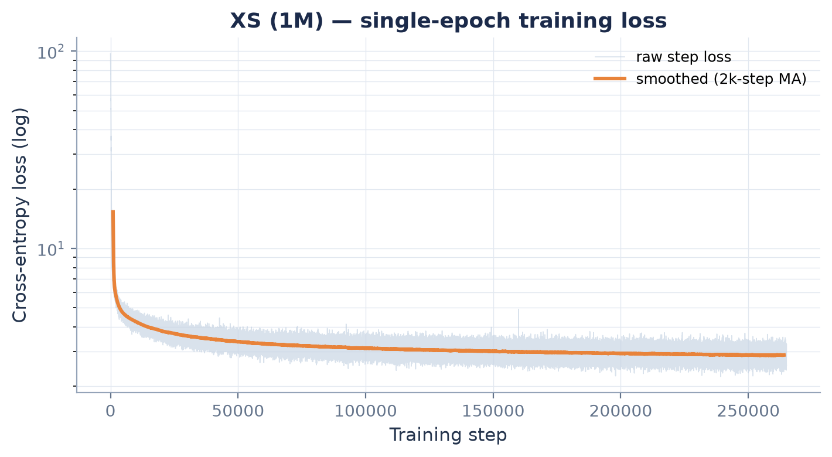
3 · REPRODUCTION
Experimental setup
FIVE MODELS — SCALING WIDTH & DEPTH
Model | Params | d_model | Layers
XS | 1.2M | 96 | 3
Small | 3.0M | 128 | 7
Medium | 9.8M | 224 | 10
Large | 28.7M | 512 | 10
XL | 56.2M | 544 | 12
Training converges within one epoch
All five trained for one epoch on TinyStories-train; 10k-token vocabulary, 512-token context.
10k
512
50×10
1
Loss falls from ~97 → 2.2 (cross-entropy over 10k vocab). All sizes follow the same shape; XS shown as representative.
vocab
context
eval samples
epoch
Reproducing TinyStories · DLNLP Reproducibility & Extension Challenge
6

Slide 7
3 · REPRODUCTION — CLAIM 1
Bigger models tell more coherent stories
INTERPRETATION
Consistency rises monotonically
4.1 → 7.6
mean consistency, XS → XL (+86%)
Every metric improves with scale — and the steepest gains are in consistency and plot sense, exactly the higher-order story skills.
✓ Claim 1 reproduced.
Reproducing TinyStories · DLNLP Reproducibility & Extension Challenge
7

Slide 8
3 · REPRODUCTION — CLAIM 2
Grammar emerges before consistency & plot
INTERPRETATION
Grammar leads, plot lags
At XS, grammar already scores 5.1 while plot sense sits at just 3.1.
Grammar − consistency gap
XS: 1.08
XL: 0.16
The gap shrinks 7× — smaller models keep grammar but lose the higher-order skills. ✓ Claim 2 reproduced.
Reproducing TinyStories · DLNLP Reproducibility & Extension Challenge
8

Slide 9
3 · REPRODUCTION — CLAIM 3
Outputs are generated, not memorized
INTERPRETATION
No memorization signal
Absolute overlap is ~99% against both train and valid — expected, since common short character strings saturate over millions of stories.
The honest test is the train−valid gap: a memorizing model would echo training stories far more. Instead the gap stays below 0.5 pp and never grows with size.
✓ Claim 3 reproduced.
Reproducing TinyStories · DLNLP Reproducibility & Extension Challenge
9

Slide 10
3 · REPRODUCTION
What the numbers look like — XS vs. XL
Prompt: “Once upon a time, there was a little girl named Lucy. She was very adventurous. One day, she found …”
XS · 1M
XL · 56M
“… a big, scary cat. The cat was very happy. The cat was very happy. The cat was very happy. The cat was very happy. The cat was happy to have a friend. The cat was happy.”
“… a big box in her room. She wanted to see what was inside. Lucy tried to open the box, but it was locked. She asked her mom for help. Her mom said, ‘I will help you, but first you must promise to be careful.’ Lucy promised …”
grammar 5 consistency 2 plot 2
grammar 10 consistency 10 plot 7
Same prompt, same decoding. XS collapses into a repetition loop; XL introduces a goal, a problem (locked box), dialogue and a resolution.
Reproducing TinyStories · DLNLP Reproducibility & Extension Challenge
10

Slide 11
3 · REPRODUCTION
Challenges & design decisions
!
Paper gives few exact configs
!
GPT-4 grading is costly & noisy
We chose our own width/depth ladder to hit 1M–56M targets, and matched the paper's eval protocol (50 prompts × 10 samples, temp 1).
Scores vary run-to-run; we average over 50 prompts per model and report means to keep the comparison stable.
!
A useful memorization metric
!
Compute budget
Char 6-gram overlap saturates near 100% on a huge corpus. We shifted to the train−valid gap, which is the signal that actually distinguishes memorization.
One epoch per model on a single machine; sufficient to reproduce the qualitative trends without the paper's full training run.
Reproducing TinyStories · DLNLP Reproducibility & Extension Challenge
11

Slide 12
4 · EXTENSION
We built our own modern GPT
Rather than reuse nanoGPT, we implemented the whole transformer ourselves — and the same code is the backbone for all five reproduced models. It pairs two recent ideas for quality and efficiency:
DECODER BLOCK (×N layers)
Token embedding (tied)
Differential Attention
RMSNorm
Two softmax maps subtracted (λ-weighted) to cancel attention noise and sharpen focus on relevant tokens — the DIFF Transformer idea.
Differential Attention + GQA + RoPE
⊕ residual
Grouped-Query Attention
RMSNorm
Query heads share a smaller set of key/value heads, cutting KV memory & compute for cheaper, faster inference.
SwiGLU feed-forward
⊕ residual
Modern building blocks
RoPE positional encoding · RMSNorm (pre-norm) · SwiGLU feed-forward · weight-tied embedding & LM head.
LM head (weight-tied)
Reproducing TinyStories · DLNLP Reproducibility & Extension Challenge
12

Slide 13
4 · EXTENSION
Motivation & outcome
WHY BUILD IT OURSELVES
Deeper understanding — implementing attention, RoPE and normalization end-to-end forces real understanding of the architecture the paper takes for granted.
A stronger reproduction — TinyStories used a vanilla GPT; we test whether the same conclusions hold on a more modern backbone.
Efficiency — GQA shrinks the KV cache and Differential Attention improves the signal-to-noise of attention, both attractive at the tiny-model scale.
OUTCOME
The paper's conclusions hold on a modern architecture
✓
All three claims reproduced
Scaling, grammar-first emergence and no-memorization all appear with Diff-Transformer + GQA.
✓
Clean training
Stable single-epoch convergence across 1M–56M with weight tying and pre-norm RMSNorm.
✓
Efficiency by design
GQA halves KV heads (n_kv = n_heads / 2) with no loss of story quality at this scale.
Reproducing TinyStories · DLNLP Reproducibility & Extension Challenge
13

Slide 14
5 · CONCLUSION
Findings & reproducibility verdict
✓ C1 Scale → coherence
✓ C2 Grammar first
✓ C3 Not memorized
Consistency 4.1 → 7.6 across XS→XL
Grammar−plot gap shrinks 7× with size
Train−valid overlap gap < 0.5 pp
Verdict: TinyStories reproduces cleanly. All three target claims hold — and they survive being ported onto a Differential-Transformer + GQA backbone we built from scratch.
FUTURE WORK
Probe depth vs. width directly, as in the paper's layer ablations
Add an instruct/feature-controlled split (TinyStories-Instruct)
Ablate Differential Attention & GQA against a vanilla baseline
14

Slide 15
Thank you
Reproducing & extending TinyStories — questions welcome.
⌥
github.com/clemhut/tinystories
Paper: Eldan & Li (2023), “TinyStories: How Small Can Language Models Be and Still Speak Coherent English?”

