Slide 1
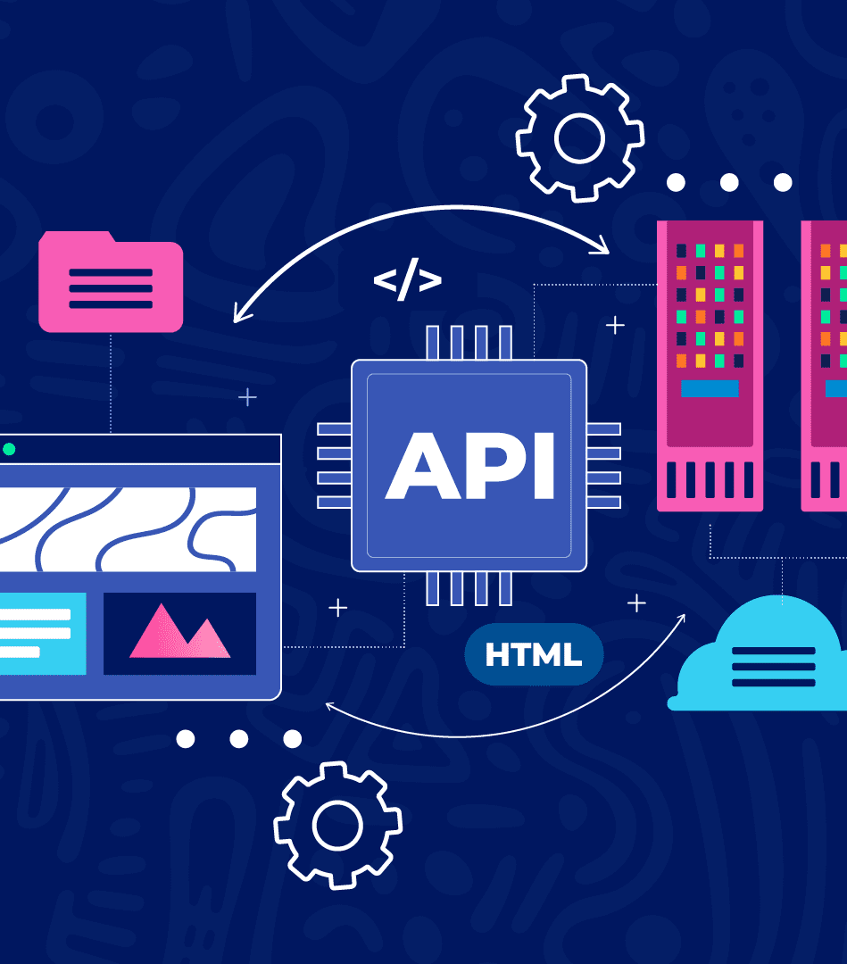
API Intelligence Plane Integration Bobathon Winner Idea (Mar 2026)

Slide 2
Overview
API Control Intelligence Plane
AI-driven
Real-time findings and remediations
Proactive, Autonomous
Vendor-neutral
MCP – Agentic Interface

Slide 3
Features
Autonomous API Discovery
Predictive Health Management
Security Scanning
Real-time Performance Optimization
Compliance Scanning and Reports
Natural Language Interface
MCP Interface

Slide 4
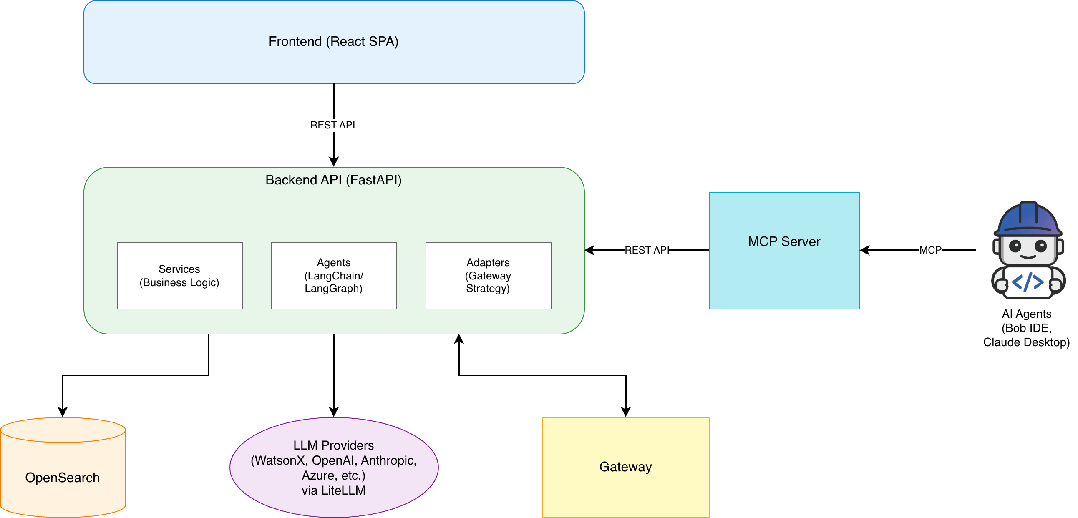
Architecture

Slide 5
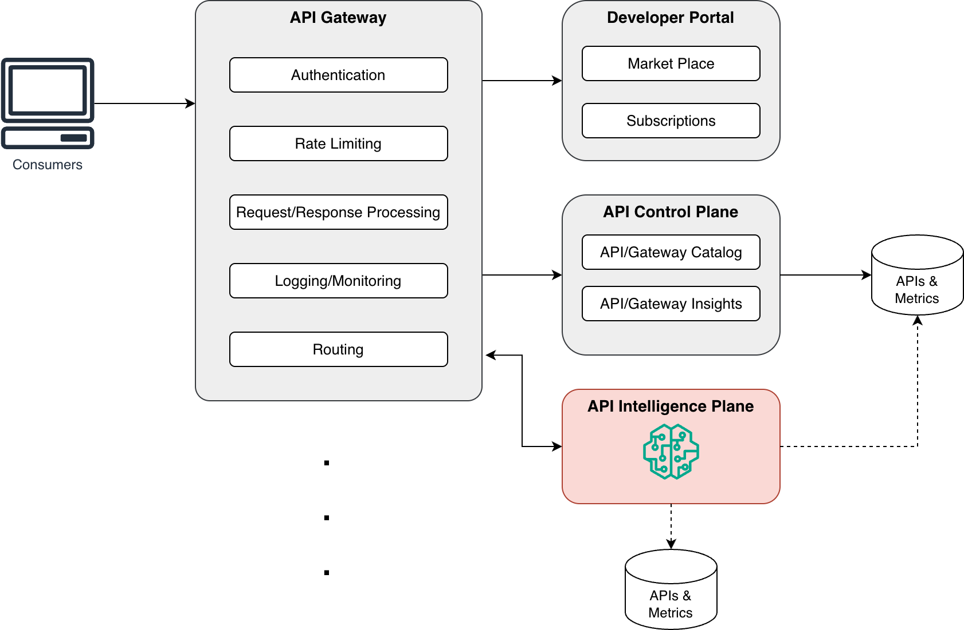
Positioning in IBM API Connect

Slide 6

Autonomous API Discovery
Vendor-neutral
Gateway Registration
API Discovery
Metrics Collection
Shadow API
Health Score

Slide 7

Predictive Health Management
24 – 48 Hours Window
Failure, Degradation, Security, Capacity
Rule Based + AI Powered

Slide 8
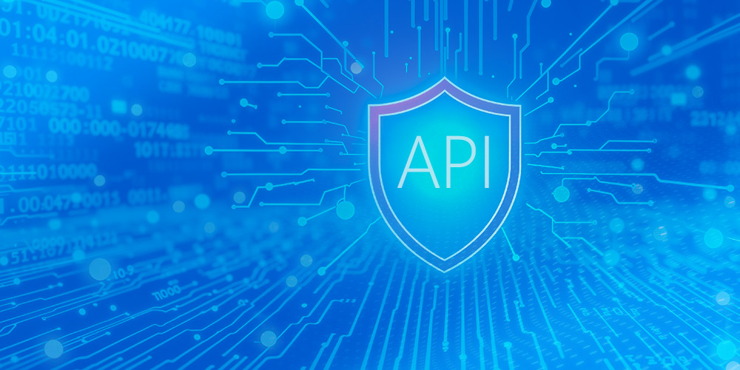
Security Scanning
Vulnerabilities Detection
Authentication, Authorization, Injection, Data Protection, Rate Limiting, TLS, CORS, Input Validation
Remediation - Applying policy to Gateway
Rule Based + AI Powered

Slide 9

Performance Optimization
Caching, Rate Limiting, Compression
Remediation - Applying policy to Gateway
Rule Based + AI Powered

Slide 10
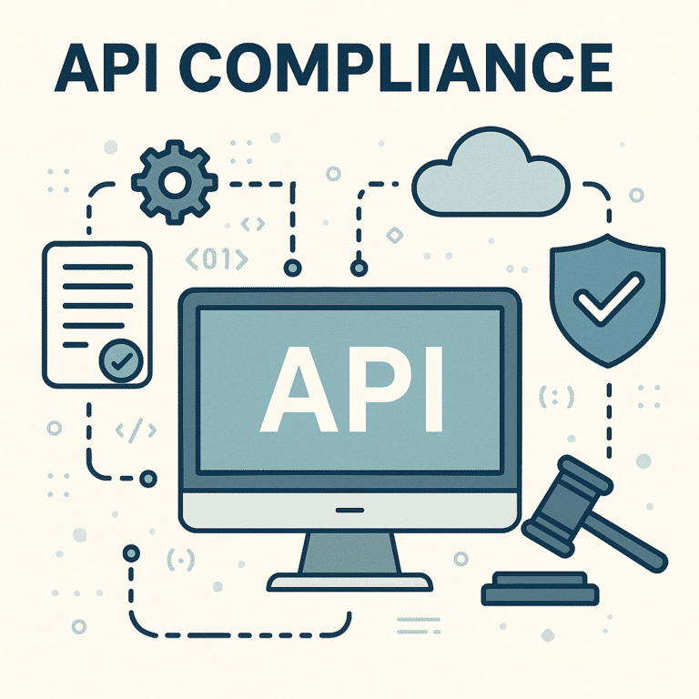
Compliance Scanning
Violations across regulatory standards
GDPR, HIPAA, SOC2, PCI_DSS, ISO_27001
Rule Based + AI Powered
Automatic Report Generation

Slide 11

Natural Language Interface
Intent Generation
OpenSearch query generation
Natural language response
Schema matching + Agentic
Context Preservation

Slide 12
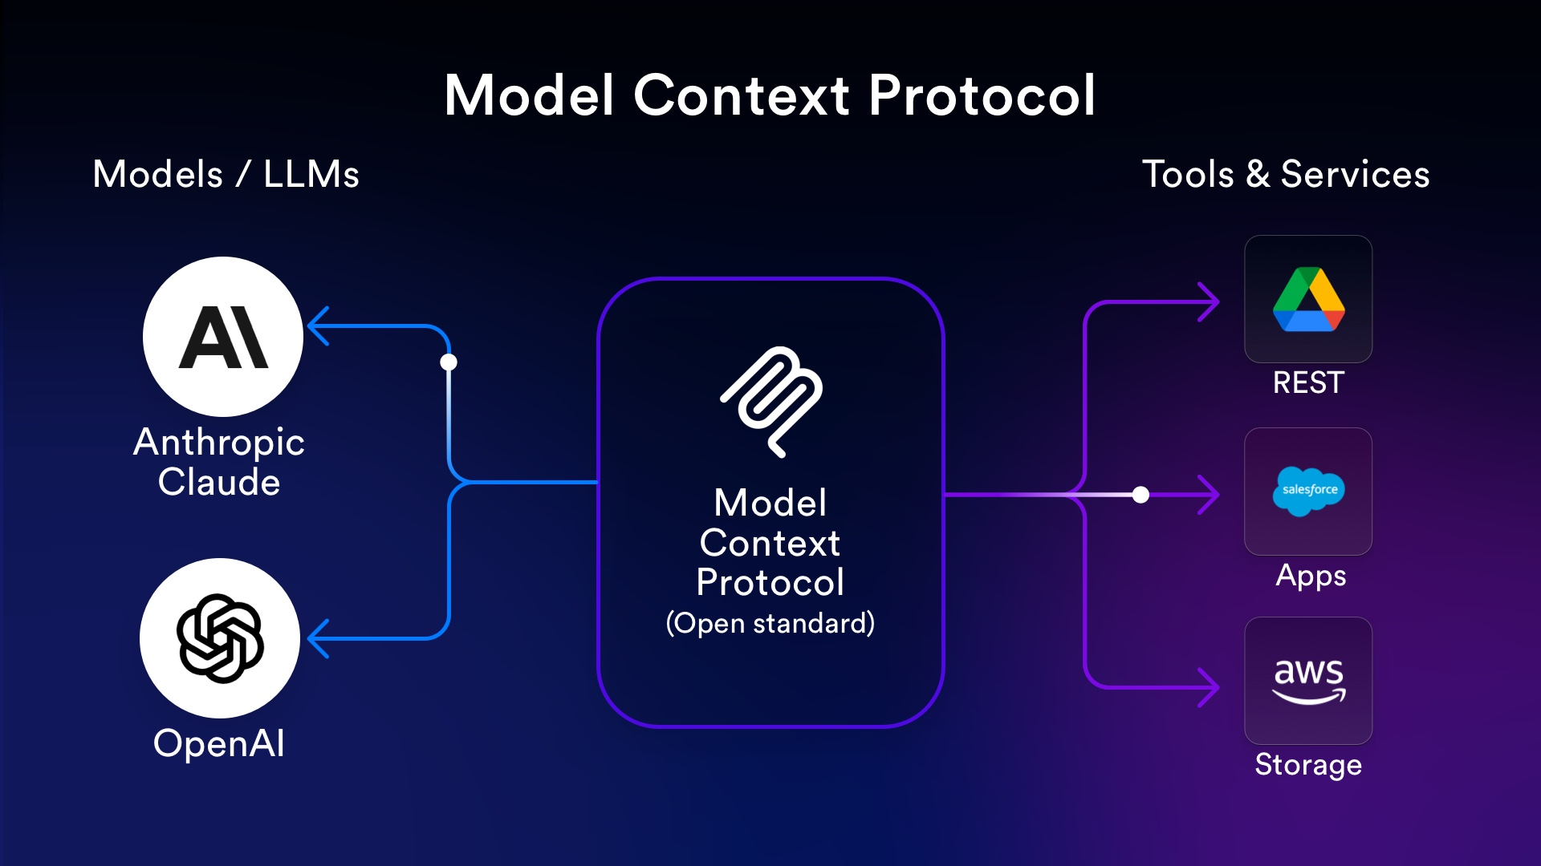
MCP Interface
API Endpoints as MCP Tools
For Agentic Clients

Slide 13
Gaps
Full API Policies coverage
More API vendors support (IBM API Connect, Apigee, Kong, etc.)
Remediation for Predications and Compliance Violations
Natural Language Interface to be completely Agentic

Slide 14

Demo

