Slide 1
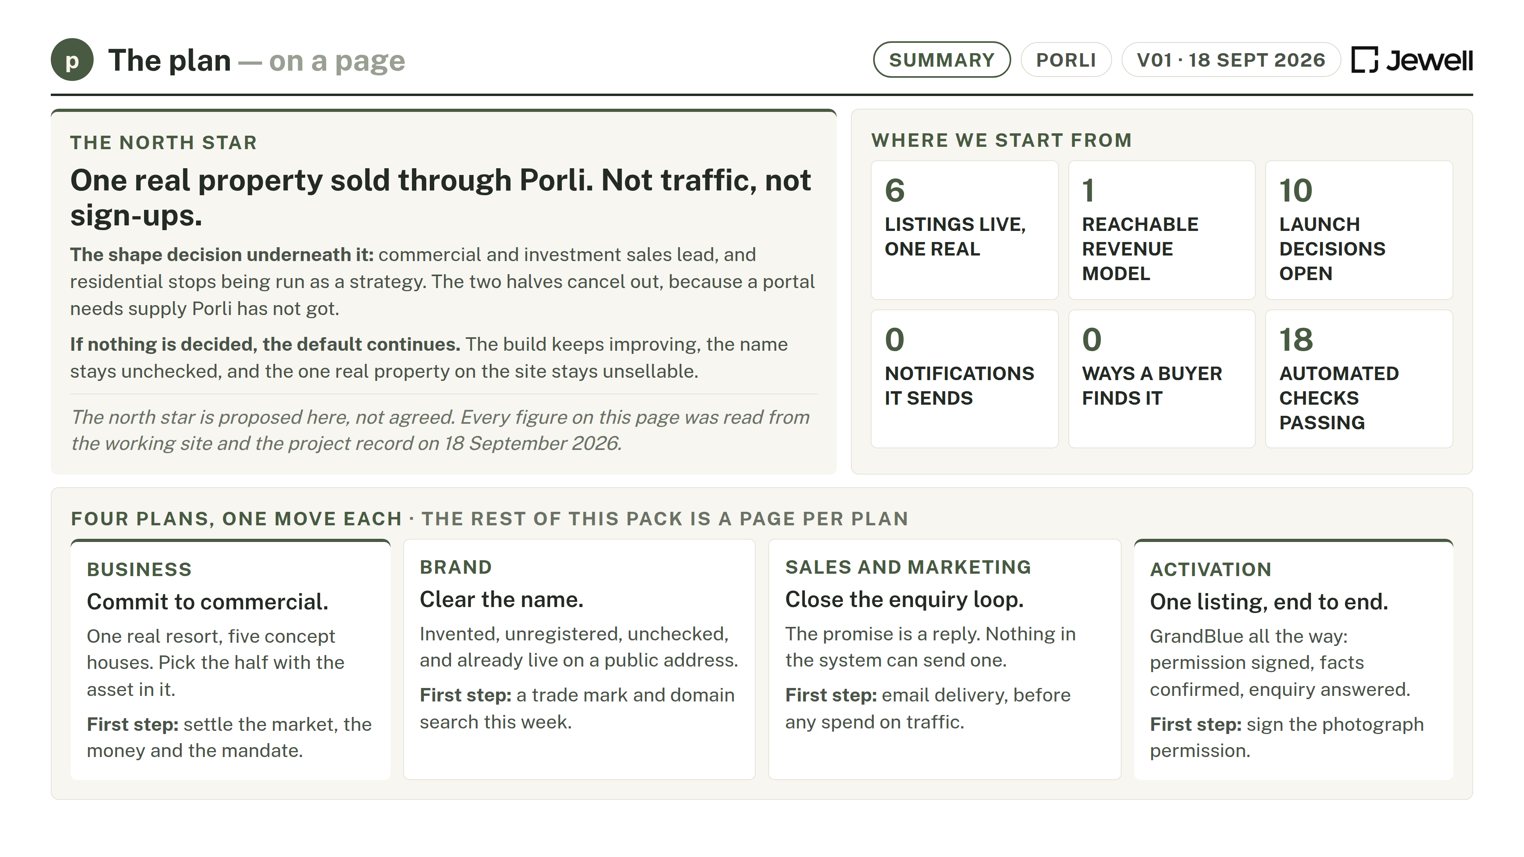
Notes:
Summary. Figures read from the working site and the project record, not supplied.

Slide 2
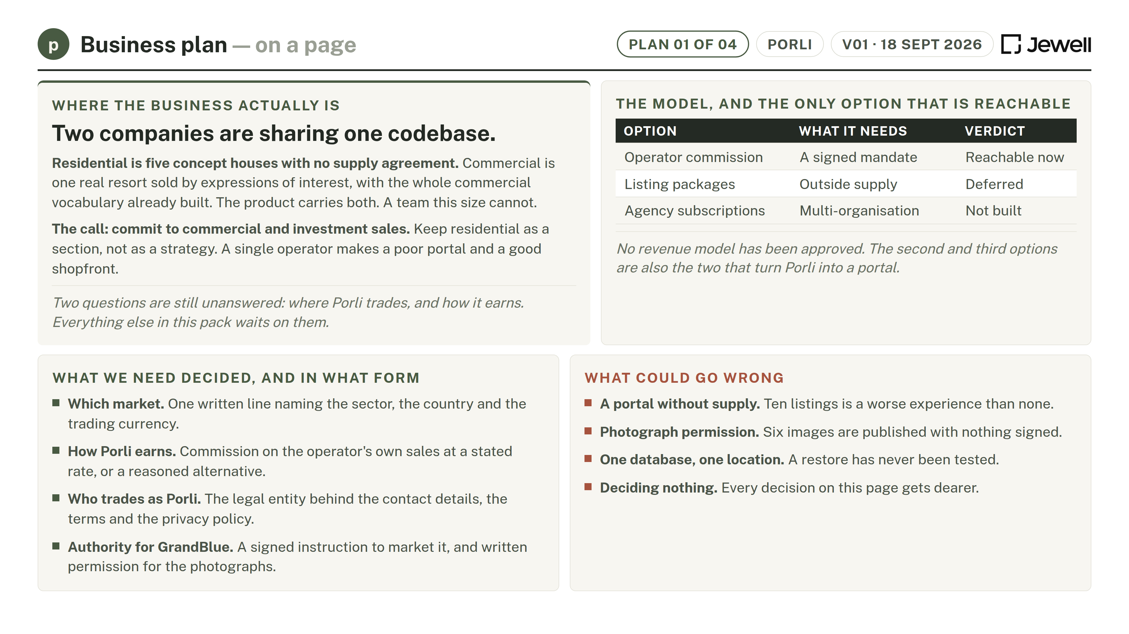
Notes:
Business plan. The shape decision, and the only revenue model reachable with what is built.

Slide 3
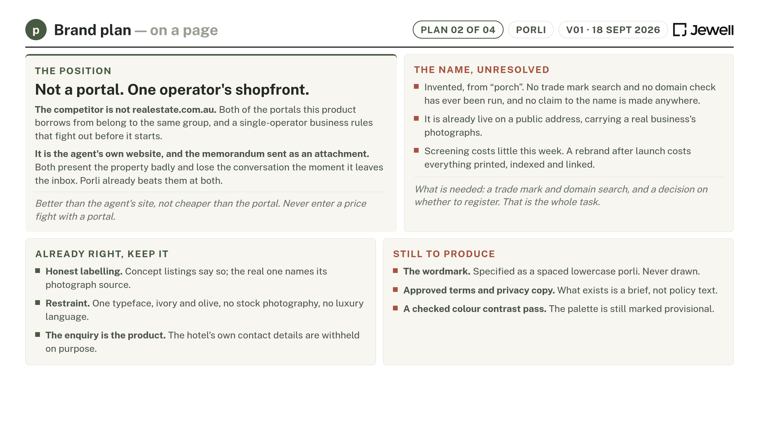
Notes:
Brand plan. Position as one operator's shopfront, and the unchecked name.

Slide 4
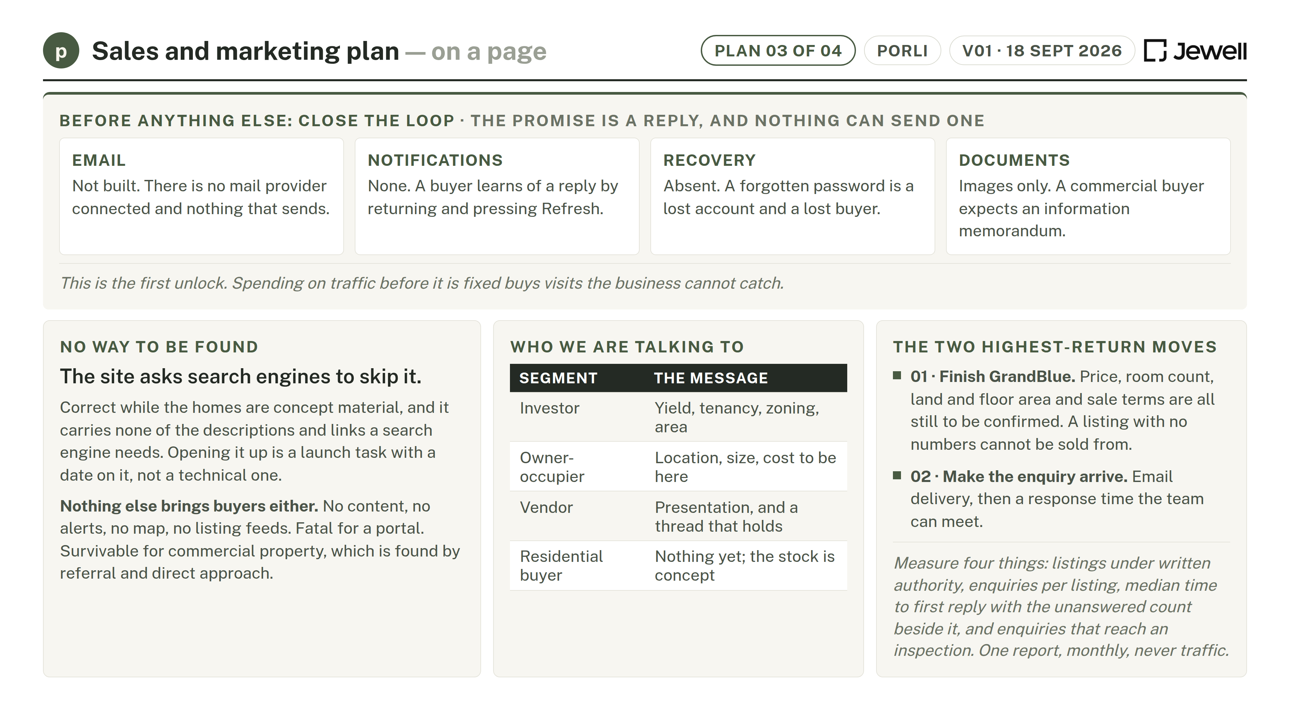
Notes:
Sales and marketing plan. Close the enquiry loop before any spend on traffic.

Slide 5
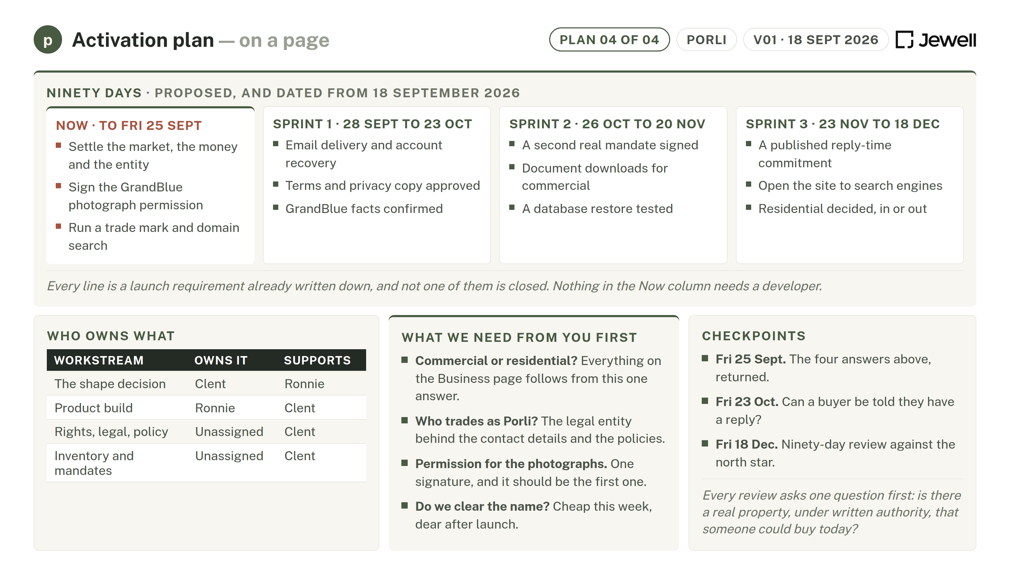
Notes:
Activation plan. Ninety days, owners, and what we need from the client first.

