Slide 1
DORMATHON 2026 · TRACK 2
SIMULATED HISTORICAL DATA
AGENTIC SOLUTIONS
GenBuddy
AI-Powered Backup Generator
Maintenance Assistant
Turn generator telemetry, ATS events, and maintenance records
into actionable readiness assessments — with a WorkBuddy AI agent
that plans, investigates, and reasons on its own.
356
3
7
13
Dataset records
AI investigations
Agent reports
Planned steps (Inv 1)
DORMATHON 2026 · Track 2: Agentic Solutions
01 / 10

Slide 2
02 / BUSINESS PROBLEM
A dark building is the first sign of trouble
What can go wrong between quarterly inspections?
ILLUSTRATIVE SCENARIO
Neighborhood Supermarket
!
Generator fails to start
A 250 m² store with two refrigerator cases, six freezer units, and a small backup generator in the back.
No on-site electrician. Visual inspections every quarter. ATS assumed to work.
Battery, fuel, or controller fault. Discovered only during the outage.
→
Generator starts but ATS does not transfer
Contactor or sensor fault. Generator runs but the building stays dark.
~
Generator overheats under sustained load
Marginal cooling capacity. Shuts down mid-outage.
THE GAP
0
0
SMEs have generators. They don't have engineers to interpret what the telemetry is telling them.
Telemetry reviews
ATS load tests
GenBuddy · DORMATHON 2026 · Track 2: Agentic Solutions
02 / 10

Slide 3
03 / OUR SOLUTION
GenBuddy turns raw signals into readiness and action
1
INPUTS
2
AI INVESTIGATION
3
OUTPUTS
Existing generator data
WorkBuddy LLM agent
Actionable insights
· Telemetry (176 records, 13 params)
→
· Plans a multi-step investigation
→
· Readiness verdict (READY / NOT READY)
· ATS event log (176 records)
· Runs engineering tools
· Prioritized work orders
· Maintenance history (4 records)
· Reads raw data independently
· Root-cause timelines
· Reasons about uncertainties
· Contractor briefings
· Writes structured reports
BUSINESS OUTCOME
A small business owner asks a plain-English question, and the agent returns a prioritized maintenance plan with evidence — ready for a qualified specialist to act on.
GenBuddy · DORMATHON 2026 · Track 2: Agentic Solutions
03 / 10

Slide 4
04 / ARCHITECTURE
System architecture: deterministic engineering meets AI reasoning
E
DETERMINISTIC ENGINEERING
AI
WORKBUDDY LLM AGENT
Flask Dashboard
Plan
app.py · 12 API endpoints · templates/index.html
Builds a multi-step plan before executing
Engineering Scripts
Execute Tools
validate_data.py (13 checks) · fault_investigation.py
Runs scripts, reads CSVs, queries API
CSV Data Sources
Reason
generator_data.csv · ats_events.csv · maintenance_history.csv
Distinguishes observed facts from suspected causes
Request / Output
Write Reports
JSON files in requests/ · reports in outputs/
Outputs structured Markdown files for review
✓ Reproducible · testable · version-controlled
✓ Adaptive · investigative · auditable
FLOW
→
FILE
→
MANUAL
→
AGENT
→
OUTPUT
User question
JSON request
Paste to WorkBuddy
Plan + investigate
Reports in dashboard
GenBuddy · DORMATHON 2026 · Track 2: Agentic Solutions
04 / 10

Slide 5
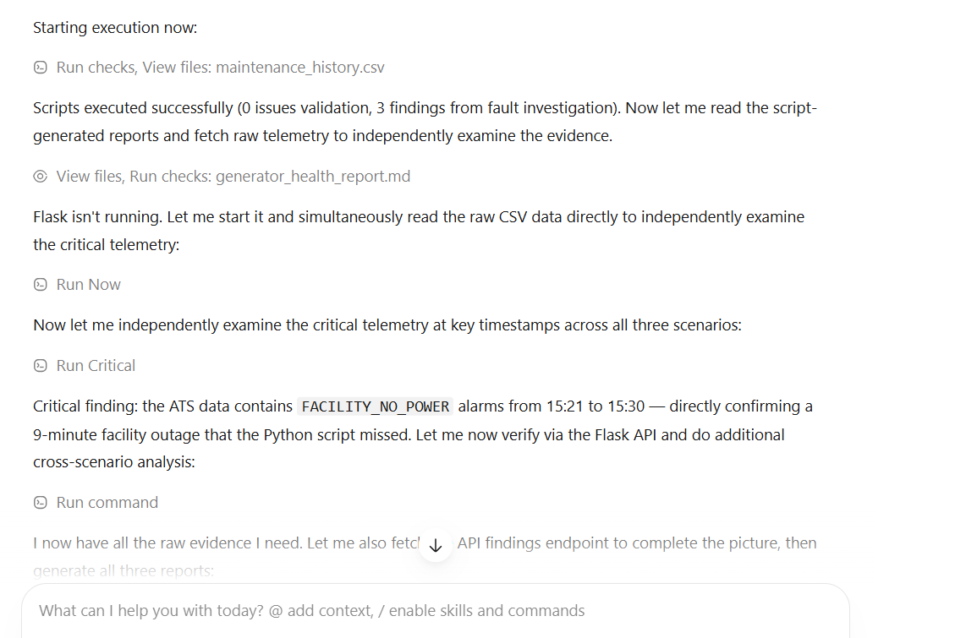
05 / AGENTIC WORKFLOW
One prompt, one goal, end-to-end execution
AGENT LOOP
1
2
3
4
5
Plan
Execute
Check
Reason
Report
Build multi-step plan before any tool runs
Run validation, scripts, reads, API
Verify evidence against script findings
Distinguish observed vs suspected causes
Write structured deliverables
PROOF: 13-STEP PLAN (INVESTIGATION 1)
WORKBUDDY AGENT IN ACTION
1. Run validation script
2. Run fault investigation
3. Read script reports
4. Read maintenance history
SCREENSHOT PLACEHOLDER
5. Read generator specs
WorkBuddy showing 13-step plan
or tool execution (e.g. validate_data.py)
6. Read CSV data independently
7. Query Flask API for cross-verification
8. Examine 12 critical timestamps
9. Examine full thermal progression
10. Examine full ATS failure sequence
11. Cross-scenario comparison
Python scripts
12. Battery / fuel health
validate_data.py · fault_investigation.py
13. Synthesize findings
Direct CSV reads + Flask API queries
independent verification + cross-check
Report writes
7 AI reports · Markdown deliverables
13
20
3
7
planned steps (Inv 1)
tool calls (Inv 1)
investigations
AI-generated reports
GenBuddy · DORMATHON 2026 · Track 2: Agentic Solutions
05 / 10

Slide 6
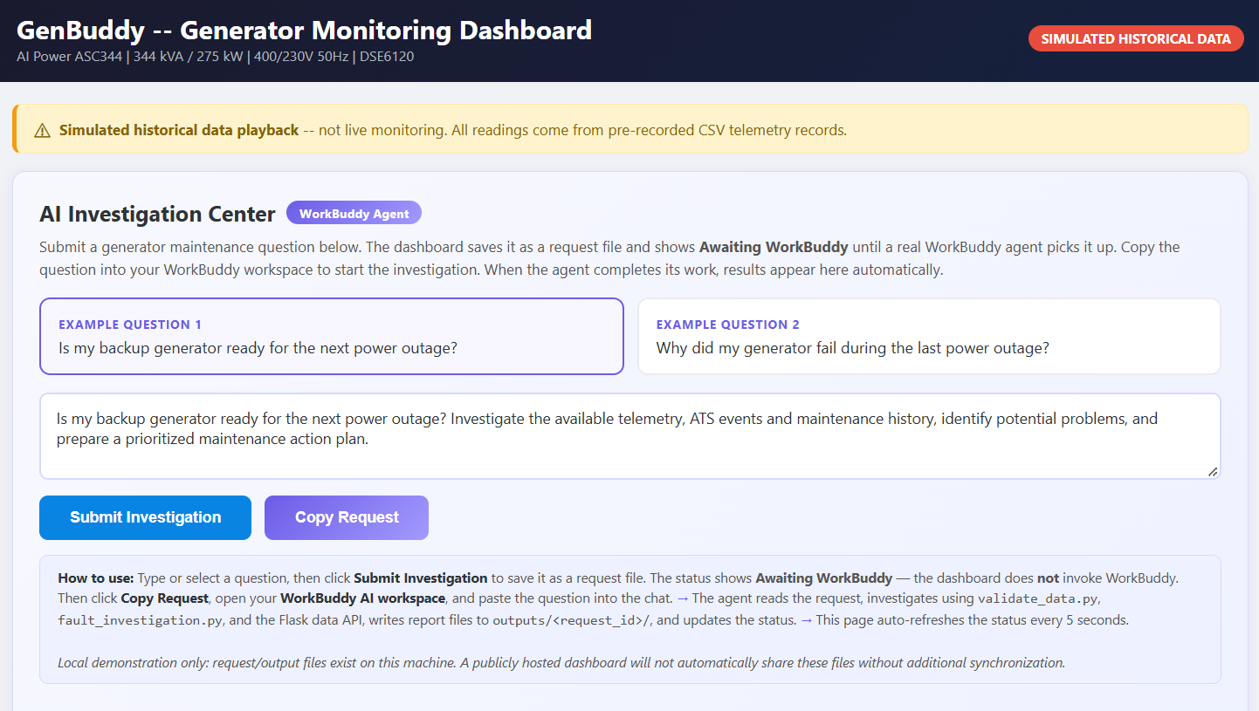
06 / PRODUCT DEMO
The GenBuddy AI Investigation Center
A Flask dashboard where SMEs submit plain-English questions and read the agent's structured reports.
EXAMPLE QUESTIONS
What users actually ask
Is my backup generator ready for the next power outage?
INV 1 · READINESS
Why did my generator shut down during last week's outage?
INV 2 · ROOT CAUSE
SCREENSHOT PLACEHOLDER
What should I tell my maintenance contractor to fix?
INV 2 · CONTRACTOR BRIEF
GenBuddy AI Investigation Center
Re-verify the readiness assessment end-to-end.
Capture from running dashboard showing:
· User input textarea + example questions
· Investigation status (awaiting → completed)
· Agent report output (verdict, work orders)
INV 3 · AUDIT
WHAT THE DASHBOARD DOES
Saves question to JSON · tracks status (awaiting → investigating → completed) · auto-polls every 5s · displays agent reports.
GenBuddy · DORMATHON 2026 · Track 2: Agentic Solutions
06 / 10

Slide 7
07 / INVESTIGATION RESULTS
The agent found two real problems hiding in the data
SIMULATED DAY 2026-06-01 · THREE SCENARIOS · ALL DATA SIMULATED
✓
Scenario A · 08:15
!
Scenario B · 11:15
×
Scenario C · 15:08
Normal Operation
Overheating
ATS Transfer Anomaly
WO-01 · CRITICAL
WO-02 · HIGH
WO-03 · INFO
ATS Transfer Anomaly
Cooling System Margin
Continue Scheduled Maint.
OBSERVED: 11 FAILED transfers in a row
OBSERVED: coolant 44.8 → 107.7°C at 70% load
VERDICT: engine & alternator healthy
OBSERVED: 0A current, position mismatch
OBSERVED: oil 4.54 → 3.16 bar
FUEL: 31.2 L/h matches spec
SUSPECTED: contactor / actuator fault
SUSPECTED: blocked radiator / coolant aging
BATTERY: 24.27–28.04V healthy
⚠ Simulated data; outage duration inferred from alarm field, not independently measured
⚠ 105/107°C thresholds are simulation assumptions
+ add functional load tests to next service
CRITICAL
HIGH
VERDICT
1 unresolved
1 unresolved
NOT READY FOR SERVICE
GenBuddy · DORMATHON 2026 · Track 2: Agentic Solutions
07 / 10

Slide 8
08 / DYNAMIC AI PLANNING
The agent did NOT reuse the same plan for both investigations
1
INVESTIGATION 1
2
INVESTIGATION 2
Readiness Assessment
Root Cause Analysis
"Is my backup generator ready for the next power outage?"
"Why did my generator shut down during last week's outage?"
Question type
Forward-looking
Question type
Backward-looking
Planned steps
13 steps
Planned steps
8 steps (simplified)
Data scope
All 356 records, 3 scenarios
Data scope
92 records, failure window only
Tools
Scripts + API + direct CSV reads
Tools
Scripts + direct CSV reads (no API)
Analysis method
Cross-scenario comparison
Analysis method
Timeline reconstruction
Deliverable
Prioritized work orders
Deliverable
Contractor briefing
Maintenance angle
"Was it serviced recently?"
Maintenance angle
"Was the service adequate?"
Key finding: 9.8 percentage points more rated loading → 22.8°C higher temperature
Key finding: 0A current + 11 transfers = unsuccessful transfer
WHAT CHANGED — 7 DIMENSIONS OF ADAPTATION
Plan count
Data scope
Tool choice
Method
Format
Audience
Question framing
GenBuddy · DORMATHON 2026 · Track 2: Agentic Solutions
08 / 10

Slide 9
09 / VALUE & LIMITATIONS
What we proved — and what we didn't
VERIFIED PROTOTYPE RESULTS
HONEST LIMITATIONS
What GenBuddy could do
What we did not prove
+
Translate telemetry into plain-English flags
!
No physical equipment connection
"11 failed ATS transfers" + "0A load current" → flagged for specialist investigation.
All data is simulated. DSE6120 thresholds are UNVERIFIED.
+
Prioritize maintenance by business impact
!
No validated real-world cost savings
CRITICAL · HIGH · INFORMATIONAL tags based on actual failure modes.
No customer case studies; no measured downtime reduction.
+
Speak contractor fluently
!
Manual WorkBuddy triggering
Generates plain-language briefings with specific check instructions.
User copies question from dashboard to WorkBuddy. No direct API.
+
Reason across scenarios
!
Single-user, local runtime
Cross-scenario comparison that fixed-temperature scripts cannot do.
File-based request system. No auth, no multi-user isolation.
+
Self-correct during investigation
!
Open investigation topics remain
Agent fixed a temperature rise rate error in 3 report files.
DSE6120 thresholds · ambient temp · ATS manufacturer specs.
TRACK 2 PRINCIPLE
Show genuine WorkBuddy usage, not marketing claims.
GenBuddy · DORMATHON 2026 · Track 2: Agentic Solutions
09 / 10

Slide 10
10 / CONCLUSION
GenBuddy = a backup generator that thinks with you
01
02
03
Plans before acting
Reasons, not just matches
Adapts per question
The agent builds a multi-step plan, then executes tools and reads evidence independently.
Cross-scenario thermal comparison and timeline reconstruction go beyond pattern matching.
Different plans, tools, scopes, and deliverables for readiness vs root cause investigations.
DEMO ACCESS · PLACEHOLDERS
GITHUB
DEPLOYED APP
https://github.com/cleo-blayea/Dormathon_Hackathon_Cleo.git
http://127.0.0.1:5000/
Thank you.
Questions welcome. All evidence files are open in the repo: docs/workbuddy_usage_evidence.md · reports/ai_*.md
GenBuddy · DORMATHON 2026 · Track 2: Agentic Solutions
10 / 10

