Slide 1
CS6460 Milestone 1
Cleo Zhang
yzhang3761@gmail.com

Slide 2
Overview
Goals:
To demonstrate the progress I have made so far
To get suggestions and feedback
List of Content:
Recruitment Procedure
Research Methodology
Work I have Done so far

Slide 3
Recruitment Procedure
Leverage Ed Discussion to Recruiting CS6460 students to participate.
CS6460 students were the most accessible potential participants to me, and I think that earning participation points for engaging in research or surveys is an effective mechanism for incentivizing participation. Here are the posts I published for this purpose:
Research Track - Learn a new language using Duolingo with me!
Participant Recruiting! Come learn a new language with me!
Participation points for my participants?
Virtually or physically invite friends of mine to participate.
This was originally my backup plan, and when I realized that I needed more feedback as expected from Ed Discussion, I immediately initiated this step to recruit participants simultaneously.

Slide 4
Unforeseen Changes of Plan
After my recruitment of participants, several students who previously agreed to participate emailed me that they would not be able to participate anymore.
Some also expressed their willingness to participate in Duolingo learning activities after the recruitment had ended.
So, I decided to use the data collected since week 9 instead of week 8.
At the same time, this also left me some time to start drafting the Final Project Outline ahead of schedule.

Slide 5
Research Methodology
Controlled Experiments
18 Participants in total
Goal: to examine the effects of interest and self-motivation on Student Engagement and Learning Outcomes in a remote learning context.
Approach: Participants were randomly grouped into experimental and control groups
Data Collecting:
Participants' weekly feedback
Final Duolingo levels and badges
Data Analysis:
Quantitative
Qualitative

Slide 6
Research Methodology - Quantitative Analysis
Engagement Assessment
I will quantitatively evaluate the engagement levels of the experimental and control groups by examining the participants' weekly feedback, encompassing tracking how many participants in each group reduced the frequency of their learning or discontinued learning in any given week.
Learning Outcome Evaluation
I will quantitatively assess the participants' final Duolingo levels to gauge the extent of their learning outcomes.

Slide 7
Research Methodology - Qualitative Analysis
Understanding Learning States
I will delve into understanding the participants' evolving learning states by collecting weekly feedback from participants. This qualitative aspect will focus on identifying the obstacles and challenges encountered by participants during their learning journey.
Reflection and Discussion
towards the culmination of the study in week 15, I will invite participants to reflect on their overall learning experience and encourage them to raise any noteworthy points they believe are worth discussing in the future. This qualitative input will enable me to gain deeper insights into their perspectives, potentially shedding light on the future direction of Educational Technology.

Slide 8
Work I have done so far
Participant Recruitment and Engagement
Data Collecting
Final Paper Outlining

Slide 9
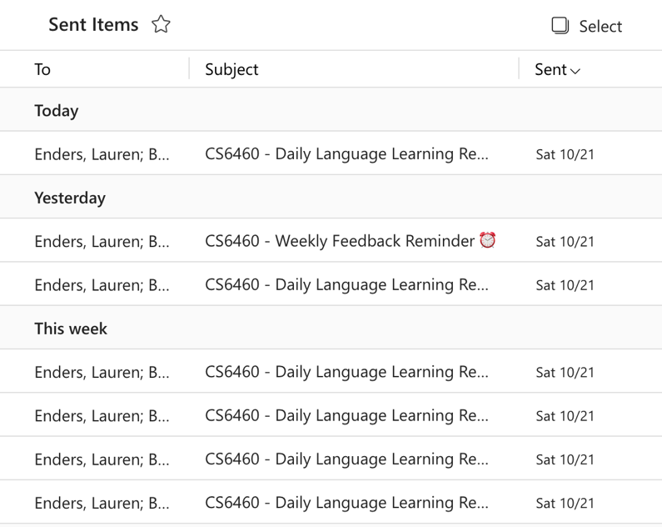
Participant Engagement
As planned, I sent participants daily learning reminders for the first two weeks and weekly feedback reminders to reflect on the previous week.
This is to help participants get on board and get used to the rhythm of learning a new language in the early stages.

Slide 10
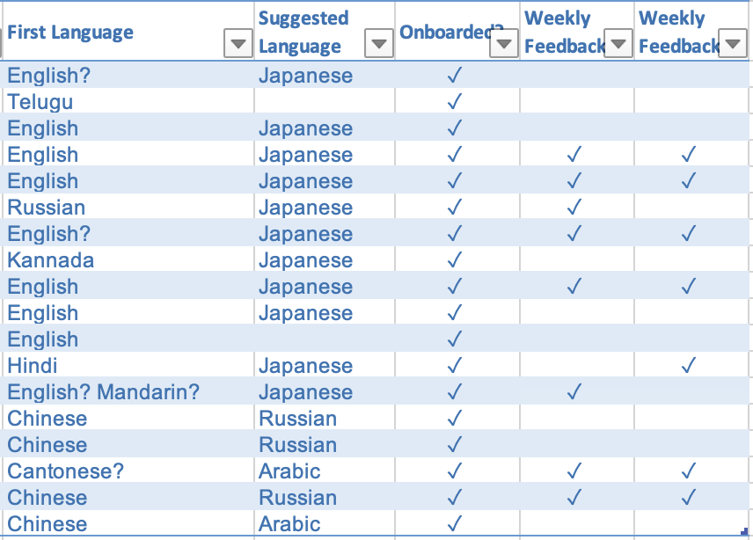
Data Collecting
As of this writing, I have created Excel spreadsheets for confirmed participants (18 total) to track their status and contact information and have been collecting weekly feedback for two weeks.

Slide 11
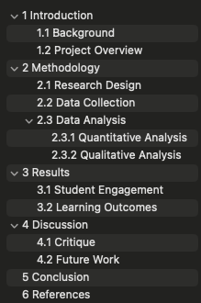
Final Paper Outlining
The outline shown will be gradually refined while my research dives more profoundly, and for now, it only represents my current understanding of the project.

Slide 12
Challenges
Despite being only two weeks into my research, I was only able to receive Weekly Feedback from roughly half of the participants, and while I probably knew that this phenomenon seemed very much in line with the reality of remote learning, I was likewise more concerned that I didn't have enough data to conduct the final analysis - after all, I didn't have a very large number of participants per se.
I am not sure if I should go for an intervention for more data but the intervention itself will bring biases to my study.
Or maybe I just let the participants go with the flow and draw conclusions based on the small amount of data.
Suggestions needed here.

Slide 13
The End
If you have any questions, please email me at yzhang3761@gmail.com
Thanks for your attention!

