Slide 1
CS6460 Milestone 2
Cleo Zhang
yzhang3761@gmail.com

Slide 2
Overview
Goals:
To demonstrate the progress I have made so far
To get suggestions and feedback
List of Content:
Overview of the Preliminary Data I have collected
Early Observation and Conclusion
Challenges I am facing

Slide 3
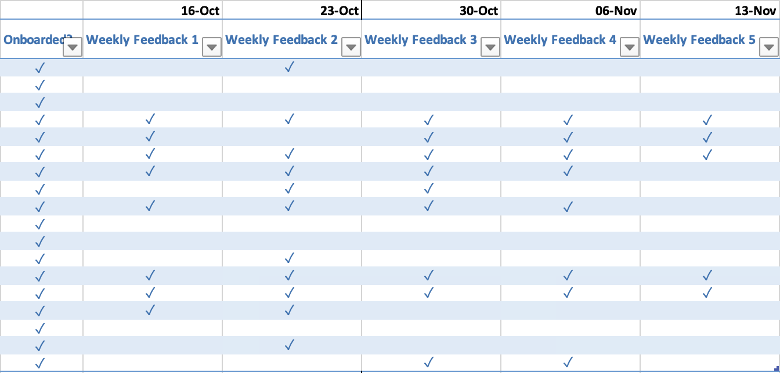
Preliminary Data – Weekly Feedbacks
Figure 1 – Weekly Feedback Collection Snapshots

Slide 4
Early Observations and Conclusion
The weekly feedback I received dropped significantly starting from the third week, probably because I stopped sending out daily learning reminders in the third week.
Although the number of weekly feedback decreased in both the control and experimental groups, the current data cannot explain the specific differences.
If a participant has sent me timely feedback the previous week, the participant will likely send me feedback the following week as well. If participants don’t send me weekly feedback the week before, they will likely not send me feedback the next week either.
Based on these early data observations, I expect the experimental and control groups to diverge in the data over the next few weeks.

Slide 5
Work I have done
Participant Engagement
Data Collecting
Research on the Chart Types
Final Paper Drafting

Slide 6
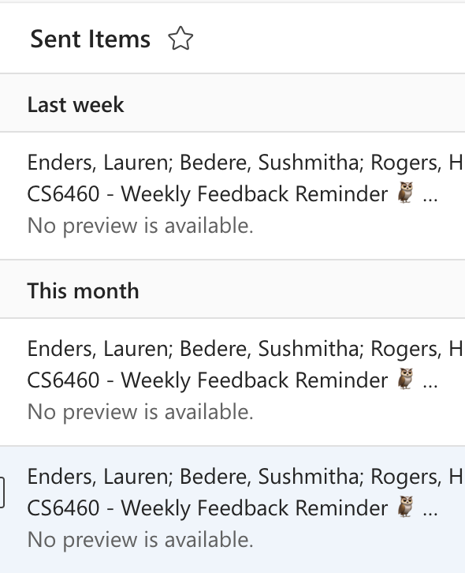
Participant Engagement
After milestone 1, I stopped sending the daily learning reminders and kept asking for weekly feedback every Friday as planned. I automate the sending of reminders through Outlook's scheduled send feature.
Figure 2 – Reminders to Collect Weekly Feedback

Slide 7
Data Collecting
I will continue to send out reminders to participants to collect weekly feedback every Friday for the next few weeks and invite participants to rate the activity for qualitative analysis during the last week of the study.

Slide 8
Chart Types
Double Bar Graph
Line Chart
Box Plots
Word Cloud

Slide 9
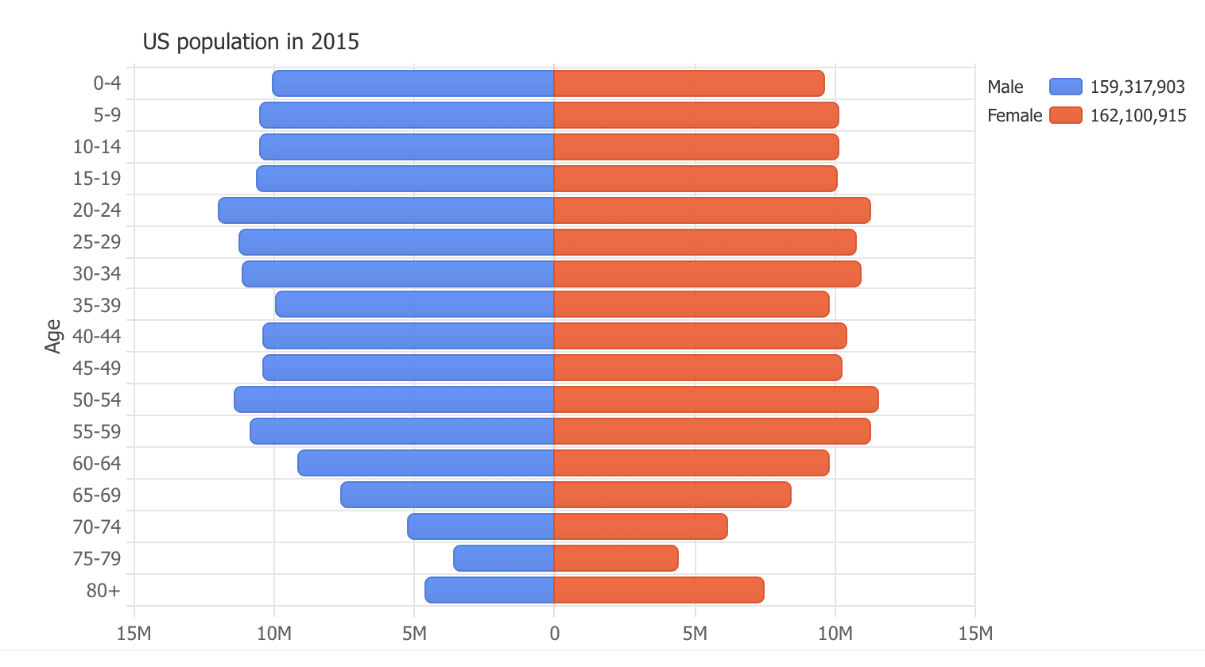
Double Bar Graph
A double bar graph can effectively compare two data sets. In the context of student engagement analysis, comparing engagement levels between the control and experimental groups could be helpful.
Figure 3 – Example of Double Bar Graph.

Slide 10
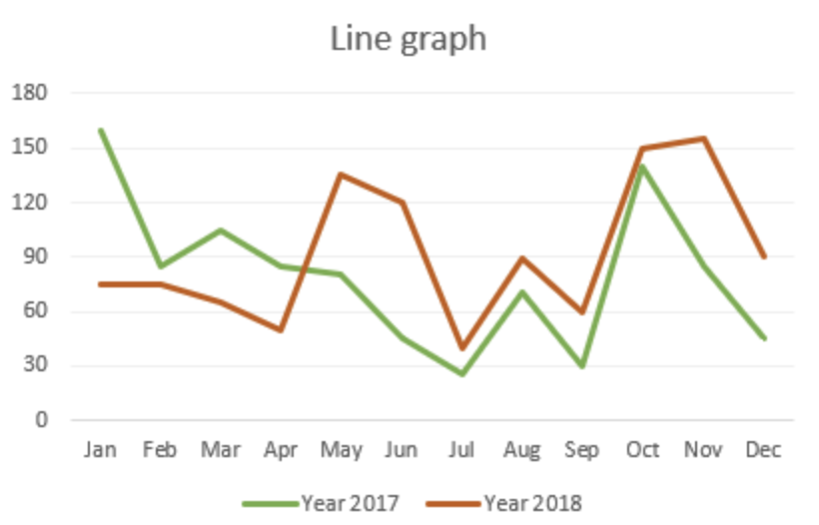
Line Chart
A line chart is great for showing trends over time. It can be helpful to illustrate the change in student engagement over weeks.
Figure 4 – Example of Line Graph.

Slide 11
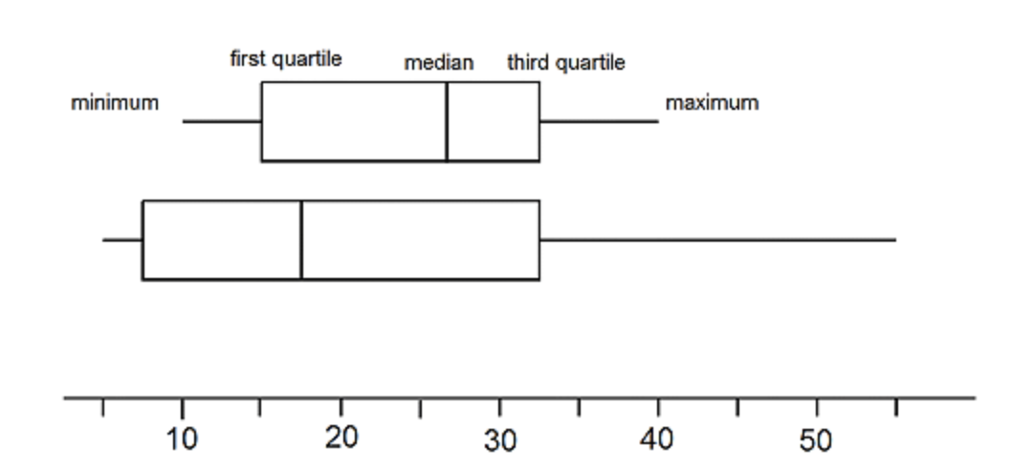
Box Plots
Figure 5 – Example of Box Plots.
Box plots help display the distribution and spread of data, particularly for comparing learning outcomes across different groups. They showcase the median, quartiles, and outliers, giving a comprehensive view of the variability in the data.

Slide 12

Word Cloud
Word clouds are visual representations where words are sized based on frequency. They can be used to analyze qualitative data, such as student feedback or responses related to the learning process.
Notes:
I will ultimately choose two or three icons to analyze the data and articulate the reasons for my choices in my final paper.

Slide 13
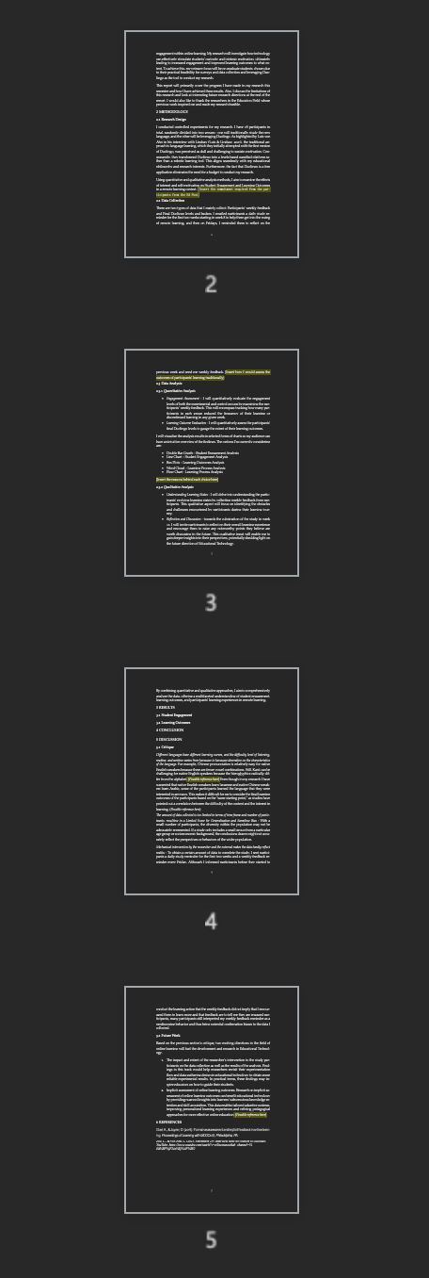
Final Paper Drafting
After the previous milestone, I started to draft the content of my final paper. I have completed the Introduction (Background and Project Overview), Methodology (Research Design, Data Collection and Analysis Methods) and Discussion (Critique) sections so far. In this process, I found some loopholes in my original research design, so the Methodology section will change accordingly after I confirm the solution. See the next section for details.

Slide 14
Challenge
As I collected data and continued my research, I realized a hole in my design. Since my research was to examine the effects of interest and self-motivation on Student Engagement and Learning Outcomes in a remote learning context through a controlled experiment, I should have provided the control and experimental groups with the same final test to assess their learning outcomes. However, my current design only considers evaluating the learning outcomes of the experimental group through Duolingo final levels and badges and does not plan for the control group.
Not only was I incapable of designing a legitimate digital test to measure each participant's learning outcomes (since I did not ask them to do any tests at the beginning), but even more so, I was unable to get participants using traditional learning methods to take the Duolingo test (since they were most likely unfamiliar with the app). I am in urgent need of a new solution that could be used to assess the learning outcomes of all the participants.
One possible solution that comes to mind is to focus on the effects of interest and self-motivation on Student Engagement and logically reason through the existing findings to the participants' Learning Outcomes. During the first three weeks of exploring, I have seen many articles discussing the correlation between Student Engagement and Learning Outcomes. I'm not sure it's acceptable to reason out certain conclusions using the data I've collected and the existing hypothesis or findings in the Educational Technology Field. Or is this approach to argumentation a common practice among researchers? Please advise.

Slide 15
The End
If you have any questions, please email me at yzhang3761@gmail.com
Thank you, and let me know what you think.

