Slide 1
Grid Rectangles
Test Data
Created By: Brian Baldos
Oct 17,2022

Slide 2
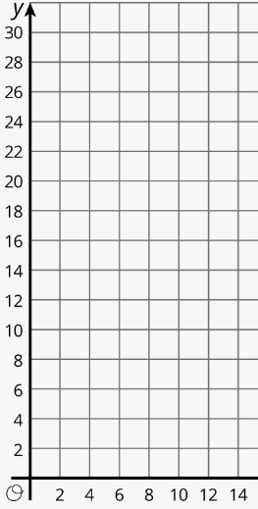

Slide 3
Overlap on Right
8,8
6,6

Slide 4
Overlap on Left
2,8
8,6

Slide 5
0,12
No overlap
8,10
0,8
2,4
10,4
0,0
10,0

