Slide 1
Presentation
Versión 07/11/2023
Computer Networks I
Course: | 1st
Type: | Core course
Credits: | 6
Degree: | Computer Science Engineering

Slide 2
Outline
Objectives of the course
Lectures
Course Contents
Bibliography
Resources
Laboratory
Grading criteria

Slide 3
Main Objective
To acquire the knowledge and to develop the necessary aptitudes regarding computer networks behavior, as well as the most relevant mechanisms and protocols used in Internet.

Slide 4
Secondary Objectives
To know the concepts of computer networks, protocol, addressing, routing, and usual terminology used in the field.
To know the difficulties related to network interconnection.
To understand network architecture and reference models.
To know application protocols and basic services frequently used in Internet: DNS, NAT, VPN, MAIL, HTTP, etc.
To know the tools that are usually employed for the analysis and debugging of protocols and applications.

Slide 5
Lectures & Labs
The subject is taught in 2 lectures (2 hours and 40 minutes) and one lab session (1 hour and 20 minutes) per week.
 | Monday | Tuesday | Wednesday | Thursday | Friday
8:30
9:50
10:00 | 1ºC - F1.1 |  | 1ºA – A1.1
11:20 |  |  | 1ºC – F1.1
11:30 | 1ºD - A2.2 | 1ºD – A2.2 |  | 1ºA – A1.1
12:50
13:00
14:20
15:30
16:50
17:00 | Lab A1 – LD3 | Lab C1 – LD3 | Lab B1 – LD2
18:20
18:30 | Lab A2 – LD3 | Lab BC – LD3 | 1ºB – A1.2 | 1ºB – A1.2
19:50 | Lab CD – LD4 | Lab D1 – LD2
20:00
21:20

Slide 6
Subject Context
Compulsory subjects related:
Computer networks II (2º)
Distributed Systems (3º)
Speciality (4º):
Planificación e Integración de Sistemas y Servicios
Gestión y Administración de Redes
Diseño de Infraestructuras de Red
Redes y Servicios Móviles
Aplicaciones Distribuidas en Internet

Slide 7
Course content
Lesson 0. Introduction to Computer Networks
Lesson 1. Computer Networks Architecture
Lesson 2. Applications and Services
Lesson 3. TCP/IP Transport Layer
Lesson 4. Internet, IP protocol
Lesson 5. IP Addressing
Lesson 6. Routing
Lesson 7. Network Technologies
Lesson 8. Transmission Media

Slide 8
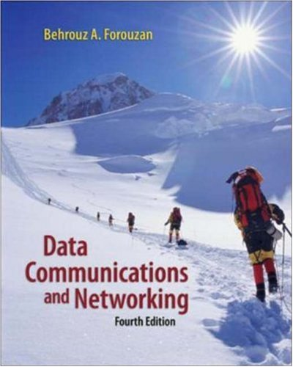

Basic Bibliography
Behrouz A. Forouzan. Data Communications and Networking. Mc Graw Hill, 5th edition, 2013
A.S. Tanenbaum. Computer Networks. Prentice-Hall, 5th edition, 2010.
William Stallings. Computer Networking with Internet Protocols and Technology. Prentice-Hall, 2004.
Campus Virtual course page.

Slide 9

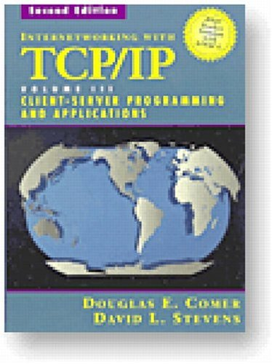
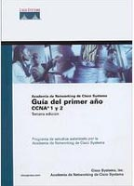
Complementary Bibliography
Behrouz A. Forouzan. TCP/IP Protocol Suite. McGraw-Hill, 2003.
Douglas E. Comer. Internetworking with TCP/IP. Prentice Hall, 1994
Cisco Systems. Inc. Guía del primer año. CCNA 1 y 2. Cisco Press, 2003.
Richard W. Stevens. Unix Network Programming. Prentice-Hall, 2007.

Slide 10
Teaching Staff
Teaching staff | Office | Grupo de teoría | Grupo de prácticas
Inocente Sánchez Ciudad (Coordiantor) | A1.9 | 1ºC 1ºD | -
Xavier del Toro García | 3.12 | 1ºA (in English) | -
Arturo Villegas Gómez | Asociados | 1ºA (in English) | -
Jesús Blanco Rodríguez de Guzmán |  |  | Lab A1 (in English) Lab A2 (in English) Lab B1
José Luis Segura Lucas |  |  | Lab BC Lab C1
Cleto Martín Angelina | Asociados

Slide 11
Evaluation (ordinary period)
Final test:
50% → Written test (Compulsory) on the exam date.
Laboratory sessions:
30% → Online tests during lab sessions (Compulsory).
Theoretical papers assessment:
10% → Assignment (Non-compulsory).
Participation:
10% → Use of Campus Virtual and progress tests (Non-compulsory).
In the compulsory parts, a minum mark of 4 our of 10 is required. If a compulsory part is not passed, a maximum mark of 4 out 10 will assigned. The final mark must be ≥ 5 out of 10 to pass the course.

Slide 12
Evaluations (retake period)
Re-sit exam:
50% → Theory final exam or grade obtained in the ordinary period
30% → Labs final test or grade obtained in the ordinary period
10% → Assignment or grade obtained in the ordinary period
10% → Can be retaken or grade obtained in the ordinary period
Attendance is not mandatory
  No penalty in grading

Slide 13
Any question?

