Slide 1
Introduction to
Network Architecture
application
transport
network
link
physical
JuanPablo.Rozas@uclm.es David.Villa@uclm.es

Slide 2
Outline
Network architectures
Reference models
  OSI model
  TCP/IP model
Addressing fundamentals
References

Slide 3
Network architecture
It is a framework that describe a communication network, its components and protocols.
The network design is organized as a layer stack.
Each layer provides a set of services to the upper layer and requires services to the lower layer.
The layer 'n' of a node maintains a virtual conversation with the same layer the destination node. That conversation must meet a specific protocol.

Slide 4
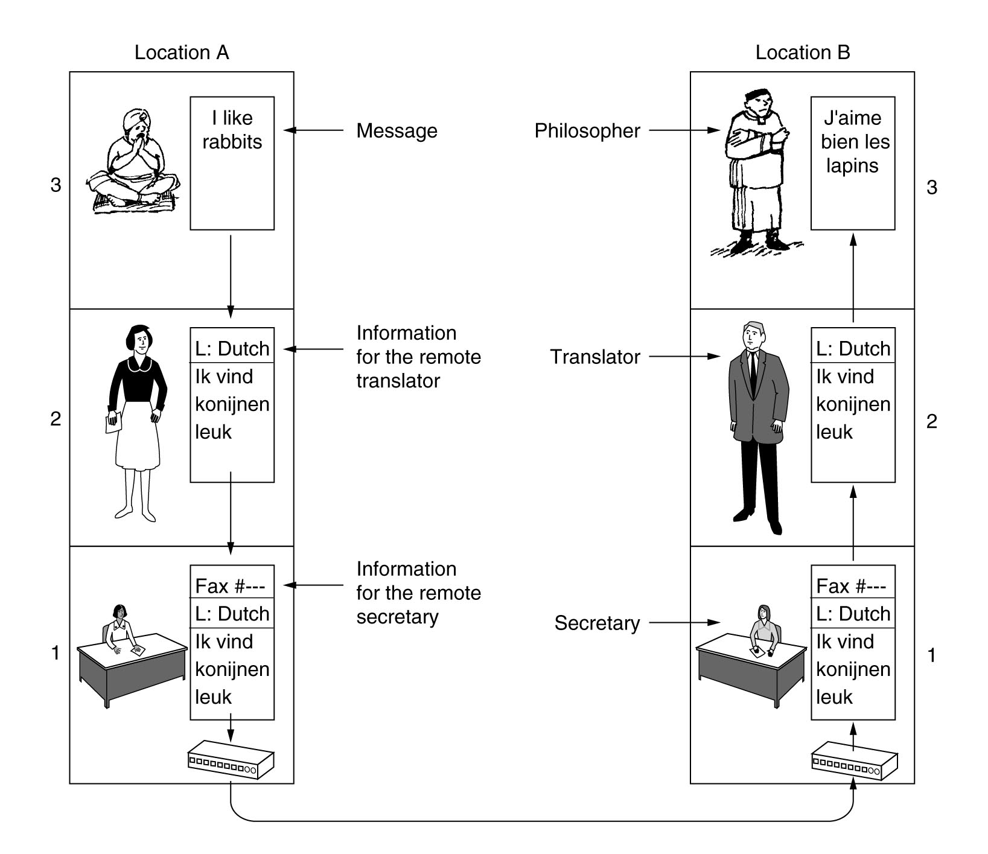
Example of layering
Philosophers Analogy
Tanenbaum

Slide 5
Reference models
OSI model
TCP/IP model
The reference model and the protocol suite implementation are very different things. They must not be confused.
i

Slide 6
OSI model
The Open System Interconnection (OSI) is an ISO (International Organization for Standardization)
It provides a general conceptual model to describe and study any protocol stack.
The model defines three basic concepts:
  service: the function that a layer may provide.
  interface: the way to get the layer services.
  protocol: the set of rules between homologous peers.

Slide 7
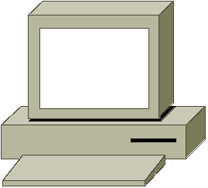
OSI layering
application
application
presentation
presentation
session
session
transport
transport
segments
network
network
packets
link
link
frames
physical
physical
bits
physical media

Slide 8
OSI model media layers
1. Physical layer
It defines the electrical, mechanical and temporal characteristics for devices required in a particular data communication technology.
2. Data link layer
It supports data transfers between directly reachable nodes (neighbors). It provides physical addressing.
3. Network layer
It supports end-to-end communication with variable length individual messages. It provides the logical addressing.

Slide 9
OSI model host layers
4. Transport layer
It provides a reliable error-free communication channel between end users. It also support process multiplexing.
5. Session layer
It allows us to create sessions among hosts and it manages synchronization.
6. Presentation layer
It defines on-the-wire data representation and its semantic.
7. Application layer
Application specific protocols like mail, news, remote shell, etc.

Slide 10
TCP/IP model
The TCP/IP model arrives years later of first implementations. The aim is to formalize and standardize its use and development.
It is closely related with TCP/IP protocols stack, and it can not be used to describe other protocols or networks.
application
transport
inter-net
host to net

Slide 11
TCP/IP model
Application layer
High level protocols like: DNS, SMTP, HTTP, FTP and many others.
Transport layer
It defines transport protocols: TCP (Transport Control Protocol) and UDP (User Datagram Protocol).
Inter-network layer
It provides mechanisms to network interconnection and package routing. It defines the IP protocol, that provides a connectionless delivery service.
Host-to-net layer
It provides (does not provide) required mechanisms to make it possible that “an IP packet reaches other host in the network”.

Slide 12
OSI, TCP/IP and hybrid models
OSI
TCP/IP
hybrid
7
application
application
application
6
presentation
5
session
4
transport
transport
transport
3
network
inter-net
network
2
data link
host to net
data link
1
physical
physical
When we talk about a “x layer thing”
we always refer to the OSI model.
Although... we will use the hybrid.
i
i

Slide 13
Encapsulation
The user information can not go directly “on the wire”.
Data transmission requires group bytes in PDUs (Protocol Data Units). The PDU adds control information as header and tails.
application
user data
application
transport
header
transport
transport
segment
network
network
header
packet
network
data link
link
header
tail
frame
data link
physical
bits
physical

Slide 14
Encapsulation
The recipe
1. Data build (from an application).
2. Segment the data for end-to-end transportation.
3. Add network addresses and build one (or several) datagrams.
4. Add physical link address and build frames for each datagram.
5. Code frame bits in signals that can be sent by the physical medium.

Slide 15
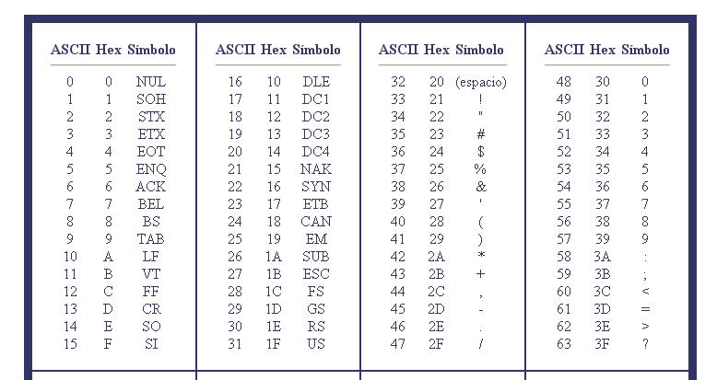
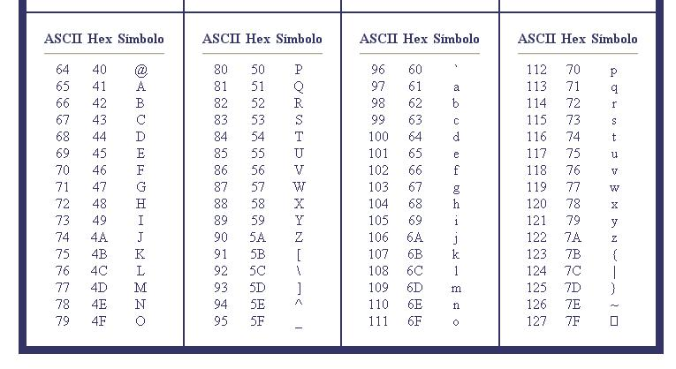
ASCII table
Redes de Computadores I

Slide 16
Example: UDP encapsulation
Send the string “Redes~I” using UDP as transport protocol from port 57000 to port 8888, from IP address 161.67.27.124 to 161.67.48.57. The host MAC address is 00:21:5D:E9:7F:80 y the router’s MAC address is 00:64:40:3A:C9:40. All values are in hexadecimal
<............................................……......... 64 Bytes …............................................................>
<.. 7 Bytes ..>
User data:
52..............49
Padding:
00...........00
aplicación
aplicación
<..... 8 Bytes ….>
Transport header:
DE.................E9
User
Datagram
transport
transport
52.............49 00............00
<.... 20 Bytes ....>
network
Network header:
4500.............7C
IP datagram
network
DE................E9 52.............4900..............00
<... 14 Bytes ...>
<......................................... 46 Bytes ……............................>
<.. 4 Bytes..>
data-link
Data-Link header:
0064.........0800
Tail:
XXXXXXXX
Ethernet
frame
data-link
4500...............7C DE.............E952................4900...............00
physical
bits
physical
Redes de Computadores I

Slide 17
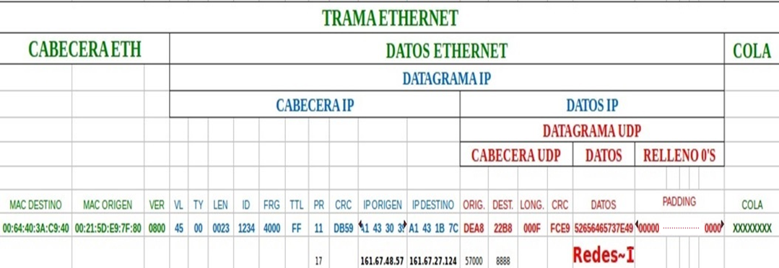
Encapsulation overview
Redes de Computadores I

Slide 18
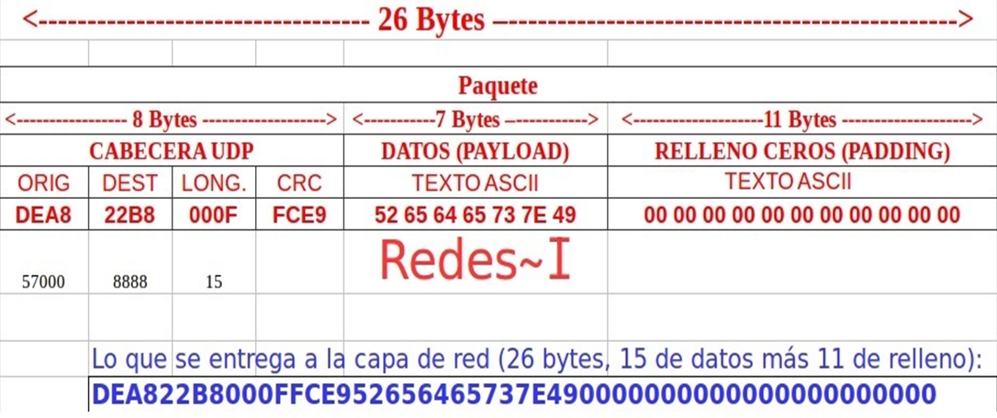
Example: UDP encapsulation
Redes de Computadores I

Slide 19
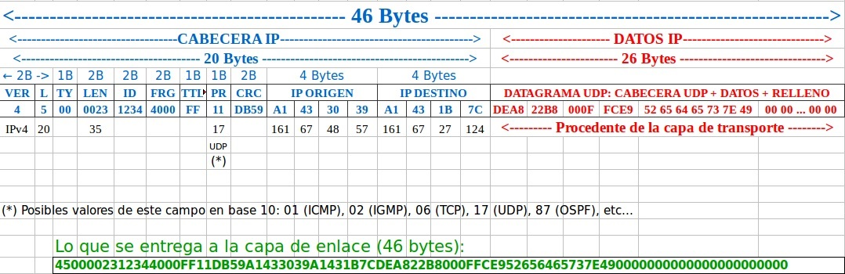
Example: IP encapsulation
Redes de Computadores I

Slide 20
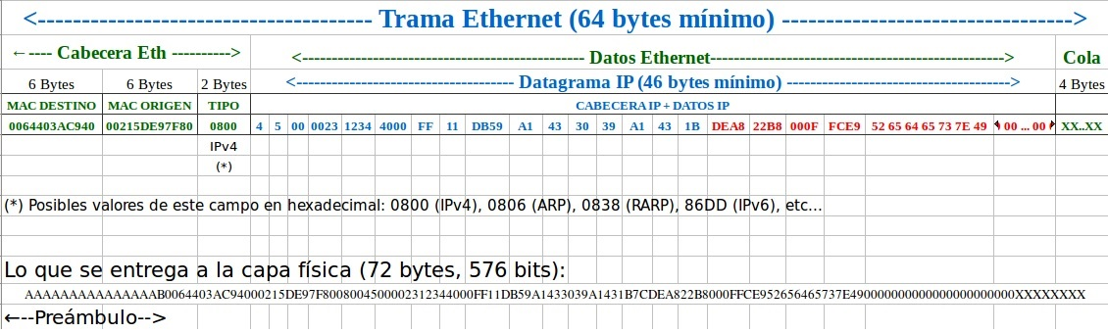
Example: Ethernet encapsulation
Redes de Computadores I

Slide 21
Addressing fundamentals
- Physical vs logical addresses
- Lower-level layers vs higher-level layers.
- Global uniqueness vs network-wide uniqueness.
- Can’t be changed vs change frequently.
Tannenbaum

Slide 22
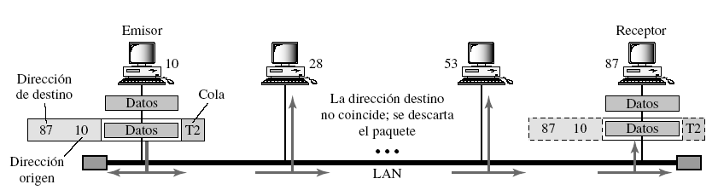
Physical address
Physical address = MAC address = Ethernet address
Tannenbaum

Slide 23
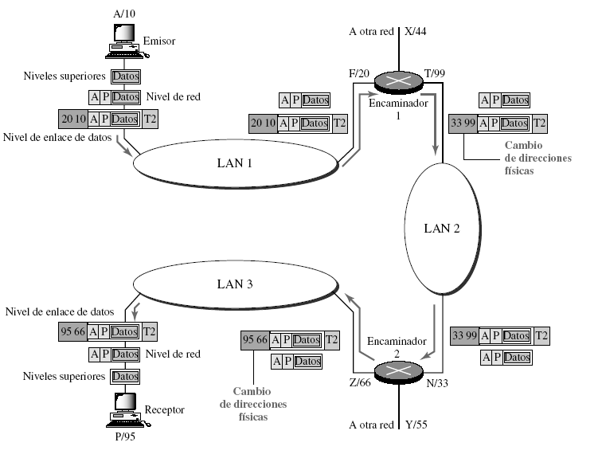
Logical address or IP address
A: source IP
P: destination IP
Tannenbaum

Slide 24

References
B.Forouzan. Transmisión de datos y redes de comunicaciones, 3th edition 2007.
Chapter 1
A.S.Tanenbaum Redes de computadoras. Pearson, 4th edition, 2003.
Chapter 1: Sections 1.1 a 1.4 y 1.6
CISCO Systems. Inc. Guía del primer año. CCNA 1 y 2. Cisco Press, 2003.
Chapter 1
Chapter 2: Pages 39 – 69
CISCO Networking Academy e-learning.
Modules 1 y 2.
All unlabeled figures are taken from the Wikipedia.

Slide 25




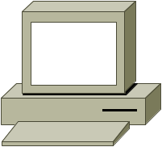
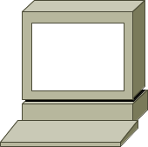


CISCO Icons
Bridge
hub
switch
multilayer
switch
router
PC
dumb terminal
laptop
file server
FDDI
FDDI ring
serial line
circuit switched
serial line
network cloud
Ethernet

