Slide 1
Transport Layer
transport

Slide 2
Contents
General concepts
  Process to process delivery
  Sockets
  Multiplexing and demultiplexing
  Pushing & Pulling
  Flow Control
  Error Control
  Connectionless vs connection-oriented service
  Reliable vs unreliable
UDP vs TCP

Slide 3
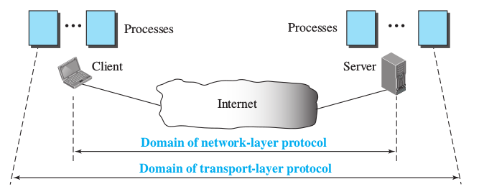
Process to process delivery
Transport layer:
  Responsible for process-to-process delivery
  Processes communicate using the client-server paradigm

Slide 4
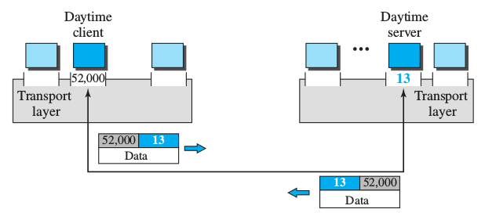
Port Numbers
Every server process listens at a certain port
The client uses an ephemeral port for the reception of the replies

Slide 5
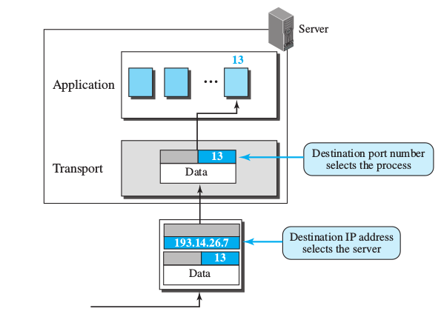
IP addrs. vs port nums
The IP address indentifies the host
The port identifies a particular process in the host

Slide 6
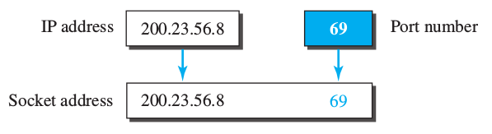
Sockets
Combination of the IP + port
  Uniquely define the process
  Sockets → basic abstraction for network programming in most OS
# Connect to server
s.connect((HOST, PORT))

Slide 7
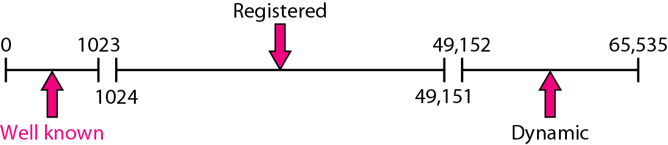
ICANN Ranges
Well-known ports: 0 - 1023
  Assigned and controlled by IANA
Registered ports: 1024 to 49,151
  Not assigned nor controlled by IANA
  Registered with IANA to prevent duplication.
Dynamic ports. 49,152 - 65,535
  temporary or private port numbers.
https://www.iana.org/assignments/service-names-port-numbers/service-names-port-numbers.txt

Slide 8
Well-known ports
In Unix stored in a file called /etc/services
Example: ftp server
  2 port numbers
  One for each different transport protocol

Slide 9
Well-known ports
DIY
Explore the file
/etc/services
$ less /etc/services
tcpmux 1/tcp # TCP port service multiplexer
echo 7/tcp
echo 7/udp
discard 9/tcp sink null
discard 9/udp sink null
systat 11/tcp users
daytime 13/tcp
daytime 13/udp
netstat 15/tcp
qotd 17/tcp quote
msp 18/tcp # message send protocol
msp 18/udp
….
$ grep domain /etc/services
domain 53/tcp # Domain Name Server
domain 53/udp

Slide 10
Who is listening?
DIY
Listen on TCP port 12345
$ nc -l 127.0.0.1 12345
$ netstat –lptn
...
Proto Recv-Q Send-Q Local Address Foreign Address State PID/Program name
tcp 0 0 127.0.0.1:38153 0.0.0.0:* LISTEN -
tcp 0 0 127.0.0.1:12345 0.0.0.0:* LISTEN 10665/nc
tcp 0 0 127.0.0.1:25 0.0.0.0:* LISTEN -
...

Slide 11
Encapsulation and decapsulation
Client
Server
Message
Message
Logical channel
H
Message
H
Message
Encapsulation
Decapsulation

Slide 12
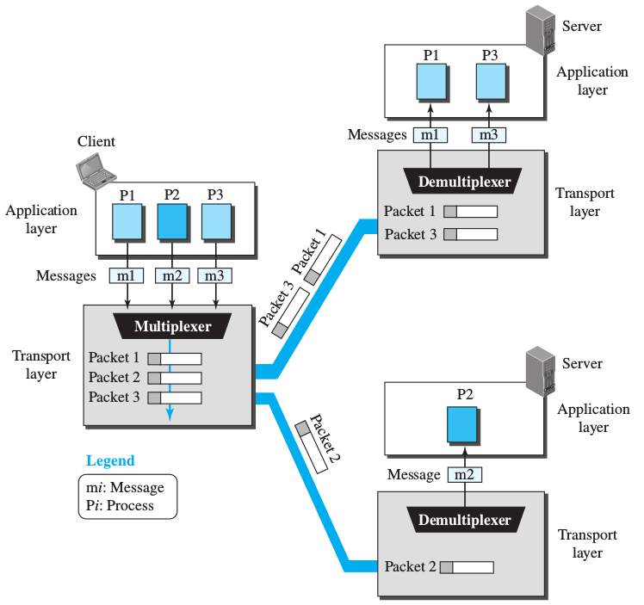
Multiplexing and demultiplexing

Slide 13
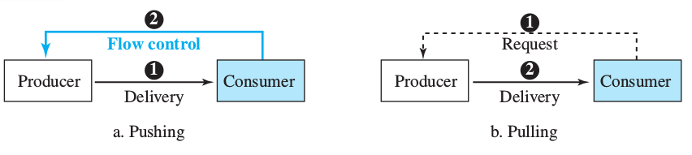
Flow control: Pushing & pulling
Delivery can occur in two ways
  Pull: producer delivers items when requested
      No flow control required
  Push: producer delivers items when produced
    No request from consumer
    The consumer may be overwhelmed
      Need for flow control

Slide 14
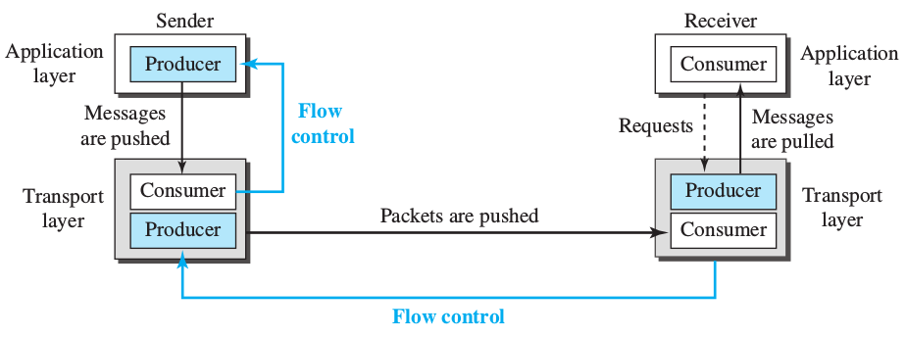
Flow control at the transport layer
Sender: producer
Transport layer at sender: producer & consumer
Transport layer at sender: consumer & producer
Receiver: consumer

Slide 15
Error control
The network layer is unreliable
When reliability is required at the transport layer, error control is responsible for:
  Detect and discard corrupt packets
  Keep track of lost and discarded packets (resend)
  Discard duplicates
  Buffer out-of-order packets
Implemented through:
  Checksums
  Sequence numbers
  Acknowledgement
  Timers

Slide 16
Congestion control
Congestion: the load of a network
It typically happens at network level
  Routers and switches use queues
  They can be full
  Nodes need to wait
Transport layer may provide congestion control if the network layer does not

Slide 17
Connectionless protocols
Message divided into chunks (datagrams) by the application layer
Each datagram treated as a single unit
  Independent from the rest
  Encapsulated as a packet by the transport layer
Packets sent in order
Reception may be out of order
  Problem because no sequence numbers
  Neither error control

Slide 18
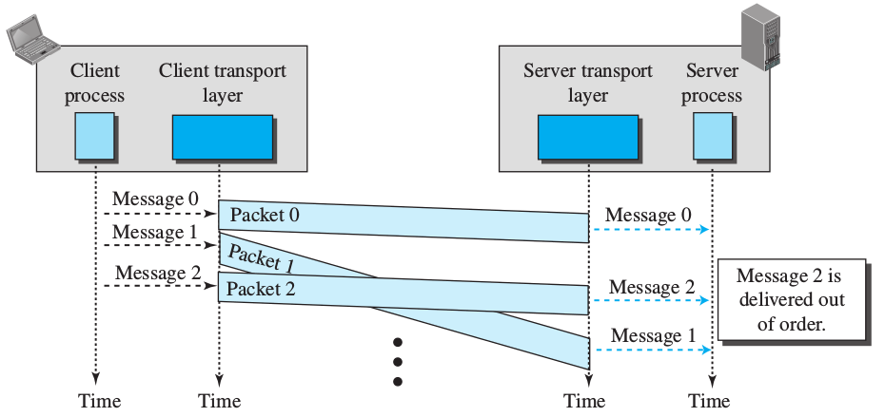
Connectionless protocols

Slide 19
Connection-oriented protocols
First establishment of logical connection
  End to end service
May be implemented even over connectionless protocols at the network layer
Can implement flow & error control

Slide 20
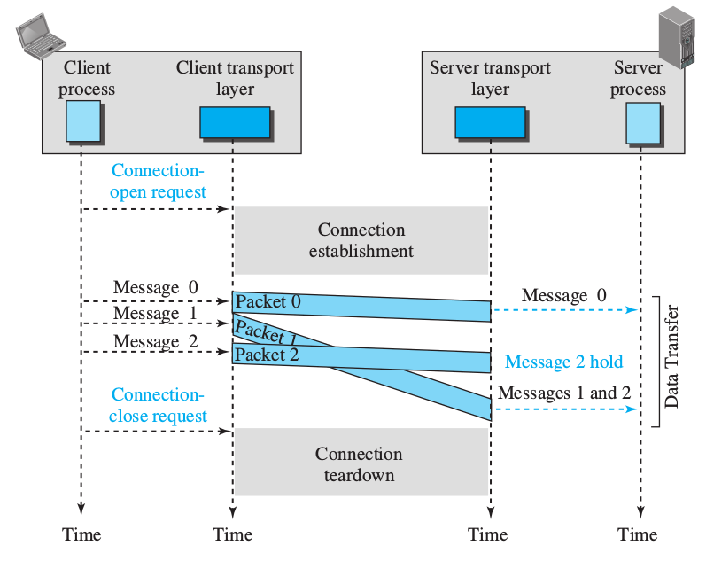
Connection-oriented protocols

Slide 21
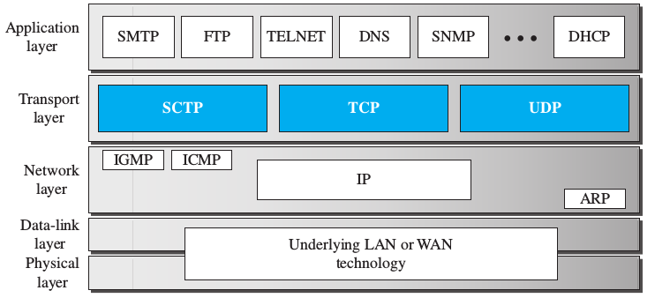
Transport layer protocols in TCP/IP suite

Slide 22
User Datagram Protocol (UDP)
Connectionless
Unreliable
Very simple => minimum overhead
Control can be provided by the Aplication Layer

Slide 23
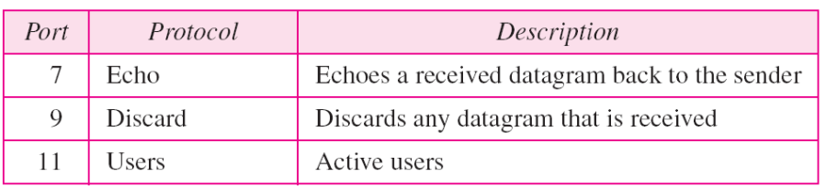
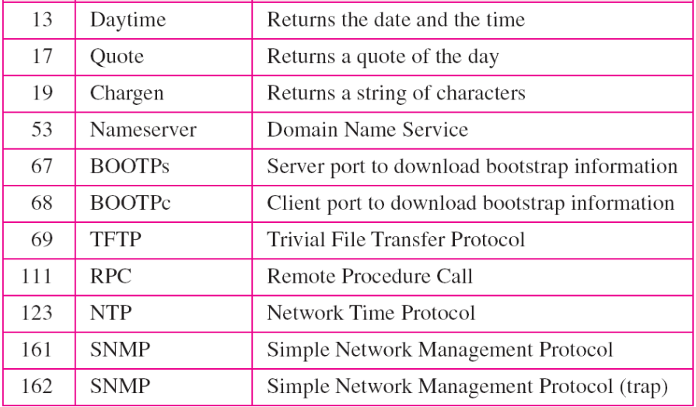
Well-known ports used with UDP

Slide 24
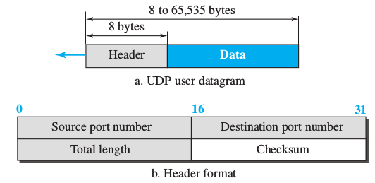
User Datagram
Fixed size header of 8 bytes
Mainly used for the specification of ports
Optional checksum
  Pseudoheader + UDP header + UDP data
Up to 64KB size

Slide 25
UDP
Connectionless protocol
  Messages not numbered
No flow control
No error control
  Except for the checksum. Wrong packets discarded
No congestion control
Flow control or error control might by provided at the application layer

Slide 26
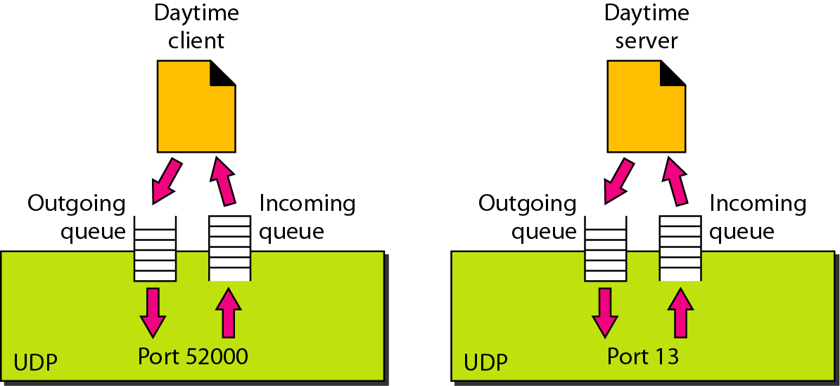
UDP ports: queues

Slide 27
inetsim: UDP server examples
DIY
$ nc -u 127.0.0.1 7
$ nc -u 127.0.0.1 13
$ nc -u 127.0.0.1 13
$ nc -u 127.0.0.1 13
import socket
port = 53
ip = '127.0.0.1'
data = (
b"D\xcb\x01\x00\x00\x01\x00\x00\x00\x00\x00\x00\x07"
b"example\x03com\x00\x00\x01\x00\x01"
)
sock = socket.socket(socket.AF_INET, socket.SOCK_DGRAM)
sock.sendto(data, (ip, port))
reply = sock.recv(512)
print(reply)

Slide 28
Transmission Control Protocol (TCP)
Connection-oriented
Reliable
  Based on Go-Back-N approach
  Use of checksums
  Retransmission of lost or corrupted packets
  Cumulative and selective ACKs
Complex protocol with multiple phases
  Connection establishment
  Data transfer
  Connection teardown
Full-duplex communication
  Data flows in both directions at the same time

Slide 29
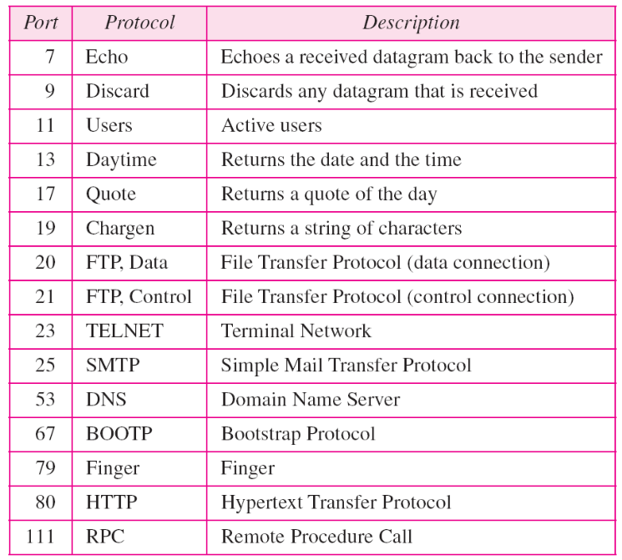
Well-known ports used with TCP

Slide 30
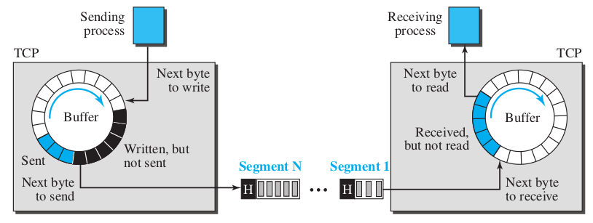
Stream delivery service
Stream oriented protocol
  Two processes connected by imaginary tube
Sending & receiving circular buffers
  Provides flow and error controls
Data is sent in packets called segments
Stream of bytes

Slide 31
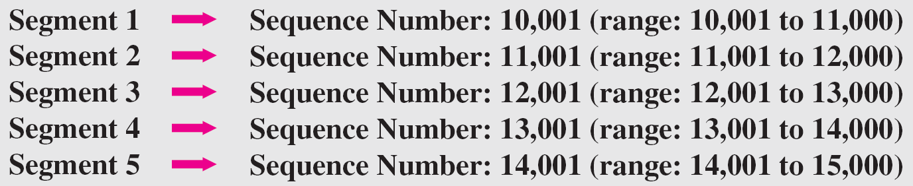
Numbering system
All bytes are numbered
  Numbering independent in each direction
  Arbitrary start number
Sequences are also numbered
  Number of the first data byte contained
  Some special cases for control messages

Slide 32
Numbering system
Segments also include an acknowledgement number:
  Number of the next byte expected
Cummulative numbering:
  Example: ack number = 5643
    All bytes from the beginning up to 5642 received
    Doesn’t mean a total number of 5642 received
    The initial one is random and therefore probably not 0

Slide 33
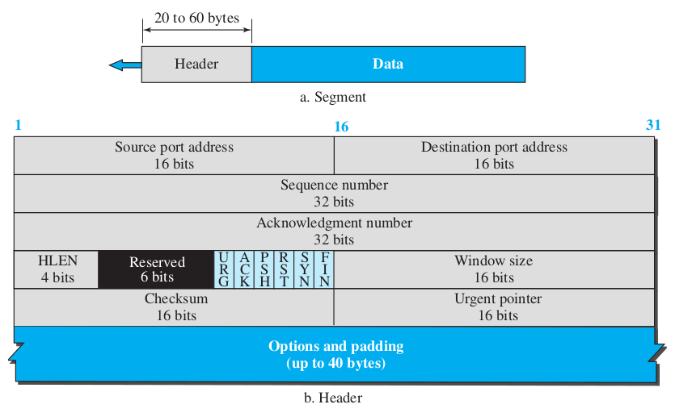
TCP Segment

Slide 34
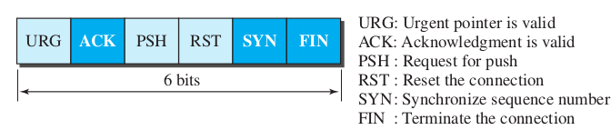
TCP Segment
Sequence Number
  Starting at a random Initial Sequence Number (ISN)
Header Length:
  Number of 4-byte words in the header
  Total number of bytes = HLEN * 4
Control
  Flags for connection establishment & control flow

Slide 35
TCP Segment
Window size:
  Max 65535 bytes
  Set by the receiver (rwnd)
  The sender must obey dictation of the receiver
Checksum:
  Mandatory in TCP
Urgent pointer: valid when urgent flag set
  Value to be added to sequence number to get the last urgent byte
Options: up to 40 extra bytes

Slide 36
TCP Connection
Logical path establishment between source and destination
Three phases:
  Connection establishment
  Data transfer
  Connection termination

Slide 37
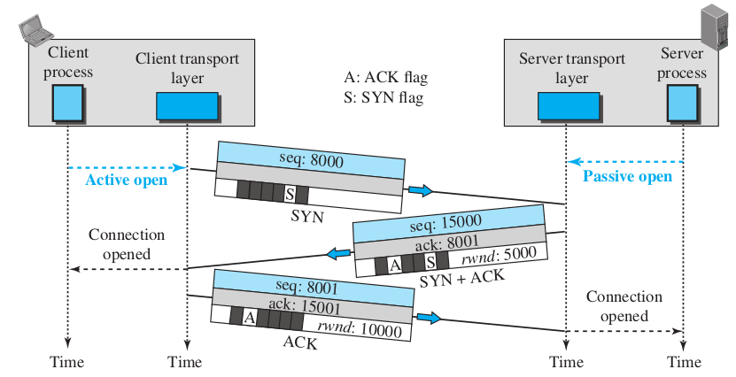
Connection Establisment
Three-way handshake
No data but consume 1 seq number
ISN
If no data no seq number consumed

Slide 38
Connection Establisment
SYN flooding attack
Malicious attackers send a large number of SYN segments faking IP addresses
The server allocates resources which are never used until it runs out
Denial of service attack
  With so many requests the server may reject the valid ones
Some implementations wait for the allocation until connection has been established

Slide 39
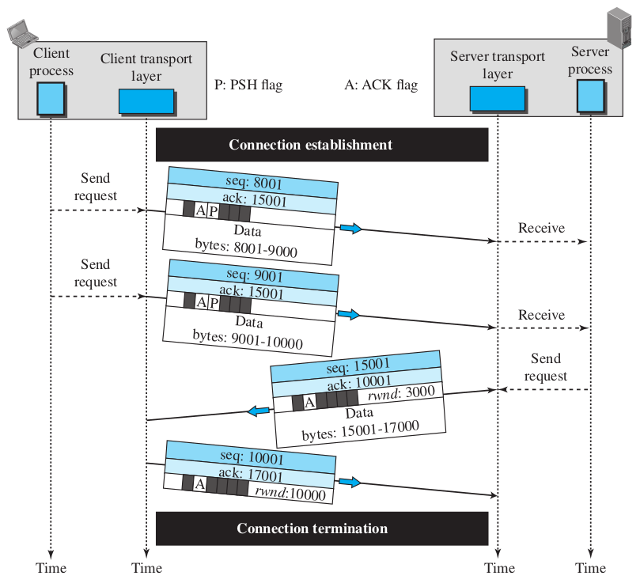
Data Transfer
Data sent in both
directions
ACKs piggybacked
with data

Slide 40
Data Transfer
Pushing Data
  Sender enables PUSH flag to request immediate response
  Avoids waiting in the buffers
Urgent Data
  When some bytes are urgent
  Receiver sets URGENT flag
  Sender puts urgent bytes at the beginning of the segment
  Sender sets urgent pointer at the end of the urgent data
  The rest of the data are nonurgent

Slide 41
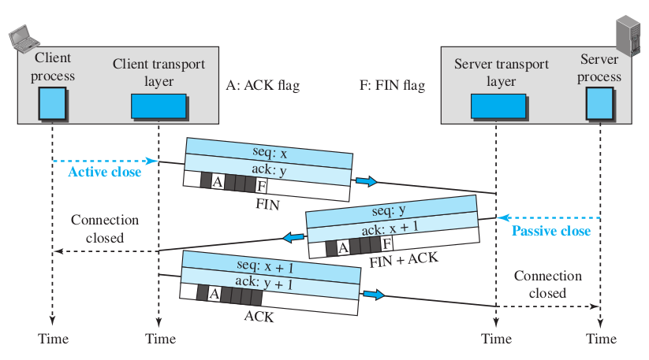
Connection Termination
Three way handshaking
Consumes 1 seq number if no data is carried

Slide 42
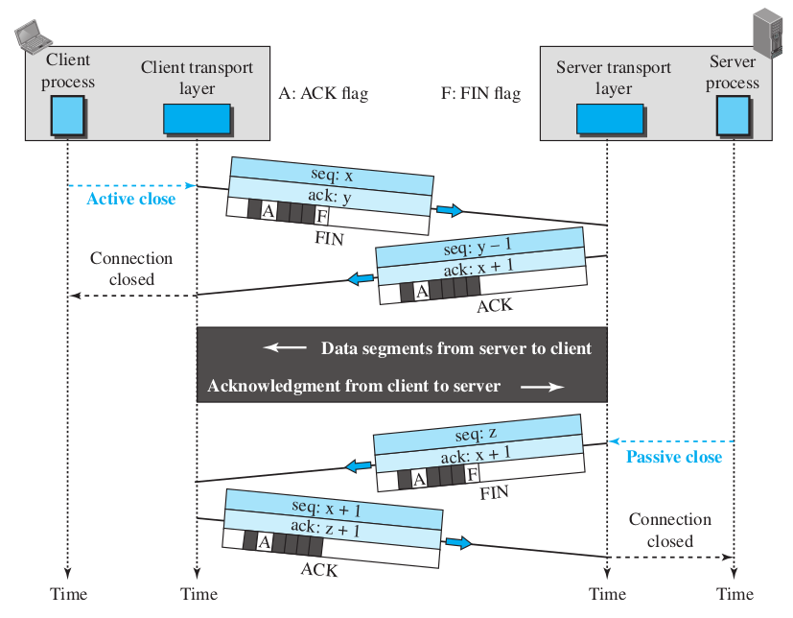
Connection Termination
Half Close

Slide 43
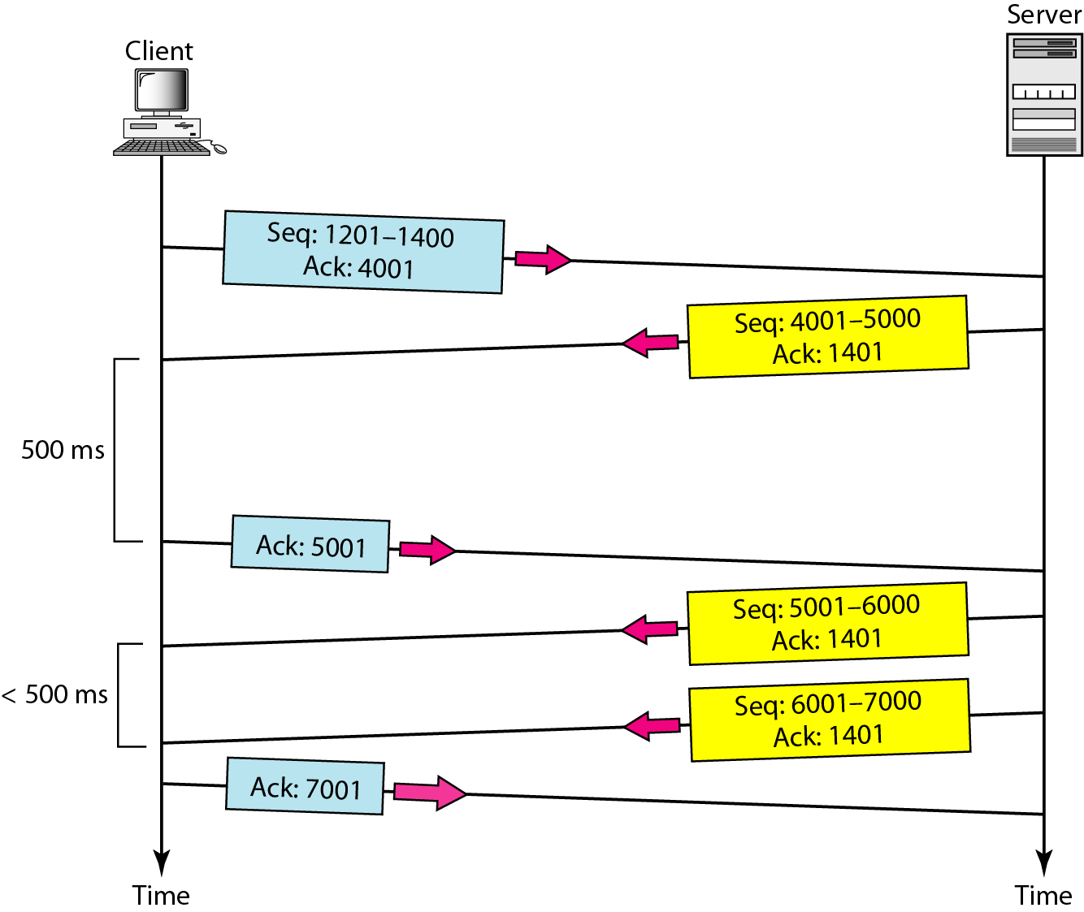
Normal Operation

Slide 44
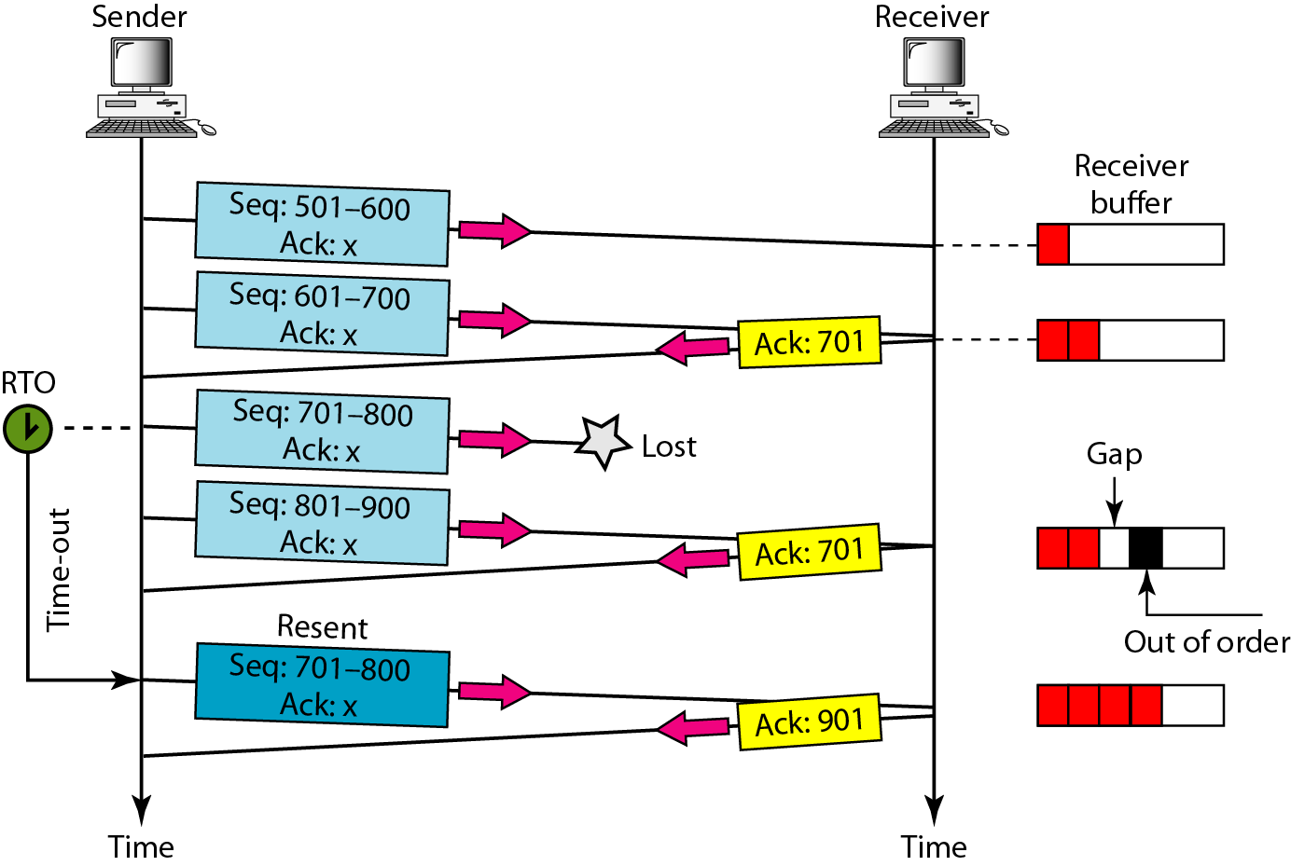
Lost Segment

Slide 45
Reliable protocols

Slide 46
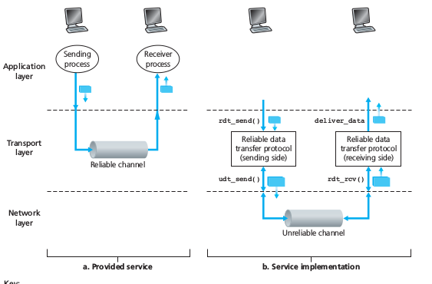
Reliable protocols
Let's analyze how to provide reliability
From the simplest case to a real one, increasing the complexity
  Simple protocol
  Stop & wait
  Go back N

Slide 47
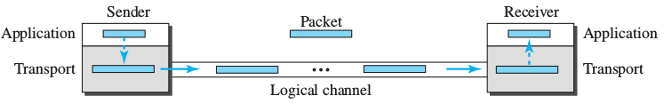
Simple protocol
Connectionless
Assumes ideal conditions
No error nor flow control are required
Not realistic at all

Slide 48
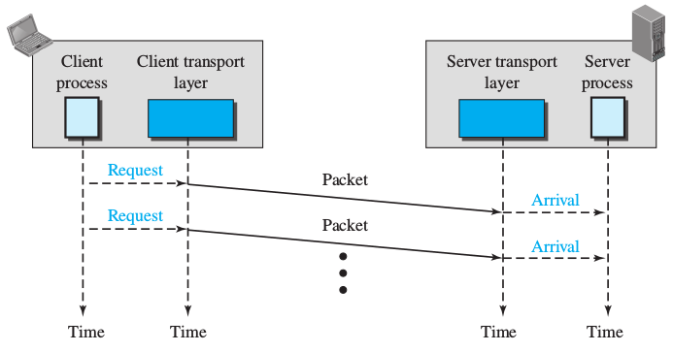
Simple protocol
Flow diagram

Slide 49
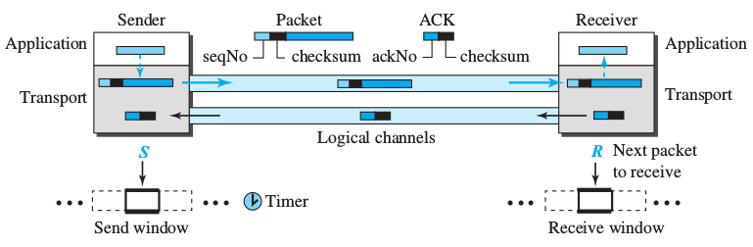
Stop & Wait
Connection-oriented
Error and control flow
  Acknowledgement for each packet
  Checksum to check integrity
  Sequence numbers
    Requires a sliding window of size 1
  timer
Sender waits for reception of ACKs before sending a new packet

Slide 50
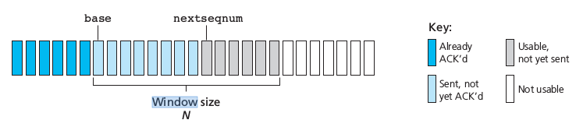
Sliding Window
Sequence numbers use modulo 2^{m}
  Size of the window N = 2^{m}-1
While there's room inside the window new packets can be sent
An ACK makes the window slide
Sliding direction

Slide 51
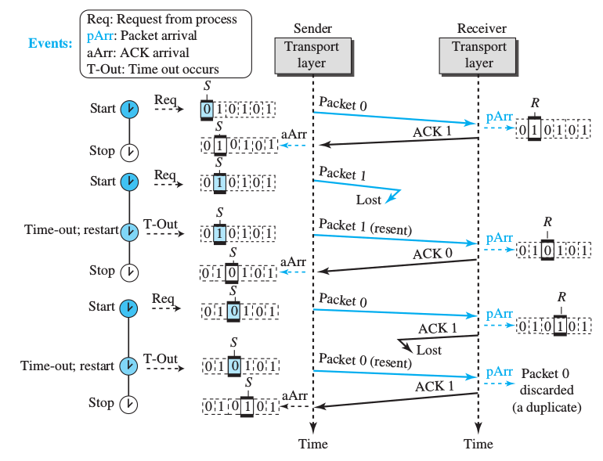
Stop & Wait
Flow diagram
ACK announces
the next packet
expected

Slide 52
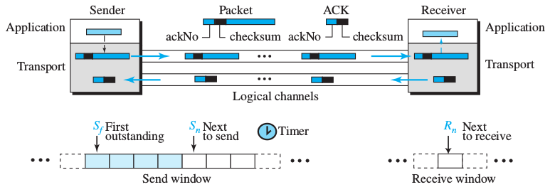
Go Back N
Waiting for a frame to be ack'd before sending a new one implies little channel efficiency
To improve efficiency the channel must be pipelined
  Continuous flow of requests
  Some may be pending the acknowledge
  Errors may force to go back and retransmit more than one frame
Sliding window
  More than one pending frame
  N bits required for 2^{m}-1 window size (sequence numbers)

Slide 53
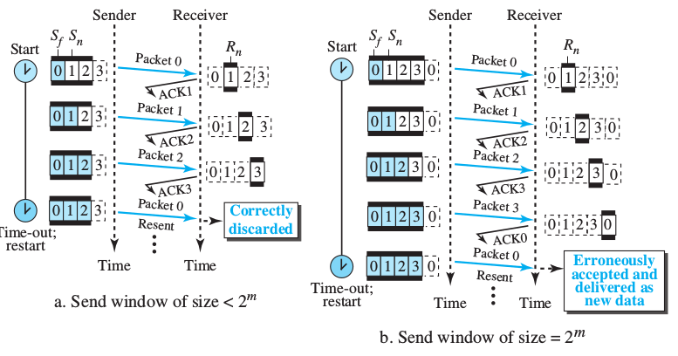
Go Back N

Slide 54
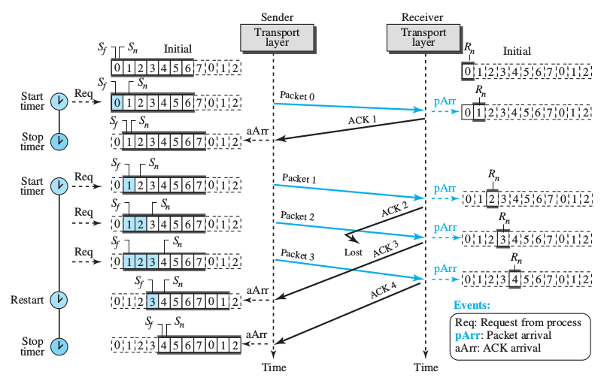
Go Back N
m = 3
window size = 2³ -1 = 7
for the sender
Window size = 1
for the receiver

Slide 55
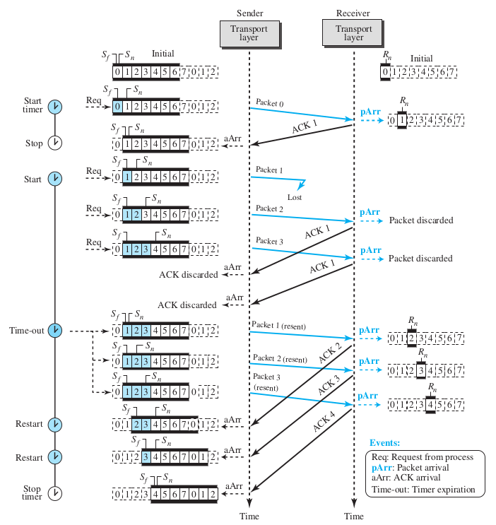
Go Back N

