Slide 1
Application Layer
application
Most of this presentation was based on the official slides of the Kurose&Ross textbook

Slide 2
Presentation based on slides by
Kurose and Ross, Computer Networking: A Top-Down Approach
available at Pearson:
http://www-net.cs.umass.edu/kurose-ross-ppt-6e/

Slide 3
Contents
Application layer paradigms
Web / HTTP
DNS
P2P

Slide 4
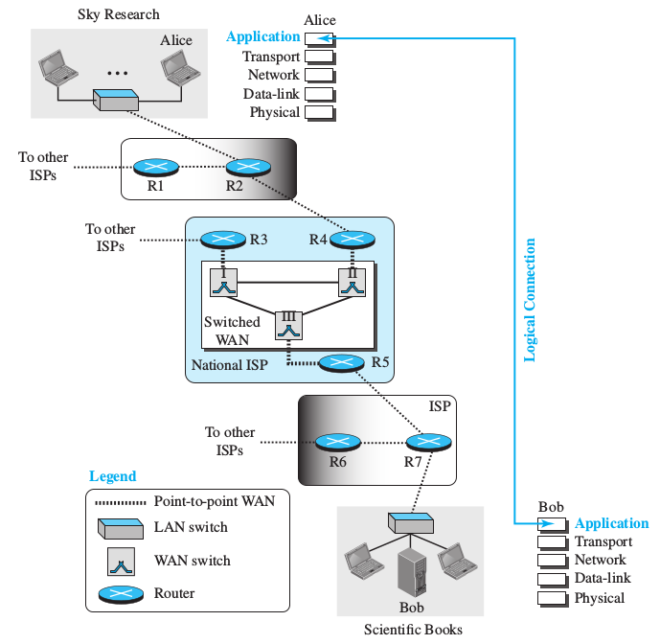
Logical connection
The Application Layer provides services to the user
Logical connection between app layers on both sides
But physically, connection takes place through the physical layer

Slide 5
App-layer protocol defines
Types of messages exchanged,
  e.g., request, response
Message syntax:
  what fields in messages & how fields are delineated
Message semantics
  meaning of information in fields
Rules for when and how processes send & respond to messages
Public-domain protocols:
defined in RFCs
allows for interoperability
e.g., HTTP, SMTP, IMAP
Proprietary protocols:
e.g., WhatsApp, Skype

Slide 6
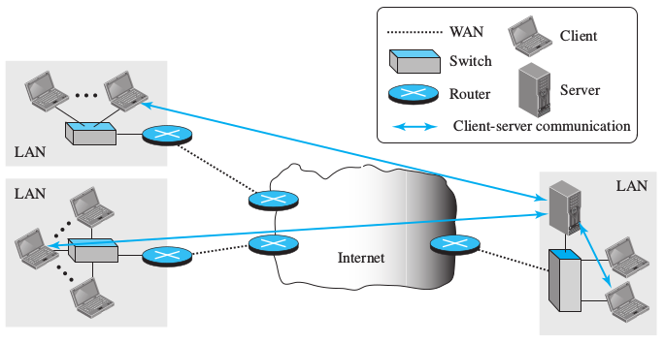
Client-server paradigm
client:
  communicate with server
  may be intermittently connected
  may have dynamic IP addresses
  do not communicate directly with each other
server:
  always-on host
  permanent IP address, port listening
  difficult to scale
    Server farms

Slide 7
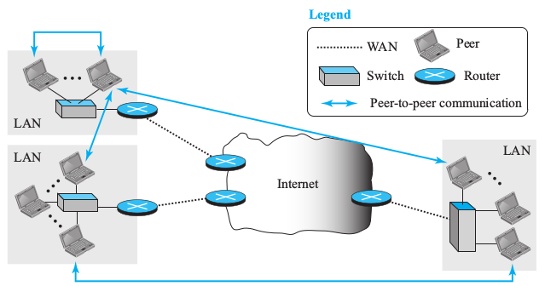
Peer-to-peer paradigm
no always-on server
arbitrary end systems directly communicate
peers are intermittently connected and change IP addresses
Highly scalable but difficult to manage

Slide 8
Hybrid of client-server and P2P
Skype
  Internet telephony app
  Finding address of remote party: centralized server(s)
  Client-client connection is direct (not through server)
Instant messaging
  Chatting between two users can be P2P
  Presence detection/location centralized:
    User registers its IP address with central server when it comes online
    User contacts central server to find IP addresses of buddies

Slide 9
What transport service does an app need?
Data loss
some apps (e.g., audio) can tolerate some loss
other apps (e.g., file transfer, telnet) require 100% reliable data transfer
Bandwidth
some apps (e.g., multimedia) require minimum amount of bandwidth to be “effective”
other apps (“elastic apps”) make use of whatever bandwidth they get
Timing
some apps (e.g., Internet telephony, interactive games) require low delay to be “effective”
Notes:
Ejemplo para la medida de la latencia:
ping <host>
Ejemplo para medir el throughput (paquete netdiag). Envía 300 bloques de datos a un host, por defecto al puerto 9. También es posible medir el throughput con tcpblast:
udpblast <host>

Slide 10
Transport service requirements of common apps
Application
file transfer
e-mail
Web documents
real-time audio/video
stored audio/video
interactive games
instant messaging
Data loss
no loss
no loss
no loss
loss-tolerant
loss-tolerant
loss-tolerant
no loss
Bandwidth
elastic
elastic
elastic
audio: 5kbps-1Mbps
video:10kbps-5Mbps
same as above
few kbps up
elastic
Time Sensitive
no
no
no
yes, 100’s msec
yes, few secs
yes, 100’s msec
yes and no

Slide 11
Internet transport protocols services
TCP service:
connection-oriented: setup required between client and server processes
reliable transport between sending and receiving process
flow control: sender won’t overwhelm receiver
congestion control: throttle sender when network overloaded
does not provide: timing, minimum bandwidth guarantees
UDP service:
unreliable data transfer between sending and receiving process
does not provide: connection setup, reliability, flow control, congestion control, timing, or bandwidth guarantee
Q: why bother? Why is there a UDP?

Slide 12
Internet apps: application, transport protocols
Application
layer protocol
SMTP [RFC 2821]
Telnet [RFC 854]
HTTP [RFC 2616]
FTP [RFC 959]
proprietary
(e.g. RealNetworks)
proprietary
(e.g., Vonage,Dialpad)
Underlying
transport protocol
TCP
TCP
TCP
TCP
TCP or UDP
typically UDP
Application
e-mail
remote terminal access
Web
file transfer
streaming multimedia
Internet telephony

Slide 13
Web and HTTP

Slide 14
World Wide Web
RFC
1946
2616
Developed in the CERN by Tim Berners-Lee in 1989
The WWW is a huge client-server distributed service
Definitions:
  Web pages: documents distributed all over the Internet
  Site: location providing web pages
  Hypermedia: linked objects inside web pages (text, audio, video, ..)
  Browser: client tool to display web pages

Slide 15



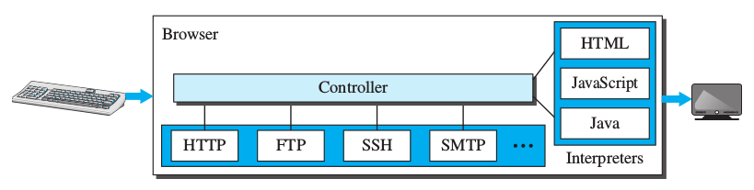
Web browser
Displays web pages (web client)
Three components
  Controller
  Client protocols
  Interpreters

Slide 16
Uniform Resource Locator (URL)
Each object in the network is uniquely identified by an URL
  Method: client protocol used
  Host: IP or host name
  Port: of the web service in the server (80 by default)
  Path: to the object inside the web server
http://www.someschool.edu/someDept/pic.gif
host name
path name
Examples: http://localhost:631
ftp://ftp.rediris.es/mirror

Slide 17
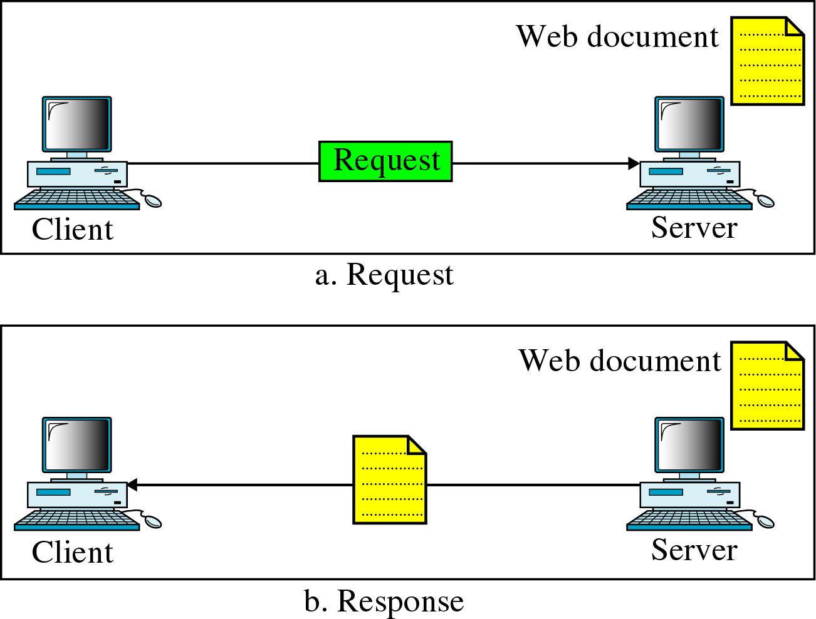
Web documents
Grouped into 3 categories
  Static
    Documents stored in the server
    Client gets a copy
    Languages used:
      HTML, XML, XSL, XHTML
  Dynamic
  Active
Static web page request
Notes:
https://tools.ietf.org/rfc/rfc2616.txt (RFC de HTTP, documento estático)
https://www.rfc-editor.org/errata_search.php?rfc=2616
(buscador de RFC y erratas, dinámico)

Slide 18
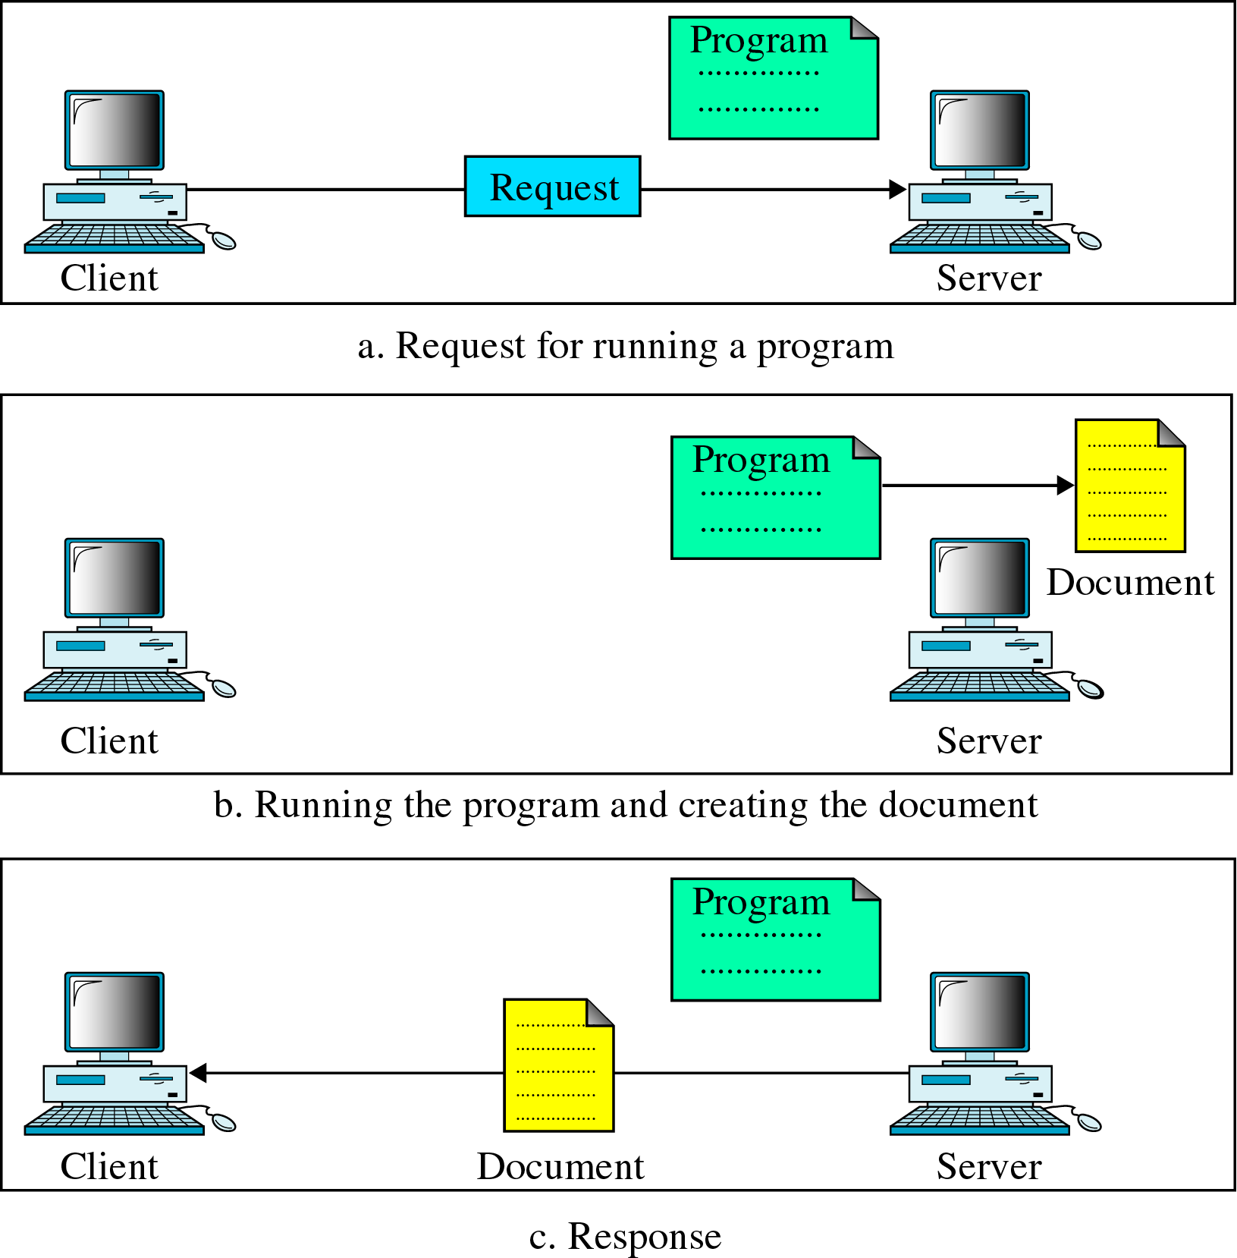
Web documents
Dynamic document
  Created by the server upon request
  May vary from request to request
  Programs used:
    Common Gateway Interface - CGI (obsolete)
    Java Server Pages (JSP)
    Active Server Pages (ASP)
Dynamic web page request

Slide 19
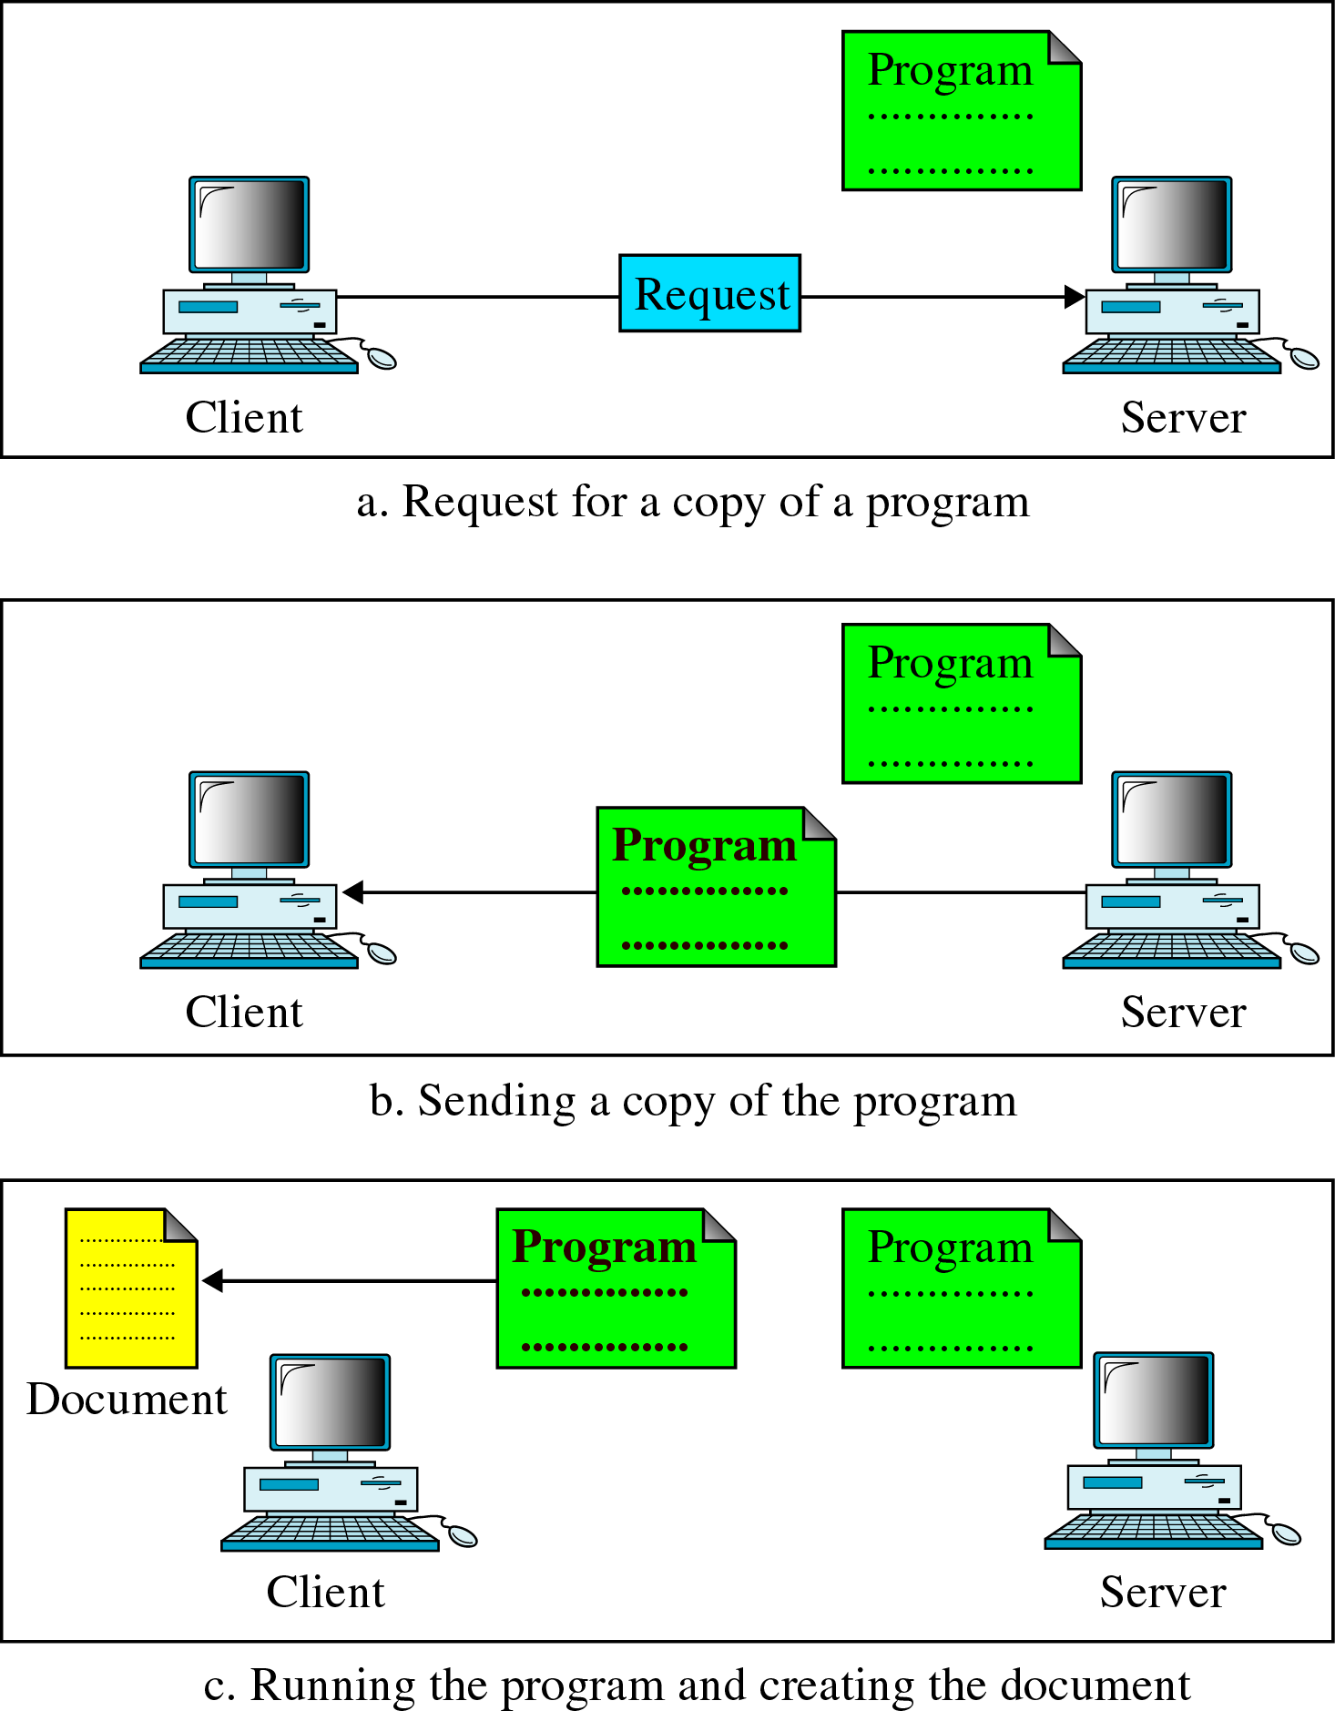
Web documents
Active web page
  Program runs in the client
  Client programs
    Java applets
    JavaScript
Active web page request

Slide 20
HTTP overview
Uses TCP as transport protocol:
  client initiates TCP connection to server, port 80
  server accepts TCP connection from client
  HTTP messages exchanged between browser and Web server
  TCP connection closed
HTTP is stateless
  server maintains no information about past client requests

Slide 21
HTTP connections
Nonpersistent HTTP
  At most one object is sent over a TCP connection
  A new connection per each object in the web page
  HTTP/1.0 uses nonpersistent HTTP
Persistent HTTP
  Multiple objects can be sent over single TCP connection between client and server.
  HTTP/1.1 uses persistent connections in default mode

Slide 22
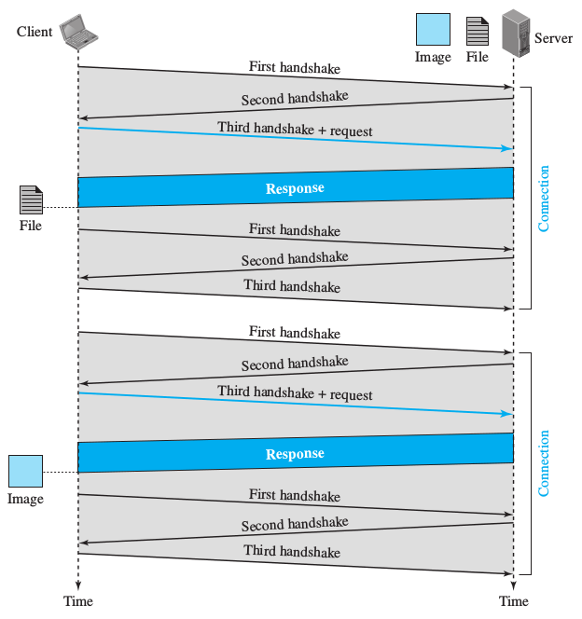
Nonpersistent HTTP connection
Example: html file with a link to an image
  Each connection implies 3 TCP msgs.
  Request sent in the 3rd one
  New connection for every object
    1 for the html
    1 for the image

Slide 23
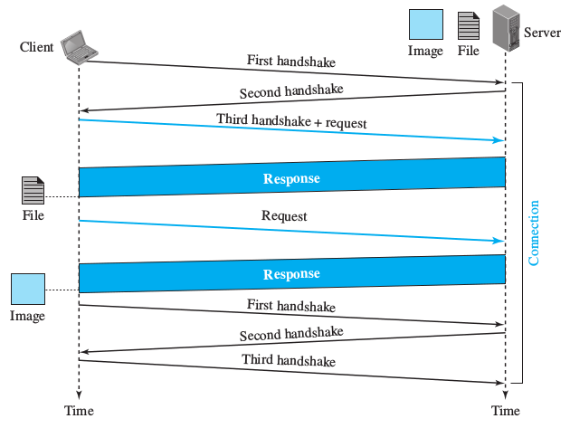
Persistent HTTP connection
Same example:
  Only one connection
  Image request sent separately

Slide 24
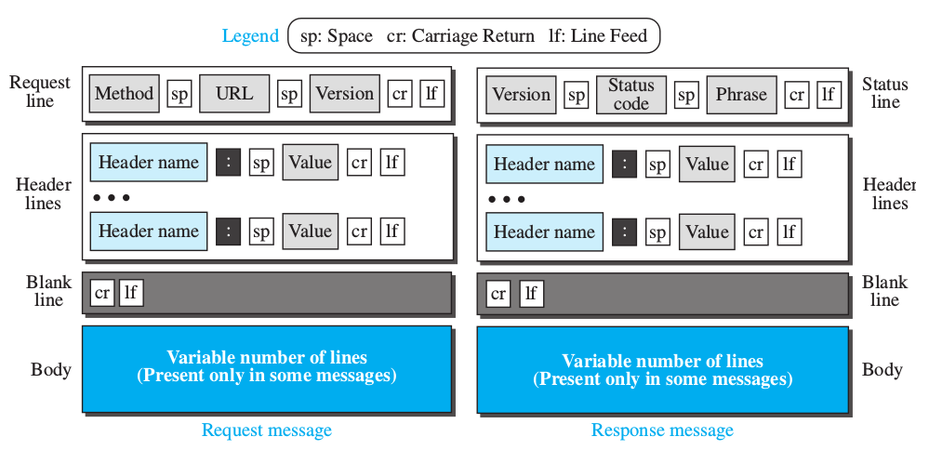
HTTP message format
Two types of HTTP messages: request, response
HTTP request message:
  ASCII (human-readable format)
4 sections

Slide 25
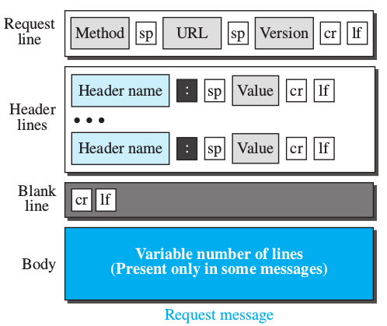
HTTP request message
Method : (GET, POST, HEAD commands)
GET /somedir/page.html HTTP/1.1
Host: www.someschool.edu
User-agent: Mozilla/4.0
Connection: close
Accept-language:fr
(extra carriage return, line feed)
Carriage return, line feed
indicates end of message

Slide 26
HTTP request message
Some of the method types (not a complete list):
  GET: request a resource
    Most used. Empty body
    May upload information using the URL parameters of the request line
      http://www.somesite.com/animalsearch?monkeys&banana
  HEAD: request only info about the document
    Ex: last modification time
    Empty body in the response
  PUT: sends a document to the server (only HTTP 1.1)
    Inverse of the GET
  POST: sends information to the server
    Sends information to be added to the web page, or to modify it
      Ex.: web page with an input form
      Input is uploaded in the body, not as part of the URL

Slide 27
HTTP request message
Request header:
  Optional, from 0 to several lines
  Additional information sent to the server
Header | Description
User-agent | Identifies the client program
Accept | Shows the media format the client can accept
Accept-charset | Shows the character set the client can handle
Accept-encoding | Shows the encoding scheme the client cant handle
Accept-language | Shows the language the client can accept
Authorization | Shows what permissions the client has
Host | Shows the host and port number of the client
Date | Shows the current date
Upgrade | Specifies the preferred communication protocol
Cookie | Returns the cookie to the server
If-Modified-Since | If the file is modificed since a specific date

Slide 28
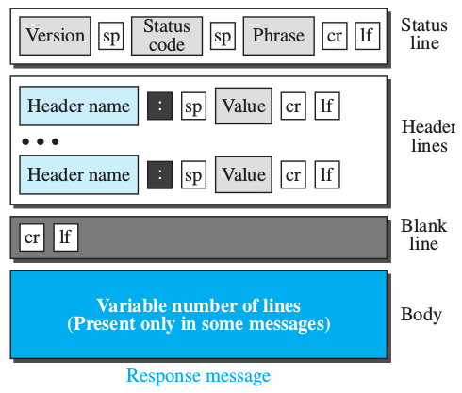
HTTP response message
HTTP/1.1 200 OK
Connection: close
Date: Thu, 06 Aug 1998 12:00:15 GMT
Server: Apache/1.3.0 (Unix)
Last-Modified: Mon, 22 Jun 1998 …...
Content-Length: 6821
Content-Type: text/html
data data data data data ...
data,
e.g., requested HTML file

Slide 29
HTTP response status codes
A few sample codes:
  200 OK
    request succeeded, requested object later in this message
  301 Moved Permanently
    requested object moved, new location specified later in this message (Location:)
  400 Bad Request
    request message not understood by server
  404 Not Found
    requested document not found on this server
  505 HTTP Version Not Supported

Slide 30
HTTP request message
Response header:
  Optional, from 0 to several lines
  Additional information sent from the server
Header | Description
Date | Shows the current date
Upgrade | Specifies the preferred communication protocol
Server | Gives information about the server
Set-Cookie | The server asks the client to save a cookie
Content-Encoding | Specifies the encoding scheme
Content-Language | Specifies the language
Content-Length | Shows the length of the document
Content-Type | Specifies the media type
Location | To ask the client to send the request to another site
Accept-Ranges | The server will accept the requested byte-ranges
Last-modified | Gives the date and time of the last change

Slide 31
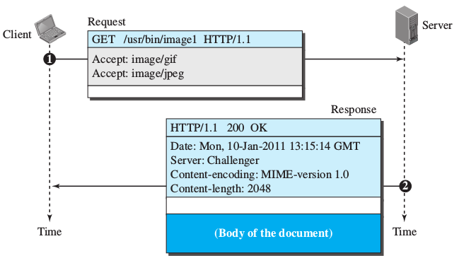
HTTP GET request example
The client retrieves an image
  May accept gif & jpeg formats
The server provides the image encoded (MIME)

Slide 32
HTTP GET request
DIY
Regular GET
$ ncat example.org 80
GET / HTTP/1.1
Host: example.org
HTTP/1.1 200 OK
Cache-Control: max-age=604800
Content-Type: text/html
Date: Tue, 21 Feb 2017 10:13:07 GMT
Etag: "359670651+ident"
Expires: Tue, 28 Feb 2017 10:13:07 GMT
Last-Modified: Fri, 09 Aug 2013 23:54:35 GMT
Server: ECS (iad/182A)
Vary: Accept-Encoding
X-Cache: HIT
Content-Length: 1270
<!doctype html>
<html>
<head>
<title>Example Domain</title>
[ … ]

Slide 33
301 Moved permanently
DIY
$ curl -Lvs -o /dev/null google.es
> GET / HTTP/1.1
> Host: google.es
> User-Agent: curl/7.52.1
> Accept: */*
>
< HTTP/1.1 301 Moved Permanently
< Location: http://www.google.es/
< Content-Type: text/html; charset=UTF-8
< Date: Tue, 21 Feb 2017 11:50:24 GMT
< Expires: Thu, 23 Mar 2017 11:50:24 GMT
< Cache-Control: public, max-age=2592000
< Server: gws
< Content-Length: 218
< [ … ]
<
> GET / HTTP/1.1
> Host: www.google.es
> User-Agent: curl/7.52.1
> Accept: */*
>
< HTTP/1.1 200 OK
< Date: Tue, 21 Feb 2017 11:50:24 GMT
< Cache-Control: private, max-age=0
< [ … ]
Client
Server
GET /
Host: google.es
301
Location: www.google.es
GET /
Host: www.google.es
200 OK

Slide 34
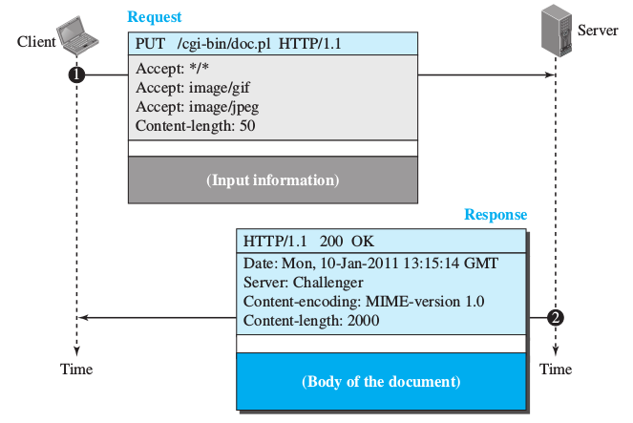
HTTP PUT response example
The client sends a web page to be posted on the server
  The body contains the page
The server returns the result of the execution of the CGI script in the body

Slide 35
HTTP conditional requests
The client may include a condition in the request
  The server sends a response in case it matches
Mainly used for date & time modifications
GET http://www.MyServer.com/info/file1 HTTP/1.1 Request line
If-Modified-Since: Wed, Jan 06 00:00:00 GMT Header line
Blank line
Request if changed
after the 6th of
January at 0 hours
HTTP/1.1 304 Not Modified Status line
Date: Thu, Jan 07 01:20:48 GMT Header lines
Server: MyServer.com
Blank line
(Empty Body) Empty body
Not changed
therefore
page not sent

Slide 36
Cookies
The web was designed as a stateless entity
But today state is required in situation such as:
  Electronic stores (shopping cart)
  Restricted access to registered users
  Portals where the user controls what it's displayed
  etc.

Slide 37
Cookies
Cookie creation process
  The server receives a request from a client and stores certain information (cookie) in a database
    Domain name, user name, timestamp, etc
  The server includes the cookie in the response
    In the header line
  The client stores the cookie locally
    Local filesystem and associated to the user profile
Use of the cookie
  On the request the browser looks for a locally stored cookie
  If it exists, it is sent to the server that will “recognize” the user
    In the header line

Slide 38
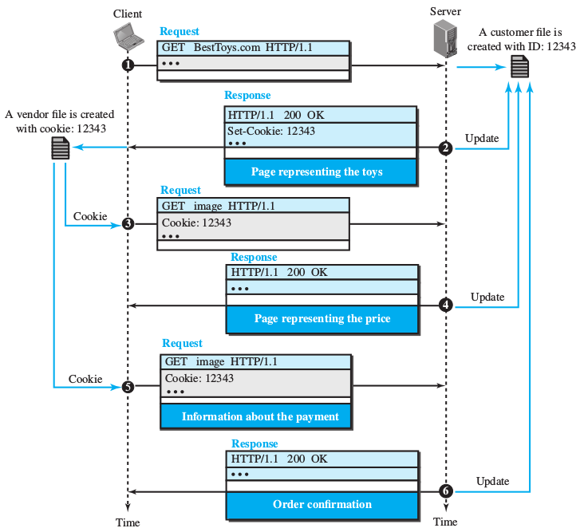
Cookies example
On-line toys store
  Request
  Empty cart with code 12343 + page with the toys
  Client requests a toy
  Server updates the cart and sends a page with total price
  The client sends payment data
While the cookie is not deleted the server will remember about you

Slide 39
Proxy servers
It’s a intermediate service that acts on behalf the client to reach a remote server.
Purposes:
  Logging
  Restriction policies
  Caching

Slide 40


Web caches (proxy server)
Goal: satisfy client request without involving origin server
user sets browser: Web accesses via cache
browser sends all HTTP requests to cache
  object in cache: cache returns object
  else cache requests object from origin server, then returns object to client
proxy
server
HTTP request
HTTP request
client
origin
server
HTTP response
HTTP response
HTTP request
HTTP response
client
origin
server

Slide 41
More about Web caching
Cache acts as both client and server
Typically cache is installed by ISP (university, company, residential ISP)
Why Web caching?
Reduce response time for client request.
Reduce traffic on an institution’s access link.
Internet dense with caches: enables “poor” content providers to effectively deliver content (but so does P2P file sharing)

Slide 42

Caching example
Assumptions
average resource size = 100,000 bits
avg. request rate from institution’s browsers to origin servers = 15,4/sec
delay ISP ↔ internet server = 2s
delay ISP ↔ inst. Router = 1s
delay inst. Router ↔ pc = 10ms
download time = 1,54 Mb / 1,54 Mbps = 1s
Consequences
utilization on LAN = 0,154%
utilization on access link = 100%
Response time = delay ISP ↔ inet. Serv + delay ISP ↔ inst. Router + LAN delay + down. Time = 4.01 s
origin
servers
public
Internet
1.54 Mbps
access link
institutional
network
1 Gbps LAN
Notes:
Calculo del ancho de banda
100Kb/object * 15.4object/s = 1.54 Mbps

Slide 43

Caching example (cont)
Possible solution
increase bandwidth of access link to, say, 10 Mbps
download time = 1,54 Mb / 10 Mbps = 0,154s
Consequences
utilization on LAN = 0,154%
utilization on access link = 15,4%
Time to get the object = delay ISP ↔ inet. Serv + delay ISP ↔ inst. Router + LAN delay + down. Time
Response time = 2 + 1+ 0,01 + 0,154 = 3,164 s
often a costly upgrade
origin
servers
public
Internet
1.54 Mbps
access link
10 Mbps
local web
cache
1 Gbps LAN

Slide 44
Caching example (cont II)
Install cache
suppose hit rate is 40%
Consequences
40% requests will be satisfied
hit_dwn_time 40% (1.54Mb) = 616Kb/1Gbps = 0,616ms
60% requests satisfied by origin
miss_dwn_time 60% (1.54Mb) = 924Kb/1.54Mbps = 600 ms
Response time = delay ISP ↔ inet. Serv + delay ISP ↔ inst. Router + LAN delay + hit_dwn_time + miss_dwn_time = 2+1+0.01+0.000616+0.6 = 3,610616s
origin
servers
public
Internet
1.54 Mbps
access link
institutional
network
1 Gbps LAN
local web
network

Slide 45
RFC
1034
1035
DNS

Slide 46
DNS: Domain Name System
People: many identifiers:
  SSN, name, passport #
Internet hosts, routers:
  IP address (32 bit) - used for addressing datagrams
  “name”, e.g., www.yahoo.com - used by humans
Q: map between IP addresses and name ?
Domain Name System:
distributed database implemented in hierarchy of many name servers
application-layer protocol host, routers, name servers to communicate to resolve names (address/name translation)
  note: core Internet function, implemented as application-layer protocol
  complexity at network’s “edge”

Slide 47
DNS
Why not centralize DNS?
Single point of failure
Traffic volume
Distant centralized database
Maintenance
Doesn’t scale!
DNS services
Hostname to IP address translation
Host aliasing
  Canonical and alias names
Mail server aliasing
Load distribution
  Replicated Web servers: set of IP addresses for one canonical name

Slide 48
Distributed, Hierarchical Database
Root DNS Servers
com DNS servers
org DNS servers
edu DNS servers
yahoo.com
DNS servers
pbs.org
DNS servers
poly.edu
DNS servers
umass.edu
DNS servers
amazon.com
DNS servers
Client wants IP for www.amazon.com; 1st approx:
Client queries a root server to find “com” DNS server
Client queries “com” DNS server to get “amazon.com” DNS server
Client queries “amazon.com” DNS server to get IP address for “www.amazon.com”

Slide 49

DNS: Root name servers
Contacted by local name server that can not resolve name
Root name server:
  contacts authoritative name server if name mapping not known
  gets mapping
  returns mapping to local name server
a Verisign, Dulles, VA
c Cogent, Herndon, VA (also Los Angeles)
d U Maryland College Park, MD
g US DoD Vienna, VA
h ARL Aberdeen, MD
j Verisign, ( 11 locations)
k RIPE London (also Amsterdam, Frankfurt)
i Autonomica, Stockholm (plus 3 other locations)
m WIDE Tokyo
e NASA Mt View, CA
f Internet Software C. Palo Alto, CA (and 17 other locations)
13 root name servers worldwide
b USC-ISI Marina del Rey, CA
l ICANN Los Angeles, CA

Slide 50
TLD and Authoritative Servers
Top-level domain (TLD) servers: responsible for com, org, net, edu, etc, and all top-level country domains uk, fr, ca, jp.
  Network solutions maintains servers for com TLD
  Educause for edu TLD
  CIRA for ca TLD
Authoritative DNS servers: organization’s DNS servers, providing authoritative hostname to IP mappings for organization’s servers (e.g., Web and mail).
  Can be maintained by organization or service provider

Slide 51
Local Name Server
Does not strictly belong to hierarchy
Each ISP (residential ISP, company, university) has one.
  Also called “default name server”
When a host makes a DNS query, query is sent to its local DNS server
  Acts as a proxy, forwards query into hierarchy.

Slide 52
Example
Host at cis.poly.edu wants IP address for www.uwaterloo.ca
root DNS server
2
3
TLD DNS server
4
5
local DNS server
dns.poly.edu
7
6
1
8
authoritative DNS server
dns.cs.umass.edu
requesting host
cis.poly.edu
gaia.cs.umass.edu

Slide 53
Recursive queries
recursive query:
puts burden of name resolution on contacted name server
heavy load?
iterated query:
contacted server replies with name of server to contact
“I don’t know this name, but ask this server”
root DNS server
2
3
7
6
TLD DNS
server
local DNS server
dns.poly.edu
5
4
1
8
authoritative DNS server
dns.cs.umass.edu
requesting host
cis.poly.edu
gaia.cs.umass.edu

Slide 54
DNS: caching and updating records
Once (any) name server learns mapping, it caches mapping
  cache entries timeout (disappear) after some time
  TLD servers typically cached in local name servers
    Thus root name servers not often visited
Update/notify mechanisms under design by IETF
  RFC 2136
  http://www.ietf.org/html.charters/dnsind-charter.html

Slide 55
DNS records
DNS: distributed db storing resource records (RR)
RR format: (name, value, type, ttl)
Type=A
  name is hostname
  value is IP address
Type=CNAME
  name is alias name for some “canonical” (the real) name
  www.ibm.com is really
servereast.backup2.ibm.com
  value is canonical name
Type=NS
  name is domain (e.g. foo.com)
  value is hostname of authoritative name server for this domain
Type=MX
  value is name of mailserver associated with name

Slide 56

DNS protocol, messages
DNS protocol : query and reply messages, both with same message format
msg header
identification: 16 bit # for query, reply to query uses same #
flags:
  query or reply
  recursion desired
  recursion available
  reply is authoritative

Slide 57
DNS protocol, messages
Name, type fields
for a query
RRs in response
to query
records for
authoritative servers
additional “helpful”
info that may be used

Slide 58
Inserting records into DNS
Example: just created startup “Network Utopia”
Register name networkuptopia.com at a registrar (e.g., Network Solutions)
  Need to provide registrar with names and IP addresses of your authoritative name server (primary and secondary)
  Registrar inserts two RRs into the com TLD server:
(networkutopia.com, dns1.networkutopia.com, NS)
(dns1.networkutopia.com, 212.212.212.1, A)
Put in authoritative server Type A record for www.networkuptopia.com and Type MX record for networkutopia.com
How do people get the IP address of your Web site?

Slide 59
Querying DNS
DIY
DNS servers
$ cat /etc/resolv.conf
nameserver 87.216.1.65
nameserver 87.216.1.66
Simple query
$ host uclm.es
uclm.es has address 161.67.137.239
uclm.es mail is handled by 0 uclm-es.mail.protection.outlook.com.
This has MX only
$ host alu.uclm.es
alu.uclm.es mail is handled by 10 alu-uclm-es….outlook.com.
Capture
$ sudo tshark -f "udp port 53"
1 0.000000000 192.168.1.139 → 87.216.1.65 DNS 67
Standard query 0x3494 A uclm.es
2 0.140573157 87.216.1.65 → 192.168.1.139 DNS 83
Standard query response 0x3494 A uclm.es A 161.67.137.239
3 0.141045803 192.168.1.139 → 87.216.1.65 DNS 67
Standard query 0xaf73 AAAA uclm.es
4 0.362192200 192.168.1.139 → 87.216.1.65 DNS 67
Standard query 0xbc66 MX uclm.es
5 0.566520929 87.216.1.65 → 192.168.1.139 DNS 118
Standard query response 0xbc66 MX uclm.es MX 0 uclm-es.mail.protection.outlook.com

Slide 60
dig
DIY
Record A
$ dig +short google.es
216.58.210.163
Record AAAA
$ dig +short google.es aaaa
2a00:1450:4003:808::2003
Record SOA
$ dig +short google.es soa
ns1.google.com. dns-admin.google.com. 148594331 900 900 1800 60
Record MX
$ dig +short google.es mx
30 alt2.aspmx.l.google.com.
40 alt3.aspmx.l.google.com.
50 alt4.aspmx.l.google.com.
20 alt1.aspmx.l.google.com.
10 aspmx.l.google.com.
Record PTR
$ dig +short -x 161.67.137.169
www.uclm.es.

Slide 61
RFC
5694
P2P Sharing

Slide 62
P2P file sharing
Example
Alice runs P2P client application on her notebook computer
Intermittently connects to Internet; gets new IP address for each connection
Asks for “Hey Jude”
Application displays other peers that have copy of Hey Jude.
Alice chooses one of the peers, Bob.
File is copied from Bob’s PC to Alice’s notebook: HTTP
While Alice downloads, other users uploading from Alice.
Alice’s peer is both a Web client and a transient Web server.
All peers are servers = highly scalable!

Slide 63


P2P: centralized directory
original “Napster” design
when peer connects, it informs central server:
        IP address
        Content
Alice queries for “Hey Jude”
Alice requests file from Bob
Con’s:
  Single point of failure
  Performance bottleneck
Bob
centralized
directory server
1
peers
1
1
3
2
1
Alice

Slide 64
BitTorrent
Born in 2002 (Brahm Cohen)
Motivation:
  Peers in P2P leave often
    bad if Alice leaves while Bob is downloading a (huge) file from her
  Popularity decreases quickly along time
Focused on efficient fetching:
  files broken into segments of 256 KB (sharing units)
  peers request segments that are rare early on to increase their availability
BitTorrent does not provide mechanism for locating content
  assumes that clients have a “.torrent” file, listing name of “tracker server”, which keeps track of peers having segments

Slide 65
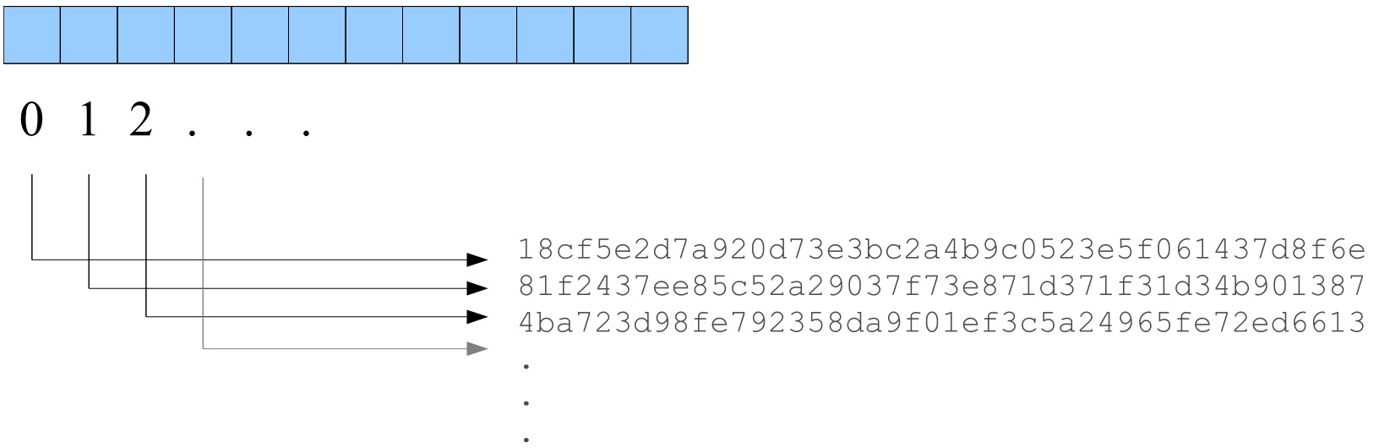
Bittorrent: how it works
A metadata file (.torrent) is distributed to all peers
  Usually via Web, Email, etc…
The metadata contains:
  SHA-1 hashes of all pieces
  Tracker reference (URL)
  Piece Length: usually 256KB
    is it better smaller or bigger pieces ?

Slide 66

Bittorrent: how it works
Tracker:
keeps list of peers
Torrent:
List of peers
3) chunk exchange
between peers
1) request list of peers
2) make the file available (seed)
peer

Slide 67
BitTorrent: Tit-for-Tat
Actors:
  Downloader: any peer with missing parts
  Leecher: a downloader with low share rate
  Seeder: user that has offers the whole file
Incentive: Tit-for-Tat
  The more you share, the more you can download
  Encourages fast peers to upload to you

Slide 68
P2P: Other uses
Not only for sharing files
  Content delivery, software publication
    DIY: research how Windows 10 delivers updates
  Streaming media applications
  Distributed computations (volunteer computing)
  Distributed search engines
  Social applications
  ...

Slide 69
Remarkable concepts
Client and server
Scalability
Bandwidth, latency, data loss
CO-mode vs. CL-mode
TCP vs. UDP
Reliability
Flow control
Congestion control
Stateless vs. Statefull
Proxy and cache
Logical addressing
Domain names

Slide 70
References
Behrouz A. Forouzan. Data Communication and Networking. Mc Graw Hill, 2013.
  Chapter 25.
A.S. Tanenbaum. Computer Networks. Pearson, Fourth edition, 2003.
  Chapter 7.
For further understanding:
  Behrouz A. Forouzan. TCP/IP Protocol Suite. McGraw-Hill, 2003.
    Chapters 18, 20, 22, 24, 25.
  Cited RFCs.

