Slide 1
Network Layer
network

Slide 2
Outline
Network layer
IP protocol
  Format
  Fragmentation
  Addressing
  Subnetting
Network configuration/management protocols
IP routing
  Delivery
  Forwarding
  Routing tables
  Dynamic Routing

Slide 3
Network Layer
Payload encapsulation
Routing
  host-to-host: The datagram may go through other hosts (or networks).
  Usually more than one possible route
  Help from routing protocols (not this year)
  connectionless: Packets are routed to its destination as individual (not related) entities.
Forwarding
  By routers to choose next hop, based on a routing table
Unreliable: It does not assure packet delivery nor arrival order. It performs a best-effort service.
Network layer main feature:
  Heterogeneous network interconnection

Slide 4
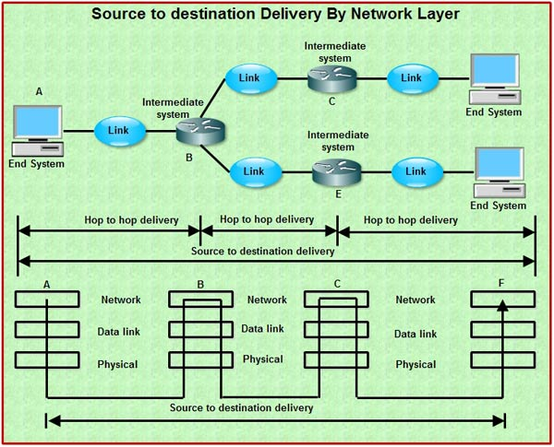
Network Layer

Slide 5

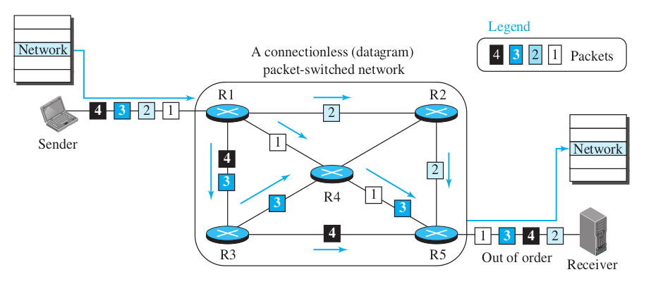
Network Layer
Connectionless service

Slide 6
IP: Inter-network Protocol
RFC
791
“The purpose of IP (inter-network protocol) is to move datagrams through an interconnected set of networks”
RFC 791
All in this section is about IP version 4
i

Slide 7
IP: Inter-network Protocol
IP deals with the fundamental issues of network layer:
Package format
Logical addressing
Datagram routing

Slide 8
IP datagram
Header format
IP datagram
header
payload
0
1
2
3
0
1
2
3
4
5
6
7
8
9
0
1
2
3
4
5
6
7
8
9
0
1
2
3
4
5
6
7
8
9
0
1
version
IHL
type of service
Total length
identification
D
F
M
F
fragment offset
time to live
protocol
header checksum
source address
destination address
options

Slide 9
IP datagram
Header
Version (4 bits): It is the IP protocol version. It is 4 for IPv4 and 6 for IPv6.
IHL (Internet Header Length) (4 bits): It is the header length, expressed a number of 32-bit words.
Type of service (8 bits)
It may be used to traffic prioritization or service differentiation. This is called Quality of Service (QoS).
Total length (16 bits)
Total length of packet, including header. Therefore, the maximum size of an IP packet is 65.535 bytes.

Slide 10
IP datagram
Header (fragmentation fields)
Identification (16 bits): When a packet is fragmented, all fragments have the same value in this field.
DF (Don't Fragment) (1 bit). Tells the routers not to fragment the packet,
MF (More Fragments) (1 bit). Indicates that this is not the last fragment. Non-fragmented packages have always a 0 in this field.
Offset (13 bits). Position of the fragment in the original datagram. The value is expressed as a number of 8 byte (64 bit) words. It may be 8192 fragments as much. The first fragment and not fragmented datagram have always a 0 in this field.
The fragment length must be multiple of 8, except the last one.

Slide 11
IP datagram
Header
Time to live (8 bits): It is the maximum hops the packet may live. When the router forwards the packet, it must decrease at least this value in 1. If the TTL is 0, the packet is discarded
Protocol (8 bits): A code that refers the payload protocol.
ICMP – 1
IGMP – 2
IP – 4
TCP – 6
UDP – 17
OSPF – 89
All protocol numbers in:
https://www.iana.org/assignments/protocol-numbers/protocol-numbers.xhtml
i

Slide 12
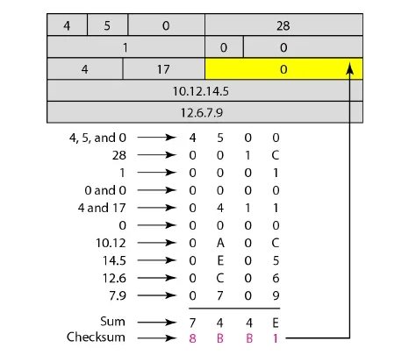
IP datagram
Header
Checksum (16 bits): Computed over the header data to detect errors. It must be recomputed in each hop.
[from: B.A.Forouzan, Data communications and Networking]

Slide 13
IP datagram
Header
Source (32 bits): IP address of the source host interface.
Destination (32 bits): IP address of the destination host interface.

Slide 14
IP datagram
Options
Options are used to indicate rare features or to extend the protocol functionality.
32
code
length
data
8
0/8
Variable
class
number
copy
1
2
5
copy: copy this option to all fragments (1) or only the first (0)
class: 00 (control), 10 (debug and measure), 11 y 01 (not defined)
number: It identifies the option. There are 8 options, currently.

Slide 15

IP Fragmentation
IP routers forward datagrams between different networks.
The maximum frame size or Maximum Transfer Unit (MTU) may change from network to network.
MTU: 1000
MTU: 500
Packets must be “sliced” by routers.
Only destination host can reassembly fragments.
Why?
?

Slide 16
IP Fragmentation
Example
MTU: 5000
source
R1
destination
f.1 and f.3
R2
MTU: 1420
MTU: 2500
MTU: 2500
R3
R4
R5
f.2
MTU: 820

Slide 17
IP Fragmentation example
1420
f.1
14.567
1
000
data
0000 - 1399
820
f.2.1
14.567
1
175
4020
1420
f.2
14.567
0
000
14.567
1
175
data
1400 - 2199
data
0000 - 3999
data
1400 - 2799
620
f.2.2
14.567
1
275
original datagram
1220
f.3
14.567
0
350
data
2200 - 2799
data
2800 - 3999
[from: B.A.Forouzan, TCP/IP Protocol Suite]

Slide 18
Forcing sender fragmentation
DIY
DIY
$ sudo tshark -f "ip dst 120.1.1.1"
Capturing on 'eth0'
1 0.000000000 192.168.1.135 → 120.1.1.1
IPv4 1514 Fragmented IP protocol (proto=ICMP 1, off=0, ID=fcec)
2 0.000028922 192.168.1.135 → 120.1.1.1
IPv4 1514 Fragmented IP protocol (proto=ICMP 1, off=1480, ID=fcec)
3 0.000034101 192.168.1.135 → 120.1.1.1
ICMP 1082 Echo (ping) request id=0x002a, seq=1/256, ttl=64
POSIX
$ ping -c 1 -s 4000 120.1.1.1
PING 120.1.1.1 (120.1.1.1) 4000(4028) bytes of data.
4008 bytes from 120.1.1.1: icmp_seq=1 ttl=234 time=280 ms
Why 4028 bytes of data?

Slide 19
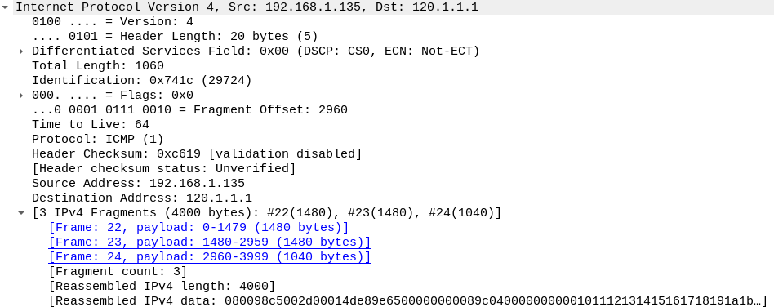
Forcing sender fragmentation
DIY
DIY
POSIX
$ ping -c 1 -s 3992 120.1.1.1
PING 120.1.1.1 (120.1.1.1) 4000(4020) bytes of data.
4000 bytes from 120.1.1.1: icmp_seq=1 ttl=234 time=280 ms

Slide 20
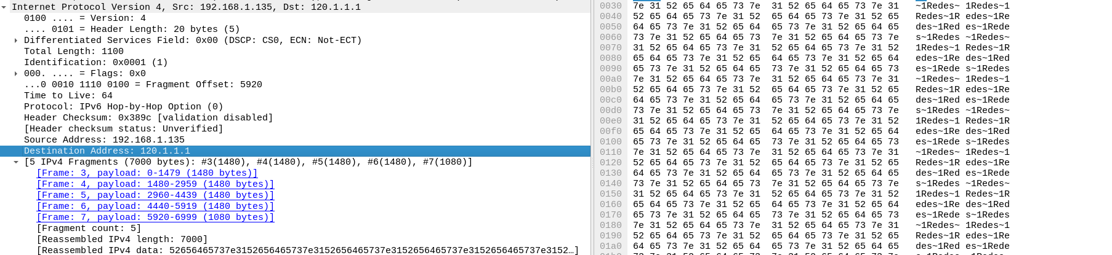
Forcing sender fragmentation
DIY
DIY
from scapy.all import *
# Build an IP datagram
d = IP(dst="120.1.1.1")
# Set the payload: 7000 bytes
d.add_payload("Redes~1"*1000)
# Send the datagram
send(d)
Python

Slide 21
IP addressing

Slide 22
IP addressing
The IP address is a 32 bit integer.
The address identifies a connection point (a NIC).
IP addresses are universally unique.
The addressing space is 2³² = 4.294.967.296
A single host may have several interfaces and it must have an address per connected interface.

Slide 23
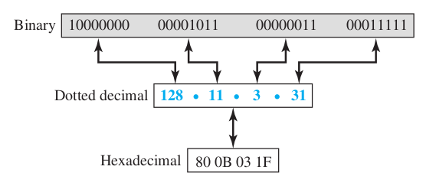
IP addressing
Three types of notation

Slide 24
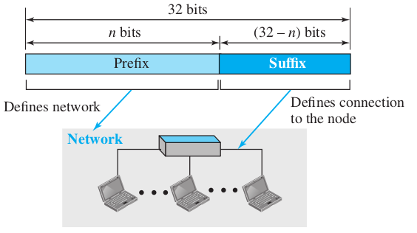
IP addressing
Hierarchical addressing
  NetID, identifies the network (designed by a global authority) IANA
  HostID, identifies a host inside the network.

Slide 25
Check your laptop IP
(POSIX SO)
DIY
DIY
$ ip addr
1: lo: <LOOPBACK,UP,LOWER_UP> mtu 65536 qdisc noqueue state UNKNOWN group default qlen 1
link/loopback 00:00:00:00:00:00 brd 00:00:00:00:00:00
inet 127.0.0.1/8 scope host lo
valid_lft forever preferred_lft forever
inet6 ::1/128 scope host
valid_lft forever preferred_lft forever
2: eth0: <BROADCAST,MULTICAST,UP,LOWER_UP> mtu 1500 qdisc pfifo_fast state UP group
default qlen 1000
link/ether 98:90:96:a5:02:be brd ff:ff:ff:ff:ff:ff
inet 161.67.27.119/24 brd 161.67.27.255 scope global eth0
valid_lft forever preferred_lft forever
inet6 fe80::9a90:96ff:fea5:2be/64 scope link
valid_lft forever preferred_lft forever

Slide 26
Check your laptop IP
(Windows SO)
DIY
DIY
C:\> ipconfig /all
[...]
Ethernet adapter Local Area Connection:
Connection-specific DNS Suffix . : dns.reskit.com
Description . . . . . . . . . . . : Realtek C45
Physical Address. . . . . . . . . : 00-AB-55-87-4C-AD
DHCP Enabled. . . . . . . . . . . : Yes
IP Address. . . . . . . . . . . . : 161.67.120.12
Subnet Mask . . . . . . . . . . . : 255.255.248.0
Default Gateway . . . . . . . . . : 172.16.240.1
DHCP Server . . . . . . . . . . . : 172.16.248.8
DNS Servers . . . . . . . . . . . : 172.16.55.85
172.16.55.134
172.16.55.54
Lease Obtained. . . . . . . . . . : Friday, May 05, 2017 2:21:40 PM
Lease Expires . . . . . . . . . . : Monday, May 07, 2017 2:21:40 PM

Slide 27
Special addresses
RFC
3330
0.0.0.0
This host (any interface)
11111111.11111111.11111111.11111111
All hosts: 255.255.255.255
XX ... XX
00 ... 00
This network
XX ... XX
11 ... 11
All hosts in this network
00 ... 00
XX ... XX
A host in this network
01111111.X.X.X
Loopback: 127.0.0.1

Slide 28
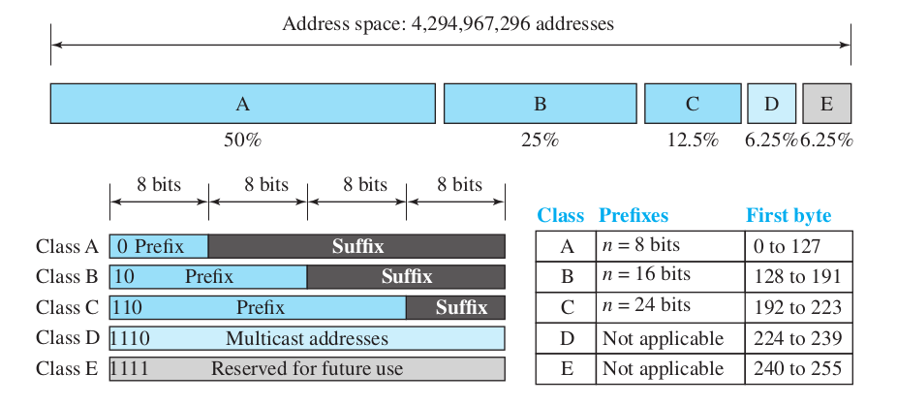
Classful addressing
Original division of the Internet Addressing
Obsolete. Why?
i

Slide 29
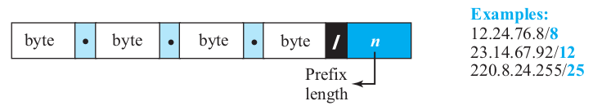
Classless addressing
Classful address is little flexible.
Classless allows to define variable length blocks of any size (power of 2).
The first address and the mask defines the block
It implies routing problems, solved by CIDR.
We use classless addressing normally
Then we have to add the network mask ALWAYS

Slide 30
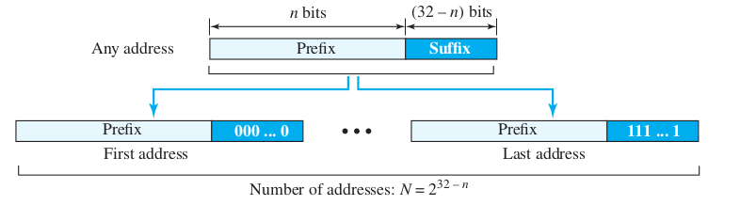
Address Info Extraction
Example: 167.199.170.82/ 27
  Num. of available addr. in the network 2³²⁻²⁷=2⁵=32
  Bin. Notation: 10100111.11000111.10101010.01010010
167 . 199 . 170 . 82
  First addr: 10100111.11000111.10101010.01000000
167 . 199 . 170 . 64
  Last Addr: 10100111.11000111.10101010.01011111
167 . 199 . 170 . 95
(net addr)
(bcast addr)

Slide 31
Addressing
Network mask
The mask is a 32-bit integer that determines the net-id.
network address = host address AND mask
161.67.213.172 mask 255.255.254.0 ¿net-addr?
161
67
213
172
It is a B class network
But...
i
1010 0001
0100 0011
1101 0101
1010 1100
mask
1111 1111
1111 1111
1111 1110
0000 0000
network address
1010 0001
0100 0011
1101 0100
0000 0000
Network address 161.67.212.0 with mask 255.255.254.0

Slide 32
Addressing
Network mask
Default masks for the three classes
A
255
0
0
0
B
255
255
0
0
C
255
255
255
0
The mask is required because we don't use classful addressing usually (deprecated).
Other way to specify the mask is the “CIDR notation”.
  Example: The mask 255.255.254.0 may be indicated like:
  161.67.213.172 /23

Slide 33
Addressing
CIDR
Class Inter-Domain Routing: a method for allocating IP addresses and perform IP routing.
Introduced for replacing classful addresses in the Internet.
IP ranges assigned by IANA:
  5 Regional Internet Registries provide IP ranges across the world to local entities.
CIDR is based on VLSM (Variable Length Subnet Mask) for defining subnets of any size.
Routers had to update their routing tables to include the mask as part of the routing calculation.

Slide 34
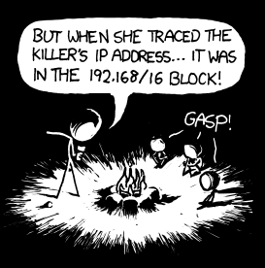
Private addresses
RFC
1918
Some blocks are reserved for private addressing (privately administered). The packets with a private destination address must be not forwarded
outside the network.
10.0.0.0-10.255.255.255 (10/8 prefix)
(16.777.216 hosts in one 24 bit block)
172.16.0.0 -172.31.255.255 (172.16/12 prefix)
(1.048.576 hosts in one 20 bit block)
192.168.0.0-192.168.255.255(192.168/16prefix)
(65.536 hosts in one 16 bit block)
http://xkcd.com/742/

Slide 35
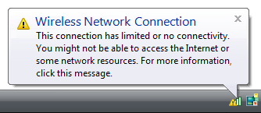
Link-local addresses
RFC
3927
It is a method to auto-assign an IP address without DHCP or other external service.
The host selects an address in the block 169.254/16 using a pseudo-random number.
These addresses are valid only to communicate with neighbours (same physical or logical link).
These are not routable address.

Slide 36
Subnetting
RFC
950
Problem: The A and B class networks are underutilized.
Solution: Divide them in smaller sub-networks. Part of the host id is used to identify the sub-net.
0
1
2
3
RFC
1878
0
1
2
3
4
5
6
7
8
9
0
1
2
3
4
5
6
7
8
9
0
1
2
3
4
5
6
7
8
9
0
1
10
net id
host id
n bits -> 2^{n} subnet
i
sub-net id
The scheme shows a 4-bit sub-net id. Therefore, there are 16 subnets with 2¹²-2 hosts each.

Slide 37
Subnetting
The number of subnets must be a power of 2.
It may be applied to any not-used block.
That is a local decision, taken by the administrator. It is not perceived from outside.
Sample: Apply subnetting to the next network to obtain 4 blocks:
141.14.0.2
141.14.0.3
141.14.0.253
141.14.0.254
Network: 141.14.0.0/24
141.14.0.1
Internet

Slide 38
Subnetting sample (cont)
141.14.0.2
141.14.0.3
141.14.0.62
141.14.0.66
141.14.0.67
141.14.0.126
Subnet: 141.14.0.0/26
X.X.X.00000000
Bcast: 141.0.0.63
X.X.X. 00111111
Subnet: 141.14.0.64/26
X.X.X.01000000
Bcast: 141.0.0.127
X.X.X. 01111111
141.14.0.1
141.14.0.65
141.14.0.130
141.14.0.131
141.14.0.190
141.14.0.194
141.14.0.195
141.14.0.254
Subnet: 141.14.0.128/26
X.X.X.10000000
Bcast: 141.0.0.191
X.X.X. 10111111
Subnet: 141.14.0.192/26
X.X.X.11000000
Bcast: 141.0.0.255
X.X.X. 11111111
Original network divided
in 4 equal size subnets
141.14.0.129
141.14.0.193
Internet

Slide 39
ICMP
Internet Control Message Protocol
RFC
792
It is a network layer protocol. It complements IP to provide:
Reports about issues in IP packet delivery.
Requests several information about hosts and routers.
ICMP messages are encapsulated on IP packets.
ICMP
header
ICMP data
IP header
IP payload
frame header
frame payload
frame tail

Slide 40
ICMP
Message format
0
1
2
3
0
1
2
3
4
5
6
7
8
9
0
1
2
3
4
5
6
7
8
9
0
1
2
3
4
5
6
7
8
9
0
1
type
code
checksum
rest of header
data
Types of messages:
Errors
  destination unreachable
  source quench
  time exceeded
  parameter problem
  redirection
Requests
  Echo (request and reply)
  Timestamp (request and reply)
  Address mask (request and reply)
  Router solicitation o advertisement

Slide 41
ICMP
Errors
ICMP error messages are always sent to the source host.
ICMP never fixes, it only reports.
Some cases that do not generate ICMP errors:
  An error in an IP packet carrying an ICMP message.
  A fragment different that the first.
  Multicast packets.
  IP packets with special address, like 127.0.0.1
ICMP error messages include the header of the problematic IP packet and 8 bytes of its payload.
Why?
?
Why?
?

Slide 42
ICMP
Errors
Destination unreachable
Sent by a router (or destination host) to indicate that the IP packet can not be delivered.
The message includes a reason (16 different codes).
Source quench
It is a basic congestion/flow control mechanism. It requests the source to decrease data rate.
Time exceeded
Sent by a router to indicate that the packet TTL came to 0
Sent by the destination host if a fragmentation timeout occurs.

Slide 43
ICMP
Errors
Parameter problem
Sent by router or destination host if the packet is malformed or there are missing fields.
Redirect
Sent by routers to hosts to indicate there is a better first router for them.
The host may use that information to update its routing table.

Slide 44
ICMP
Requests
Echo
Used to verify network connectivity. When a host (or router) receives an Echo-Request, it should answer with an Echo-Reply.
Timestamp
It may be used to measure latency between remote hosts.
Address mask
Hosts may query for the network mask to use to a router.
Router Solicitation
Hosts may query about local routers with this kind of message. Routers answer with their identification.

Slide 45
Measuring RTT with ICMP Echo
DIY
DIY
$ ping google.com
PING google.com (21.58.2.23) 56(84) bytes of data.
64 bytes from mad0.1e100.net (21.58.2.23): icmp_seq=1 ttl=56 time=4.58 ms
64 bytes from mad0.1e100.net (21.58.2.23): icmp_seq=2 ttl=56 time=4.51 ms
64 bytes from mad0.1e100.net (21.58.2.23): icmp_seq=3 ttl=56 time=4.59 ms
64 bytes from mad0.1e100.net (21.58.2.23): icmp_seq=4 ttl=56 time=4.59 ms
^C
--- google.com ping statistics ---
4 packets transmitted, 4 received, 0% packet loss, time 3004ms
rtt min/avg/max/mdev = 4.518/4.573/4.595/0.057 ms
POSIX
RTT: Round Trip Time

Slide 46
Create your own ping
DIY
DIY
from scapy.all import *
# Build an IP datagram
d = IP(dst="8.8.8.8")/ICMP(type=8)
# Send the datagram and receive the reply
r = sr1(d, timeout=3)
# Show some fields
print(r)
Python

Slide 47
DHCP
(Dynamic Host Configuration Protocol)
RFC
2131
Automatically configure host network parameters
IP address
Network mask
Local gateway
DNS
Hostname / domain
Time server
etc.

Slide 48
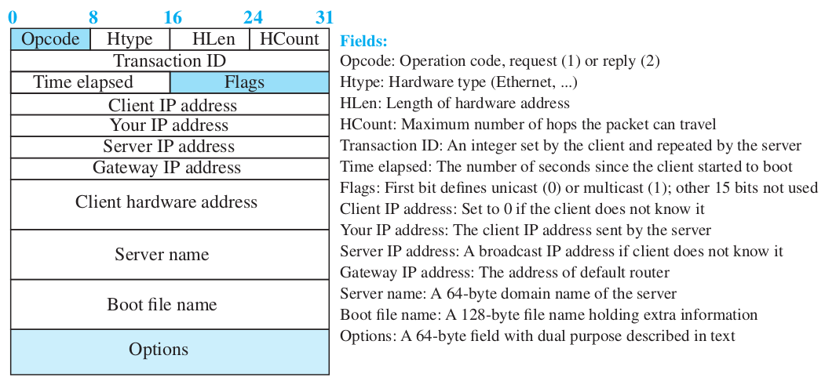
DHCP
Message format

Slide 49
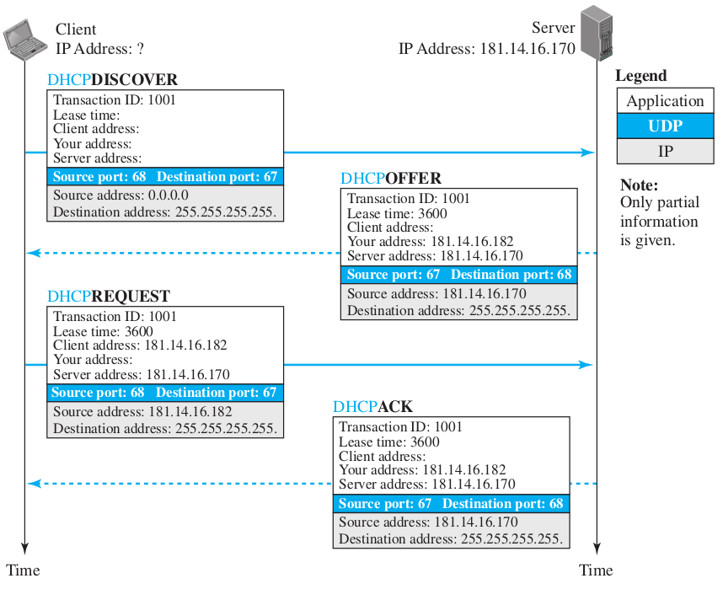
DHCP
Operations

Slide 50
Requesting DHCP
DIY
DIY
$ sudo dhclient -v
Internet Systems Consortium DHCP Client 4.3.5
Copyright 2004-2016 Internet Systems Consortium.
All rights reserved.
For info, please visit https://www.isc.org/software/dhcp/
Listening on LPF/eth0/98:90:96:a5:02:be
Sending on LPF/eth0/98:90:96:a5:02:be
Sending on Socket/fallback
DHCPDISCOVER on eth0 to 255.255.255.255 port 67 interval 5
DHCPREQUEST of 161.67.27.119 on eth0 to 255.255.255.255 port 67
DHCPOFFER of 161.67.27.119 from 161.67.27.1
DHCPACK of 161.67.27.119 from 161.67.27.1
RTNETLINK answers: File exists
bound to 161.67.27.119 -- renewal in 239633 seconds.
POSIX

Slide 51
IP routing

Slide 52
IP routing
All IP hosts have a routing table that associates (IP address, mask) tuples with a delivery method:
Next hop address (a neighbor router)
Direct delivery (destination is a neighbor host)

Slide 53
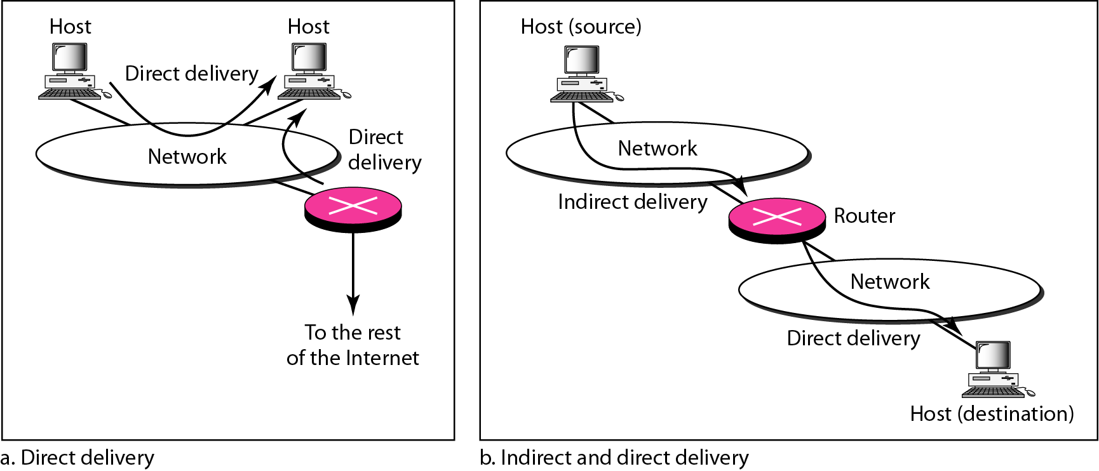
Delivery: direct and indirect
The network layer supervises the handling of the packets by the underlying physical networks. That is the delivery of a packet.
Copyright © The McGraw-Hill Companies, Inc.

Slide 54
Forwarding
To place the packet in its route to its destination
Requires a host or a router to have a routing table
When a host has a packet to send or when a router has received a packet to be forwarded, it looks at this table to find the route to the final destination.
Topics discussed in this section:
Forwarding Techniques
Forwarding Process
Routing Table
Copyright © The McGraw-Hill Companies, Inc.

Slide 55
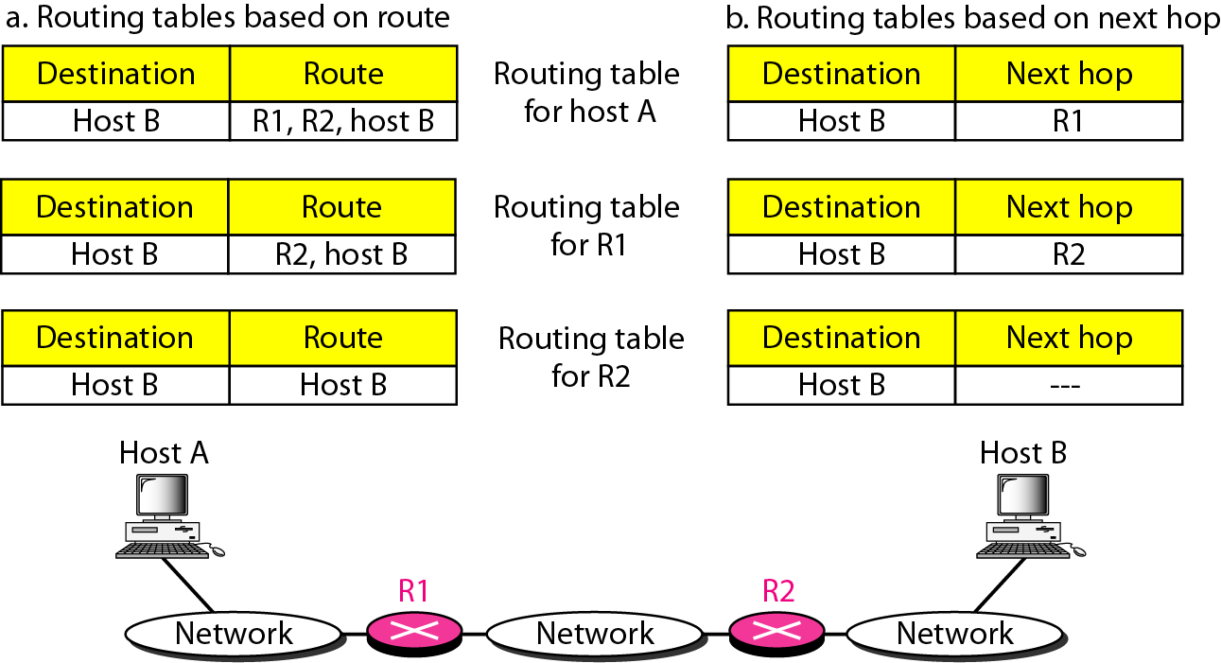
Route method vs next-hop method
Figure 22.2
Copyright © The McGraw-Hill Companies, Inc.

Slide 56
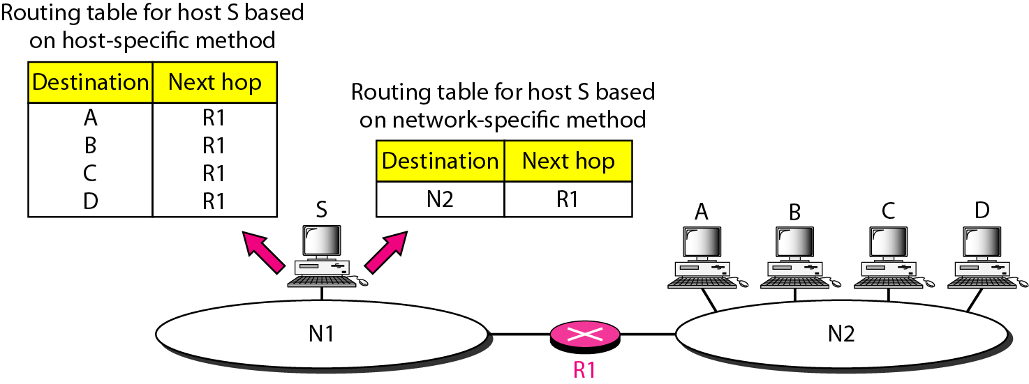
Host-specific vs. network-specific method
Figure 22.3
Copyright © The McGraw-Hill Companies, Inc.

Slide 57
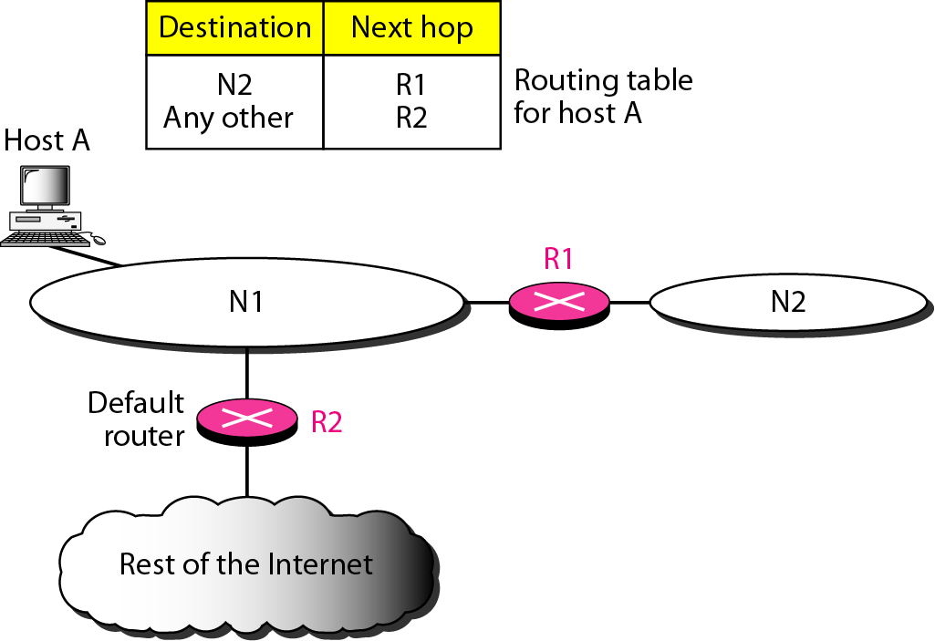
Default method
Figure 22.4
Copyright © The McGraw-Hill Companies, Inc.

Slide 58
Routing procedure
d = datagram.destination
for row in routing_table:
n = d & row.mask
if n == row.destination:
forward(datagram, row.next_hop)
return
if default_router:
forward(datagram, default_router)
else:
raise RoutingError # send ICMP error message

Slide 59
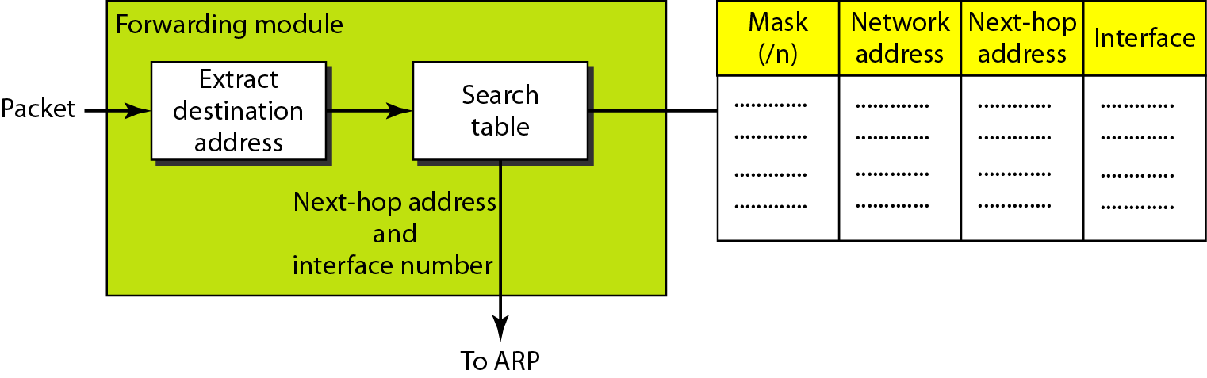
Simplified forwarding module in classless address
Figure 22.5
Copyright © The McGraw-Hill Companies, Inc.

Slide 60
In classless addressing, we need at least four columns in a routing table.
i
Copyright © The McGraw-Hill Companies, Inc.

Slide 61

Example
30.0.0.0
128.1.0.0
30.0.0.7
128.1.0.8 - eth1
128.1.0.9
40.0.0.7
40.0.0.8 - eth0
192.4.10.9
40.0.0.0
192.4.10.0

Slide 62
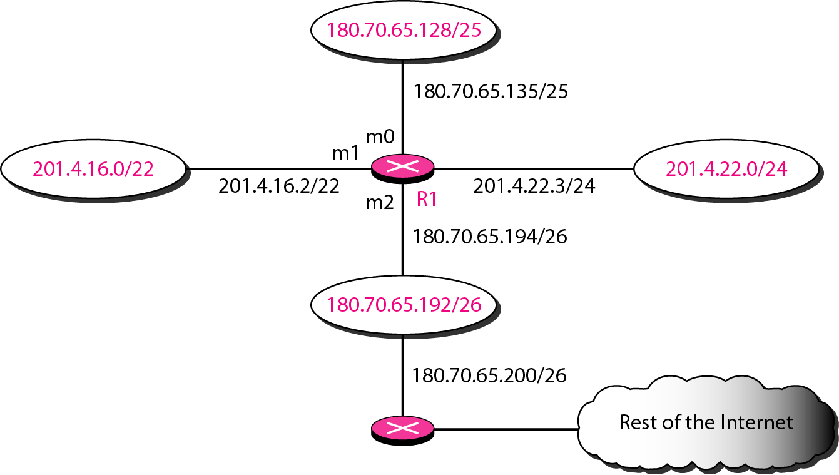
Example 22.1
Make a routing table for router R1:
Figure 22.6
Copyright © The McGraw-Hill Companies, Inc.

Slide 63
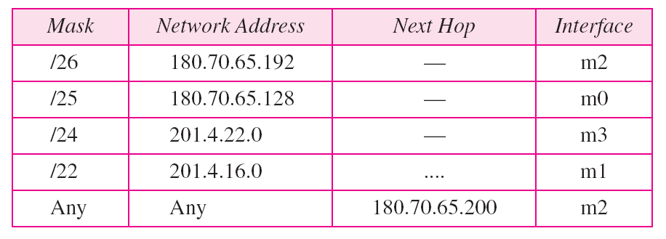
Example 22.1
Table 22.1 Routing table for router R1 in Figure 22.6
/0
0.0.0.0
Copyright © The McGraw-Hill Companies, Inc.

Slide 64
Example 22.2
Show the forwarding process if a packet arrives at R1 in Figure 22.6 with the destination address 180.70.65.140.
Solution
The router performs the following steps:
1. The first mask (/26) is applied to the destination address. The result is 180.70.65.128, which does not match the corresponding network address.
2. The second mask (/25) is applied to the destination address. The result is 180.70.65.128, which matches the corresponding network address. The next-hop address and the interface number m0 are passed to ARP for further processing.
Copyright © The McGraw-Hill Companies, Inc.

Slide 65
Example 22.3
Show the forwarding process if a packet arrives at R1 in Figure 22.6 with the destination address 201.4.22.35.
Solution
The router performs the following steps:
1. The first mask (/26) is applied to the destination address. The result is 201.4.22.0, which does not match the corresponding network address.
2. The second mask (/25) is applied to the destination address. The result is 201.4.22.0, which does not match the corresponding network address (row 2).
Copyright © The McGraw-Hill Companies, Inc.

Slide 66
Example 22.3 (continued)
3. The third mask (/24) is applied to the destination address. The result is 201.4.22.0, which matches the corresponding network address. The destination address of the packet and the interface number m3 are passed to ARP.
Copyright © The McGraw-Hill Companies, Inc.

Slide 67
Example 22.4
Show the forwarding process if a packet arrives at R1 in Figure 22.6 with the destination address 18.24.32.78.
Solution
This time all masks are applied, one by one, to the destination address, but no matching network address is found. When it reaches the end of the table, the module gives the next-hop address 180.70.65.200 and interface number m2 to ARP. This is probably an outgoing package that needs to be sent, via the default router, to someplace else in the Internet.
Copyright © The McGraw-Hill Companies, Inc.

Slide 68
Host routing table example
DIY
DIY
POSIX
$ /sbin/route -n
Kernel IP routing table
Destination Gateway Genmask Flags Metric Ref Use Iface
0.0.0.0 161.67.48.1 0.0.0.0 UG 600 0 0 wlan0
161.67.48.0 0.0.0.0 255.255.254.0 U 600 0 0 wlan0
POSIX
$ ip route
default via 161.67.48.1 dev wlan0 proto static metric 600
161.67.48.0/23 dev wlan0 proto kernel scope link src 161.67.48.238 metric 600
There equivalent routing tables for same host.
You may read this table as:
if packet destination is a neighbor (161.67.48.0/23):
send directly to it
else:
send it to the default-router (161.67.48.1)

Slide 69
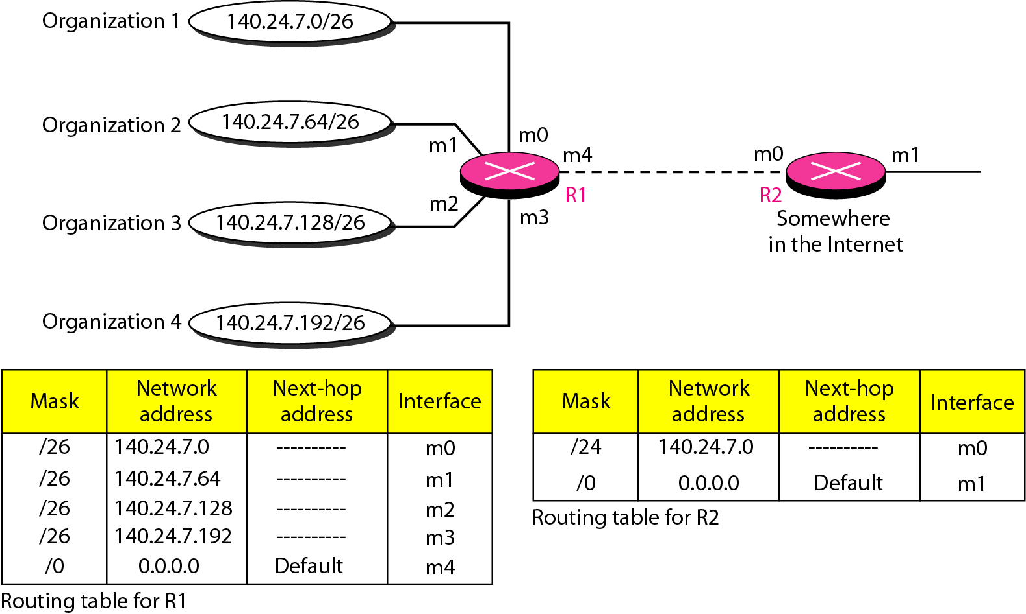
Address aggregation
Figure 22.7
Copyright © The McGraw-Hill Companies, Inc.

Slide 70
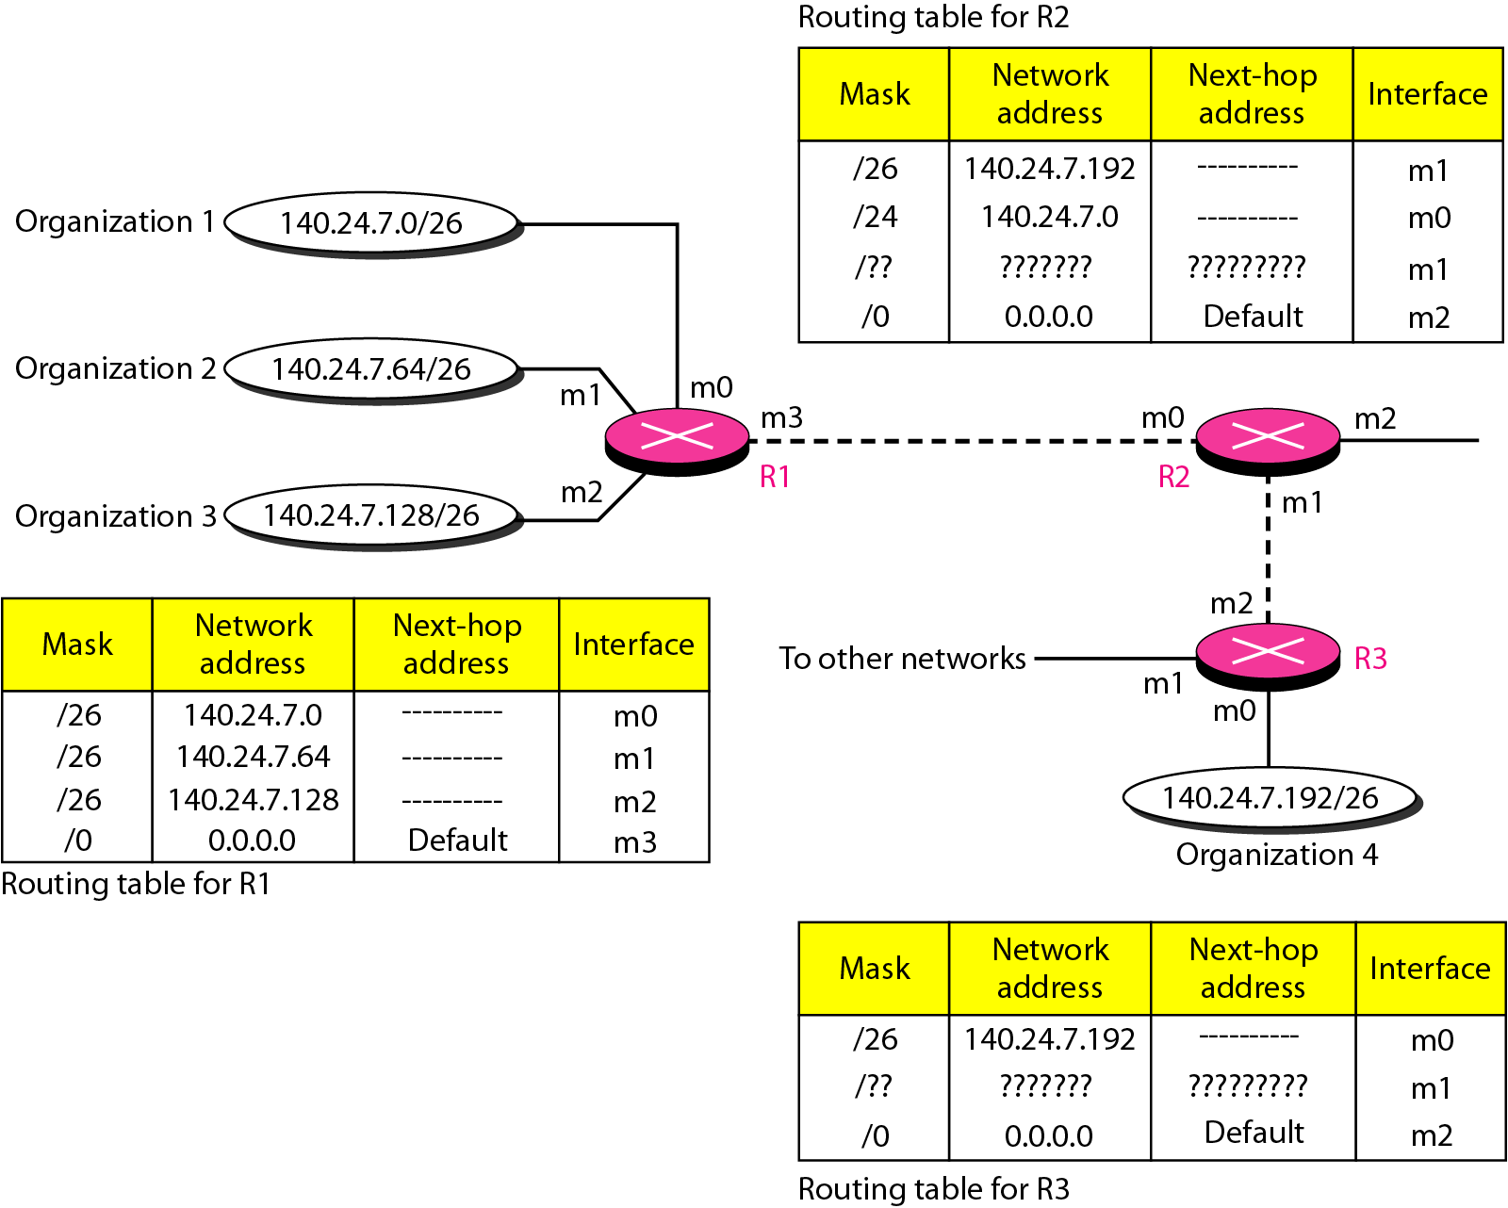
Longest mask matching
Figure 22.8
Copyright © The McGraw-Hill Companies, Inc.

Slide 71
Example 22.5
As an example of hierarchical routing, let us consider Figure 22.9. A regional ISP is granted 16,384 addresses starting from 120.14.64.0. The regional ISP has decided to divide this block into four subblocks, each with 4096 addresses. Three of these subblocks are assigned to three
local ISPs; the second subblock is reserved for future use. Note that the mask for each block is /20 because the original block with mask /18 is divided into 4 blocks.
The first local ISP has divided its assigned subblock into 8 smaller blocks and assigned each to a small ISP. Each small ISP provides services to 128 households, each using four addresses.
Copyright © The McGraw-Hill Companies, Inc.

Slide 72
Example 22.5 (continued)
The second local ISP has divided its block into 4 blocks and has assigned the addresses to four large organizations.
The third local ISP has divided its block into 16 blocks and assigned each block to a small organization. Each small organization has 256 addresses, and the mask is /24.
There is a sense of hierarchy in this configuration. All routers in the Internet send a packet with destination address 120.14.64.0 to 120.14.127.255 to the regional ISP.
Copyright © The McGraw-Hill Companies, Inc.

Slide 73
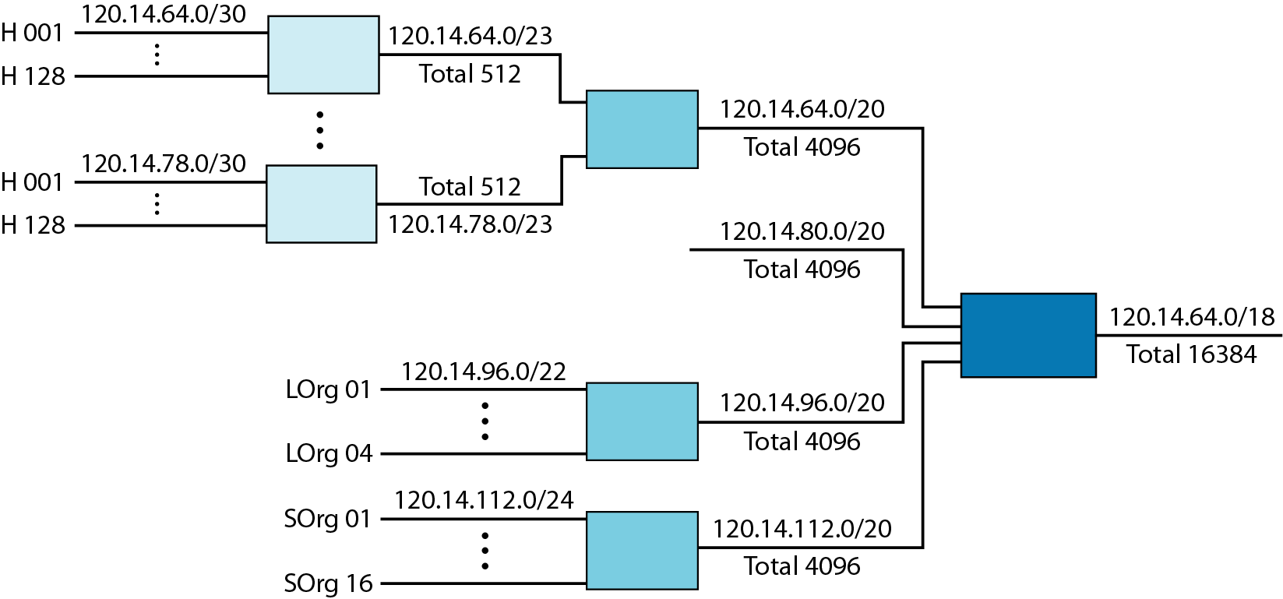
Hierarchical routing with ISPs
Figure 22.9
Copyright © The McGraw-Hill Companies, Inc.

Slide 74
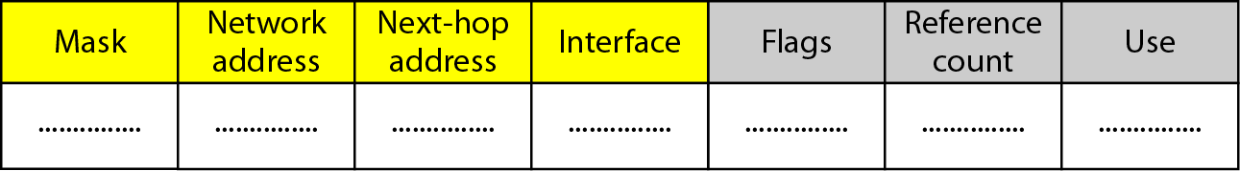
Common fields in a routing table
Copyright © The McGraw-Hill Companies, Inc.

Slide 75
Example 22.6
One utility that can be used to find the contents of a routing table for a host or router is netstat in UNIX or GNU/Linux. The next slide shows the list of the contents of a default server. We have used two options, r and n.
The option r indicates that we are interested in the routing table, and the option n indicates that we are looking for numeric addresses. Note that this is a routing table for a host, not a router.
Copyright © The McGraw-Hill Companies, Inc.

Slide 76
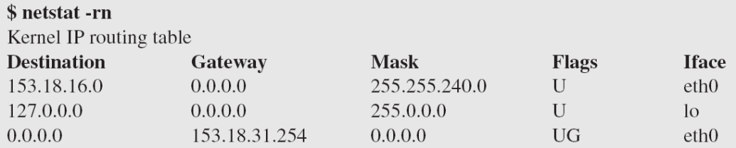
Example 22.6 (continued)
The destination column here defines the network address. This column actually defines the address of the next hop.
The value 0.0.0.0 shows that the delivery is direct. The last entry has a flag of G, which means that the destination can be reached through a router (default router). The Iface defines the interface.
Copyright © The McGraw-Hill Companies, Inc.

Slide 77
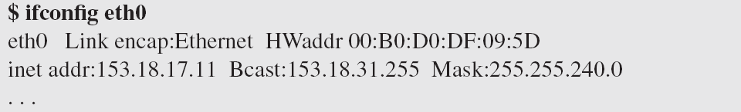
Example 22.6 (continued)
More information about the IP address and physical address of the server can be found by using the ifconfig command on the given interface (eth0)
Copyright © The McGraw-Hill Companies, Inc.

Slide 78
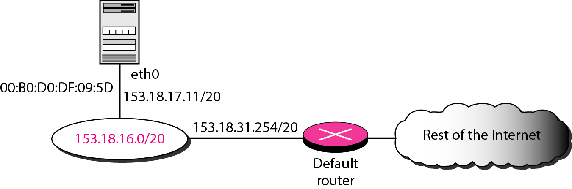
Configuration of the server for Example 22.6
Figure 22.11
Copyright © The McGraw-Hill Companies, Inc.

Slide 79
Unicast routing protocols
A routing table can be either static or dynamic.
A static table is one with manual entries.
A dynamic table is one that is updated automatically when there is a change somewhere in the Internet.
A routing protocol is a combination of rules and procedures that lets routers in the Internet inform each other of changes.
Copyright © The McGraw-Hill Companies, Inc.

Slide 80
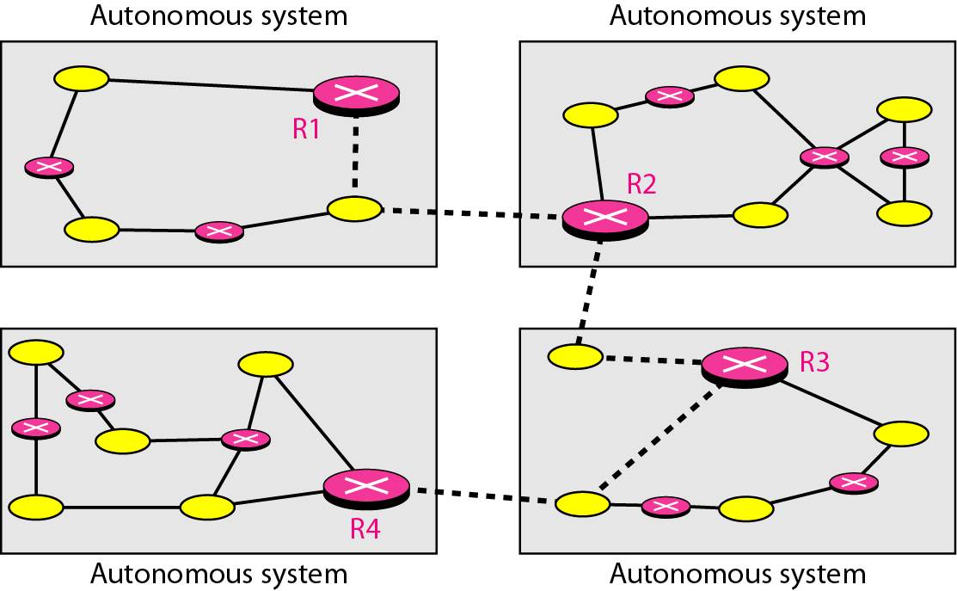
Autonomous systems
Copyright © The McGraw-Hill Companies, Inc.

Slide 81
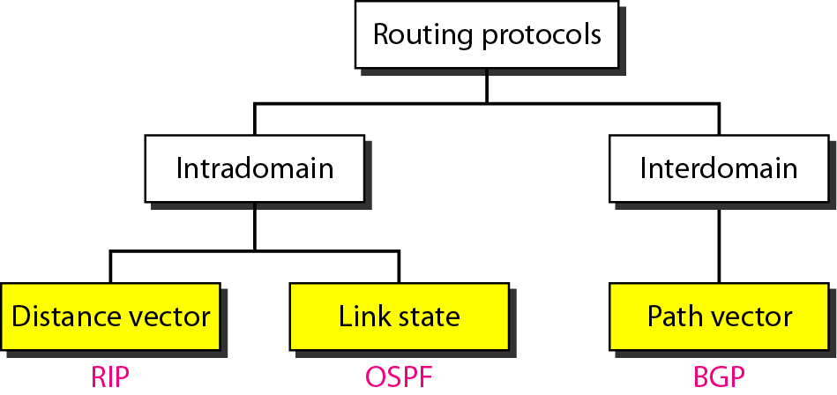
Popular routing protocols
Copyright © The McGraw-Hill Companies, Inc.

