Slide 1
Introduction to
Network Architecture
application
transport
network
link
physical
JuanPablo.Rozas@uclm.es David.Villa@uclm.es

Slide 2
Outline
What is a network?
Network classification
Inter-networks
Networking issues
Packet switching modes
Network architectures
Reference models
  OSI model
  TCP/IP model
Addressing fundamentals
References

Slide 3
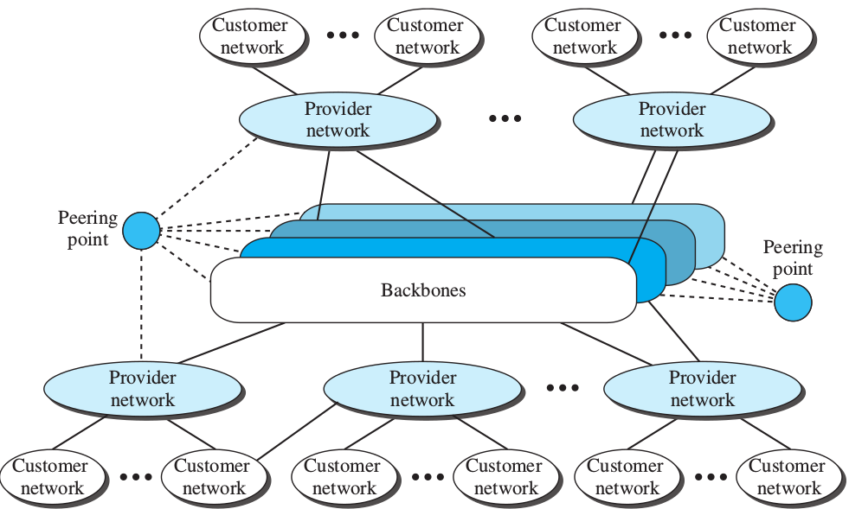
Internet today
ISP
Forouzan 5ed

Slide 4
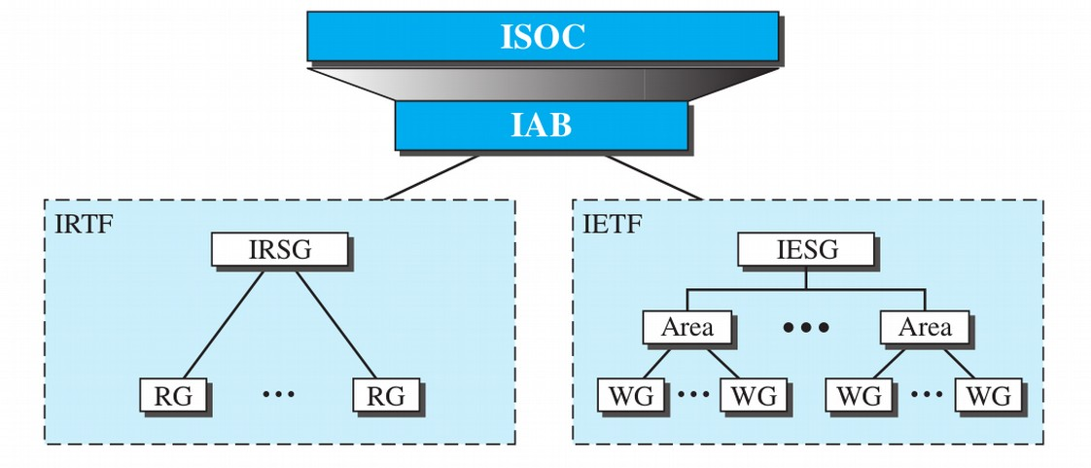

Internet: administration
Forouzan 5ed
ISOC Internet Society
IETF Internet Engineering Task Force
IESG Internet Engineering Work Group
WG Work Group
RFC

Slide 5
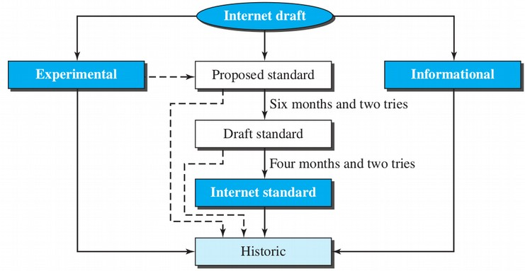
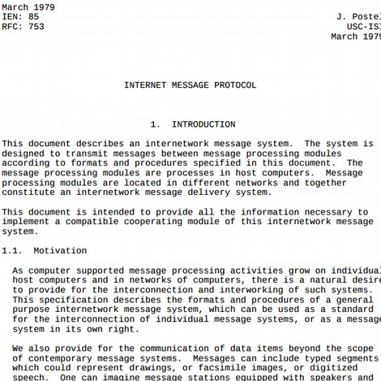
Request for Comment (RFC)
Forouzan 5ed

Slide 6



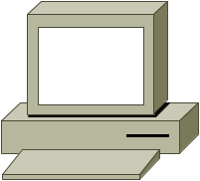
What is a network?
It is a set of interconnected autonomous computers so they may interchange information.
The network users are aware that there are different computers with associated resources.
The network is usually represented by a cloud, to emphasize that we do not know its internal structure.
i

Slide 7
Network classification
By link type
By scale
By topology

Slide 8
Networks by link type
A point-to-point connection provides a link that can only be used by the two peers.
Usually they are wires, but microwaves or satellite links are also feasible.

Slide 9
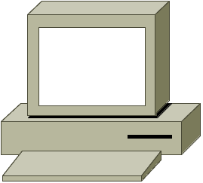
Networks by link type
In a multipoint connection several nodes (more that two) share a link.
Usually, it allows different addressing methods:
  Unicast. The address identifies a single destination host.
  Broadcast. A special address identifies all hosts in the net.
  Multicast. The address identifies a host subset.

Slide 10
Networks by scale
IPN: InterPlanetary and Delay Tolerant Networks (DTN).
Global (Internet).
WAN: Wide Area Network – a country or intercontinental links.
MAN: Metropolitan Area Network – A city or part of it.
LAN: Local Area Network – A department or building.
PAN: Personal Area Network – Computer and desktop.
SAN: System Area Network – Clusters and embedded systems.
NoC: Network On Chip – Network concepts inside a chip.

Slide 11
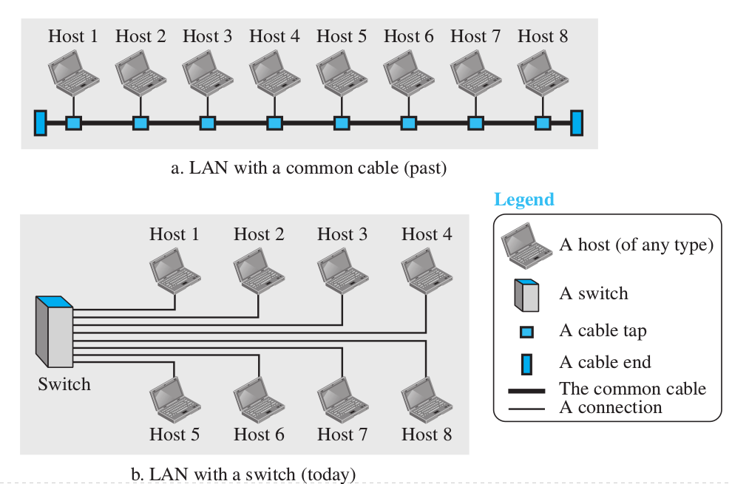
Networks by scale: LAN
The LAN is privately administered.
High speed (100Mbps – 1Gbps), focused on resource sharing and the needs of a set of people.
It uses a single transmission technology and topology.

Slide 12
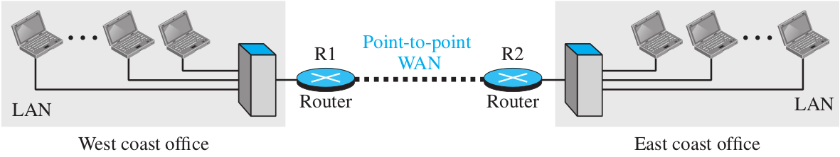
Networks by scale: WAN
It involves hosts and sub-networks (that use p-t-p links).
A subnet is composed by:
  Link lines
  Routers
subnet
router
router
The router must store messages and forward them to the appropriate destination. That “store and forward” mechanism (or “packet switching”) is the opposite of “circuit switching”.
Other example net

Slide 13
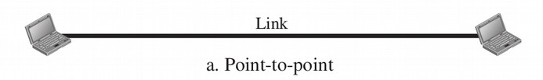
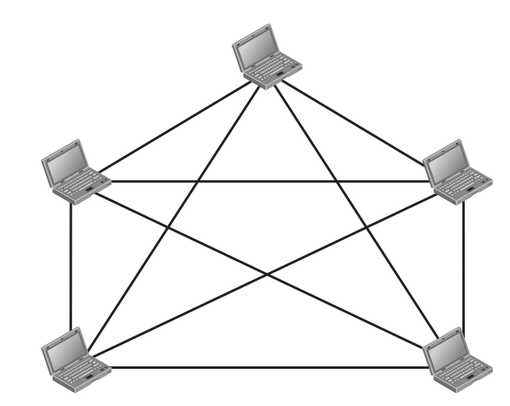
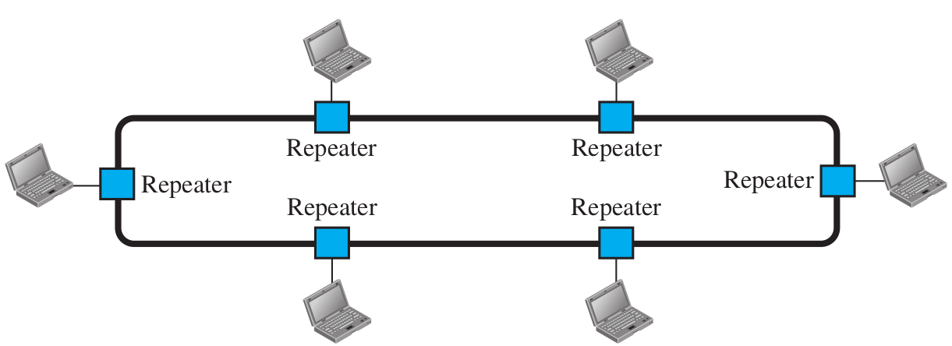

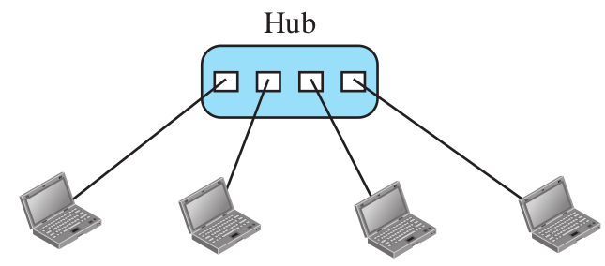
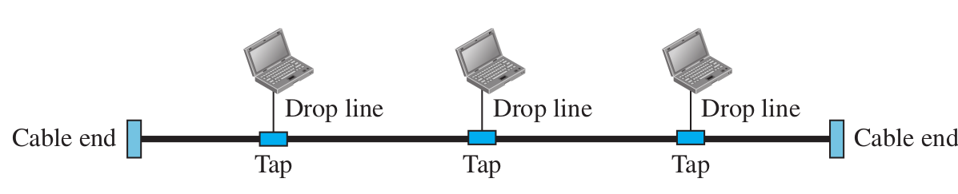
Networks by topology
Ring
Fully connected mesh
n(n-1)/2 links
Star
Bus

Slide 14
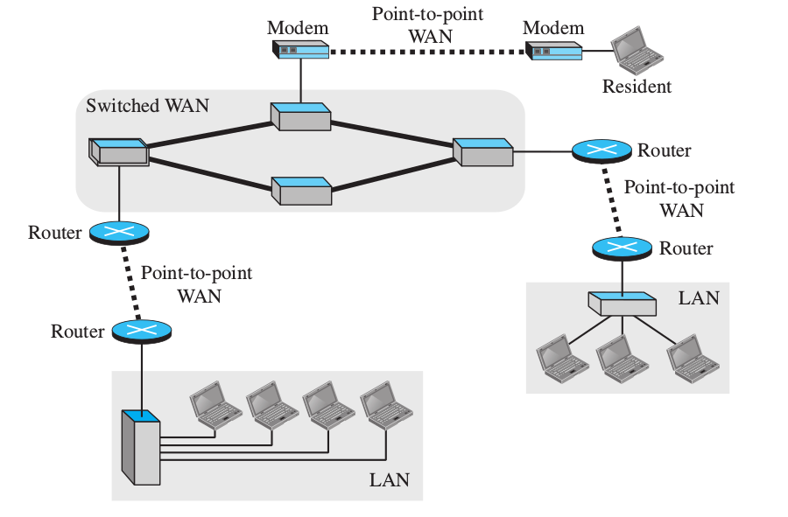
inter-networks
An inter-network is a set of interconnected (heterogeneous) networks.
Networks with different software and hardware technology may share information due to a logical network protocol and gateways.

Slide 15
Networking main issues
Addressing
Errors detection and correction
Message ordering
Flow control
Fragmentation
Multiplexing
Routing
...

Slide 16
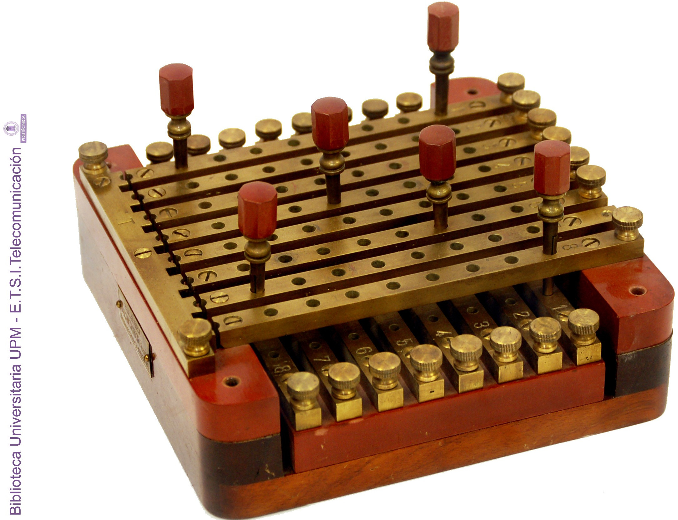
Physical switching networks
Circuit Switching Network
The “old” telephone system
End to end
3 phases: Call (connection), talk, hook (disconnection)
Message Switching Network
The “old” telegraph system
End to post, post to post,... post to end
1 phase: message interchange
Packet Switching Network
Similar to the postal service
“Modern” computer networks

Slide 17
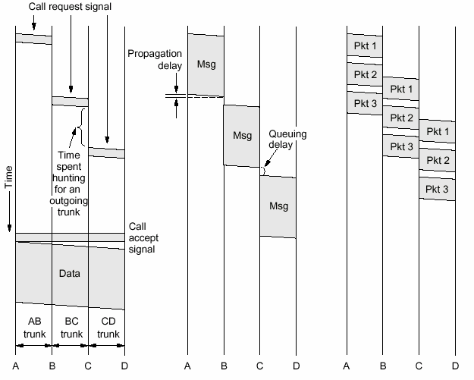
Comparing
circuit switching
message switching
packet switching
Tanenbaum

Slide 18
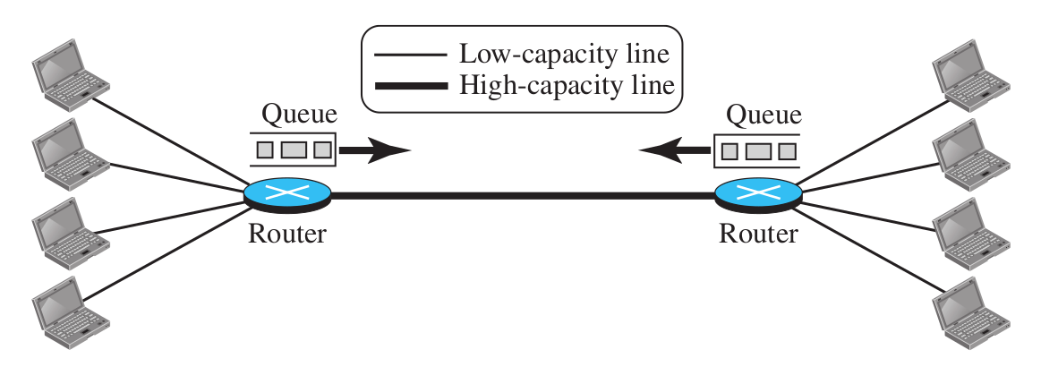
Packet switching modes
Today “all” computer networks
Similar to the postal service
Message is chopped in small messages called: PACKET
Forouzan 5ed

Slide 19
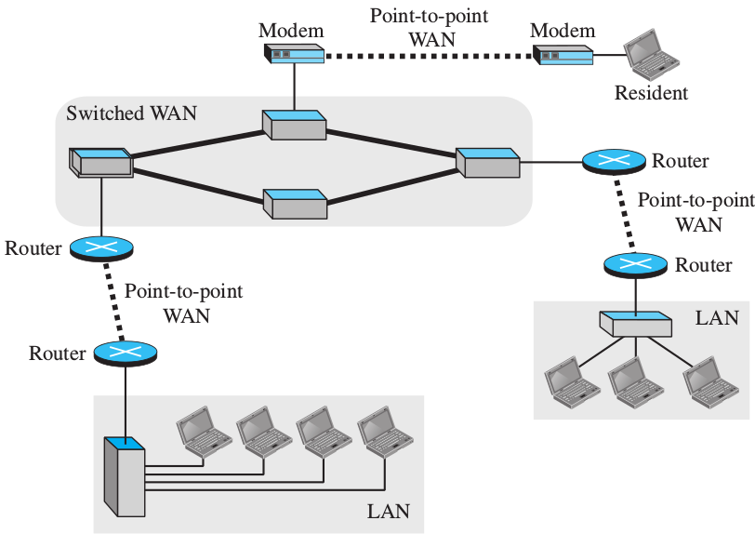
Packet switching modes
Forouzan 5ed

Slide 20
Packet switching modes
Connectionless
Each packet is sent as a unrelated individual unit. The message includes destination (and probably source) address and other information for its delivery.
Connection-oriented
It requires a connection set-up phase, then the communication works as a continuous byte stream, usually supporting duplex transmission. End disconnection.

Slide 21
Network architecture
It is a framework that describe a communication network, its components and protocols.
The network design is organized as a layer stack.
Each layer provides a set of services to the upper layer and requires services to the lower layer.
The layer 'n' of a node maintains a virtual conversation with the same layer the destination node. That conversation must meet a specific protocol.

Slide 22
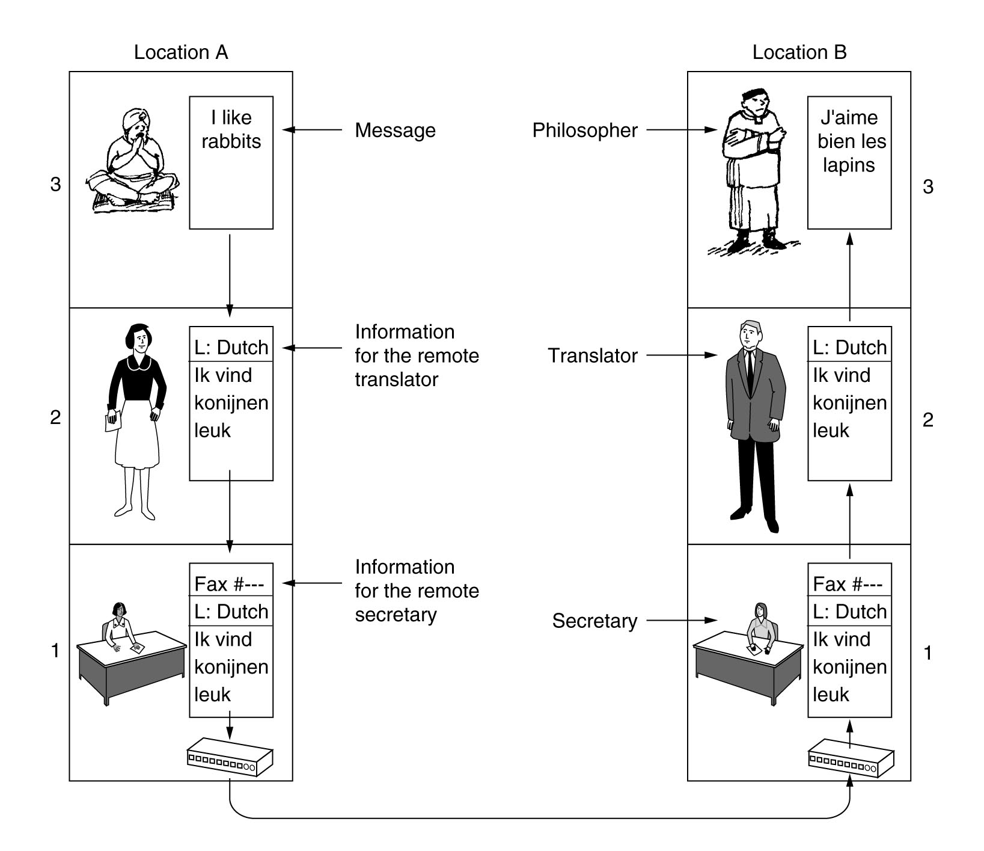
Example of layering
Philosophers Analogy
Tanenbaum

Slide 23
Reference models
OSI model
TCP/IP model
The reference model and the protocol suite implementation are very different things. They must not be confused.
i

Slide 24
OSI model
The Open System Interconnection (OSI) is an ISO (International Organization for Standardization)
It provides a general conceptual model to describe and study any protocol stack.
The model defines three basic concepts:
  service: the function that a layer may provide.
  interface: the way to get the layer services.
  protocol: the set of rules between homologous peers.

Slide 25
OSI layering
application
application
presentation
presentation
session
session
transport
transport
segments
network
network
packets
link
link
frames
physical
physical
bits
physical media

Slide 26
OSI model media layers
1. Physical layer
It defines the electrical, mechanical and temporal characteristics for devices required in a particular data communication technology.
2. Data link layer
It supports data transfers between directly reachable nodes (neighbors). It provides physical addressing.
3. Network layer
It supports end-to-end communication with variable length individual messages. It provides the logical addressing.

Slide 27
OSI model host layers
4. Transport layer
It provides a reliable error-free communication channel between end users. It also support process multiplexing.
5. Session layer
It allows us to create sessions among hosts and it manages synchronization.
6. Presentation layer
It defines on-the-wire data representation and its semantic.
7. Application layer
Application specific protocols like mail, news, remote shell, etc.

Slide 28
TCP/IP model
The TCP/IP model arrives years later of first implementations. The aim is to formalize and standardize its use and development.
It is closely related with TCP/IP protocols stack, and it can not be used to describe other protocols or networks.
application
transport
inter-net
host to net

Slide 29
TCP/IP model
Application layer
High level protocols like: DNS, SMTP, HTTP, FTP and many others.
Transport layer
It defines transport protocols: TCP (Transport Control Protocol) and UDP (User Datagram Protocol).
Inter-network layer
It provides mechanisms to network interconnection and package routing. It defines the IP protocol, that provides a connectionless delivery service.
Host-to-net layer
It provides (does not provide) required mechanisms to make it possible that “an IP packet reaches other host in the network”.

Slide 30
OSI, TCP/IP and hybrid models
OSI
TCP/IP
hybrid
7
application
application
application
6
presentation
5
session
4
transport
transport
transport
3
network
inter-net
network
2
data link
host to net
data link
1
physical
physical
When we talk about a “x layer thing”
we always refer to the OSI model.
Although... we will use the hybrid.
i
i

Slide 31
Encapsulation
The user information can not go directly “on the wire”.
Data transmission requires group bytes in PDUs (Protocol Data Units). The PDU adds control information as header and tails.
application
user data
application
transport
header
transport
transport
segment
network
network
header
packet
network
data link
link
header
tail
frame
data link
physical
bits
physical

Slide 32
Encapsulation
The recipe
1. Data build (from an application).
2. Segment the data for end-to-end transportation.
3. Add network addresses and build one (or several) datagrams.
4. Add physical link address and build frames for each datagram.
5. Code frame bits in signals that can be sent by the physical medium.

Slide 33
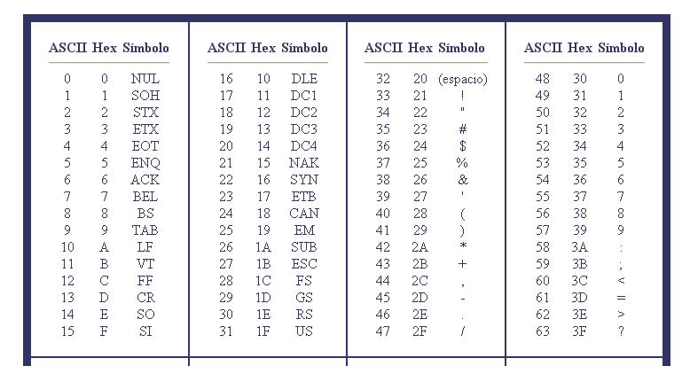
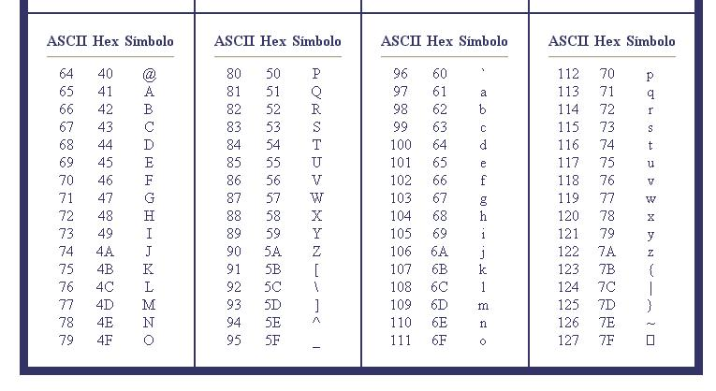
ASCII table
Redes de Computadores I

Slide 34
Example: UDP encapsulation
Send the string “Redes~I” using UDP as transport protocol from port 57000 to port 8888, from IP address 161.67.27.124 to 161.67.48.57. The host MAC address is 00:21:5D:E9:7F:80 y the router’s MAC address is 00:64:40:3A:C9:40. All values are in hexadecimal
<............................................……......... 64 Bytes …............................................................>
<.. 7 Bytes ..>
User data:
52..............49
Padding:
00...........00
aplicación
aplicación
<..... 8 Bytes ….>
Transport header:
DE.................E9
User
Datagram
transport
transport
52.............49 00............00
<.... 20 Bytes ....>
network
Network header:
4500.............7C
IP datagram
network
DE................E9 52.............4900..............00
<... 14 Bytes ...>
<......................................... 46 Bytes ……............................>
<.. 4 Bytes..>
data-link
Data-Link header:
0064.........0800
Tail:
XXXXXXXX
Ethernet
frame
data-link
4500...............7C DE.............E952................4900...............00
physical
bits
physical
Redes de Computadores I

Slide 35
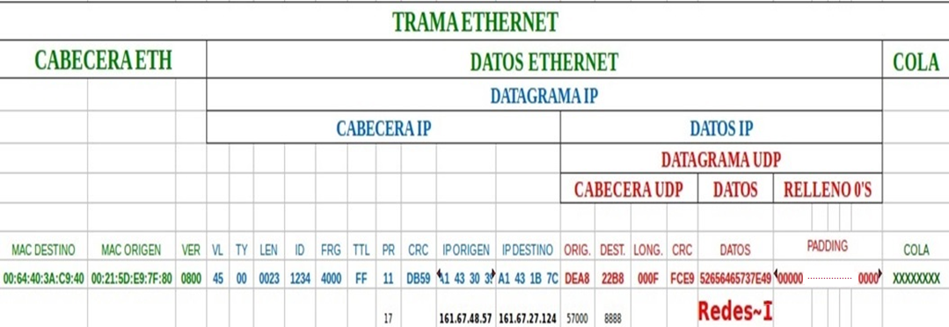
Encapsulado con todas las capas
Redes de Computadores I

Slide 36
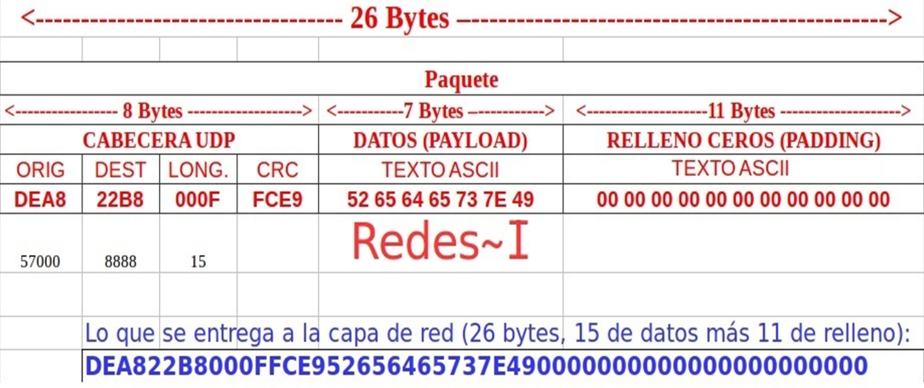
Detalle de la capa de transporte con el protocolo UDP
Redes de Computadores I

Slide 37
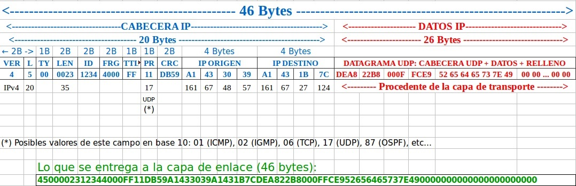
Detalle de la capa de red con el protocolo IP
Redes de Computadores I

Slide 38
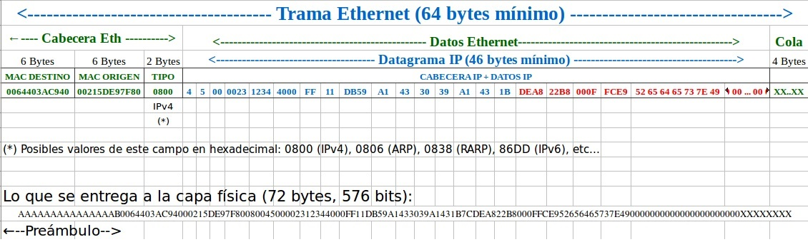
Detalle de la capa de enlace con el protocolo Ethernet
Redes de Computadores I

Slide 39
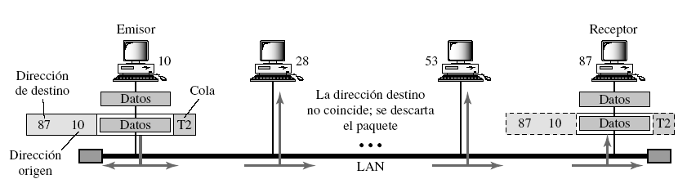
Physical address
Physical address = MAC address = ethernet addr.
Tannenbaum

Slide 40
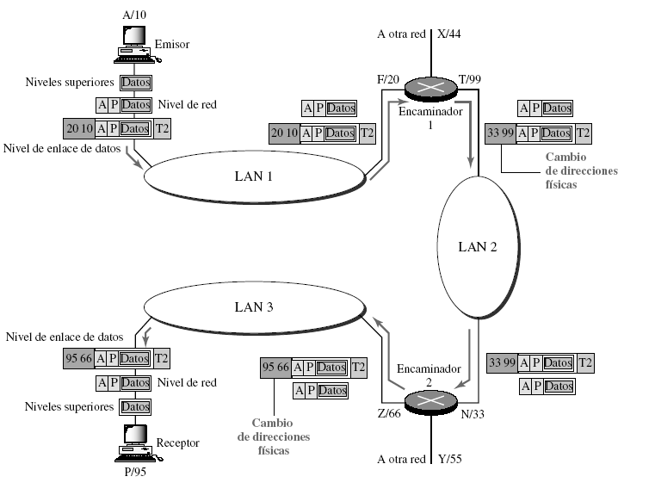
Logical address or IP
A: IP origen
P: IP destino
Tannenbaum

Slide 41

References
B.Forouzan. Transmisión de datos y redes de comunicaciones, 3th edition 2007.
Chapter 1
A.S.Tanenbaum Redes de computadoras. Pearson, 4th edition, 2003.
Chapter 1: Sections 1.1 a 1.4 y 1.6
CISCO Systems. Inc. Guía del primer año. CCNA 1 y 2. Cisco Press, 2003.
Chapter 1
Chapter 2: Pages 39 – 69
CISCO Networking Academy e-learning.
Modules 1 y 2.
All unlabeled figures are taken from the Wikipedia.

Slide 42




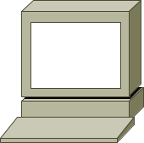

CISCO Icons
Bridge
hub
switch
multilayer
switch
router
PC
dumb terminal
laptop
file server
FDDI
FDDI ring
serial line
circuit switched
serial line
network cloud
Ethernet

