Slide 1
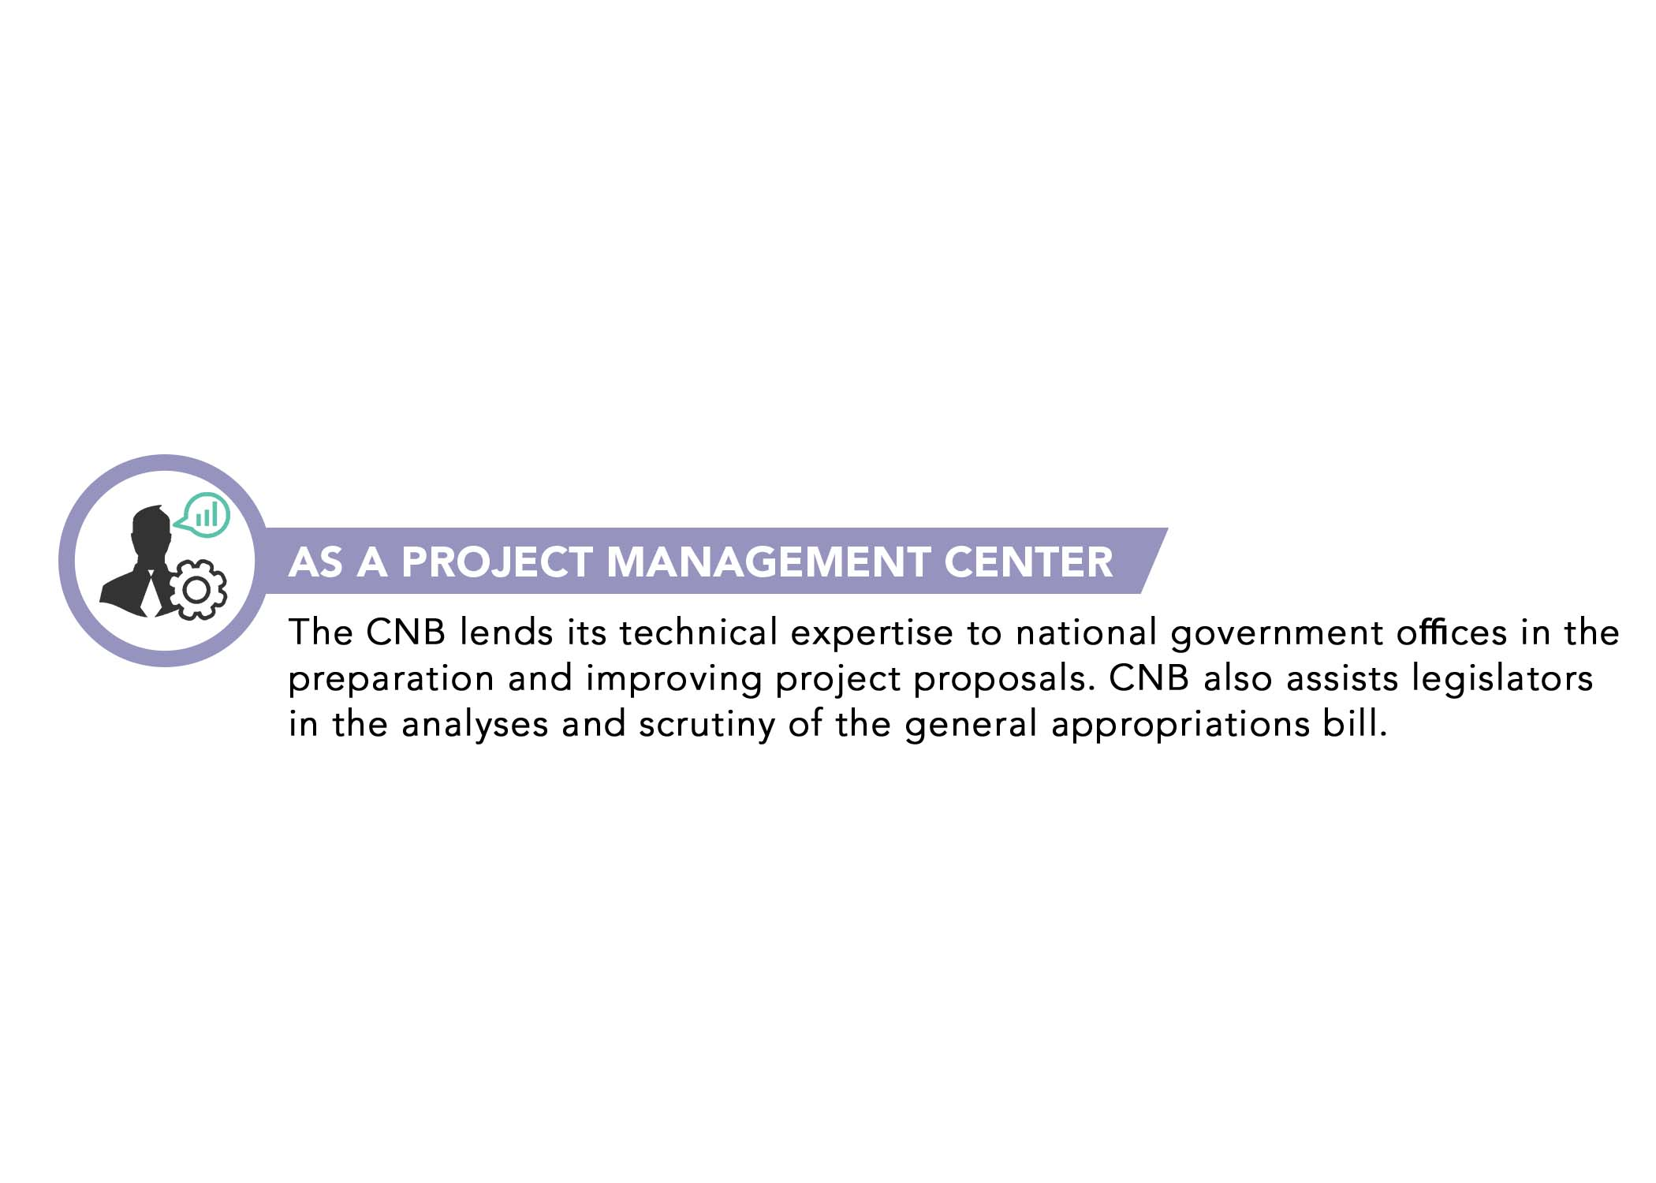

Slide 2


Slide 5

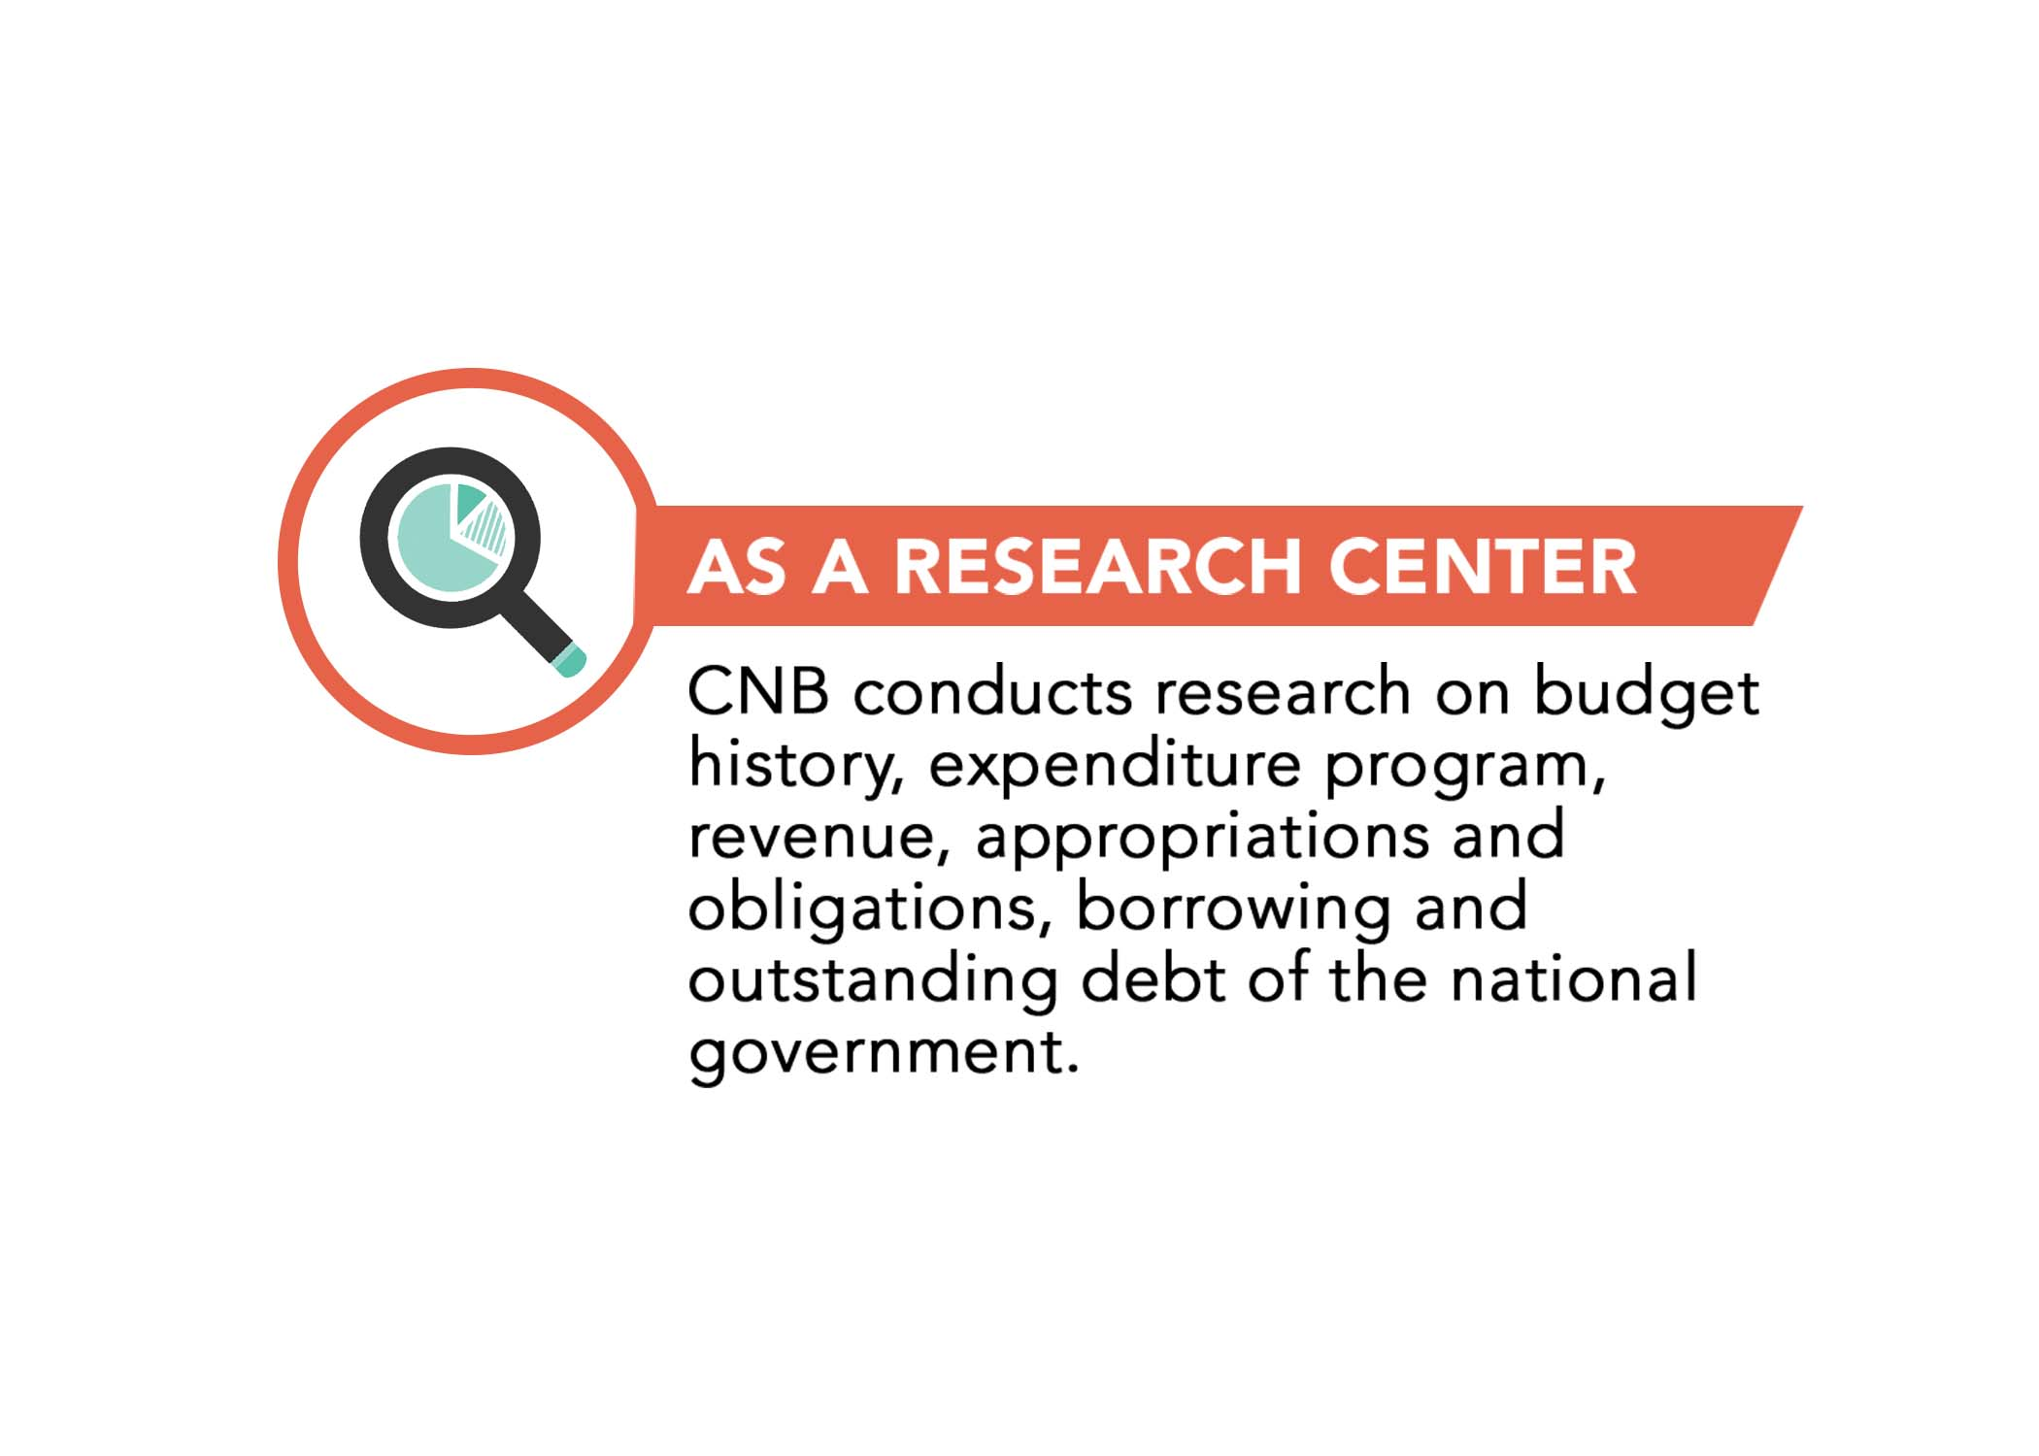

Slide 6

AS AN EDUCATION CENTER
To inspire and empower every
Filipino with the knowledge of
the national budget through
education.

Slide 7
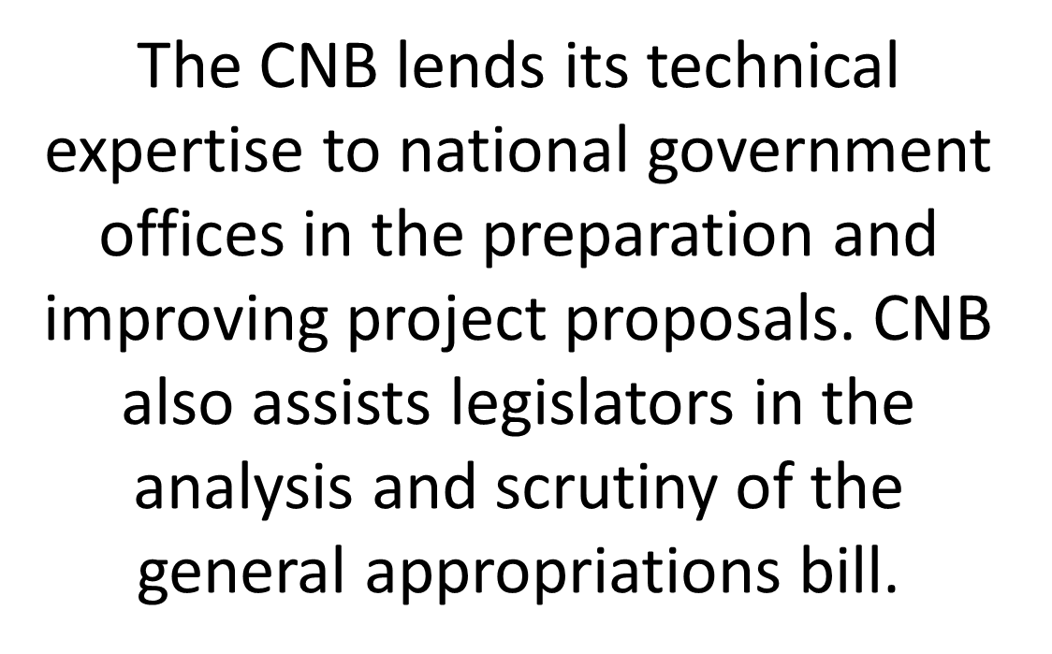
AS A PROJECT MANAGEMENT CENTER
The CNB lends its technical expertise to national government offices in the preparation and improving project proposals. CNB also assists legislators in the analysis and scrutiny of the general appropriations bill.

Slide 8


Slide 9


CNB produces books and periodicals as well as briefing materials

Slide 10
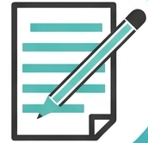

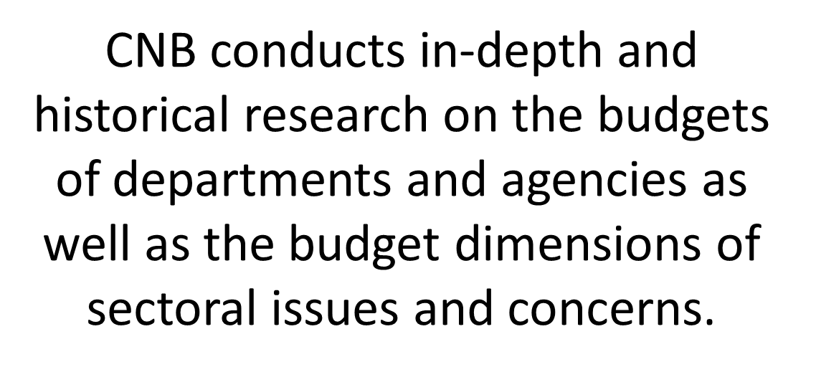

Slide 11

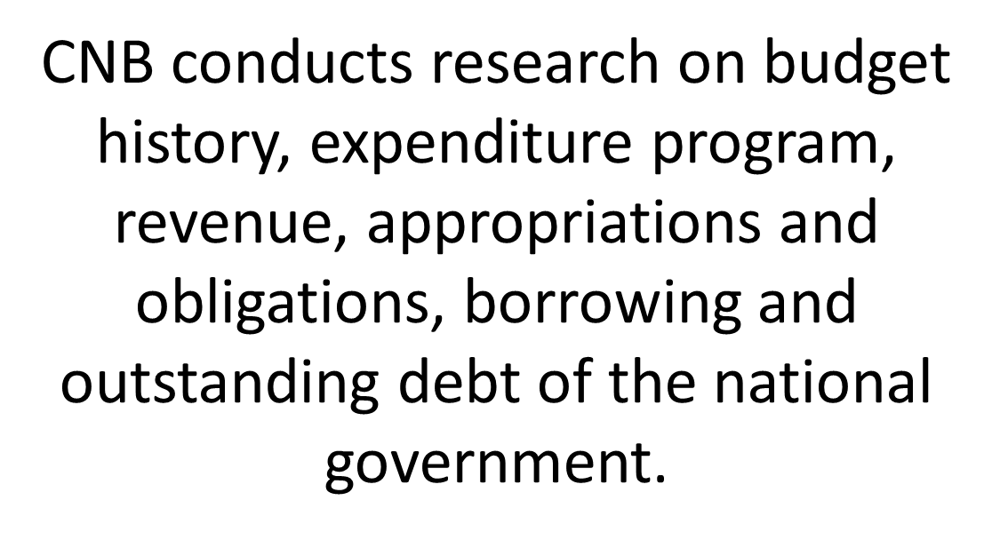

Slide 12
To inspire and empower every
Filipino with the knowledge of
the national budget through
education.

