Slide 1
ParkGuide AI
ParkGuide AI
A retrieval-augmented visitor assistant
for U.S. national parks
MSAI 633 / Project presentation / October 2026
01
Notes:
Introduce the project as a retrieval-augmented national park visitor assistant for MSAI 633. Explain that the slides combine the original proposal with the current repository, while keeping formal evaluation pending.
Sources: https://github.com/cleveee/parkguide-ai/blob/main/README.md
Proposal: ParkGuide_AI_Project_Proposal (2).docx, dated October 9, 2026. Repository and live website reviewed October 10, 2026.

Slide 2
The Visitor Information Problem
Scattered information
Fees, permits, camping rules and accessibility details live across many NPS pages.
Context matters
Park, season and the effective date can change which information applies.
Evidence matters
A fluent answer needs supporting passages and a clear response when evidence is missing.
02
Notes:
Visitor information appears across official pages, PDFs and tables. Seasonal dates complicate interpretation. Our project reduces the effort of locating evidence and exposes the source used. These are motivation statements, not measured visitor-research findings.
Sources: https://github.com/cleveee/parkguide-ai/blob/main/README.md
Proposal: ParkGuide_AI_Project_Proposal (2).docx, dated October 9, 2026. Repository and live website reviewed October 10, 2026.

Slide 3
Project Scope
Three national parks
Yosemite, Yellowstone and Grand Canyon
Visitor planning
Fees, camping, permits, accessibility, facilities and seasonal rules
Scope boundaries
No reservations, private booking lookup, live availability or personalized hiking-safety assessment
Current conversation
One selected park, with follow-up questions and inspectable sources
03
Notes:
The proposal covers Yosemite, Yellowstone and Grand Canyon. The current UI enforces one park per conversation and clears history on a park change. Cross-park comparisons in the proposal are not an enabled current UI workflow.
Sources: https://github.com/cleveee/parkguide-ai/blob/main/README.md
Proposal: ParkGuide_AI_Project_Proposal (2).docx, dated October 9, 2026. Repository and live website reviewed October 10, 2026.

Slide 4
Proposal and Implemented System
Component | Original proposal | Current repository
Interface | Streamlit | React + TypeScript, FastAPI
Storage / search | Chroma | SQLite, NumPy cosine, BM25
Embeddings | Local MiniLM, 384 dimensions | OpenAI text-embedding-3-small, 1,536 dimensions
Answer generation | OpenAI GPT-4.1 mini | OpenAI GPT-6-Luna, plus claim review
Hosting | Local application | Vercel, frozen read-only database
04
Notes:
The supplied repository supersedes the older repository link and proposed stack in the document. Explain these as implementation choices, without implying the proposed stack was delivered. Azure uses text-embedding-3-small and the returned gpt-6-luna-2026-09-22 snapshot.
Sources: https://github.com/cleveee/parkguide-ai/blob/main/README.md
Proposal: ParkGuide_AI_Project_Proposal (2).docx, dated October 9, 2026. Repository and live website reviewed October 10, 2026.

Slide 5
Ingestion and Chunking
Capture and normalize
Save raw NPS pages before extracting text, headings and tables.
Fixed baseline
1,698 chunks using token windows and overlap
Structure-aware build
3,707 chunks preserving heading context and table rows
Reproducible indexing
Deterministic IDs, source spans and atomic SQLite build activation
06
Notes:
Requests follow the allowlist and robots rules at one request start per second. HTML extraction retains headings and table structure, and PDF extraction uses pdfplumber. Fixed windows target 200 tokens with 40-token overlap. Structure-aware chunks group paragraphs by heading and repeat table headers. Character spans connect chunks back to saved normalized sources.
Sources: https://github.com/cleveee/parkguide-ai/blob/main/docs/RETRIEVAL.md
Proposal: ParkGuide_AI_Project_Proposal (2).docx, dated October 9, 2026. Repository and live website reviewed October 10, 2026.

Slide 6
Grounding and Safeguards
Claim-level sources
Show saved excerpts and links to the current official NPS page.
Insufficient evidence
Refuse unsupported answers or ask for missing context.
Time-sensitive questions
Explain snapshot limits for current roads, closures or availability.
Privacy and reliability
Keep keys on the server and disclose Azure processing. AI review can still make errors.
08
Notes:
Every delivered factual claim must cite saved passages and pass AI support review. Exact quotation, number and citation checks support the model review, but semantic mistakes remain possible. The user should see source age and use current official information for safety-sensitive decisions. Browser conversation history stays in memory and clears on reload.
Sources: https://github.com/cleveee/parkguide-ai/blob/main/docs/PARK_SCOPE.md
Proposal: ParkGuide_AI_Project_Proposal (2).docx, dated October 9, 2026. Repository and live website reviewed October 10, 2026.

Slide 7
Question-to-Answer Pipeline
01 Scope and context
Validate the selected park and resolve the follow-up subject.
02 Hybrid retrieval
Combine dense cosine search with BM25 using reciprocal rank fusion.
03 Evidence selection
Keep 20 candidates, then up to five passages. Local UI adds reranking.
04 Generation and review
Draft cited claims, review their source support, then return the answer.
07
Notes:
Walk through the numbered sequence. A question may refuse or clarify during checks. Hybrid retrieval combines BM25 and dense ranks with reciprocal rank fusion, keeps 20 candidates, and selects at most five passages. Local reranking is optional in the code and enabled in the current local UI. Hosted retrieval omits it. Luna drafts claims and a separate AI call checks only their cited passages.
Sources: https://github.com/cleveee/parkguide-ai/blob/main/docs/RETRIEVAL.md
Proposal: ParkGuide_AI_Project_Proposal (2).docx, dated October 9, 2026. Repository and live website reviewed October 10, 2026.

Slide 8
Official NPS Corpus
155
150
5
45
saved documents
HTML pages
PDFs
documents with tables
Public visitor information from the three parks
Raw files, source URLs, capture dates and content hashes retained
05
Notes:
Counts come from the frozen corpus summary and were also visible in the hosted corpus browser. Table-bearing documents overlap the HTML/PDF counts. The snapshot is not a live conditions feed. Raw capture, hashes and source spans preserve provenance.
Sources: https://github.com/cleveee/parkguide-ai/blob/main/data/corpus_summary.json
Proposal: ParkGuide_AI_Project_Proposal (2).docx, dated October 9, 2026. Repository and live website reviewed October 10, 2026.

Slide 9
Initial Retrieval Experiment
Retrieval variant | Chunking | MRR
BM25 | Fixed | 0.875
Dense | Fixed | 0.550
Dense | Structure-aware | 0.854
Hybrid | Structure-aware | 0.854
Hybrid + reranker | Structure-aware | 0.781
12 diagnostic items, 8 with evidence. Labels await human verification.
Historical local run with an older generator. Hosted retrieval differs.
11
Notes:
Historical controlled run 20261010T035053Z-24ef6136 used 12 AI-authored diagnostic items, eight with source evidence, and an older generator. These MRR values are not human-verified answer accuracy. Fixed-to-structure dense MRR difference was +0.304 with paired 95% interval [+0.083,+0.513]. Adding reranking changed MRR by -0.073, interval [-0.219,+0.042], so the run does not establish a reranking gain. Top-five evidence coverage was 8/8 for all retrieval variants, a small-set ceiling.
Sources: https://github.com/cleveee/parkguide-ai/blob/main/docs/DIAGNOSTIC_ANALYSIS.md
Proposal: ParkGuide_AI_Project_Proposal (2).docx, dated October 9, 2026. Repository and live website reviewed October 10, 2026.

Slide 10
Evaluation Status and Remaining Work
Observed diagnostics
21/21 requests completed. 20/21 action and boundary checks matched.
Human verification
40 gold drafts tested by human verification
Formal benchmark
Freeze a 24/16 dev/test split, approve the configuration, then run the test once.
Report quality
Measure evidence recall, ranking, answer correctness, citations, refusals and latency.
12
Notes:
21 → 20 → 40 → 24/16 → Quality
“This slide shows where we currently are with the evaluation of our chatbot and what work is still remaining.
First, in our diagnostic testing, we completed all 21 requests. We also matched 20 out of 21 expected action and boundary checks. This means the chatbot generally behaved the way we expected during these tests.
We also used human verification with 40 gold drafts. Basically, these are reference questions and answers that we use to compare and evaluate the performance of the chatbot. Human verification is important because we don't want to depend only on an automated evaluation. We also want a person to check whether the information and sources are actually correct.
For the formal benchmark, we divide those 40 examples into 24 for development and 16 for testing. The development set is used while we improve and configure the system, while the test set is saved for the final evaluation.
Finally, we don't evaluate the chatbot only by whether it gives an answer. We also look at whether it finds the correct evidence, ranks the information correctly, gives accurate answers and citations, knows when to refuse a question, and how quickly it responds.
So overall, our initial results are good, but the formal evaluation helps us determine the actual quality and reliability of the system.”

Slide 11
Demonstration and Practical Limits
Demo sequence
Practical limits
1. Select Yosemite
2. Ask about bear distance outside developed areas
3. Follow up about a bear in a developed area
4. Open the citation and retrieval trace
5. Ask for current road status
Saved corpus can age
PDF tables need review
AI review can over-refuse
Hosted app omits reranking
13
Notes:
“This slide explains how we can demonstrate our chatbot and also some of its current limitations.
For the demonstration, we first select Yosemite National Park. Then we can ask a question about the correct distance to keep from a bear outside a developed area.
After that, we ask a follow-up question about what happens if the bear is in a developed area. This helps us demonstrate that the chatbot can handle a follow-up question while keeping the context of the conversation.
We can then open the citation and retrieval trace. This is important because our system is a RAG chatbot. Instead of simply generating an answer, it first retrieves information from our park documents and uses that information to answer the question. The citation lets the user see where the information came from.
Then we can ask about something like the current road status. This demonstrates an important limitation. Our chatbot works with a saved corpus of documents, so that information can become outdated. The chatbot should not pretend that old information is current.
We also have some other limitations. Information inside PDF tables can be more difficult to process correctly. AI review can sometimes refuse questions unnecessarily, and our hosted application currently doesn't use reranking.
So the main goal of the demonstration is to show both sides: what our chatbot can do successfully, but also where we still have limitations and opportunities to improve the system.”
Yosemite → Bear → Follow-up → Citation → Road → Limits

Slide 12
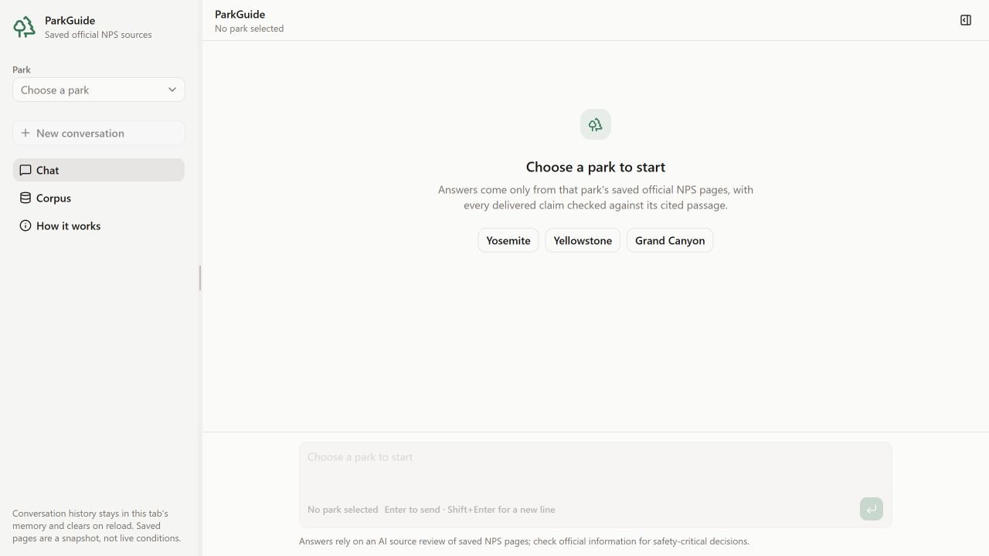
Live Application
Select a park
Ask a question
Inspect evidence
09
Notes:
Screenshot captured from the provided live website on October 10, 2026. The park selector gates chat entry. During the demo, select Yosemite and inspect the source excerpt and retrieval/data-flow tabs after a response. This slide documents the interface, not a tested answer.
Sources: https://github.com/cleveee/parkguide-ai/blob/main/README.md
Proposal: ParkGuide_AI_Project_Proposal (2).docx, dated October 9, 2026. Repository and live website reviewed October 10, 2026.

Slide 13
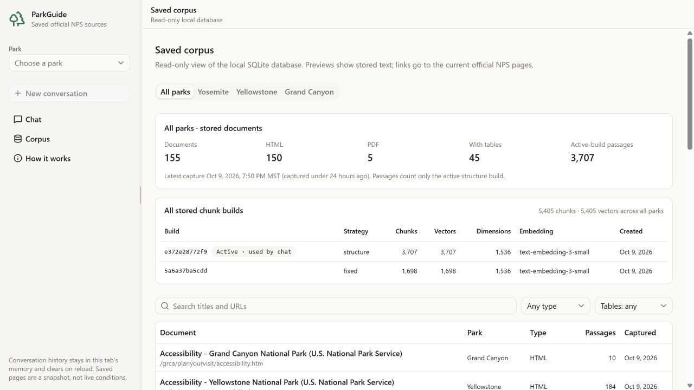
Corpus and Provenance Browser
Saved text
Build counts
Source dates
10
Notes:
Screenshot captured from the live Corpus view. It confirms 155 documents and both chunk builds. The UI separates stored text from the current official page and offers park/type filters. The visible corpus counts are operational evidence, not answer-quality results.
Sources: https://github.com/cleveee/parkguide-ai/blob/main/README.md
Proposal: ParkGuide_AI_Project_Proposal (2).docx, dated October 9, 2026. Repository and live website reviewed October 10, 2026.

Slide 14
Deliverables:
Live Park Guide Chatbot: parkguide-ai-dh24.vercel.app
Repository: github.com/cleveee/parkguide-ai
Team
Adithya S Gummadi / Danail Banov / Naaman Ondego
Pratik Bhavsar / Robin Cleve / Surya Vamsi Kolavennu / Vishal Talla
14
Notes:
Team names come from the supplied proposal. Individual role assignments remain unconfirmed. Proposed responsibilities cover ingestion, retrieval, generation/interface, and evaluation/ethics, with cross-stage contributions. Finish human verification and course collaboration requirements. The repository credits Codex and scoped agents for implementation and drafts, with no agent certification of human review. Close by inviting questions and opening the provided live demo.
Sources: https://github.com/cleveee/parkguide-ai/blob/main/README.md
Proposal: ParkGuide_AI_Project_Proposal (2).docx, dated October 9, 2026. Repository and live website reviewed October 10, 2026.

Slide 15
Thank you
14
Notes:
Team names come from the supplied proposal. Individual role assignments remain unconfirmed. Proposed responsibilities cover ingestion, retrieval, generation/interface, and evaluation/ethics, with cross-stage contributions. Finish human verification and course collaboration requirements. The repository credits Codex and scoped agents for implementation and drafts, with no agent certification of human review. Close by inviting questions and opening the provided live demo.
Sources: https://github.com/cleveee/parkguide-ai/blob/main/README.md
Proposal: ParkGuide_AI_Project_Proposal (2).docx, dated October 9, 2026. Repository and live website reviewed October 10, 2026.

