Slide 1
API TESTING
A few tips for INTERVIEW
Is API COMPLICATED?
Why API is so popular?
Fundamentals of API in INTERVIEW

Slide 2

API TESTING
INTERVIEW
30 mins expression
Motivated
Wishful
Check Post
Questions?
Notes:
=Most of the interview sessions takes about 30 mins, it means that you have only 20 mins to express yourself
Put yourself in their shoes, how any company understand your knowledge and experience in 20 minutes, IMPOSSIBLE
Key Points (End Points from document, HTTP Methots, Status Codes)
Behavioral Questions in any circumstances
=Show that you are motivated to get a job
I can adapt myself easily and
I can learn quickly
=When I checked your Job Description I noticed that you are using some new tools and new languages that exited me a lot
Because I need to improve myself day by day in dynamic IT environment
This is an soft approach to say something you are not familiar to any tools or frameworks…
=Questions allows you to take breath and expresses your interest and attention to the subject
I understood that your company is international and multi cultural,
How you gonna implement ONBOARDING process for a new person? Need time, patience,
You explained your team structure but I need to know more about how many develop and testers you have in TEAMS?

Slide 3
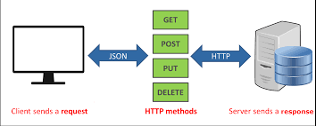
API TESTING
Is API COMPLICATED?
Notes:
API is not complicated
Why some of you guys think that is so complicated, BECAUSE of VERIFICATION Process
Hemcrest Matchers, Json Path, Json to POJO, Gson ,Serilization Deserilization
Bunch of issue makes you confused but FORGET IT
You don’t need to memorize all this staff for interview
Only you need to express your practical knowledge about API
Api is such an easy way to Retrieve info from DataBase
SQL uses SELECT INSERT UPDATE DELETE commands
API uses GET POST PUT DELETE PATCH methods
SQL is more flexible but API is faster
API is kind of RESTRICTED form of SQL, you can not manipulate data inside the dATA base
For Example AIR FRANCe created own API and gave it to SKY Scanner
=They can only retrive data of specific Date and ORIGIN DESTINATION
How API works 07.00 AM MADRID TO BARC 24-11-2021 75 EUR 5 SEATS LEFT
WHO you are? Who will hire you to IMPLEMENT API tests?
AIR FRANCE needs to know THIS API is working PROPERLY IN POSITIVE AND NEGATIVE WAYS

Slide 4
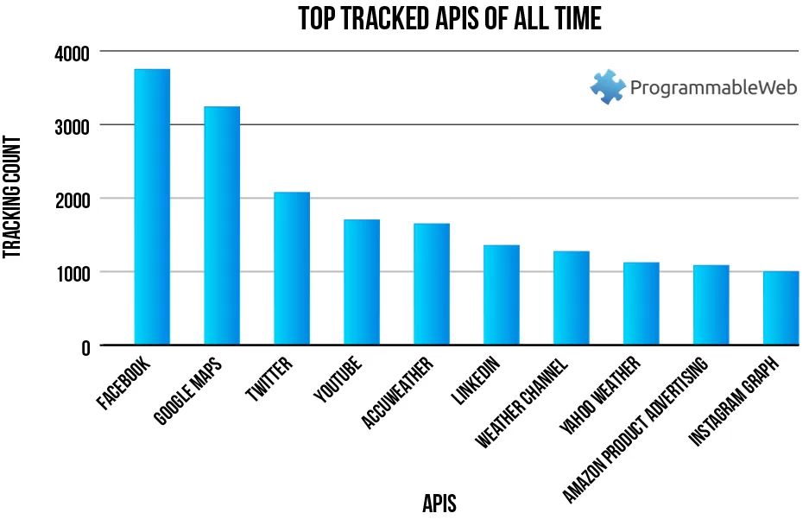
API TESTING
Why API is so popular?
Notes:
SECURE FAST AND RELIABLE
CAN NOT MANIPULATE IT
DYNAMIC and
MICROSERVICES
All those callings realizes in 20-30 miliseconds depends on your search criteria
I am talking in terms of LATECY not NETWORK Quality is another one

Slide 5
API TESTING
Fundamentals of API in INTERVIEW
SWAGGER,UI DOCS
-END POINTS
-EXPECTED RESULTS
POSTMAN MAN
-POS NEG TESTS
-GET POST PUT DELETE
-STATUS CODE HEADERS BODY
AUTOMATION
-POSTMAN
-KARATE
-REST ASSURED LIB.
Notes:
I will summarize you what we checked in two hours and your questions
3 STEPS FOR API TESTING
IT IS NOT ALL ABOUT API
You will learn bunch of new things in your company
microservices - contract testing - Authorization
Collections sometimes takes more than 5-6 mins
Compared to SQL it is so fast but it has more than 2000 test verifications inside it

Slide 6
API TESTING
SECOND SESSION (Market Session for API PRO)
What are HTTP and HTTPS?
5 main method of API (CRUD)
Investigation of documents for details(Design and swagger)
POSTMAN basics
Collections and Workspaces
3 Environments
General assertions at Test for automation(Chai library)

Slide 7
API TESTING
THIRD SESSION (Market Session for API PRO)
Pre Request
Why JS and JSON?
What is NEWMAN?
Running Collections and Getting report from Newman
GitBASH and basic commands
Import&Export – Run and Run Reports
Collection Manipulation

Slide 8
API TESTING
FOURTH SESSION (Market Session for API PRO)
DEMO
Basics
Import
Implementation
Validation
Console logging
Export
Add/Commit/Push/Merge to GitHUB

Slide 9
API TESTING
FIRST SESSION (REVIEW for all)
Don’t be afraid of API !
What is API?
Why API is so popular at market?
Basic differences RestFull Api vs SOAP
API Testing in 3 Steps for Interview

