Slide 1
EpiGrade
An open, reproducible benchmark for DNA methylation episignature classifiers
Upasana Bhaumik (23BCB0074)
Samhitaa Saravanakumar (23BCB0125)
Divyanjali Tyagi (23BCB0123)
Vellore Institute of Technology (VIT), Vellore
Notes:
Good morning. We are Upasana, Samhitaa and Divyanjali from VIT Vellore. Our project is called EpiGrade. It checks, using only public data, how far a new kind of genetic test can be trusted. We will show what we built, three things we found, and a live tool.

Slide 2
A child, a DNA change, and no answer
1
2
3
A child has a disorder
Sequencing finds a rare change
The lab cannot interpret it
Doctors suspect a genetic cause and sequence the child's DNA.
It sits in a plausible gene, but nobody has seen it before.
It is reported as a variant of uncertain significance. The family gets no answer.
An uncertain variant cannot confirm a diagnosis, guide care, or be used to test relatives.
Notes:
Start with the patient. A child has a developmental disorder, and doctors read the child's DNA to find the cause. Often they find a change that is rare and sits in a sensible gene, but nobody can say whether it causes disease. That result is called a variant of uncertain significance. For the family it means no diagnosis and no guidance.

Slide 3
A second test: the episignature
Some disease genes control chemical tags on DNA (methylation). When such a gene is broken, the pattern of tags in blood changes in a recognisable way.
Healthy control
Patient with the disorder
Pattern present: the variant is probably harmful. Pattern absent: probably harmless.
Patient with an unknown variant
Filled circle = tagged site
Notes:
There is a second way to test. Some disease genes control small chemical tags on DNA, a process called methylation. When one of these genes stops working, the pattern of tags across the genome changes in a characteristic way. That pattern is called an episignature. If a patient with an unclear variant shows the pattern, the variant is probably harmful, and if not, it is probably harmless.

Slide 4
The catch: nobody outside can check it
34
1
<40%
disease signatures reported from 42 syndromes in one landmark study (Aref-Eshghi 2020)
private reference database that these tests are validated against
sensitivity for 2 of 10 signatures when an outside group re-tested them (Husson 2024)
Results are reported in categories agreed by experts, not as a measured strength of evidence. Our question: how much can be confirmed from public data alone?
Notes:
Here is the catch. These tests are validated against one private reference database, and laboratories outside cannot inspect it. One study reported 34 signatures across 42 syndromes. But when an independent French group re-tested ten published signatures with new patients, two of them detected fewer than 40 percent of cases. So we asked how much can be confirmed using only data that anyone can download.

Slide 5
What we built: four components
1
Corpus
2
Classifiers
3,732 public samples from 18 datasets, 1,622 kept, a recorded reason for every exclusion
10 disease signatures: 1 published and reproduced, 9 re-derived under one fixed rule
3
Audit and calibration
4
Identification engine
Cross-study tests, every classifier against every disorder, and scores turned into evidence strength
Upload any signature and learn which of 12 disorders it identifies, if any
Notes:
We built four things. First, a collection of public samples where every sample we excluded has a written reason. Second, signatures for ten disorders: one published signature that we reproduced, and nine that we derived ourselves under a single fixed rule. Third, an audit that tests each signature across studies and against every other disorder, and converts scores into evidence strength. Fourth, a tool where anyone can upload their own signature and test it.

Slide 6
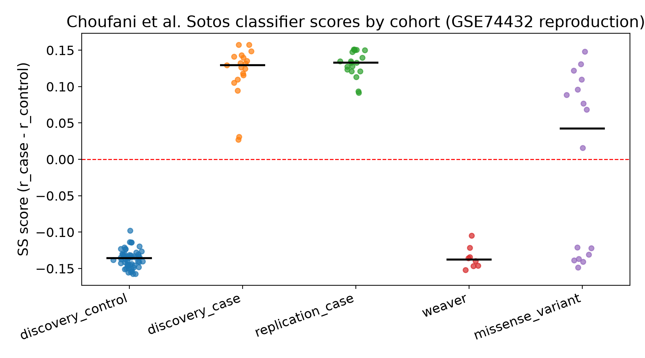
Proof it works: the Sotos syndrome signature
Published (Choufani 2015)
19 cases and 53 controls separate cleanly at a score of zero.
Ours, from the public data
19/19 cases above zero, 53/53 controls below zero. Each sample was scored without using itself.
Notes:
Before auditing anything, we had to show our pipeline is correct. The Sotos syndrome signature, published by Choufani and colleagues in 2015, comes with its full probe list, its scoring rule and its data. We rebuilt it from the public files. Every case scores above zero and every control below zero, exactly as published. Each sample was scored against profiles built without it, so the result is not inflated.

Slide 7
Four reproduction checks, all passing
Check | Published | Ours | Result
Cases and controls separate | 19 cases vs 53 controls, clean split | 19/19 and 53/53 | Pass
Similar disorder (Weaver) scores negative | 8 of 8 negative | 8/8 negative | Pass
Unclear NSD1 variants split | 9 positive, 7 negative | 9 positive, 7 negative | Pass
Held-out cases score positive | all positive | 19 of 19 positive | Pass
4 of 4 checks pass. The pipeline reproduces a published result exactly.
Notes:
We checked four things against the paper. Cases and controls separate. Eight patients with Weaver syndrome, which looks similar but has a different cause, all score negative. Sixteen unclear variants in the NSD1 gene split nine positive and seven negative, exactly as published. And nineteen cases that were never used to build the classifier all score positive. All four checks pass.

Slide 8
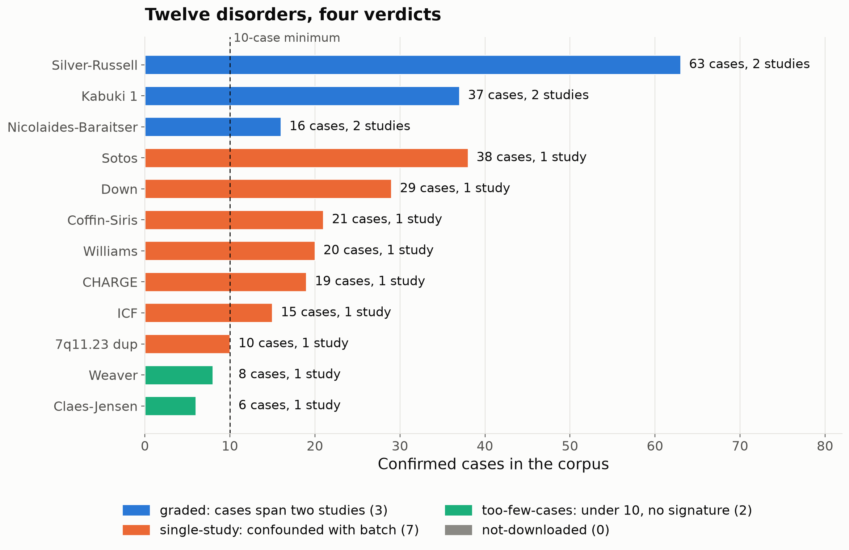
Finding 1: only 3 of 12 disorders span two studies
7
disorders have every case in one study, so disease and laboratory batch cannot be told apart
2
disorders have under 10 cases, too few for any signature
Notes:
Our first finding is about the data itself. Of twelve disorders, seven have all their cases in a single study. In that situation a difference between cases and controls could be the disease, or it could just be how that laboratory processed its samples, and we cannot tell which. Two more disorders have fewer than ten cases, which is too few to build anything. Only three disorders have cases in two independent studies.

Slide 9
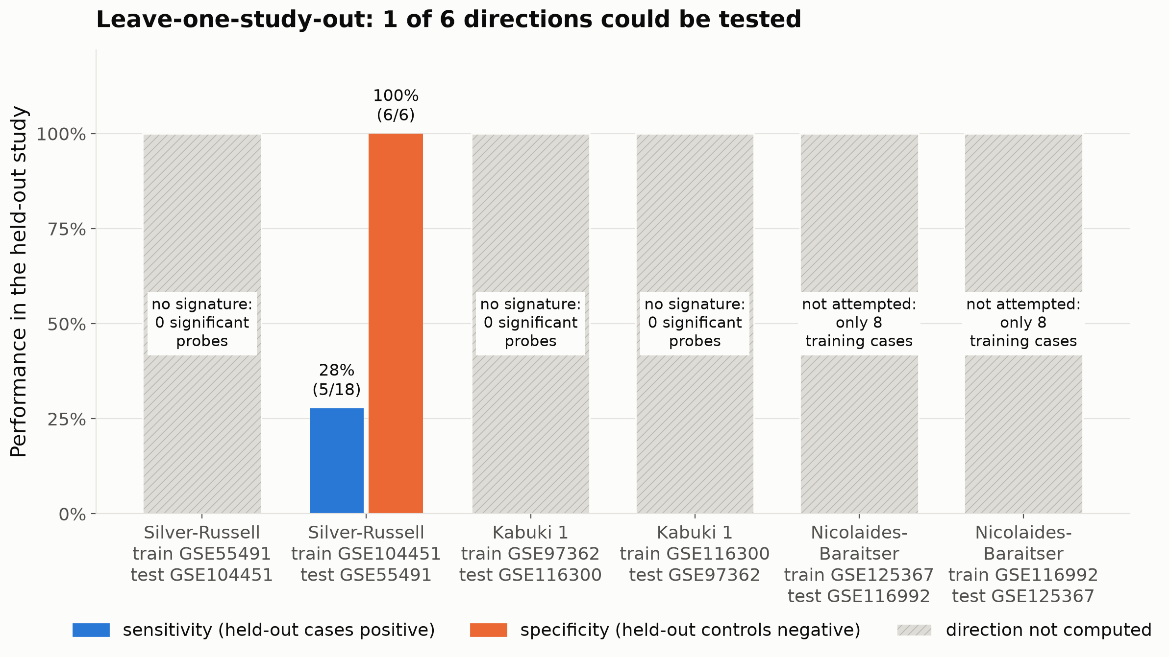
Finding 2: 1 of 6 cross-study tests could be run
5/18
held-out Silver-Russell cases detected (27.8%); 6/6 controls correctly negative
We ran one cross-study test, not three: one disorder, one direction. 2 of 3 eligible disorders have no cross-study result at all.
Notes:
The real test is to build a signature in one study and try it in another. This is called leave-one-study-out. Three disorders were eligible, which gives six possible directions. We want to be plain about this: only one of the six could be computed. That one test found five of eighteen held-out cases. Kabuki syndrome and Nicolaides-Baraitser syndrome have no cross-study result at all, because one study alone did not have enough samples to build a signature.

Slide 10
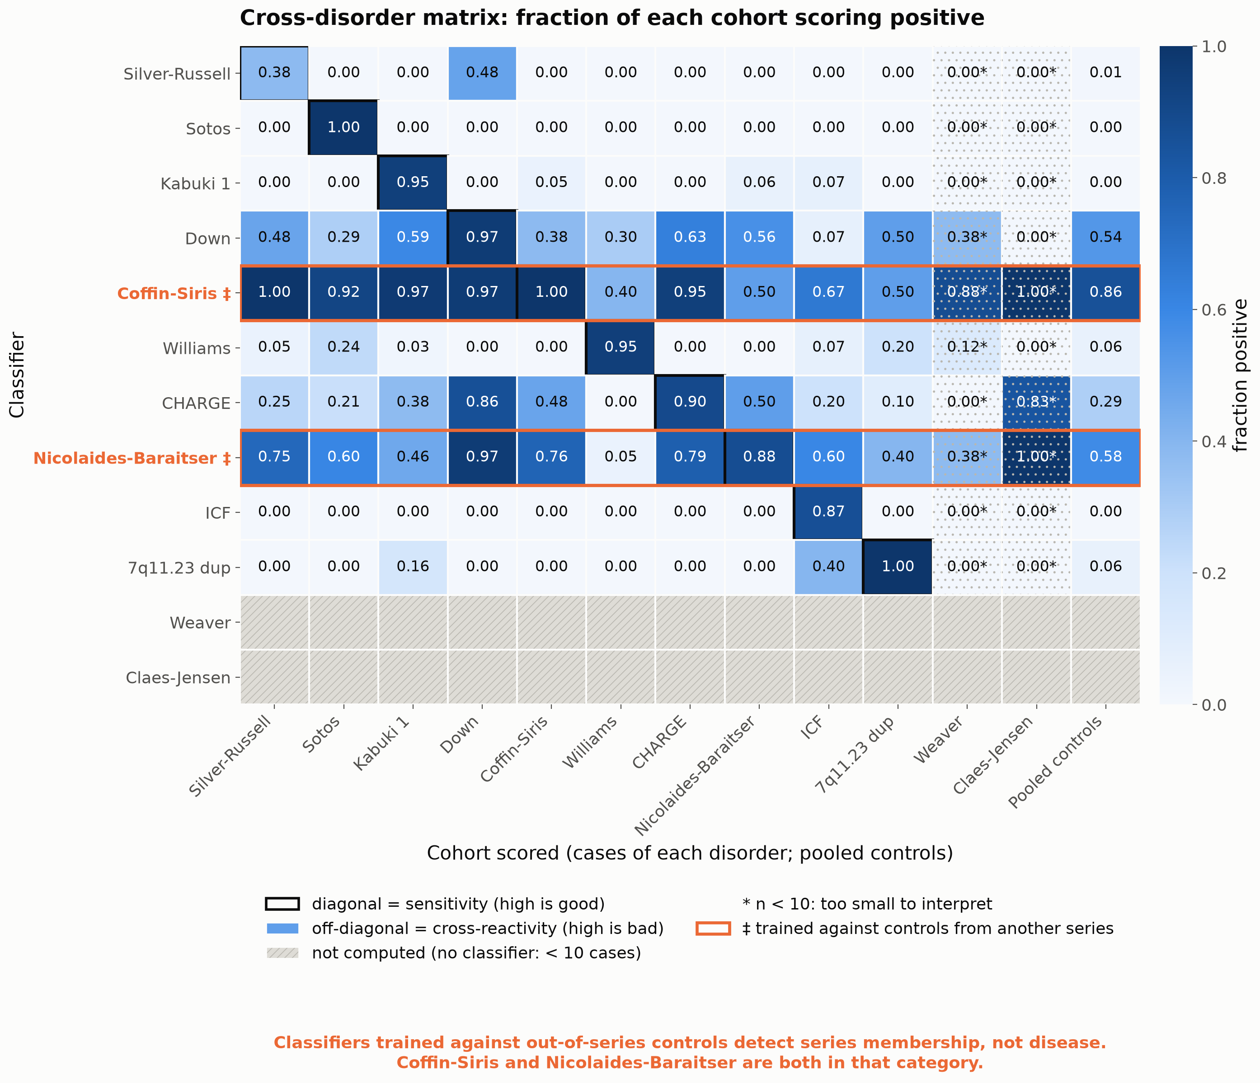
Finding 3: classifiers that fire on the wrong group
37.8%
of Kabuki cases are flagged by the CHARGE classifier (14 of 37)
Outlined rows
were trained against controls from another series. They light up almost everywhere.
Notes:
Third, we scored every classifier against every disorder and against 273 healthy controls. A good classifier lights up only its own square on the diagonal. The CHARGE syndrome classifier also flags about 38 percent of Kabuki syndrome cases. Now look at the two rows outlined in orange. They light up almost everywhere. Those two classifiers were trained against controls from a different dataset, and the next slide shows what that does.

Slide 11
Finding 4: the controls-source effect
11.9%
of other disorders' cases flagged with same-series controls (8 classifiers)
68.1%
flagged with controls from another series (2 classifiers)
Classifiers trained against out-of-series controls detect series membership, not disease. Coffin-Siris and Nicolaides-Baraitser are both in that category.
Notes:
This is the result in one comparison. When a classifier's controls come from its own dataset, it wrongly flags about 12 percent of patients who have a different disorder. When the controls come from another dataset, it flags about 68 percent. The two orange bars are Coffin-Siris and Nicolaides-Baraitser, whose source study deposited no controls. They learned to tell two laboratories apart, not to detect a disease. We keep them in the benchmark as a warning, not as signatures. One caution: both borrowed the same controls, so this is one problem seen twice.

Slide 12
Bring your own signature: five tests
Signature submitted | Result across 12 disorders
500 real Sotos probes | Sotos; score 125 against 31 for the runner-up
500 random probes | No match (though raw AUC reaches 1.00)
Sotos probes, directions inverted | Sotos; 500 of 500 directions flagged as inverted
20 Sotos probes | Sotos; score 26 against 11 for the runner-up; ceiling Moderate
500 probes not in the data | Refused: too few usable probes
Random probes reach AUC 1.00 on Williams and at least 0.70 on 7 of 12 cohorts. AUC alone is unsafe here: the score against random probes is what makes "no match" work.
Notes:
This is the feature our supervisor asked for. A laboratory uploads its own list of probes, and the engine searches all twelve disorders. We tested it with five signatures made from real data. The real Sotos probes identify Sotos, even when we flip every direction, which the tool flags. Five hundred random probes give no match. That last one is a finding about method. By the usual measure, the area under the curve or AUC, random probes score a perfect 1.0 on Williams syndrome and pass the usual threshold on seven of twelve cohorts. So AUC alone would have named a disorder for a random list. What makes the tool say no match is a second test: the probes must beat a thousand random probe sets. Also note the twenty-probe signature is capped at a lower evidence ceiling than the five-hundred-probe one.

Slide 13
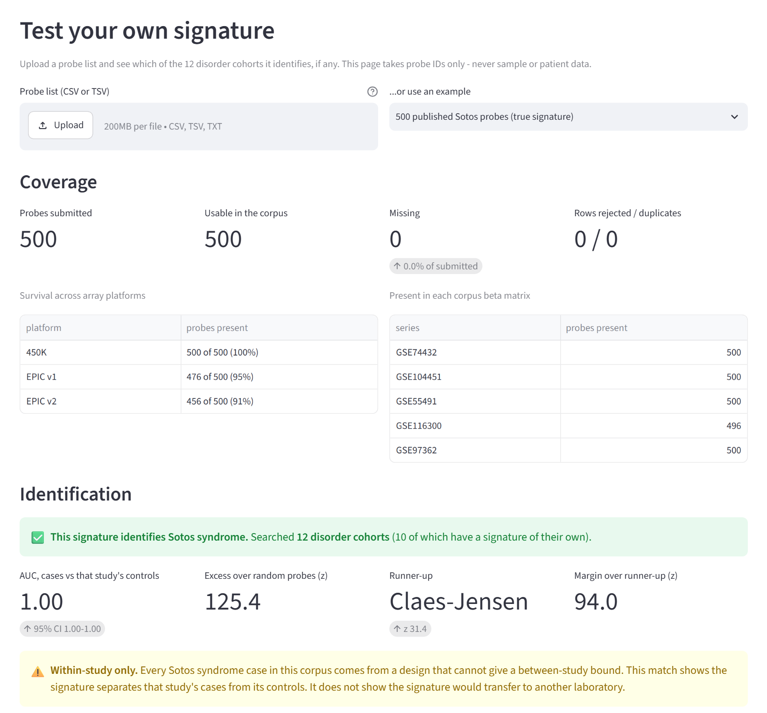
Live demo: test your own signature
Upload a probe list, or pick an example
Coverage on three array platforms
A verdict that states how many disorders were searched
A warning when the match is within one study only
Runs offline from files in the repository
Probe identifiers only. No patient data is ever accepted.
Notes:
This is the page itself, and we will now show it live. You upload a probe list or choose one of the five examples. It reports how many probes exist on each array type, then the verdict, and it always says how many disorders it searched. Here it identifies Sotos syndrome and warns that the match is within a single study. The page runs offline and only ever takes probe identifiers, never patient data.

Slide 14
What is ours and what is not
Not ours
Ours
The calibration method (Pejaver 2022; a general tool is on CRAN)
Testing one disorder against another (routine inside the private database)
Using a language model to read dataset labels (published benchmarks exist)
Every result regenerated from public data by one command
The audit: 12 verdicts, 6 cross-study attempts, a full 12 by 13 matrix
The identification engine with its random-probe control
Our claim is that this can be checked, not that the methods are new.
Notes:
We want to be exact about our contribution. The calibration method is not ours: it follows Pejaver and colleagues, and a general package already exists. Testing one disorder against another is routine inside the private database. Using a language model to read dataset labels has published benchmarks. What is ours is that every result can be regenerated from public data with one command, the audit itself, and the identification tool.

Slide 15
Limitations, before you ask
Small numbers
One cross-study test
That one cross-study result rests on 18 cases and 6 controls.
Only 1 of 6 directions was computed. We are not claiming three disorders were tested across studies.
Optimistic self-scores
Labels checked by AI only
Probes were chosen using all training samples, so own-disorder sensitivity is flattering.
Two AI-written rule sets agree on 81 of 81 samples. Human curation is still pending.
Notes:
We would rather tell you the weaknesses ourselves. Only one of six cross-study directions was computed, and it is based on only eighteen cases and six controls. We are not claiming that three disorders were tested across studies. Scores on a classifier's own disorder are optimistic, because the probes were chosen using those same samples. And our label check compares two computer-written rule sets, so a human review is still needed.

Slide 16
Public data support far less than within-study numbers suggest
1 of 6 cross-study tests could be run; 2 of 3 eligible disorders were never tested across studies
Borrowed controls: 68.1% false positives on other disorders, against 11.9%
2 disorders have a between-study bound; both read "No evidence"
What the field needs: the same disorder from more than one site, with each site's own controls
python scripts/reproduce.py
github.com/cleverlyblue0009/EpiGrade
Notes:
To conclude. Results measured inside one study look far stronger than public data can confirm. Only one cross-study test in six could be run, and two of the three eligible disorders were never tested across studies. Classifiers built with borrowed controls flagged about two thirds of unrelated patients. The fix is not a new method. It is data: the same disorder deposited by more than one site, each with its own controls. Everything we showed can be regenerated with the one command on this slide. Thank you.

Slide 17
Backup: methods, thresholds and data
Item | Detail
Scoring rule | Correlation with case profile minus correlation with control profile (Choufani 2015)
Signature threshold | Mann-Whitney test, false discovery rate 0.05, at least 10% methylation difference. Changed once, from Bonferroni and 20%.
Minimums | 10 cases to attempt a signature; 10 probes to keep one
Evidence scale | Likelihood ratio to points, base 2.08 (Tavtigian 2018); band from the conservative bound
Samples | 3,732 harvested, 1,622 retained, 2,110 excluded
Disease datasets (GEO) | GSE74432, GSE104451, GSE55491, GSE116300, GSE97362, GSE66552, GSE95040, GSE108423, GSE116992, GSE125367, GSE52588
Notes:
This backup slide is for questions on method. The scoring rule is the published one: correlation with the case profile minus correlation with the control profile. Signatures use a Mann-Whitney test with a false discovery rate of five percent and a ten percent difference floor, and that threshold was changed exactly once. All data come from the Gene Expression Omnibus, a public archive, under the accession numbers listed here.

