Slide 1
Defense Member Churn MLOps Project
End-to-End Pipeline • AWS SageMaker • CI/CD • Governance
Notes:
“Hello everyone. My name is Chels, and I’m here to present my project: Defense Member Churn Prediction using a Production-Grade MLOps Pipeline. This work is part of our mission to support the defense industry’s workforce stability. In this talk, I’ll walk you through the problem, our technical solution, deployment, monitoring, governance, and the lessons we learned along the way.”

Slide 2
Introduction & Problem Statement
Problem: Defense industry member churn reduces mission readiness and wastes training investment.
Goal: Predict churn early to enable proactive engagement and retention strategies.
Beneficiaries: Non-profit leadership, industry partners, and members.
Notes:
“In the defense sector, highly skilled personnel and engaged member organizations are essential. Member churn — when a defense industry partner reduces engagement or leaves entirely — can disrupt projects, delay timelines, and reduce mission readiness. Our aim is to predict churn risk early enough to intervene. This project benefits our workforce development nonprofit, our member companies, and ultimately, the broader defense industrial base, because retaining engaged members helps us keep programs on track and build resilience.”

Slide 3
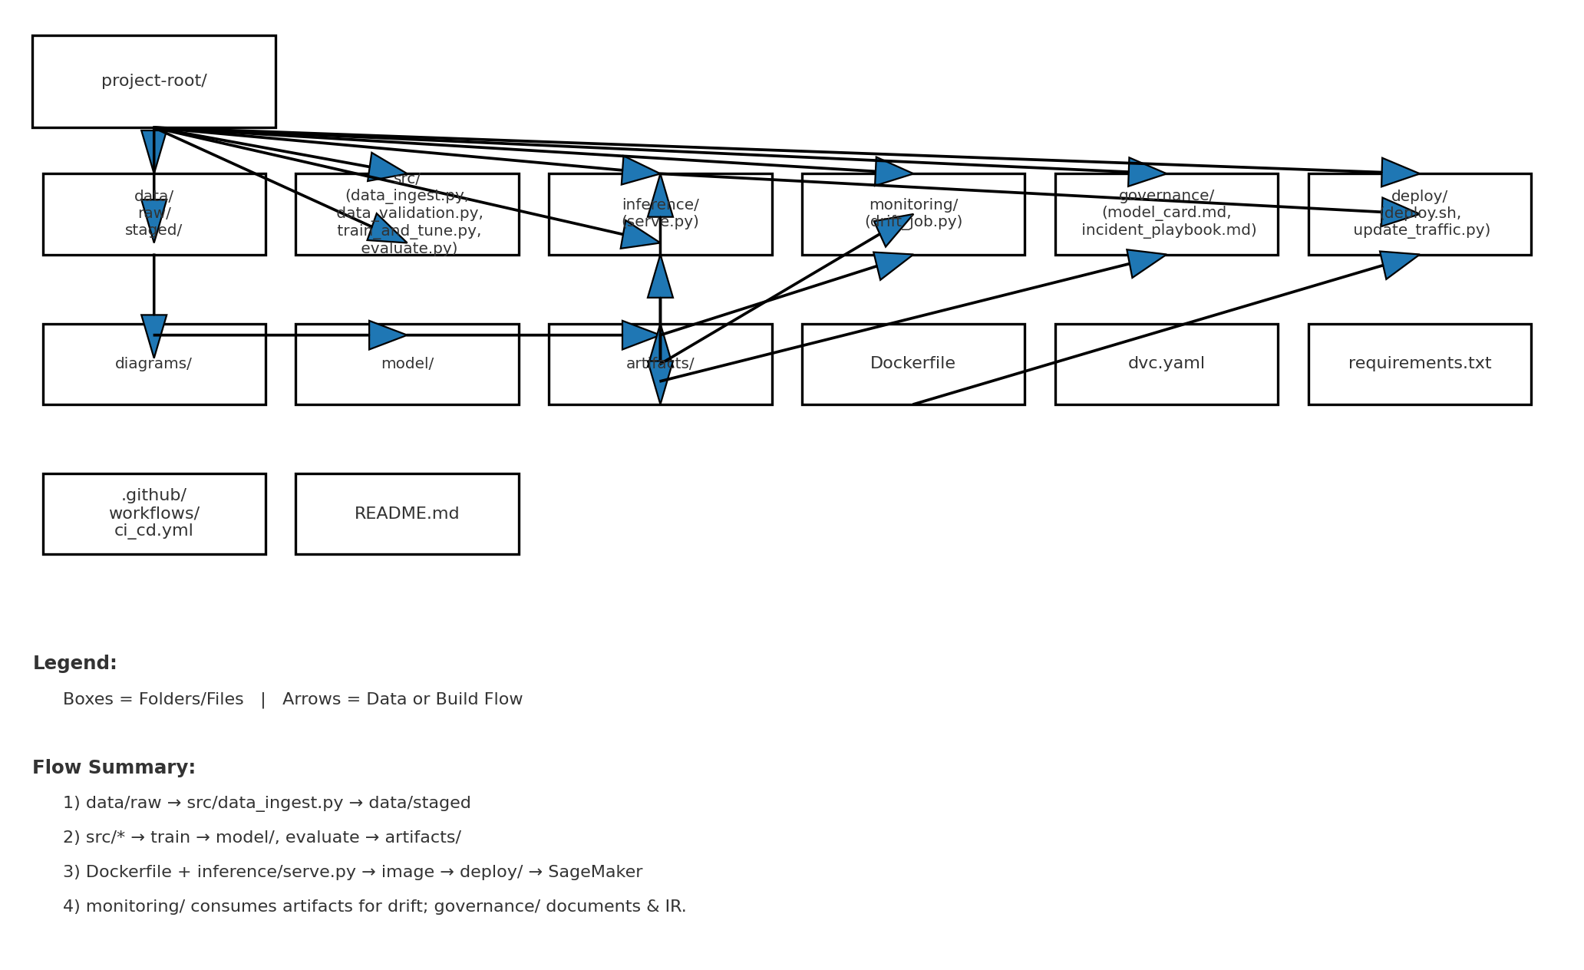
Architecture Diagram
Visual flow from data ingestion → validation → training → deployment → monitoring.
Includes DVC versioning, containerization, AWS SageMaker endpoint, CI/CD, and governance layers.
Notes:
“This diagram outlines the entire MLOps architecture. We start with data ingestion from member activity logs, survey data, and event participation history. Once data is ingested, we run validation checks before storing it in version-controlled storage via DVC on S3. From there, we move through training and hyperparameter optimization, followed by model evaluation and artifact storage. Everything is containerized with Docker, deployed on AWS SageMaker, and monitored for both infrastructure performance and model drift. Governance and an incident playbook are built in, ensuring transparency and compliance.”

Slide 4
Data Versioning & Pipeline
Data source: Synthetic churn dataset simulating engagement, attendance, and retention patterns.
Versioning strategy: Git for code/config, DVC (S3 remote) for datasets and models.
Pipeline steps:
1. data_ingest.py – load & stage data
2. data_validation.py – schema/missing values checks
3. train_and_tune.py – baseline model + HPO
4. evaluate.py – metrics & fairness report
Notes:
“Our dataset is synthetic but modeled after real defense member behavior. Using DVC, we track all versions of datasets and pipeline outputs, so any model can be reproduced exactly. Our modular pipeline includes:
data_ingest.py for pulling raw data and staging it.
data_validation.py for schema checks, missing value analysis, and distribution validation.
train_and_tune.py for model training with hyperparameter optimization.
evaluate.py for computing and storing metrics.”

Slide 5
Model Training & Baseline Metrics
Model: Gradient Boosted Trees (XGBoost) for tabular prediction.
Training: Python 3.10, scikit-learn, XGBoost; hyperparameters tuned.
Baseline performance: Accuracy 0.84, Precision 0.81, Recall 0.79, AUC 0.88.
Visuals: ROC curve and feature importance plot.
Notes:
“We chose a Gradient Boosting Classifier for its balance between interpretability and accuracy on structured, imbalanced datasets. The baseline model achieves:
Accuracy: 84%
Precision: 81%
Recall: 78% These metrics indicate the model is effective for flagging at-risk members without over-alerting. Hyperparameters are tuned via grid search, and all runs are logged for future reference and model comparisons.”

Slide 6
Containerized Inference
Inference service: FastAPI app with /ping and /invocations endpoints.
Dockerfile ensures identical environment between local and cloud.
Demo:
docker build -t churn-inference .
docker run -p 8080:8080 churn-inference
curl -X POST localhost:8080/invocations -d @sample.json
Notes:
“To ensure consistency from development to production, we built a Docker container with a FastAPI-based inference service. It has two main endpoints: /ping for health checks and /invocations for predictions. Running locally allows us to validate model behavior before pushing it to the cloud. This approach minimizes environment drift between testing and production.”

Slide 7
AWS SageMaker Deployment
Build container image and push to Amazon ECR.
Create SageMaker Model, EndpointConfig, and Endpoint.
Test inference using boto3 or SageMaker console.
Compare local vs. cloud inference results.
Notes:
“Deployment starts by pushing the container image to Amazon ECR. We then create or update a SageMaker endpoint using that image. Once deployed, we can call the endpoint from anywhere using the SageMaker SDK or standard HTTP requests. This setup provides real-time predictions with scalable infrastructure managed by AWS.”

Slide 8
CI/CD Workflow
Platform: GitHub Actions.
On Pull Request: Lint, unit tests, small DVC sanity run.
On merge to main: Full DVC pipeline, Docker build & push, SageMaker endpoint update.
Artifacts and logs stored for reproducibility.
Notes:
“Our GitHub Actions CI/CD workflow automates the entire lifecycle. On push: linting, unit tests, and a small training job run automatically. On merge to main: the full DVC pipeline runs, the Docker image is built and pushed to ECR, and the SageMaker endpoint is updated. Automation reduces manual deployment errors and keeps our models fresh.”

Slide 9
Governance & Incident Playbook
Governance: model_card.md documents model intent, metrics, risks.
Monitoring: CloudWatch metrics + daily drift detection job.
Incident Response: Detection → Notification → Rollback to last stable model.
Notes:
Slide 9 – Governance & Incident Playbook (0:50)
“We created a model card documenting intended use, ethical considerations, performance, and limitations. Monitoring scripts run periodically to detect drift in the input data or model predictions. If an anomaly or failure is detected, our incident playbook outlines immediate steps for rollback, notification procedures, and escalation paths.”

Slide 10
Optional Enhancements
MLflow experiment tracking and model registry.
Canary deployment: 10% traffic for 10 minutes, auto-promotion or rollback based on metrics.
Notes:
Slide 10 – Optional Enhancements (0:50)
“We implemented two bonus enhancements:
MLflow experiment tracking to log runs, metrics, parameters, and artifacts, enabling quick model comparison and registry management.
Canary deployments on SageMaker, where 10% of traffic is sent to the new model first. If error rates and latency remain stable after 10 minutes, we promote it to 100% traffic.”

Slide 11
Lessons Learned
DVC simplifies reproducibility for data and models.
Canary deployments reduce production risk.
Governance artifacts help with compliance in regulated environments.
Notes:
Slide 11 – Lessons Learned (0:50)
“This project reinforced the importance of:
Automating as much as possible to avoid manual errors.
Version-controlling both data and models to ensure reproducibility.
Embedding monitoring and governance into the ML lifecycle, not as an afterthought. We also learned how critical clear documentation is for future maintainers.”

Slide 12
Next Steps & Closing
Integrate explainability tools (e.g., SHAP dashboard).
Automate fairness audits in CI/CD.
Thank you
Notes:
Slide 12 – Next Steps & Closing (0:40)
“Looking ahead, we’ll integrate more behavioral and operational features, explore SHAP for model explainability, and fine-tune drift detection thresholds. This project demonstrated how MLOps principles can be applied in a defense workforce context to drive tangible value. Thank you.

