Slide 1
Multi-sensor rail track detection in automatic train operations
Master’s thesis in Data Science
Student: Attila Kovacs
1st Advisor: Lukas Rohatsch (FH Technikum)
2nd Advisor: Daniele Capriotti (M2C Expert Control GmbH)
Alignment: 02.02.2024

Slide 2
Outline
Model comparison
Parameter tuning
Results on test set
Next steps

Slide 3
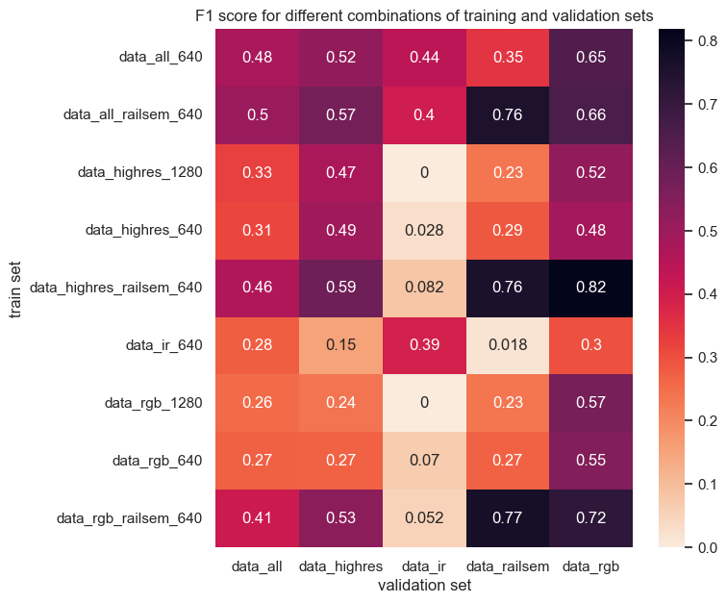
Nine models have been trained and validated Parameters set by YOLO

Slide 4
Parameter tuning
Best models trained on:
data_highres + railsem with 640x640 pixels for RGB, Highres Images
data_ir with 640x640 pixels for IR images
These models have been finetuned
300 iterations
30 epochs each
Optimizer: Adam vs SGD
16 parameters, respectively
Parameters are adjusted by evolutionary algorithm
Computational resources are a limiting factor → only 10% of training data was used
Tuning took ~ 520h with 12 CPU + GPU

Slide 5
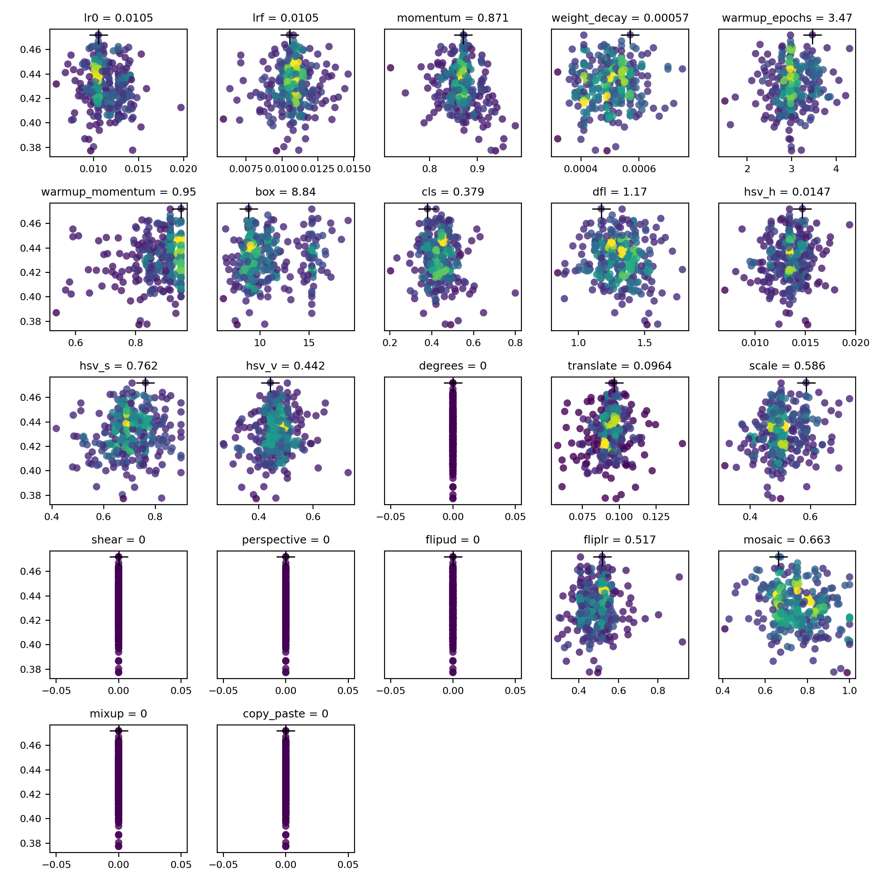
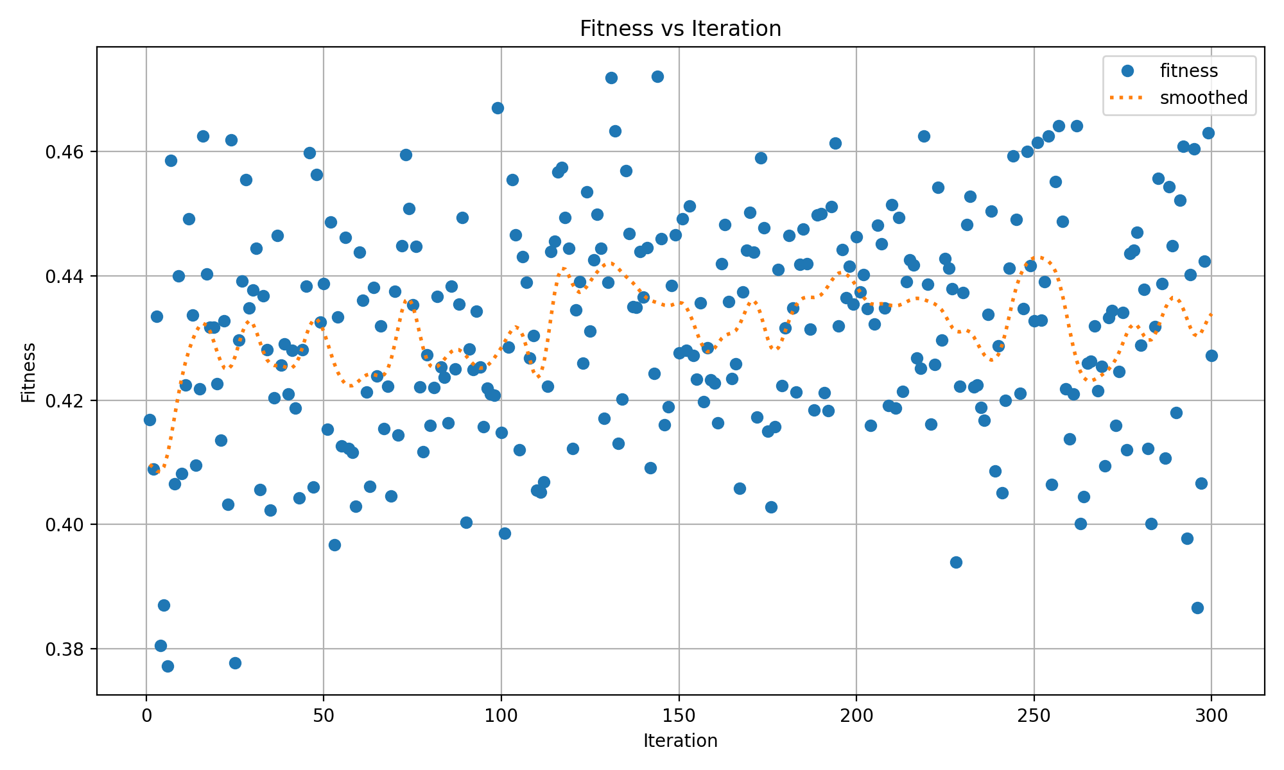
Parameter tuning Evolution of parameters for data_highres_railsem_sgd

Slide 6
Parameter tuning Default setting provides good results
validation_set | Dice - auto | Dice - sgd | Dice - adam | sgd_vs_auto [%] | adam_vs_auto [%]
data_ir | 0.440 | 0.425 | 0.375 | -3.323 | -14.703
data_highres | 0.587 | 0.5960 | 0.558 | 1.479 | -4.912
data_railsem | 0.758 | 0.765 | 0.766 | 0.878 | 1.056
data_rgb | 0.818 | 0.774 | 0.752 | -5.439 | -8.140

Slide 7
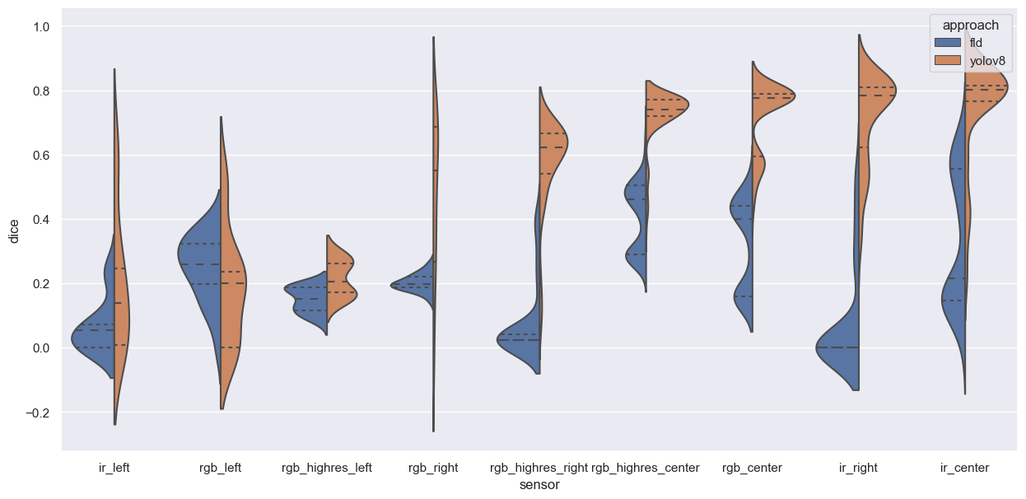
Results on test set

Slide 8
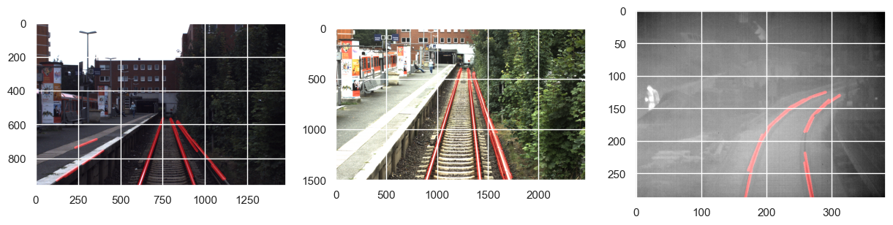
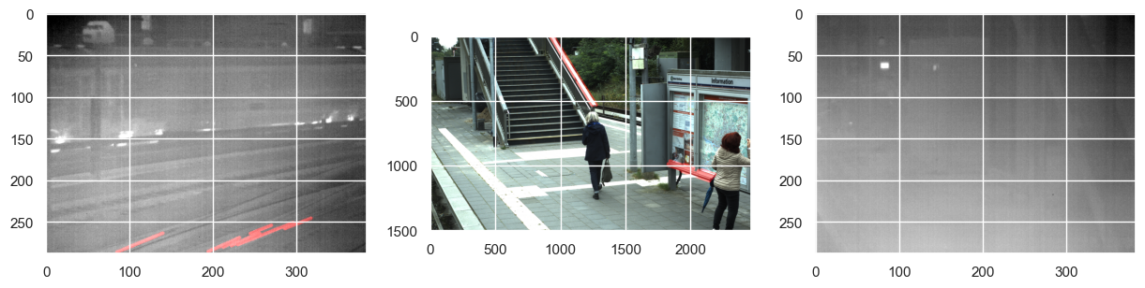
FLD Good examples and bad examples

Slide 9
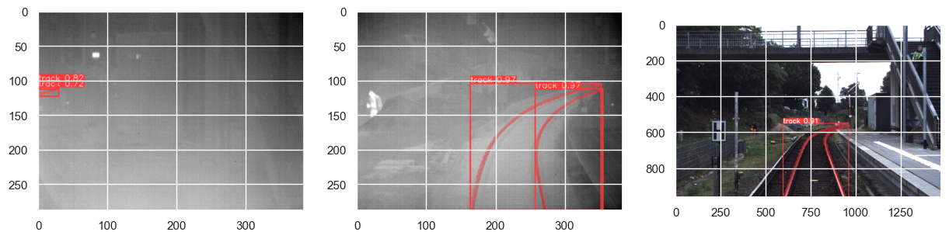
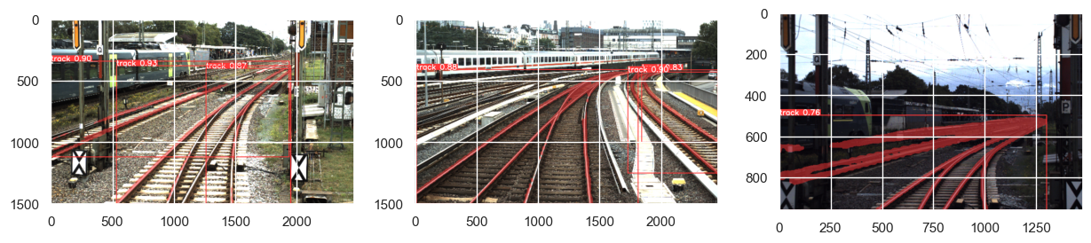
YOLO Good examples and bad examples

Slide 10
Timeline
Sep 23
Oct 23
Nov 23
Dec 23
Jan 24
Feb 24
Mar 24
Apr 24
May 24
Jun 24
DSP Kick-off
Exploratory Data Analysis
Literature Review
Base Model Selected
Establishing Baseline (CV2)
Model Finetuning
Result Analysis and Documentation of Approach
First Version Ready
Final Version Ready
Master‘s Exam

Slide 11
Thank you!

Slide 12
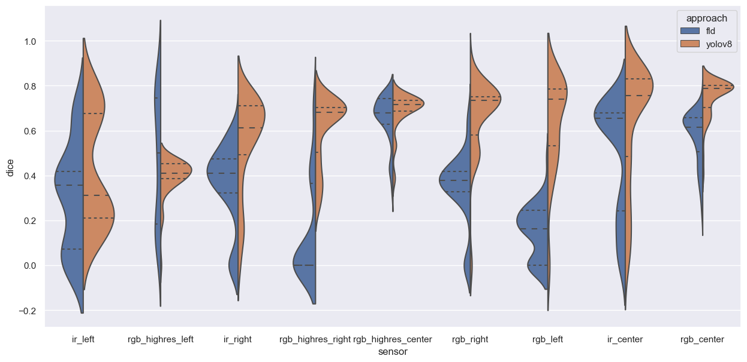
YOLOv8 vs FDL Performance on validation data

