Slide 1
Multi-sensor rail track detection in automatic train operations
Master’s thesis in Data Science
Student: Attila Kovacs
1st Advisor: Lukas Rohatsch
2nd Advisor: M2C Expert Control GmbH
12.09.2023

Slide 2
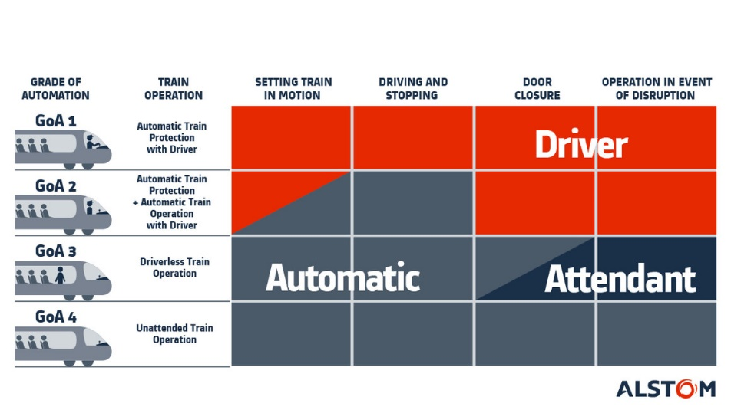
Introduction
What is Automatic train operations (ATO)? → Technology is used to automate tasks that were previously performed by rail personnel (e.g., conductor)
Why ATO?
Better utilization of infrastructure
Flexibility due to predictability (service on remote lines, automated parking)
Lower costs (e.g., maintenance)
Reduced energy
Challenges
Sensors are already on a very high level
However, application software is still in the early stages of development

Slide 3
DB Cargo to develop fully automated shunting by 2024
DB Cargo aims to develop a GoA4 (Grade of Automation) system as a retrofit solution
Challenges
Positioning of locomotive: determine the locomotive’s position in the marshalling yard without trackside installations
AI-based obstacle and signal detection: objects can be reliably detected → Up to now, no recognised approval processes have been available for AI-based object detection applications.
https://www.railtech.com/rolling-stock/2021/10/28/db-cargo-to-develop-fully-automated-shunting-by-2024/

Slide 4
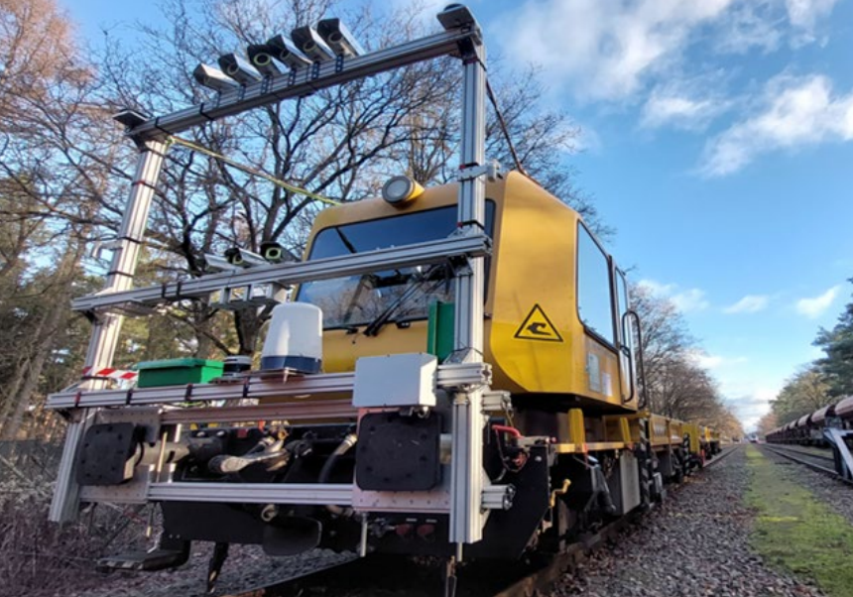
Openly available datasets for ATO applications
In May 2023, Digitale Schiene Deutschland published the first freely available multi-sensor dataset OSDaR23
Sensors:
3 high resolution cameras
3 medium resolution cameras
3 infrared cameras
3 long-range LiDARs
1 mid-range LiDAR
2 short-range LiDARs
1 long-range radar
4 inertial measurement units
4 GPS/GNSS sensors

Slide 5
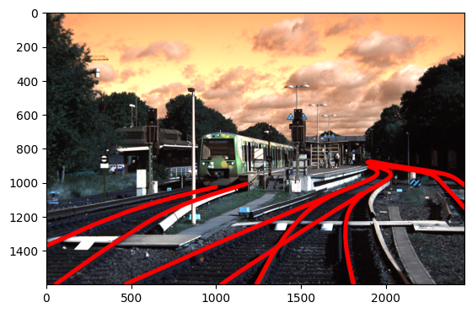
Sensor: RGB

Slide 6
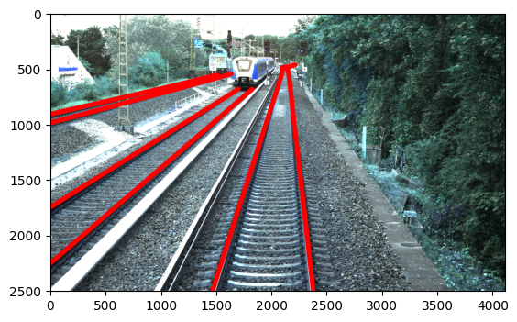
Sensor: RGB-high-res

Slide 7
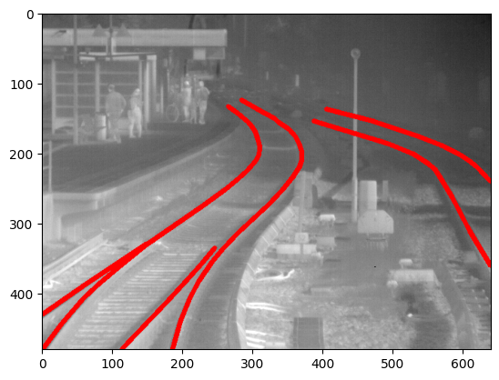
Sensor: Infrared

Slide 8
Goal of the master‘s thesis
Investigate the effect of using different sensors on the ability to detect tracks in real-time
Focus on polyline detection, i.e., tracks, crossing tracks, neighboring tracks
Selection of a proper CNN model incl. training and finetuning on available dataset (one model per sensor)
Sensors: RGB, RGB-highres, IR
Results will be compared with existing approaches based on brightness gradient segment detection
Prototype: test models in real-time object detection in video stream

Slide 9







Technologies

Slide 10
Timeline
Sep 23
Oct 23
Nov 23
Dec 23
Jan 24
Feb 24
Mar 24
Apr 24
May 24
Jun 24
DSP Kick-off
Exploratory Data Analysis
Literature Review
Base Model Selected
Establishing Baseline (CV2)
Model Finetuning
Result Analysis and Documentation of Approach
First Version Ready
Final Version Ready
Master‘s Exam

Slide 11
Q&A

