Slide 1
Multi-sensor rail track detection in automatic train operations
Master’s thesis in Data Science
Student: Attila Kovacs
1st Advisor: Lukas Rohatsch (FH Technikum)
2nd Advisor: Daniele Capriotti (M2C Expert Control GmbH)
Alignment: 22.12.2023

Slide 2
YOLO experiments
Model backbone: yolov8n-seg
Combined loss function consisting of
bounding box loss (error between the predicted and the ground truth boxes' geometry)
objectness loss (how confident the model is about the presence of an object in the bounding box)
segmentation loss (how close the predicted segmentation map is to the ground truth map)
Paramters
epochs: 300
image size: 640, 1280 (where applicable)
batch size: auto selection based on image size and available memory
Yolo defaults
Logging: Comet ML

Slide 3
Model statistics
model | train set | epochs | image size | batch | wall clock time
yolov8n-seg.pt | rgb | 121/300 | 640 | 23 | 00:37:57
yolov8n-seg.pt | ir | 196/300 | 640 | 23 | 00:51:51
yolov8n-seg.pt | rgb | 117/300 | 1280 | 5 | 01:39:58
yolov8n-seg.pt | rgb+railsem | 138/300 | 640 | 23 | 02:44:37
yolov8n-seg.pt | highres | 81/300 | 1280 | 5 | 04:20:46
yolov8n-seg.pt | highres+railsem | 110/300 | 640 | 23 | 13:36:26
yolov8n-seg.pt | highres | 130/300 | 640 | 23 | 13:53:44
yolov8n-seg.pt | all | 190/300 | 640 | 23 | 23:27:11
yolov8n-seg.pt | all+railsem | 224/300 | 640 | 23 | 23:42:53

Slide 4
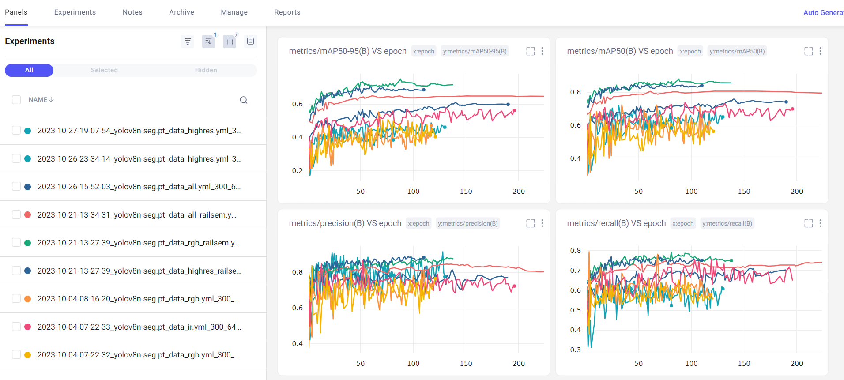
Logging

Slide 5
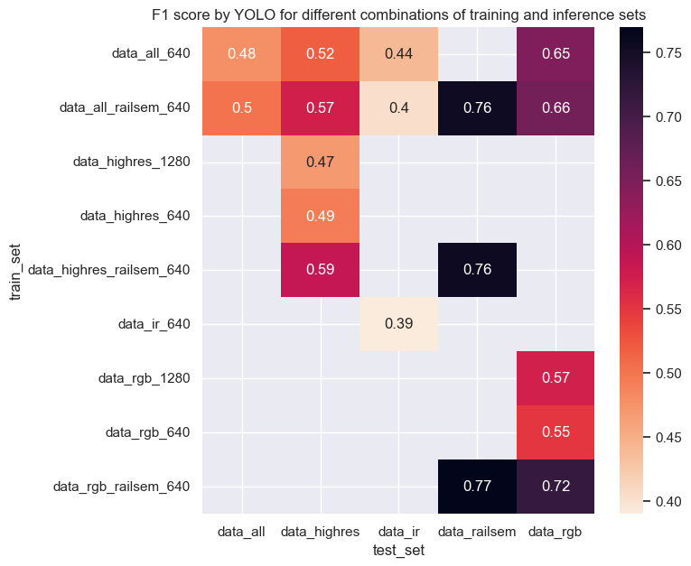
Test model on different sets
Yolo was used to apply the different models to different validation sets
Evaluation metric is the segmentation f1 score (= dice)
For each data set we select the best model

Slide 6
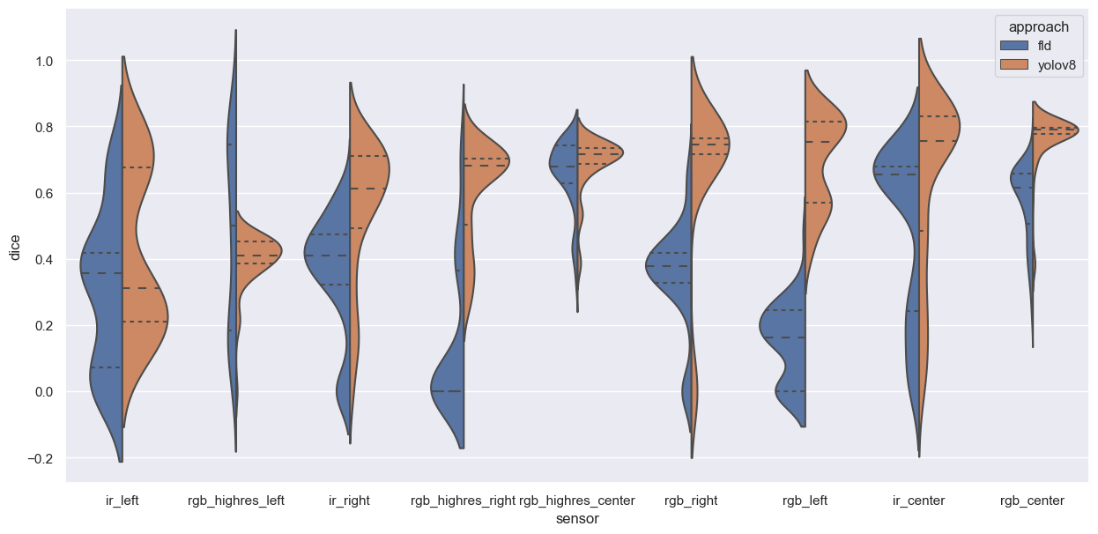
YOLO vs Baseline

Slide 7
Video stream
Video

Slide 8
Next steps
Finetuning
Finalizing the models
Evaluation on test-set

Slide 9
Research questions
Which modelling technique and which deep learning model can be applied to solve the rail detection problem?
How can the efficiency of standard, high-resolution, and infrared cameras be compared against each other; does a higher resolution result in a higher accuracy?
What is the trade-off between model accuracy and speed of providing predictions when applied to a video stream in real time?
How do deep learning models perform compared to gradient-based thresholding approaches in terms of, e.g., accuracy (share of correctly identified objects) or F1-score (mean of precision and recall)

