Slide 1
MODEL FOR PREPARATION AND FORMATTING OF THE PRESENTATION OF PAPERS
John Smith- Undergraduate from the XXXXX Course of the Federal University - UF Mary Smith- Master's student of the XXXXX Course of the State University - EU Jane Smith- Master of XXXXX Course of the State University - EU James Smith - Doctor of XXXXX Course of the State University - EU Academic Advisor - Faculty of Sciences, Ph.D Contact person@gmail.com; person@outlook.com.br; person@hotmail.co.in; person@gmail.co.uk; advisor@hotmail.com

Slide 2
Introduction
Paper sessions should be written top-up with only the main information of each item Up to 10 slides should be used The submission of the presentation file must be made in PDF format, through the participant's area of the main author (the one who submitted the work); To guarantee the certificate of presentation, the main author will need to be accredited (on-site or online) as well as send the presentation file through the system. Don't forget these details!

Slide 3
Paper Title
OBJECTIVES JUSTIFICATION INTRODUCTION METHODOLOGY THEORETICAL FRAMEWORK (Can be attached to the introduction) RESULTS AND DISCUSSION FINAL CONSIDERATIONS REFERENCES

Slide 4
Objectives
- General Objective
Assess, describe, analyze, verify...
- Specific Objectives Describe... Identify... See..

Slide 5
Materials and Methods
Characterization and Research Stages Search Location Research Instruments Subjects involved Tools used (Research instruments) Form of Data Analysis

Slide 6
Results and Discussions

Slide 7
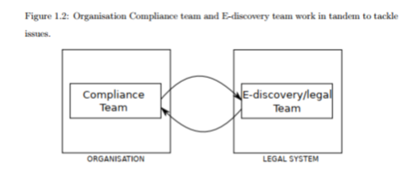
Results and Discussions

Slide 8

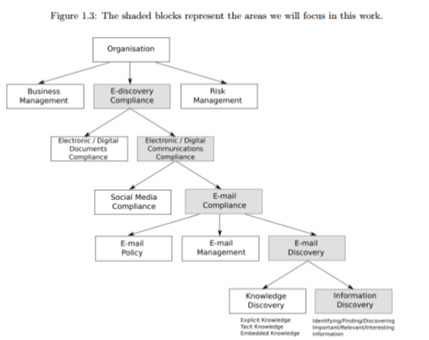
Results and Discussions

Slide 9
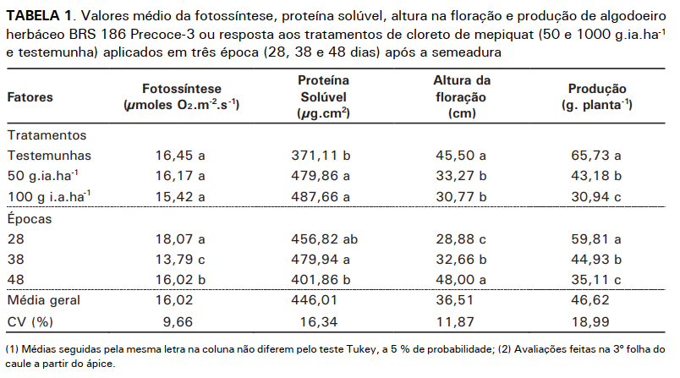
Results and Discussions

Slide 10
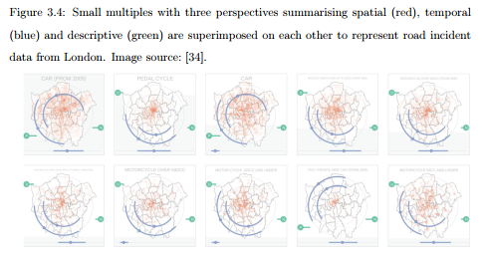
Results and Discussions

Slide 11
Final Considerations
It can be presented in topified form with the main information of each item! When drafting the Final Considerations or Conclusions, avoid bringing citations to this session. It is recommended that the authors position themselves by bringing their view on the data obtained in their study. The considerations should respond to the objectives outlined in the study.

Slide 12
References
List the authors and their respective works that were used for the preparation of the presentation slides (Follow the VCCU standards).

