Slide 1
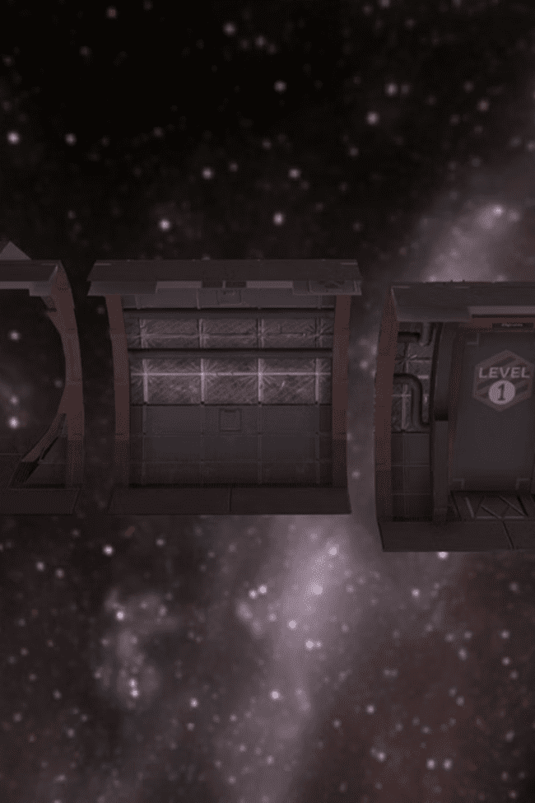
HackWithHyderabad
Duality AI's Space Station Challenge: Safety Object Detection #2
Team Cosmic Guardians
Shanmuka Sai Prabhath • Sohail • Samad • Purna Vikas • Vijay Shree • Tharuni

Slide 2
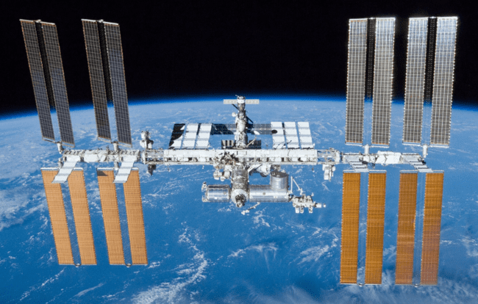
The Challenge: Space Station Safety
What We're Solving
Space stations are high-risk environments where misplaced tools or hazardous objects can cause catastrophic accidents. Our mission is to develop an AI system that automatically detects safety-critical objects.
Even a floating screwdriver can become a deadly projectile in zero gravity, making object detection crucial for astronaut safety.

Slide 3
Our Beginner-Friendly Approach
Pre-trained Models
Small Dataset Focus
Practical Implementation
Leverage existing AI models like YOLOv8 to jumpstart our detection system without building from scratch.
Work smart with limited data by focusing on key safety objects: tools, equipment, and debris.
Build a simple, working prototype that demonstrates real-world safety applications.

Slide 4
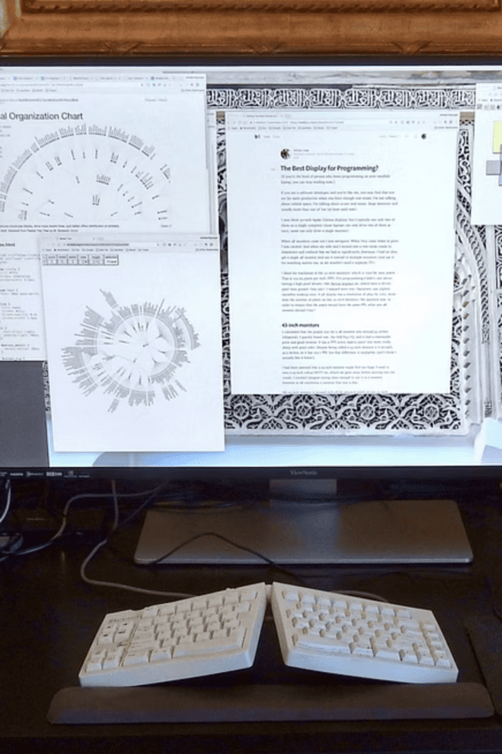

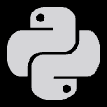

Our Technology Stack
Duality Falcon Platform
Our primary AI development environment for training and deploying models efficiently.
Python Essentials
Using Python with OpenCV, NumPy, and basic machine learning libraries for data processing.
Lightweight ML
TensorFlow Lite and PyTorch for efficient model training and real-time object detection.

Slide 5
Our Step-by-Step Execution Plan
Model Training
Data Collection & Preprocessing
Fine-tune pre-trained models on our specific dataset, focusing on accuracy for critical objects.
Gather and clean space station imagery, label safety objects, and prepare training datasets.
Final Report & Demo
Testing & Validation
Document our process, create live demonstration, and present practical use cases.
Evaluate model performance, test edge cases, and optimize detection confidence levels.

Slide 6
Challenges We're Ready to Tackle
Limited Experience
Small Dataset Handling
Accuracy Optimization
We're beginners, but that means fresh perspectives and creative problem-solving approaches to complex challenges.
Working with limited data requires smart augmentation techniques and transfer learning strategies.
Balancing detection precision with processing speed for real-time space station monitoring.

Slide 7
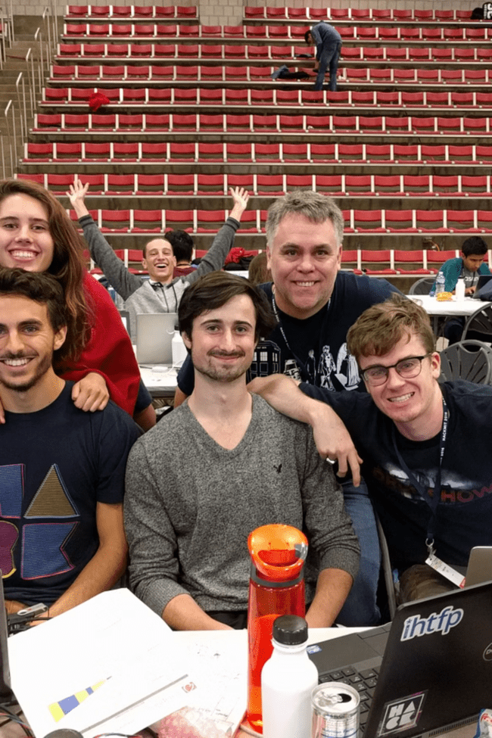

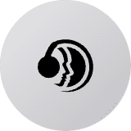


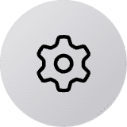

What Makes Our Solution Effective
Simplicity First
Strong Teamwork
Focus on core functionality rather than over-engineering, ensuring reliable performance.
Six dedicated minds working together, combining different skills and perspectives.
Practical Execution
Building something that works in the real world, not just impressive on paper.

Slide 8
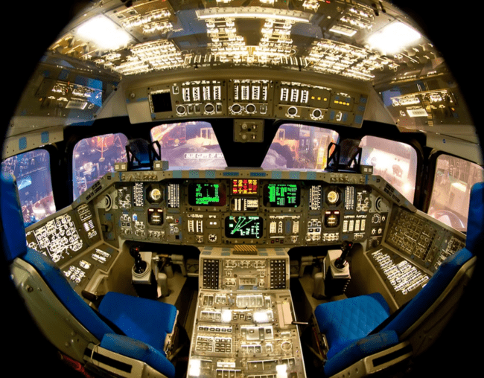
Real-World Use Case: Preventing Space Accidents
Scenario: Floating Hazards Detection
Our AI system continuously monitors space station compartments, identifying loose tools, debris, or misplaced equipment that could endanger crew members.
Impact: Early warning system prevents accidents by alerting astronauts to secure or remove dangerous floating objects before they cause harm.
Real-time monitoring of work areas
Automatic hazard classification
Instant crew notifications

Slide 9




Team Roles & Responsibilities
Shanmuka Sai Prabhath (Team Lead)
Sohail & Samad
Project coordination, development oversight, and technical architecture decisions.
Core development team - model implementation, data preprocessing, and system integration.
Purna Vikas
Vijay Shree & Tharuni
Development preparation, testing framework setup, and quality assurance protocols.
Research specialists - exploring best practices, documenting findings, and competitive analysis.

Slide 10
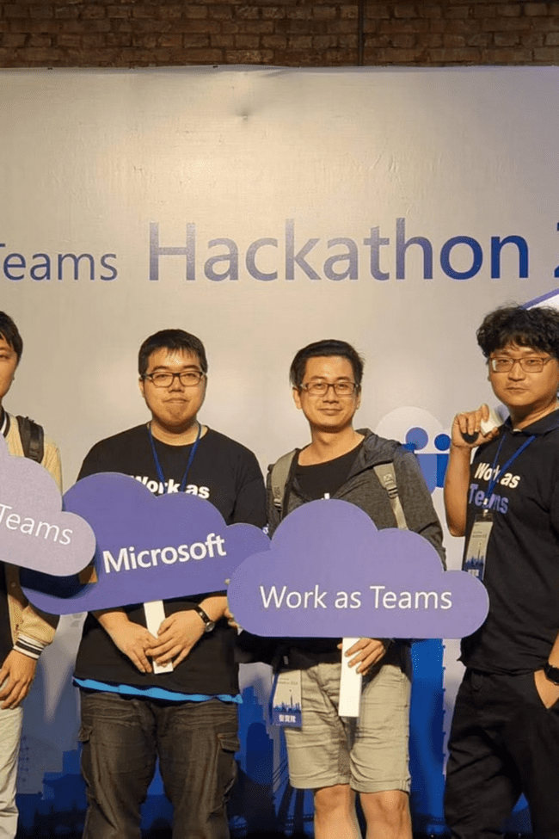
Ready to Innovate with Duality AI!
Contact Us
Team Lead: Shanmuka Sai Prabhath
Ready to make space safer through AI innovation
Our Mission
Protecting astronauts through intelligent object detection systems
Safety First, Innovation Always
Thank you for this incredible opportunity to contribute to space safety!

